Slide 1
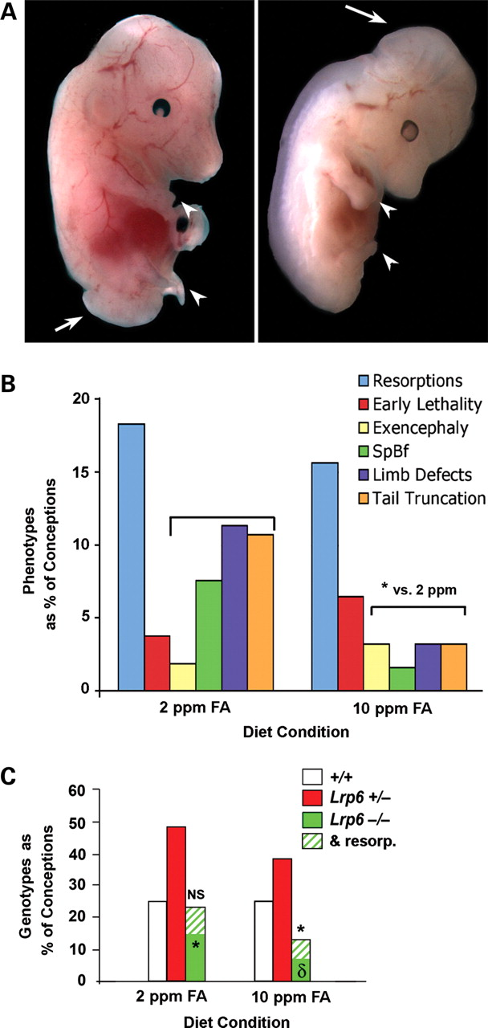
Figure 1. Incidence of NTD and morphogenic defects in pregnancies of FA-supplemented Lrp6^{+/−} mice. Observed ...
Notes:
Figure 1. Incidence of NTD and morphogenic defects in pregnancies of FA-supplemented Lrp6+/− mice. Observed implantations were scored as resorptions, embryo dead at harvest (early lethality) or live embryo with open cranial folds (exencephalic), open caudal neuropore (spina bifida), axis truncation or limb defects and graphed as a percentage of total observed implantations. (A) Lrp6−/− embryos at E13.5 that were maintained on the 2 ppm diet demonstrate each of the phenotypes scored. The embryo at left shows tail truncation and limb defects (arrowheads) and spina bifida (arrow), while the one at right exhibits limb, trunk and exencephaly (arrow) defects. (B) The incidence of each phenotype is shown as a percentage of all conceptions, with individual embryos often displaying more than one defect. The incidence of neural tube, limb and axis defects was lower among embryos maintained on the high FA (10 ppm) diet. (C) Frequency of genotypes recovered from dams on a high or low folate diet. Litters from either diet showed a significant deviation from the Mendelian ratio of 25:50:25 expected from Lrp6+/− × Lrp6+/− matings. Parallel diet studies from Lrp6+/+ matings showed a resorption rate of 10% among conceptions on the 10 ppm FA diet (Table 3). After adjusting the number of Lrp6−/− in each group by adding resorptions above the 10% baseline (green hatched bars), the 2 ppm diet approximated the predicted Mendelian distribution, but nulls were still significantly under represented in the 10 ppm FA group. *P < 0.05; δP < 0.001.
Unless provided in the caption above, the following copyright applies to the content of this slide: © The Author 2010. Published by Oxford University Press. All rights reserved. For Permissions, please email: journals.permissions@oxfordjournals.org

Slide 2
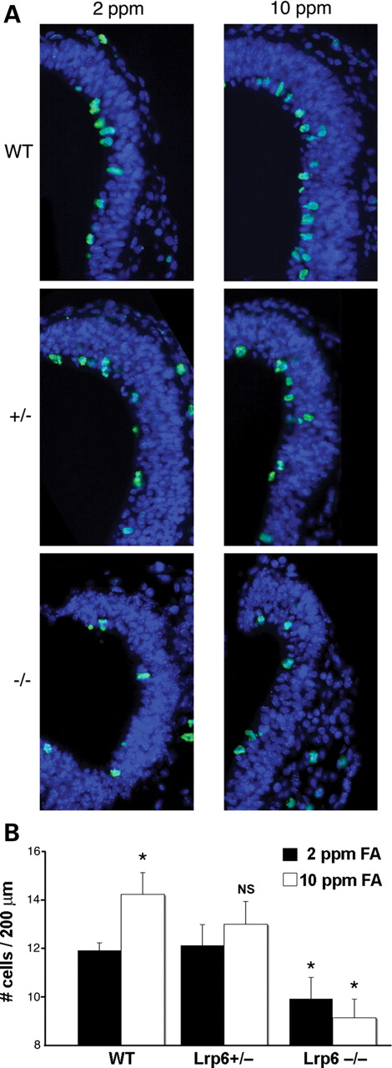
Figure 2. FA diet supplementation fails to promote proliferation in the neural tube of E10 Lrp6-deficient embryos. ...
Notes:
Figure 2. FA diet supplementation fails to promote proliferation in the neural tube of E10 Lrp6-deficient embryos. Panels compare the dorsal midbrain of wild-type (WT), heterozygous (+/−) and homozygous (−/−) E10 embryos from each diet group. (A) Cells in M-phase, labeled with anti-PH3 (green) and counterstained with DAPI (blue). (B) Stereological assessments of PH3labeled/total cells are compared by genotype. The labeling index of mitotic cells in Lrp6+/− embryos is the same as wild-type but is significantly reduced in the Lrp6−/− embryos compared among siblings maintained on 2 ppm FA diet. On the 10 ppm FA diet, proliferation in the cranial neural folds was nearly doubled in WT, but was unchanged in heterozygous Lrp6+/− embryos and was further suppressed in the homozygous nulls. n = 16 WT, 21 +/− and 14 −/− embryos; *P < 0.05, two-tailed t-test, with respect to WT on 2 ppm FA.
Unless provided in the caption above, the following copyright applies to the content of this slide: © The Author 2010. Published by Oxford University Press. All rights reserved. For Permissions, please email: journals.permissions@oxfordjournals.org

Slide 3
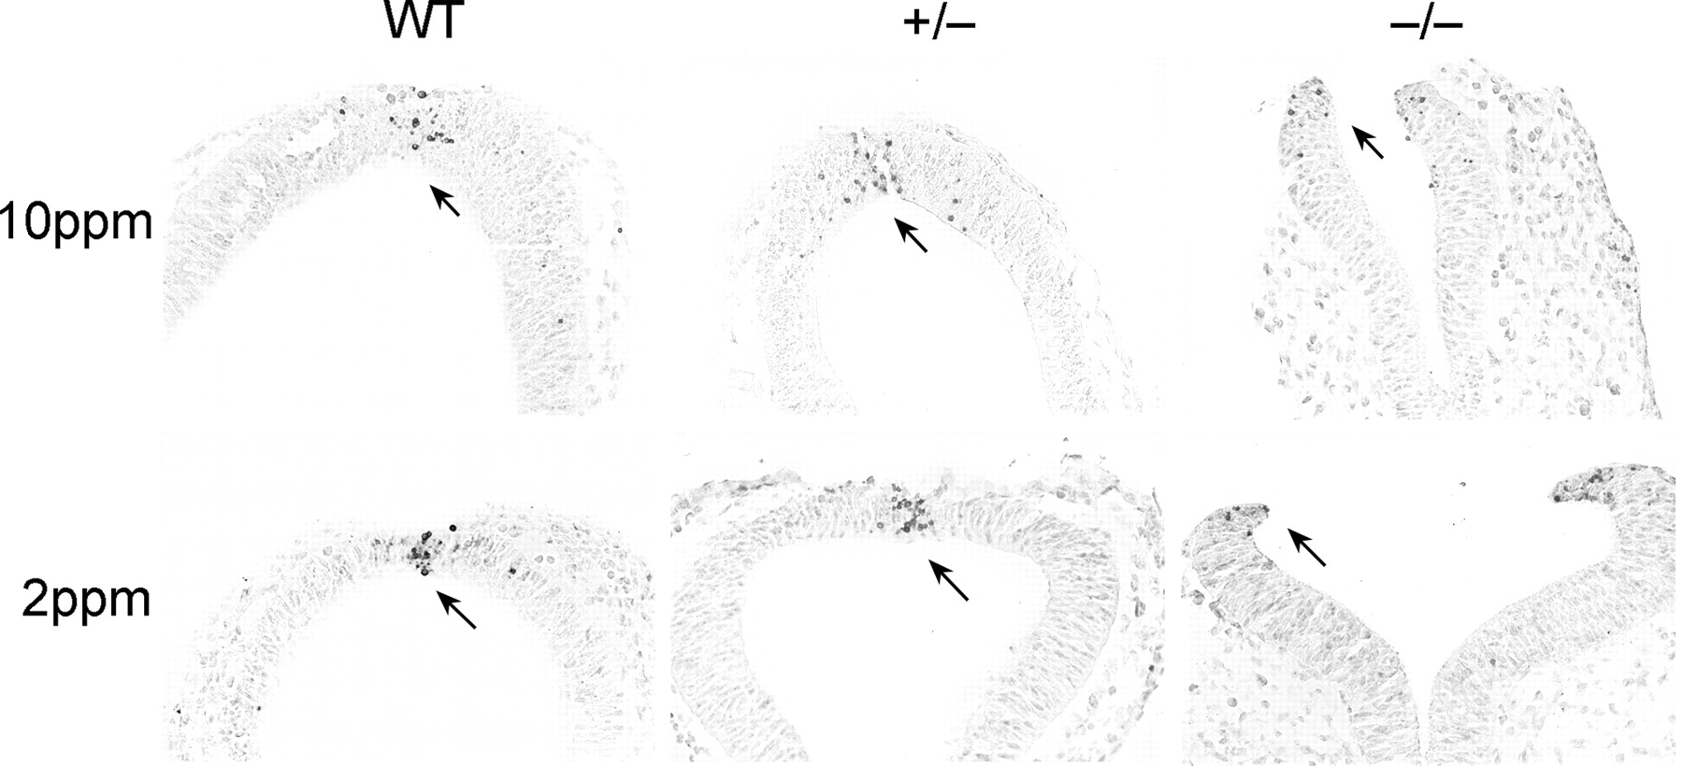
Figure 3. FA diet supplementation does not alter the pattern of apoptosis in the E10 rostral neural tube of ...
Notes:
Figure 3. FA diet supplementation does not alter the pattern of apoptosis in the E10 rostral neural tube of Lrp6-deficient embryos. Panels compare the dorsal midbrain of wild-type (WT), heterozygous (+/−) and homozygous (−/−) E10 embryos from each diet group. TUNEL labeling (arrows) in all embryos was largely confined to the dorsal tips of the neural folds where apoptosis normally occurs to facilitate intercalation of cells and promote midline fusion. Tissue was lightly counterstained with hematoxylin.
Unless provided in the caption above, the following copyright applies to the content of this slide: © The Author 2010. Published by Oxford University Press. All rights reserved. For Permissions, please email: journals.permissions@oxfordjournals.org

Slide 4
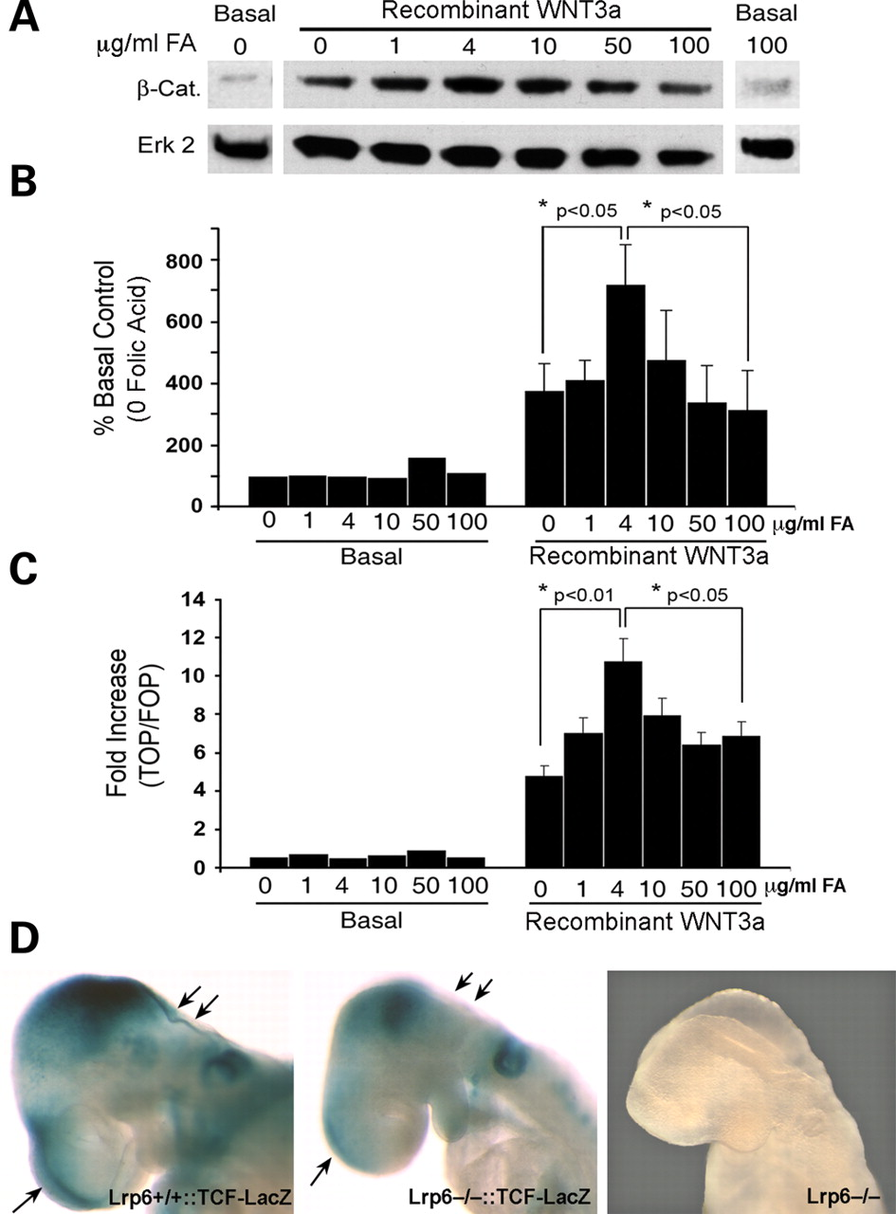
Figure 4. Impact of FA on the canonical WNT signaling pathway in vitro and demonstration of reduced WNT activity in ...
Notes:
Figure 4. Impact of FA on the canonical WNT signaling pathway in vitro and demonstration of reduced WNT activity in situ of E9.5 Lrp6−/− embryos. (A) Western blot of cytosolic β-catenin levels in NIH3T3 cells that were cultured for 3 days in folate-supplemented defined media prior to 2h stimulation with recombinant WNT3a. (B) Quantification of cytosolic β-catenin in lysates from cells, using Erk2 as protein loading controls. Normalized optical density values are expressed as a percentage of the β-catenin level in unstimulated cells after 3 days in 0 μg/ml FA. (C) WNT-regulated transcriptional activity measured by TopFlash reporter assay. NIH3T3 cells were cultured for 3 days in folate-supplemented defined media prior to transfection with the TOP and FOP reporter plasmids. Normalized luminescence values are expressed as fold increase above unstimulated (Basal) cells maintained in 0 FA media over the course of the experiment. n = 6 separate experiments, each run in duplicate, two-tailed t-test in both B and C. (D) Reduced canonical WNT activity in cranial folds of TCF-LacZ reporter mice on a Lrp6−/− background. E9.5 embryos from double heterozygous Lrp6+/−::TCF-LacZ+ mating pairs were fixed and processed for β-galactosidase reactions developed for 30 minutes. Lrp6+/+::TCF-LacZ embryos (left panel) showed high levels of activity in the midline fusion of the cranial folds (arrows) and mesencephalon. Lrp6−/−::TCF-LacZ embryos (middle panel) showed almost no WNT activity in the midline cranial folds and much reduced activity in the mesencephalon, with residual activity attributable to remaining Lrp5 function. Lrp6−/− embryos (right panel), in which a LacZ sequence interrupts the Lrp6 locus, demonstrated no visible β-galactosidase activity at 30 minutes.
Unless provided in the caption above, the following copyright applies to the content of this slide: © The Author 2010. Published by Oxford University Press. All rights reserved. For Permissions, please email: journals.permissions@oxfordjournals.org

Slide 5
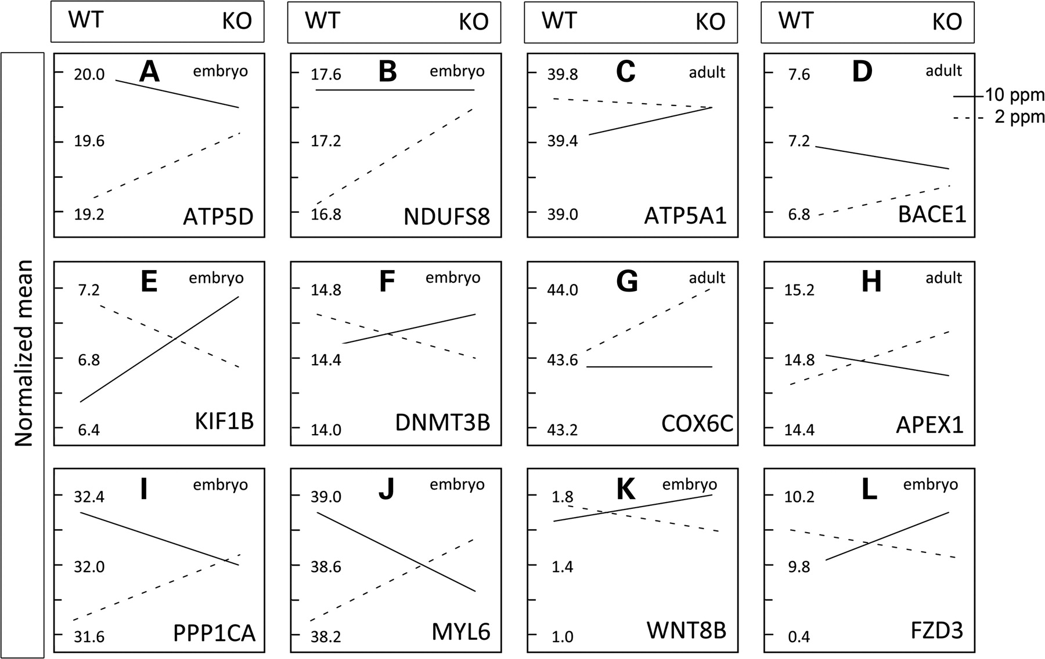
Figure 5. Examples of gene–diet interactions. Genetic factors are shown for wild-type (WT) and mutant heterozygotes ...
Notes:
Figure 5. Examples of gene–diet interactions. Genetic factors are shown for wild-type (WT) and mutant heterozygotes (KO), and dietary factors are shown for diets that were 2 (dashed lines) and 10 ppm (solid lines) in folate. Normalized means are indicated as arbitrary units distributed evenly on the Y-axis. Examples are shown for oxidative phosphorylation in embryos (A and B) and adults (C and D), purine, methionine and inositol metabolism in embryos (E and F) and adults (G and H), cytoskeletal regulation in embryos (which also co-varies in adults) (I and J) and WNT/β-catenin signaling in embryos (K and L). Abbreviations: ATP5D (ATP-synthase, H+ transporting, mitochondrial F1 complex, delta subunit); NDUFS8 [NADH dehydrogenase (ubiquinone) Fe-S protein 8, 23 kDa (NADH-coenzyme Q reductase)]; ATP5A1 (ATP-synthase, H+ transporting, mitochondrial F1 complex, alpha subunit 1); BACE1 (beta-site APP-cleaving enzyme); KIF1B (kinesin family member 1B); DNMT3B [DNA (cytosine-5)-methyltransferase 3 beta]; COX6C (cytochrome oxidase subunit VIc); APEX1 [APEX nuclease 1 (multifunctional DNA repair enzyme)]; PPP1CA (protein phosphatase 1 catalytic subunit alpha); MYL6 (myosin light chain 6); WNT8A (Wnt ligand 8A); FZD3 (Frizzled 3). (The complete list of examples of gene–diet interactions is provided in Supplementary Material, Figures S1 and S2.)
Unless provided in the caption above, the following copyright applies to the content of this slide: © The Author 2010. Published by Oxford University Press. All rights reserved. For Permissions, please email: journals.permissions@oxfordjournals.org

