Slide 1
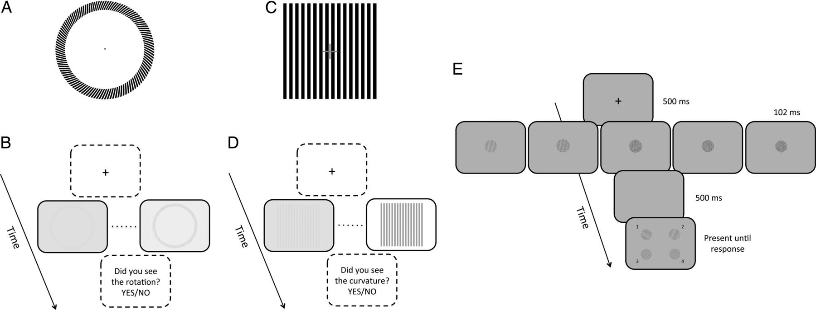
Figure 1. Psychophysical tasks. To test the magnocellular-dorsal (M-D) functioning, we used 2 illusory motion phenomena ...
Notes:
Figure 1. Psychophysical tasks. To test the magnocellular-dorsal (M-D) functioning, we used 2 illusory motion phenomena embedded in a similar task procedure: 1) the Rotating-Tilted Line Illusion (RTLI; A, B) and, 2) the Accordion Grating Illusion (AGI; C, D). Ten levels of contrast between the illusory figures and the background were used as stimuli for both the RTLI and the AGI task. To test the P-V functioning, we used a grating orientation identification task with 5 levels of superimposed random noise (E).
Unless provided in the caption above, the following copyright applies to the content of this slide: © The Author 2014. Published by Oxford University Press. All rights reserved. For Permissions, please e-mail: journals.permissions@oup.com

Slide 2
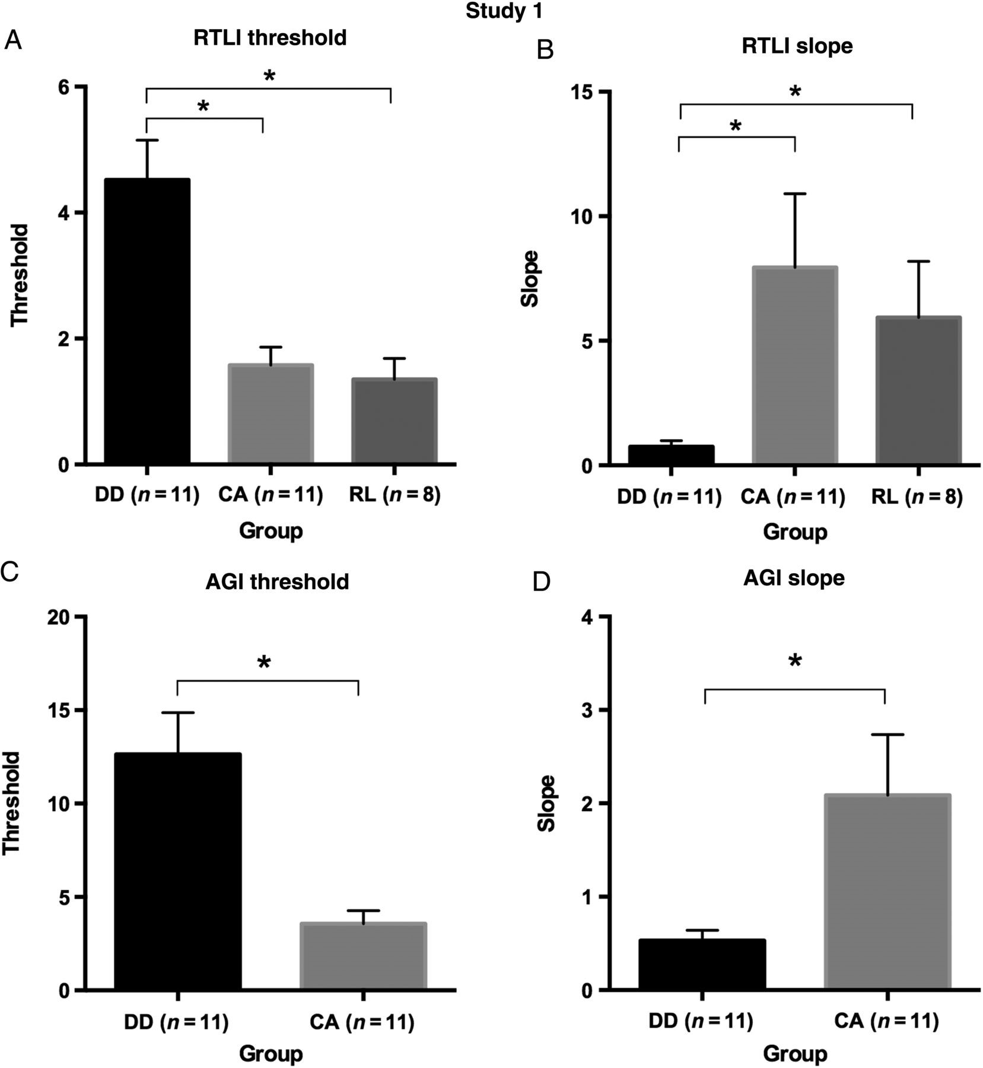
Figure 2. Study 1 results. The 50% threshold mean for the RTLI task in the 3 groups of children (DD = developmental ...
Notes:
Figure 2. Study 1 results. The 50% threshold mean for the RTLI task in the 3 groups of children (DD = developmental dyslexia; CA = chronological-age controls; RL = reading-level controls) (A). The slope mean of the fitted function for the RTLI in the 3 groups (B). The 50% threshold mean (C) and the slope mean (D) of the fitted function for the AGI task in the DD and CA groups. Error bars represent the standard error and * represents a significant difference (P < 0.05).
Unless provided in the caption above, the following copyright applies to the content of this slide: © The Author 2014. Published by Oxford University Press. All rights reserved. For Permissions, please e-mail: journals.permissions@oup.com

Slide 3
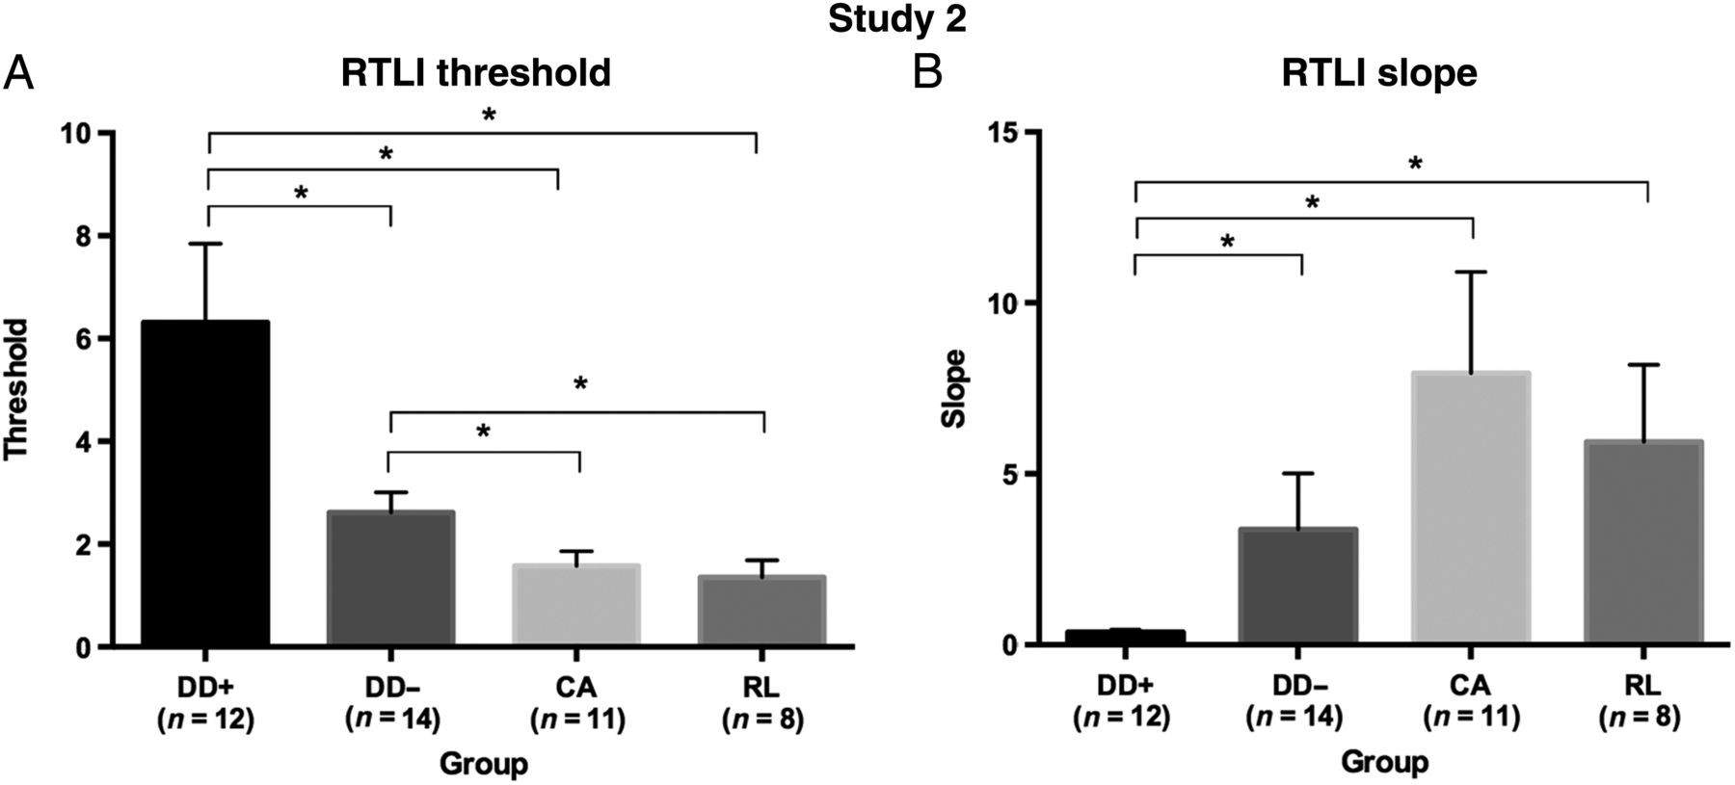
Figure 3. Study 2 results. The 50% threshold mean for the RTLI task in the 4 groups of children (DD+ = children with ...
Notes:
Figure 3. Study 2 results. The 50% threshold mean for the RTLI task in the 4 groups of children (DD+ = children with developmental dyslexia and DCDC2d; DD− = children with developmental dyslexia without DCDC2d; CA = chronological-age controls; RL = reading-level controls) (A). The slope mean of the fitted function for the RTLI in the 4 groups (B). Error bars represent the standard error and * represents a significant difference (P < 0.05).
Unless provided in the caption above, the following copyright applies to the content of this slide: © The Author 2014. Published by Oxford University Press. All rights reserved. For Permissions, please e-mail: journals.permissions@oup.com

Slide 4
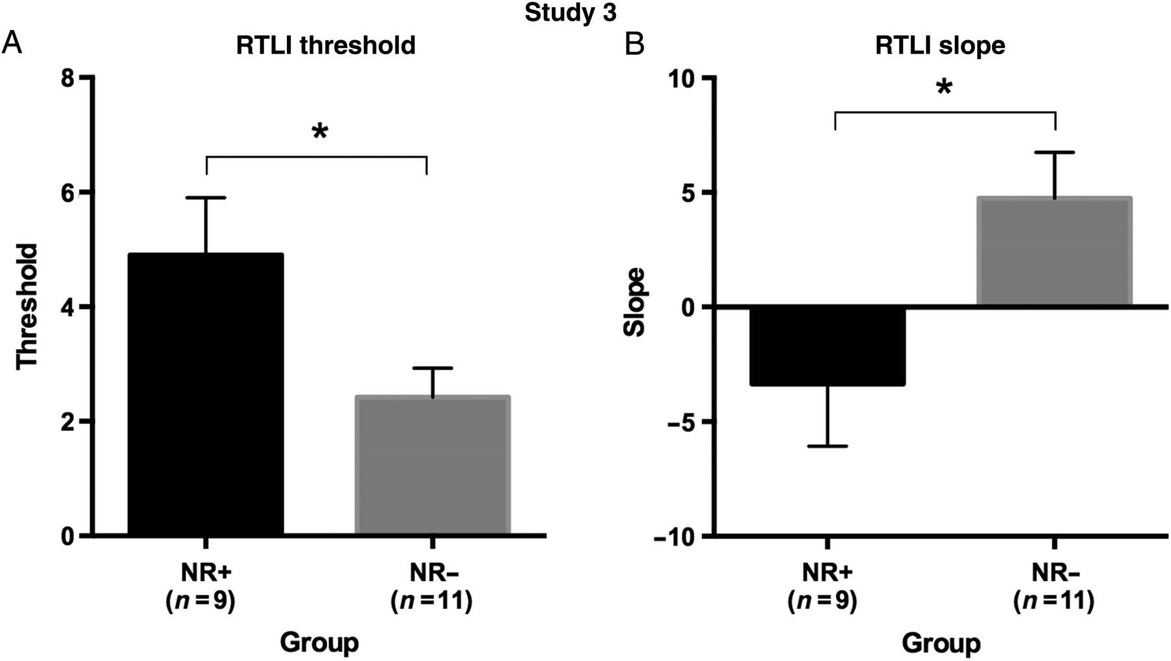
Figure 4. Study 3 results. The 50% threshold mean for the RTLI task in the 2 groups of young adults (NR+ = normal ...
Notes:
Figure 4. Study 3 results. The 50% threshold mean for the RTLI task in the 2 groups of young adults (NR+ = normal readers with DCDC2d; NR− = normal readers without DCDC2d) (A). The slope mean of the fitted function for the RTLI in the 4 groups (B). Error bars represent the standard error and * represents a significant difference (P < 0.05).
Unless provided in the caption above, the following copyright applies to the content of this slide: © The Author 2014. Published by Oxford University Press. All rights reserved. For Permissions, please e-mail: journals.permissions@oup.com

