Slide 1
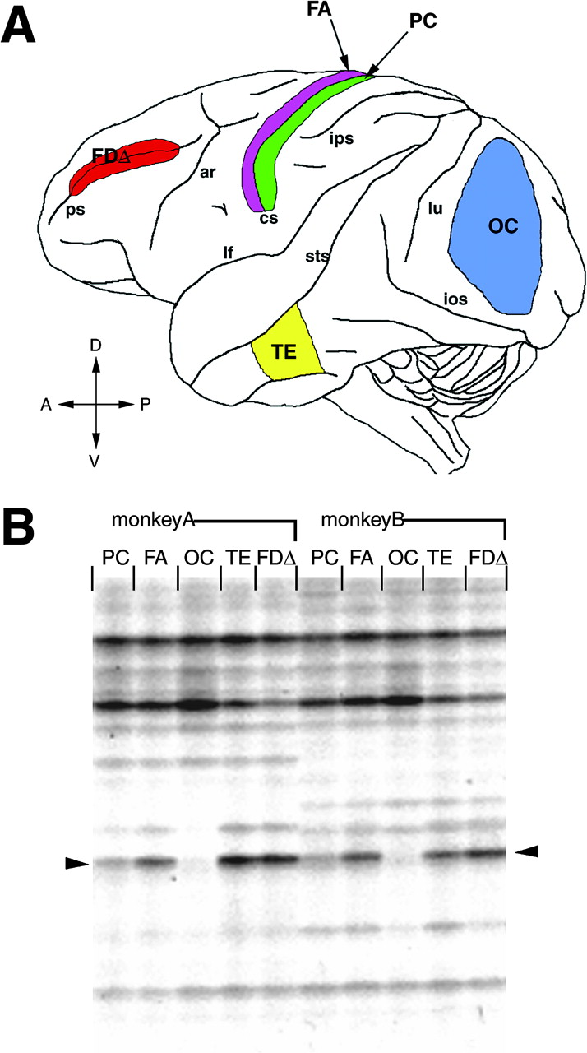
Figure 1. Differential display for five neocortical areas. (A) Lateral surface view of the monkey cerebral cortex. ...
Notes:
Figure 1. Differential display for five neocortical areas. (A) Lateral surface view of the monkey cerebral cortex. Samples for differential display screening were taken among five areas as schematically shown by different colors. FDΔ (red): from both banks of the principal sulcus (ps). OC (blue): from posterior to the lunate sulcus (lu) and superior to the inferior occipital sulcus (ios). FA (purple) and PC (green): from the anterior and the posterior banks of the central sulcus (cs), respectively. TE (yellow): from the region ventral to the superior temporal sulcus (sts). Other abbreviations are as follows: ar, arcuate sulcus; lf, lateral fissure; ips, inferior parietal sulcus; D, dorsal; V, ventral; A, anterior; P, posterior. (B) Differential display showed a band that is thick in the FDΔ and TE lanes, thin in PC and very faint in OC lane. Arrowheads indicate the DNA bands corresponding to RBP mRNA. Two young adult crab-eating macaques (monkeys A and B) were used.
Unless provided in the caption above, the following copyright applies to the content of this slide: Cerebral Cortex V 15 N 1 © Oxford University Press 2005; all rights reserved

Slide 2
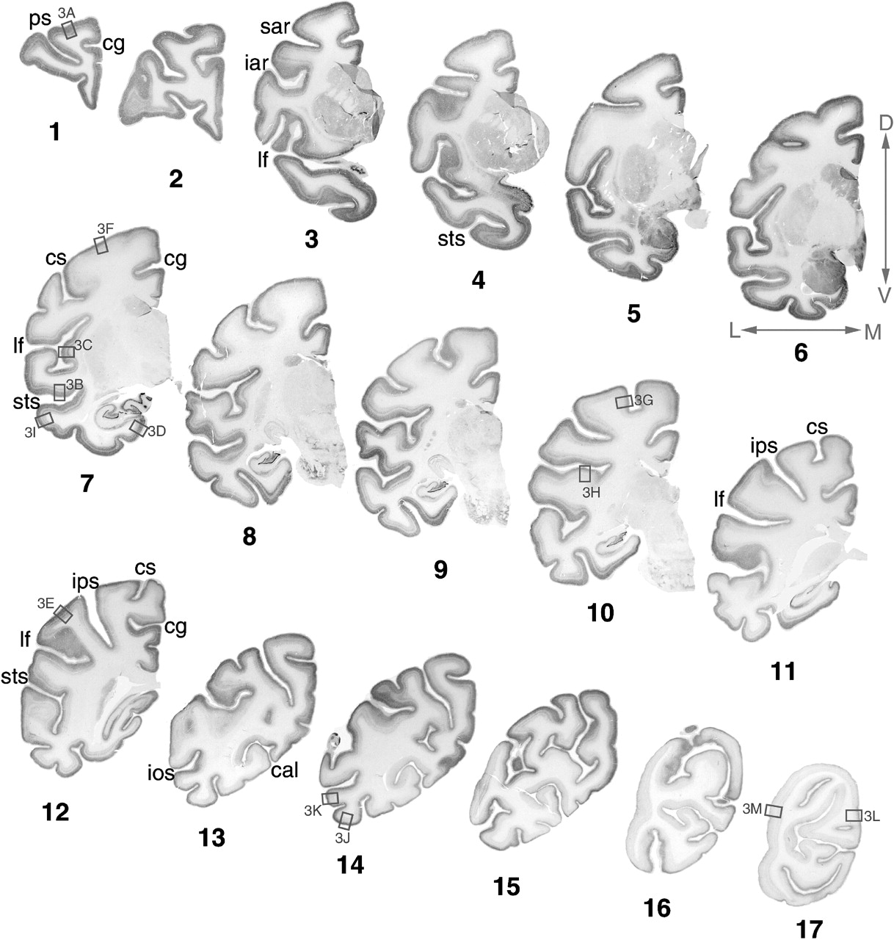
Figure 2. Distribution of RBP signals shown by in situ hybridizain. Coronal sections arranged in anteroposterior ...
Notes:
Figure 2. Distribution of RBP signals shown by in situ hybridizain. Coronal sections arranged in anteroposterior orientation (sections 1–17). RBP expression was observed in all cortical areas, but at variable levels. Boxed regions are shown at higher magnification in Figure 3. Sulcus abbreviations are as follows: cg, cingulate sulcus; sar, superior arcuate sulcus; iar, inferior arcuate sulcus; cal, calcarine sulcus. Other abbreviations are the same as in Figure 1. Orientation of each section is indicated: D, dorsal; V, ventral; L, lateral; M, medial. Scale bar = 20 mm.
Unless provided in the caption above, the following copyright applies to the content of this slide: Cerebral Cortex V 15 N 1 © Oxford University Press 2005; all rights reserved

Slide 3
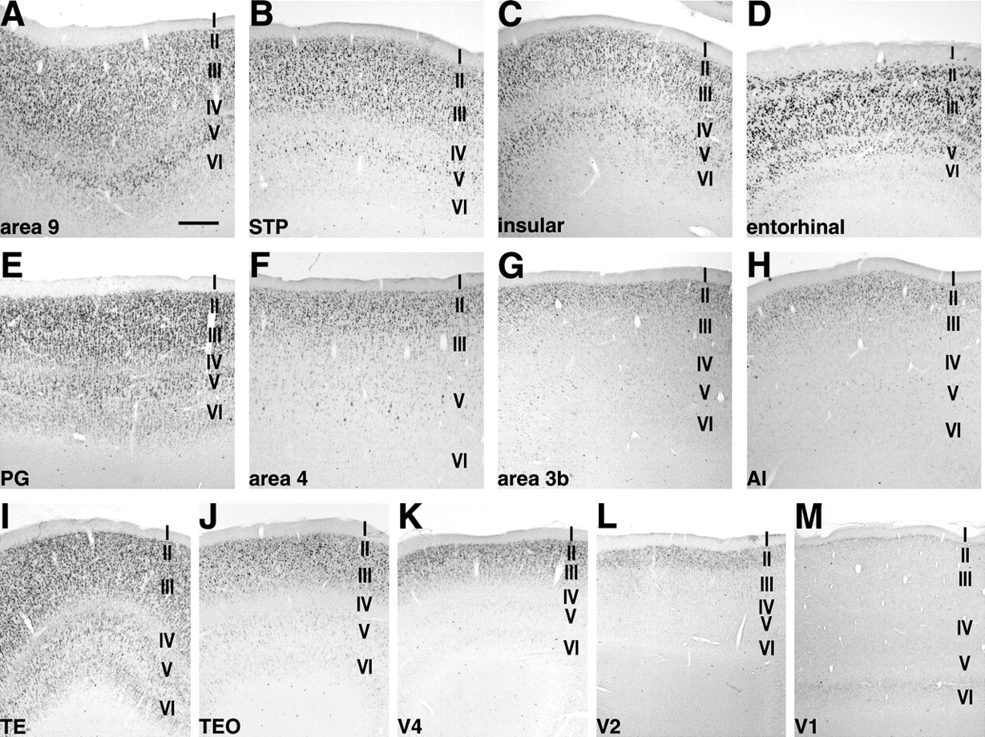
Figure 3. Layer distribution of RBP mRNA among cortical areas. A–E correspond to association and limbic cortices. (A) ...
Notes:
Figure 3. Layer distribution of RBP mRNA among cortical areas. A–E correspond to association and limbic cortices. (A) area 9, (B) STP (superior temporal area), (C) dysgranular insular cortex, (D) entorhinal cortex, (E) PG (parietal association cortex), (F) area 4 (primary motor cortex), (G) area 3b (primary somatosensory area), (H) AI is primary auditory cortex. The bottom row shows areas corresponding to the visual ventral pathway; (I) TE, (J) TEO, (K) V4, (L) V2 and (M) V1. Scale bar = 500 μm.
Unless provided in the caption above, the following copyright applies to the content of this slide: Cerebral Cortex V 15 N 1 © Oxford University Press 2005; all rights reserved

Slide 4
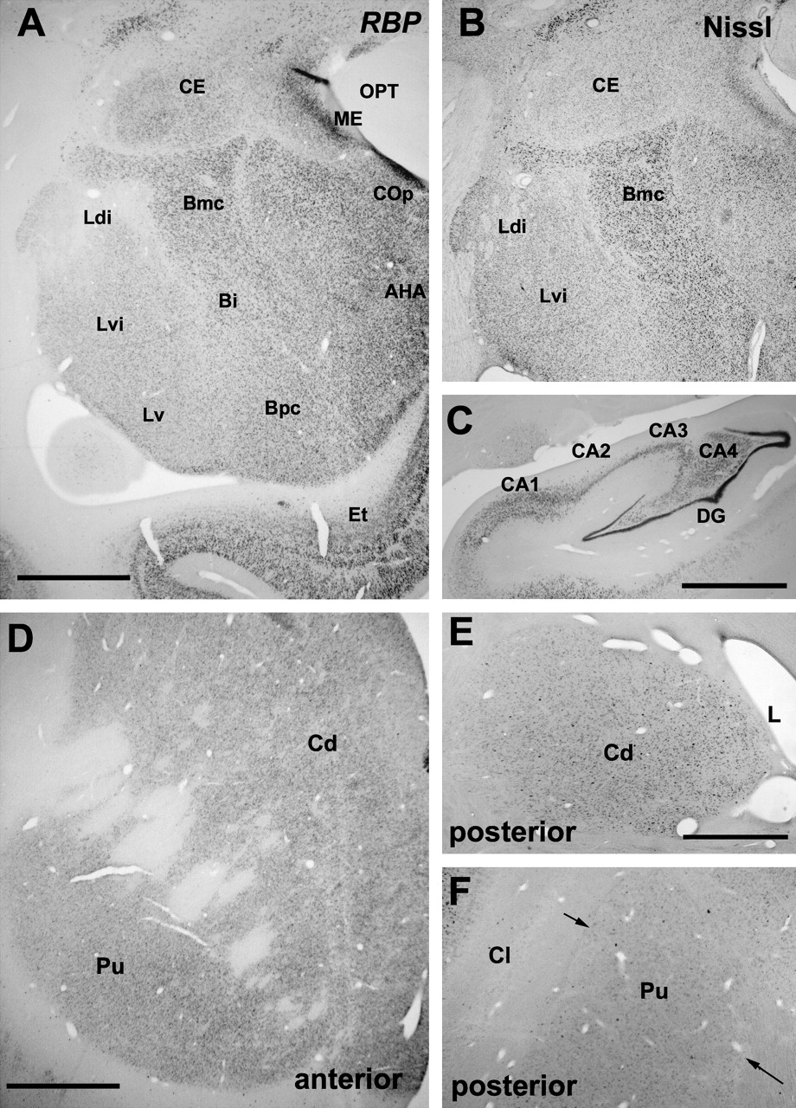
Figure 4. Subcortical distribution of RBP mRNA expression. RBP mRNA expression (A) and thionine stain (B) in the ...
Notes:
Figure 4. Subcortical distribution of RBP mRNA expression. RBP mRNA expression (A) and thionine stain (B) in the amygdala complex. RBP expression in the hippocampal formation (C), anterior (D) and posterior (E, F) striatum. Abbreviations: CE, central nucleus; Ldi, dorsal intermediate subdivision of the lateral nucleus; Lvi, ventral intermediate of the lateral nucleus; Lv, ventral subdivision of the lateral nucleus; Bmc, magnocellular subdivision of the basal nucleus; Bi, intermediate subdivision of the basal nucleus; Bpc, parvicellular subdivision of the basal nucleus; ME, medial nucleus; Cop, posterior cortical nucleus; AHA, amygdalohippocampal area; DG, dentate gyrus; Cd, caudate nucleus; Pu, putamen; Cl, posterior claustrum; L, lateral ventricle. Scale bar = 2 mm.
Unless provided in the caption above, the following copyright applies to the content of this slide: Cerebral Cortex V 15 N 1 © Oxford University Press 2005; all rights reserved

Slide 5
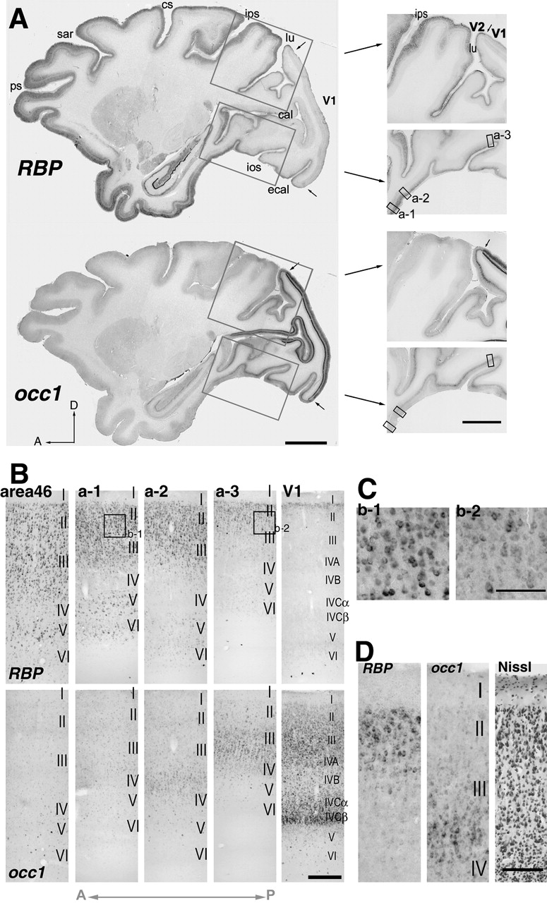
Figure 5. RBP and occ1 expression are complementary. (A) RBP mRNA signals (upper) and occ1 signals (lower) in a ...
Notes:
Figure 5. RBP and occ1 expression are complementary. (A) RBP mRNA signals (upper) and occ1 signals (lower) in a parasagittal section. Boxed regions were enlarged in right panels at higher magnification (a-1–3 are shown at further higher magnifications in B). Scale bar = 10 mm. Small arrows indicate the V1–V2 borders. Scale bar = 5 mm. (B) Layer distribution of RBP signals. With anterior progression, RBP signals gradually extended from layer II deeper into layer III (V1, a-1–3 upper panels). In layers V–VI, RBP signals increased with a scattered pattern (V1, a-1–3 upper panels). In area 46, many signals were observed throughout all layers except for layer I. Especially intense signals were observed in layers II, III and V. The lower row shows the occ1 expression in the sections adjacent to the just above sections examined for RBP expression. Scale bar = 150 μm. (C) Different expression levels in cells in layers II and III. Signals were more intense in anterior areas than in posterior areas (e.g. a-1> a-3). Scale bar = 100 μm. (D) RBP and occ1 expression in layers II and III of V2. Scale bar = 150 μm.
Unless provided in the caption above, the following copyright applies to the content of this slide: Cerebral Cortex V 15 N 1 © Oxford University Press 2005; all rights reserved

Slide 6
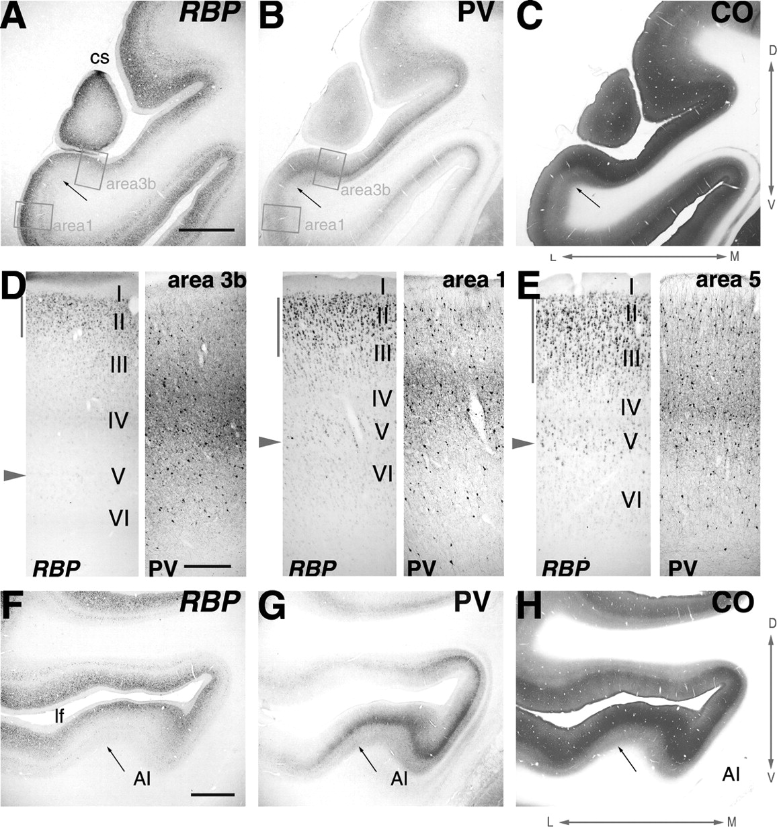
Figure 6. RBP mRNA signal distribution around the primary somatosensory area (SI) and primary auditory area (AI). (A) ...
Notes:
Figure 6. RBP mRNA signal distribution around the primary somatosensory area (SI) and primary auditory area (AI). (A) The RBP expression level of area 3b is lower than that of area1 (B, C). The lateral border of area 3b (shown by the arrow) was visualized by parvalubumin immunoreactive (PV-IR) fibers and histochemistry for cytochrome oxidase (CO). Boxed regions in (A) and (B) are enlarged in (D). cs, central sulcus. Scale bar = 2.5 mm. (D) RBP mRNA signals were weak and restricted to layer II in area 3b. PV-IR fibers in the middle layer were abundant in the adjacent section. In area 1, RBP mRNA signals were intense in layer II and moderate in layers III and V. PV-IR fibers in layers III to IV in area 1 were apparently lesser than in area 3b. (E) RBP expression was complementary to that of PV-IR fibers in the middle layers in SI but much less in area 5. RBP expression extended into deeper layer III and layer V. Side bars: the extent of intense RBP signals in the supragranular layers. Arrowheads, RBP mRNA signals of layer V. Scale bar = 350 μm. (F) RBP expression level was also low in AI and gradually increased towards the adjacent areas. (G, H) PV-IR fibers in the middle layers and CO staining indicated extent of AI. The RBP expression was complementary to the PV-IR fibers in the middle layers of AI. Arrows indicate the border between AI and belt region. lf: lateral fissure. Scale bar = 2 mm.
Unless provided in the caption above, the following copyright applies to the content of this slide: Cerebral Cortex V 15 N 1 © Oxford University Press 2005; all rights reserved

Slide 7
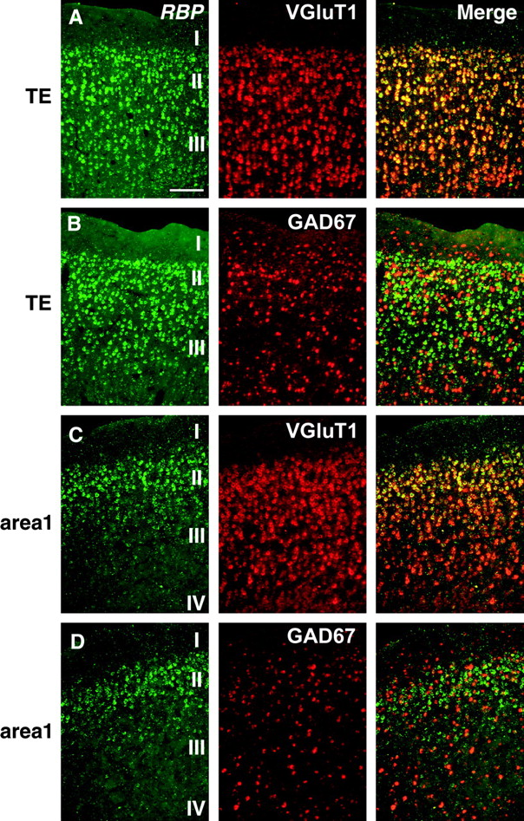
Figure 7. RBP mRNA expressed among the large population of excitatory neurons within supragranular layers. (A) RBP mRNA ...
Notes:
Figure 7. RBP mRNA expressed among the large population of excitatory neurons within supragranular layers. (A) RBP mRNA (left, Alexa 488, green) was intensely expressed among large population of VGluT1 positive cells (middle, Fast Red, red) within the sublayer labeled with RBP signals in layers II and III of TE (overlaid in the right panel). (B) The RBP expression (left, Alexa 488, green) was observed in the restricted population of GAD 67 positive neurons (middle, Fast Red, red; overlaid in right panels). (C, D) This bias was also observed in area 1 where the layer labeled with RBP signals was thinner than that of TE. (C) Compared to VGluT1, (D) Compared to GAD 67. Scale bar = 150 μm.
Unless provided in the caption above, the following copyright applies to the content of this slide: Cerebral Cortex V 15 N 1 © Oxford University Press 2005; all rights reserved

Slide 8
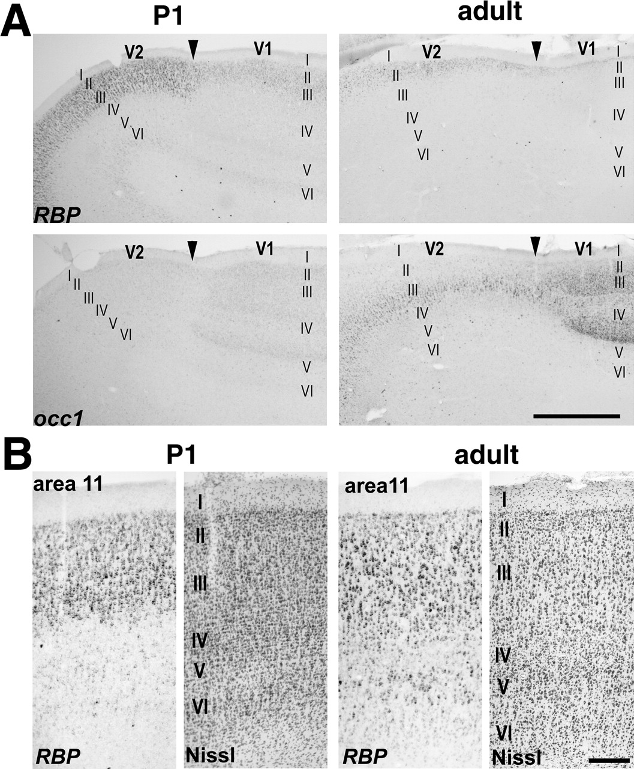
Figure 8. Neonatal laminar distribution of RBP mRNA signals. (A) Upper panel: RBP expression in V2 of a monkey at ...
Notes:
Figure 8. Neonatal laminar distribution of RBP mRNA signals. (A) Upper panel: RBP expression in V2 of a monkey at postnatal day 1 (left) and in an adult monkey (right). Lower panel: the occ1 expression in the visual areas of the P1 monkey (left) was much weaker than that in the adult monkey (right), although the V1–V2 border is already apparent at birth as previously reported (Tochitani et al., 2003). Arrowheads indicate the V1–V2 border. Scale bar = 1 mm (B) RBP expression is shown in the left panels of P1 and adult sections. Nissl staining is shown in each right panel. Scale bar = 250 μm.
Unless provided in the caption above, the following copyright applies to the content of this slide: Cerebral Cortex V 15 N 1 © Oxford University Press 2005; all rights reserved

