Slide 1
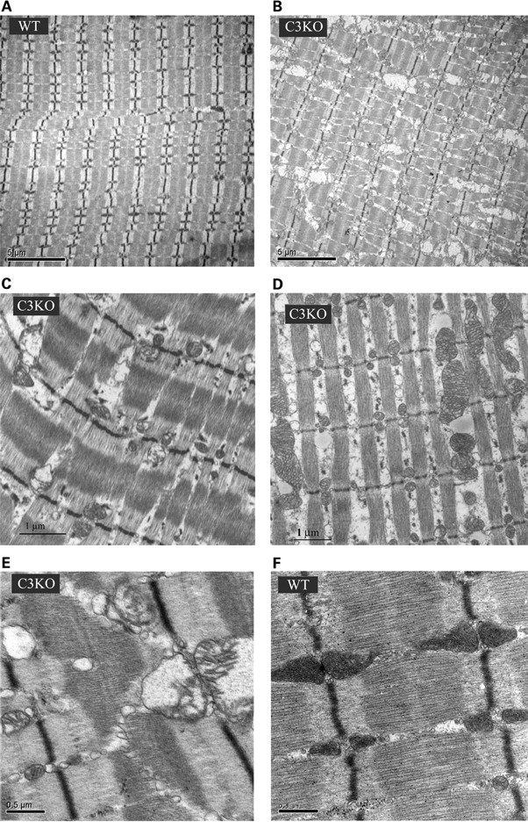
Figure 1. Ultrastructural abnormalities in mitochondria of C3KO muscles. Electron micrographs of WT soleus ( A and F ) ...
Notes:
Figure 1. Ultrastructural abnormalities in mitochondria of C3KO muscles. Electron micrographs of WT soleus ( A and F ) and C3KO soleus muscles ( B, C and E ) and diaphragm ( D ) reveal disorganized mitochondria in C3KO muscles. Higher magnification images show swollen mitochondria with disrupted cristae in C3KO muscle (E).
Unless provided in the caption above, the following copyright applies to the content of this slide: © The Author 2009. Published by Oxford University Press. All rights reserved. For Permissions, please email: journals.permissions@oxfordjournals.org

Slide 2
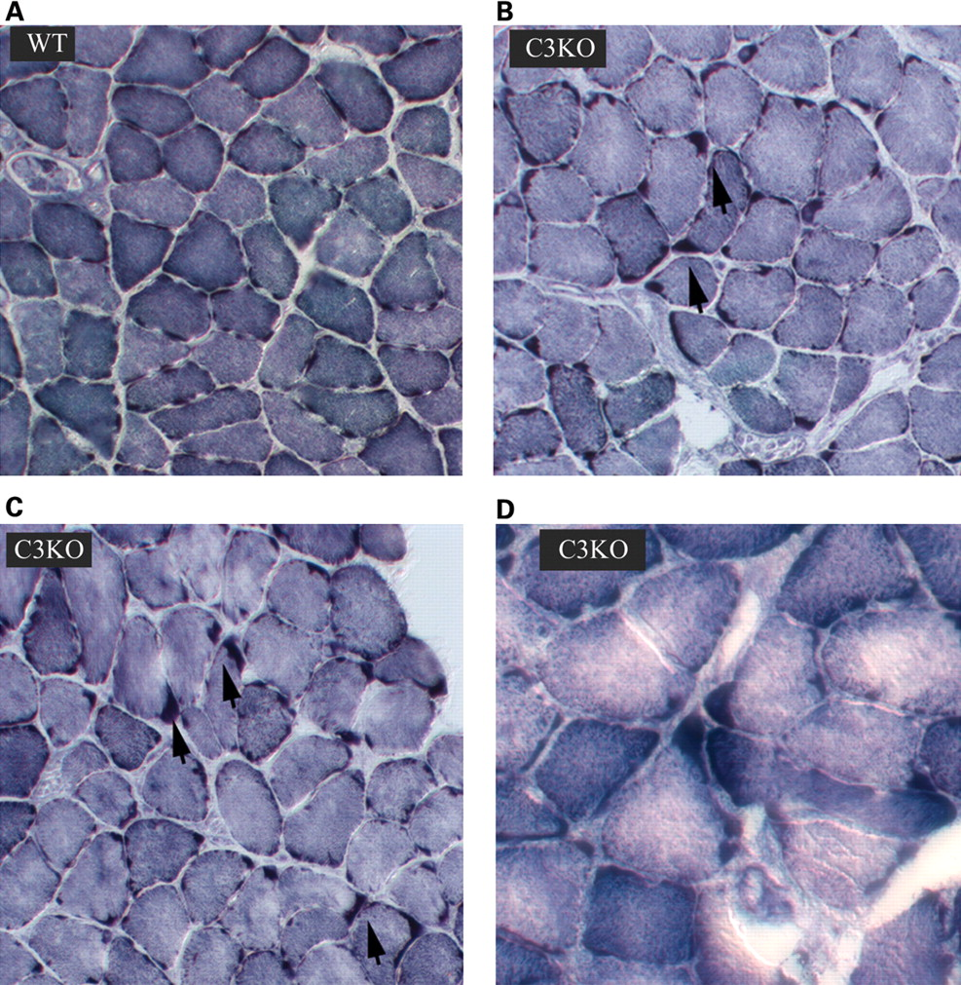
Figure 2. NADH staining of muscle sections from 1-year-old C3KO and WT mice. Staining for NADH shows an uneven ...
Notes:
Figure 2. NADH staining of muscle sections from 1-year-old C3KO and WT mice. Staining for NADH shows an uneven distribution of mitochondria in C3KO diaphragms ( B – D ) compared with WT diaphragms ( A ); arrows point to the areas of mitochondrial accumulation in C3KO muscles.
Unless provided in the caption above, the following copyright applies to the content of this slide: © The Author 2009. Published by Oxford University Press. All rights reserved. For Permissions, please email: journals.permissions@oxfordjournals.org

Slide 3
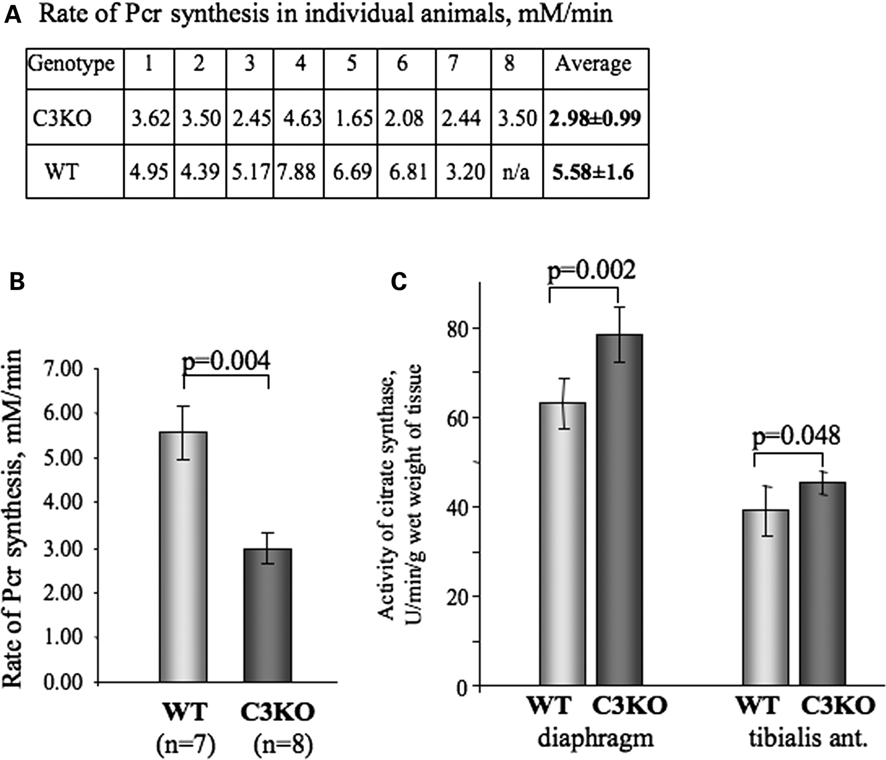
Figure 3. Rate of PCr synthesis in vivo is decreased in C3KO muscles. A reversible ischemia model was used to study ...
Notes:
Figure 3. Rate of PCr synthesis in vivo is decreased in C3KO muscles. A reversible ischemia model was used to study kinetic changes in the rate of PCr synthesis in vivo (see Materials and Methods). ( A ) Table indicating the rate of PCr synthesis in individual mice. Initial rate of PCr synthesis was measured by 31 P-MR spectroscopy in eight C3KO and seven WT mice. ( B ) An average initial rate of PCr synthesis was 53.4% slower in C3KO group compared with WT group; P < 0.05. ( C ) Level of citrate synthase activity was increased by 24% in C3KO diaphragms and by 16% in C3KO tibialis anterior muscles compared with WT ( n = 5 for each group).
Unless provided in the caption above, the following copyright applies to the content of this slide: © The Author 2009. Published by Oxford University Press. All rights reserved. For Permissions, please email: journals.permissions@oxfordjournals.org

Slide 4
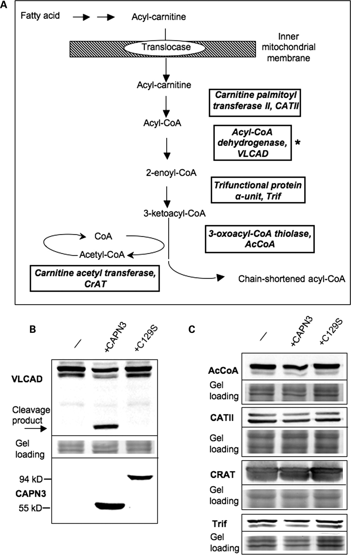
Figure 4. Assesment of mitochondrial proteins involved in β-oxidation of fatty acids as potential substrates for CAPN3 ...
Notes:
Figure 4. Assesment of mitochondrial proteins involved in β-oxidation of fatty acids as potential substrates for CAPN3 proteolytic activity. ( A ) Schematic of the β-oxidation pathway; only proteins that were identified in the proteomic screen ( 27 ) as putative substrates for CAPN3 are shown. ( B and C ) All potential substrates were cloned in baculoviral expression vectors with a V5 epitope tag introduced in frame at the C-terminal end of each protein. Each potential substrate was expressed alone (-) or co-expressed either with proteolytically active CAPN3 or the proteolytically inactive C129S mutant. If a protein can be cleaved by CAPN3, a decreased amount or additional cleavage product is expected upon co-expression with proteolytically active CAPN3. As shown in (B), VLCAD was the only protein cleaved by CAPN3; the arrow points to a product resulting from CAPN3 cleavage of VLCAD. Identical protein extracts were also stained for CAPN3 (B, bottom panel) to ensure its expression. Note that full-length CAPN3 undergoes almost complete autolysis and runs as a 55 kDa band (unlike the proteolytically inactive C129S mutant that runs as a 94 kDa band). Middle panel shows protein loading. (C) None of the other four proteins tested showed any change upon co-expression with active CAPN3 (since we did not detect any cleavage products, only full-length bands are shown).
Unless provided in the caption above, the following copyright applies to the content of this slide: © The Author 2009. Published by Oxford University Press. All rights reserved. For Permissions, please email: journals.permissions@oxfordjournals.org

Slide 5
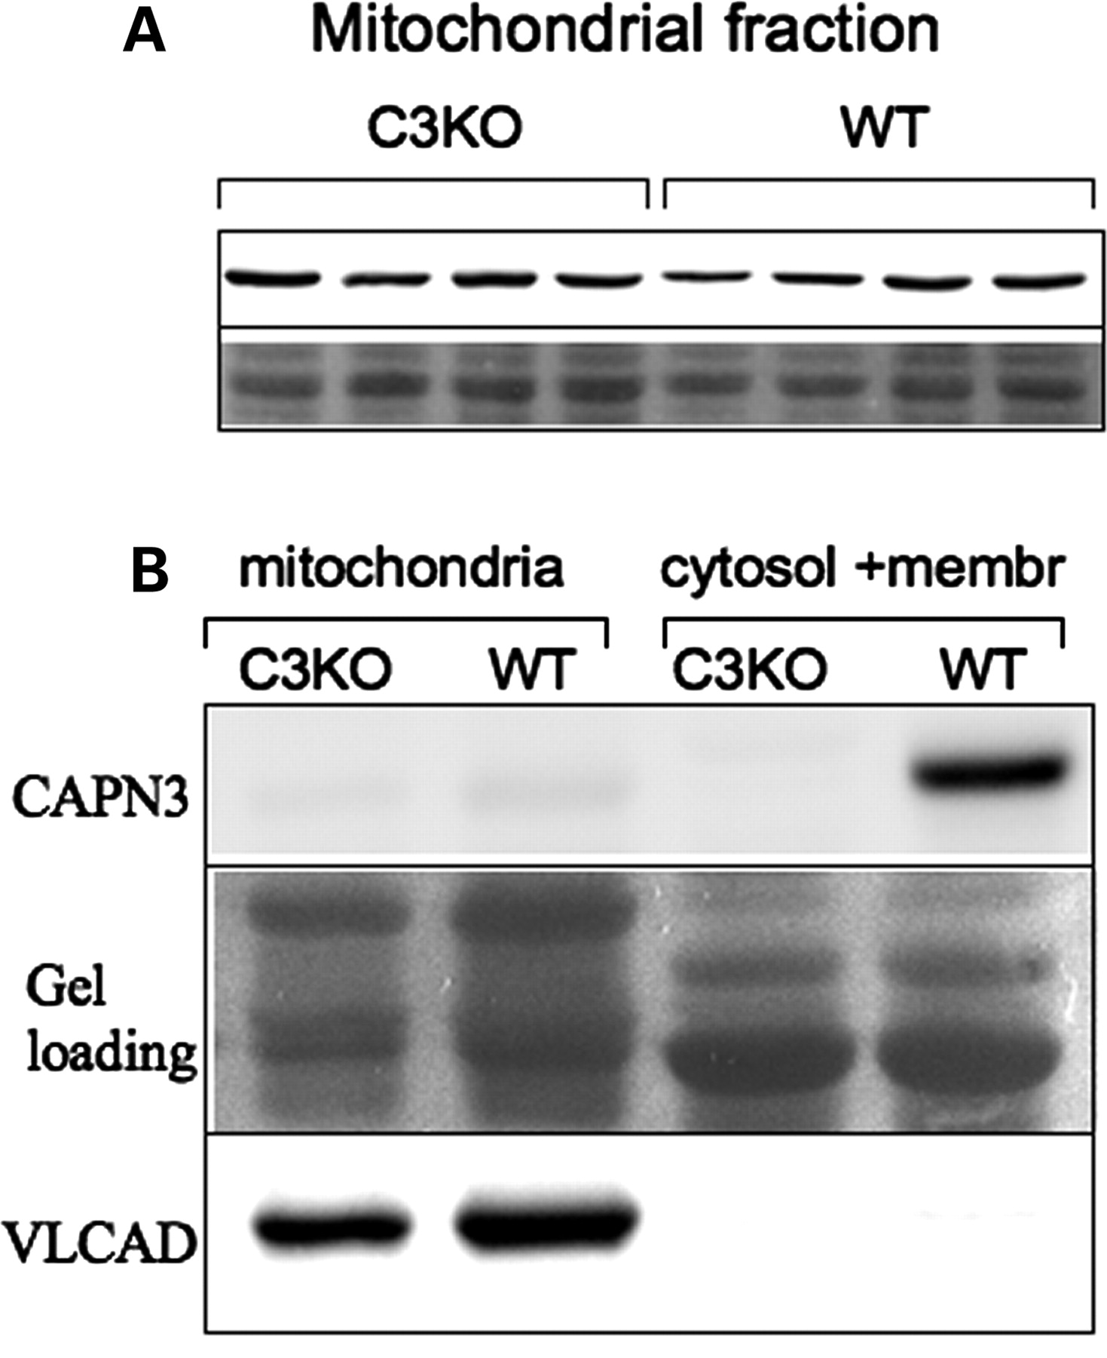
Figure 5. VLCAD concentration is not elevated in C3KO muscles. ( A ) Mitochondrial fractions from diaphragm muscles of ...
Notes:
Figure 5. VLCAD concentration is not elevated in C3KO muscles. ( A ) Mitochondrial fractions from diaphragm muscles of four WT and four C3KO males were stained for VLCAD (upper panel). No difference was found between C3KO and WT muscles, suggesting that VLCAD is not a bone fide substrate of CAPN3 in vivo . ( B ) Although CAPN3 was readily detectable in the WT fraction that contained cytosol and membrane, no CAPN3 was detected in the mitochondrial fraction from WT muscle (upper panel). C3KO muscles were examined as a negative control. Staining with anti-VLCAD antibodies was performed to confirm that the mitochondrial fractionation was carried out successfully (lower panel). Middle panel shows protein loading.
Unless provided in the caption above, the following copyright applies to the content of this slide: © The Author 2009. Published by Oxford University Press. All rights reserved. For Permissions, please email: journals.permissions@oxfordjournals.org

Slide 6
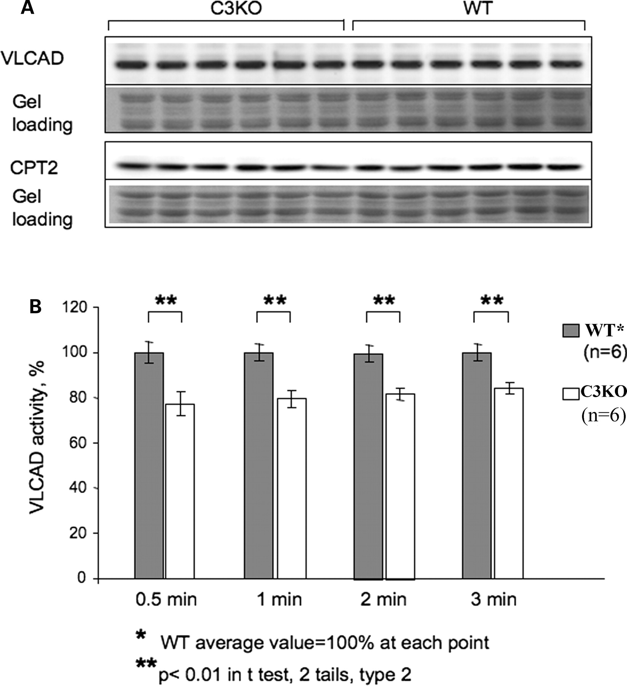
Figure 6. VLCAD activity is decreased in C3KO muscle. Mitochondria were isolated from six C3KO and six WT muscles for ...
Notes:
Figure 6. VLCAD activity is decreased in C3KO muscle. Mitochondria were isolated from six C3KO and six WT muscles for the analysis of VLCAD concentration and activity. ( A ) Western blots of mitochondrial fractions were stained with anti-VLCAD antibodies and with antibody against another mitochondrial protein (anti-CPT-2 antibody). ( B ) VLCAD activity assay. Protein concentration in the extracts was measured using the Bio-Rad Protein Assay Kit to ensure that an equal amount of the mitochondrial protein was used for measurements of VLCAD enzymatic activity. VLCAD activity was measured as described in Materials and Methods. Measurements of absorbance at 300 nm were taken after 30 s, 1 min and then every minute. The average WT VLCAD activity at each time point was set to be 100% activity. An ∼20% decrease in VLCAD activity was found in C3KO muscles compared with WT.
Unless provided in the caption above, the following copyright applies to the content of this slide: © The Author 2009. Published by Oxford University Press. All rights reserved. For Permissions, please email: journals.permissions@oxfordjournals.org

Slide 7
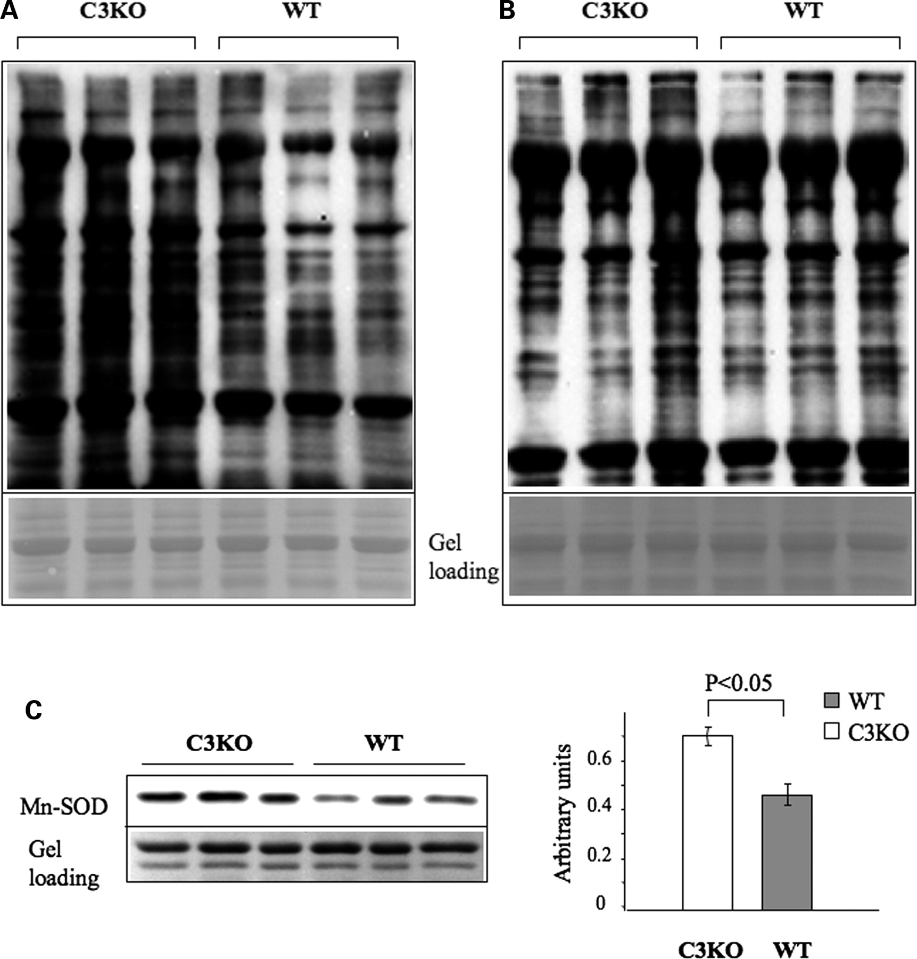
Figure 7. Evidence of increased oxidative stress in 1-year-old C3KO muscles. OxyBlot™ Protein Oxidation Detection Kit ...
Notes:
Figure 7. Evidence of increased oxidative stress in 1-year-old C3KO muscles. OxyBlot™ Protein Oxidation Detection Kit (Chemicon) was used for the immunoblot detection of carbonyl groups introduced into proteins by oxidative reactions. ( A ) Measurements of protein oxidation by OxyBlot in old C3KO mice. The concentration of oxidized proteins was higher in diaphragm muscles isolated from 10–11-month-old C3KO mice compared with diaphragm muscles isolated from WT mice of the same age. ( B ) Measurements of protein oxidation by OxyBlot in young C3KO mice. Only one out of three diaphragm extracts isolated from 2-month-old C3KO mice had an elevated concentration of oxidized proteins compared with the age-matched WT mice. ( C ) Quantitative western blot analysis showed that Mn-SOD concentration is also elevated in C3KO muscles from 1-year-old mice.
Unless provided in the caption above, the following copyright applies to the content of this slide: © The Author 2009. Published by Oxford University Press. All rights reserved. For Permissions, please email: journals.permissions@oxfordjournals.org

