Slide 1
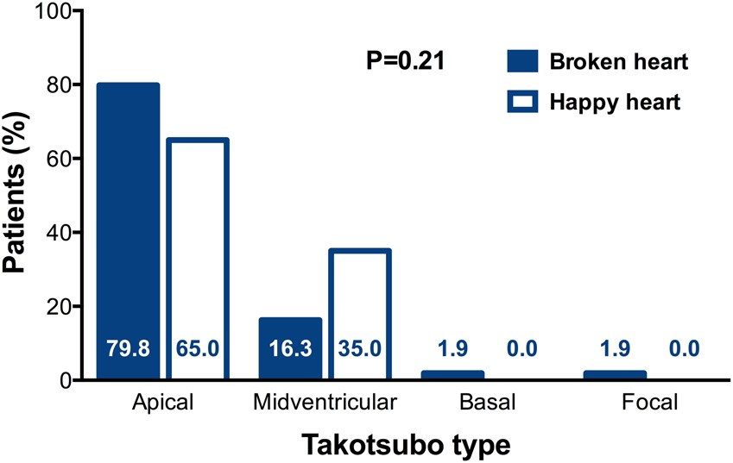
Figure 1 Overall distribution of takotsubo types in ‘happy heart syndrome’ vs. ‘broken heart syndrome’ (P = 0.21). ...
Notes:
Figure 1 Overall distribution of takotsubo types in ‘happy heart syndrome’ vs. ‘broken heart syndrome’ (P = 0.21). Post hoc P-values for comparison within takotsubo types showed a significantly higher prevalence of the midventricular takotsubo syndrome type in patients with ‘happy heart’ vs. ‘broken heart’ (P = 0.030), while no significant differences were seen in apical (P = 0.15), basal (P = 1.0), or focal (P = 1.0) takotsubo syndrome types.
Unless provided in the caption above, the following copyright applies to the content of this slide: © The Author 2016. Published by Oxford University Press on behalf of the European Society of Cardiology.This is an Open Access article distributed under the terms of the Creative Commons Attribution Non-Commercial License (http://creativecommons.org/licenses/by-nc/4.0/), which permits non-commercial re-use, distribution, and reproduction in any medium, provided the original work is properly cited. For commercial re-use, please contact journals.permissions@oup.com

