Slide 1
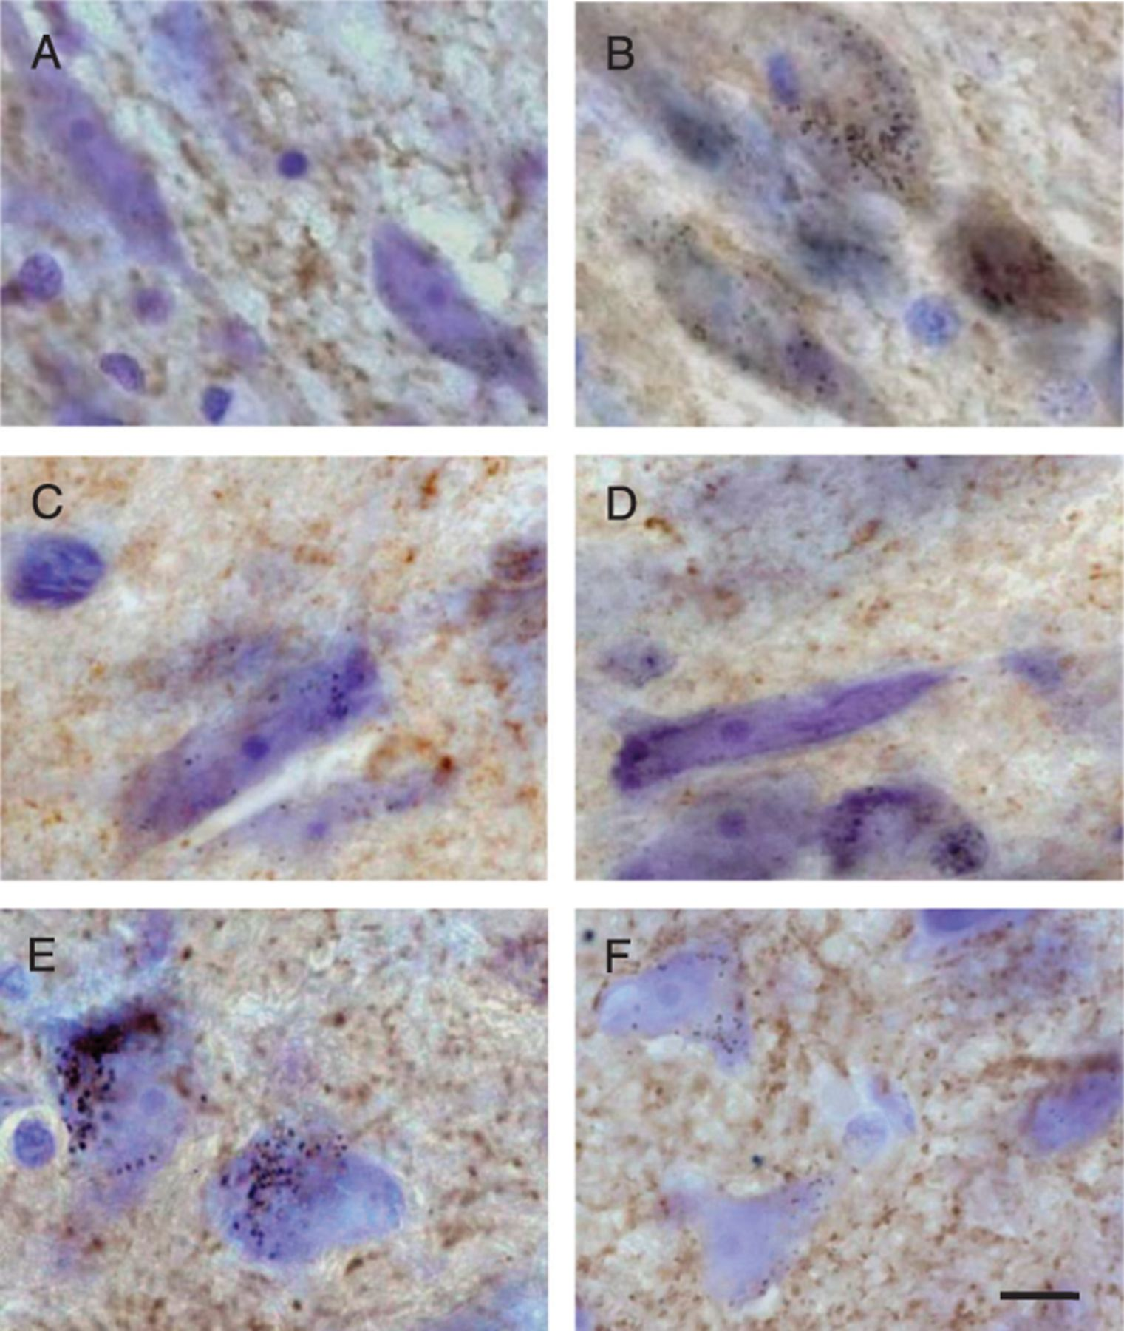
FIGURE 1. α-Synuclein, but not other synaptic proteins, is accumulated within nigral dopaminergic cell bodies of ...
Notes:
FIGURE 1. α-Synuclein, but not other synaptic proteins, is accumulated within nigral dopaminergic cell bodies of 1-methyl-4-phenyl-1,2,3,6-tetrahydropyridine (MPTP)-treated monkeys. Squirrel monkeys were given a single subcutaneous injection of either saline or MPTP and killed 4 weeks later. Representative midbrain sections from control (A, C, E) and MPTP-treated (B, D, F) animals were immunostained for α-synuclein (A, B), β-synuclein (C, D), or synaptophysin (E, F), and counterstained with cresyl violet (purple). Increased immunoreactivity (brown) for α-synuclein, but not β-synuclein or synaptophysin, is evident within neuromelanin-loaded (black granules) nigral dopaminergic cell bodies in the MPTP-treated monkey. Scale bar = (F) 10 μm (A-F).
Unless provided in the caption above, the following copyright applies to the content of this slide: Copyright © 2008 by the American Association of Neuropathologists, Inc.

Slide 2
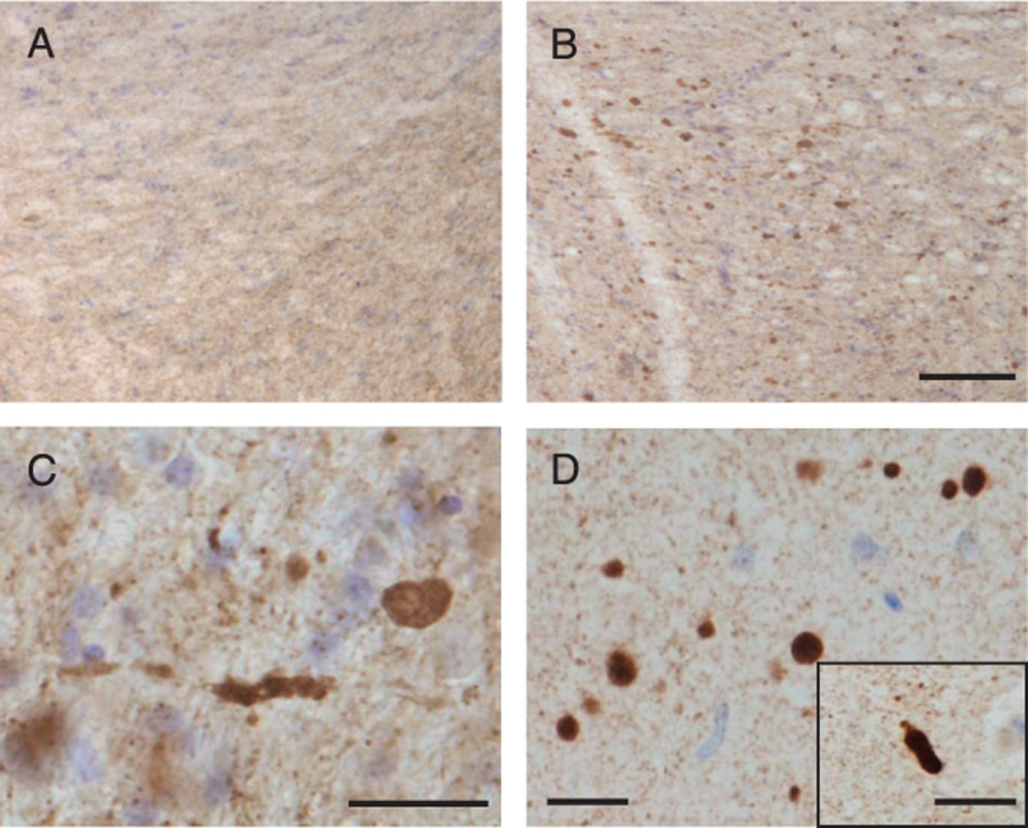
FIGURE 2. Axonal accumulation of α-synuclein in the midbrain of 1-methyl-4-phenyl-1,2,3,6-tetrahydropyridine ...
Notes:
FIGURE 2. Axonal accumulation of α-synuclein in the midbrain of 1-methyl-4-phenyl-1,2,3,6-tetrahydropyridine (MPTP)-treated monkeys resembles pathologic changes in Parkinson disease (PD) patients. (A-C) Representative sections of the ventral midbrain from monkeys injected once with either saline (A) or MPTP (B, C) and killed 4 weeks later. Tissues were immunostained with an antibody against α-synuclein and counterstained with cresyl violet. Numerous α-synuclein-immunoreactive (brown) axons are shown at low (B) and high (C) magnification in the ventral midbrain of the MPTP-treated animal. (D; panel and inset) Pathologic axons in the ventral midbrain of a PD patient. A representative midbrain section was immunostained with an antibody against α-synuclein and counterstained with cresyl violet. Scale bar = (B) 100 μm (A, B). Scale bars = (C, D, and inset) 20 μm.
Unless provided in the caption above, the following copyright applies to the content of this slide: Copyright © 2008 by the American Association of Neuropathologists, Inc.

Slide 3
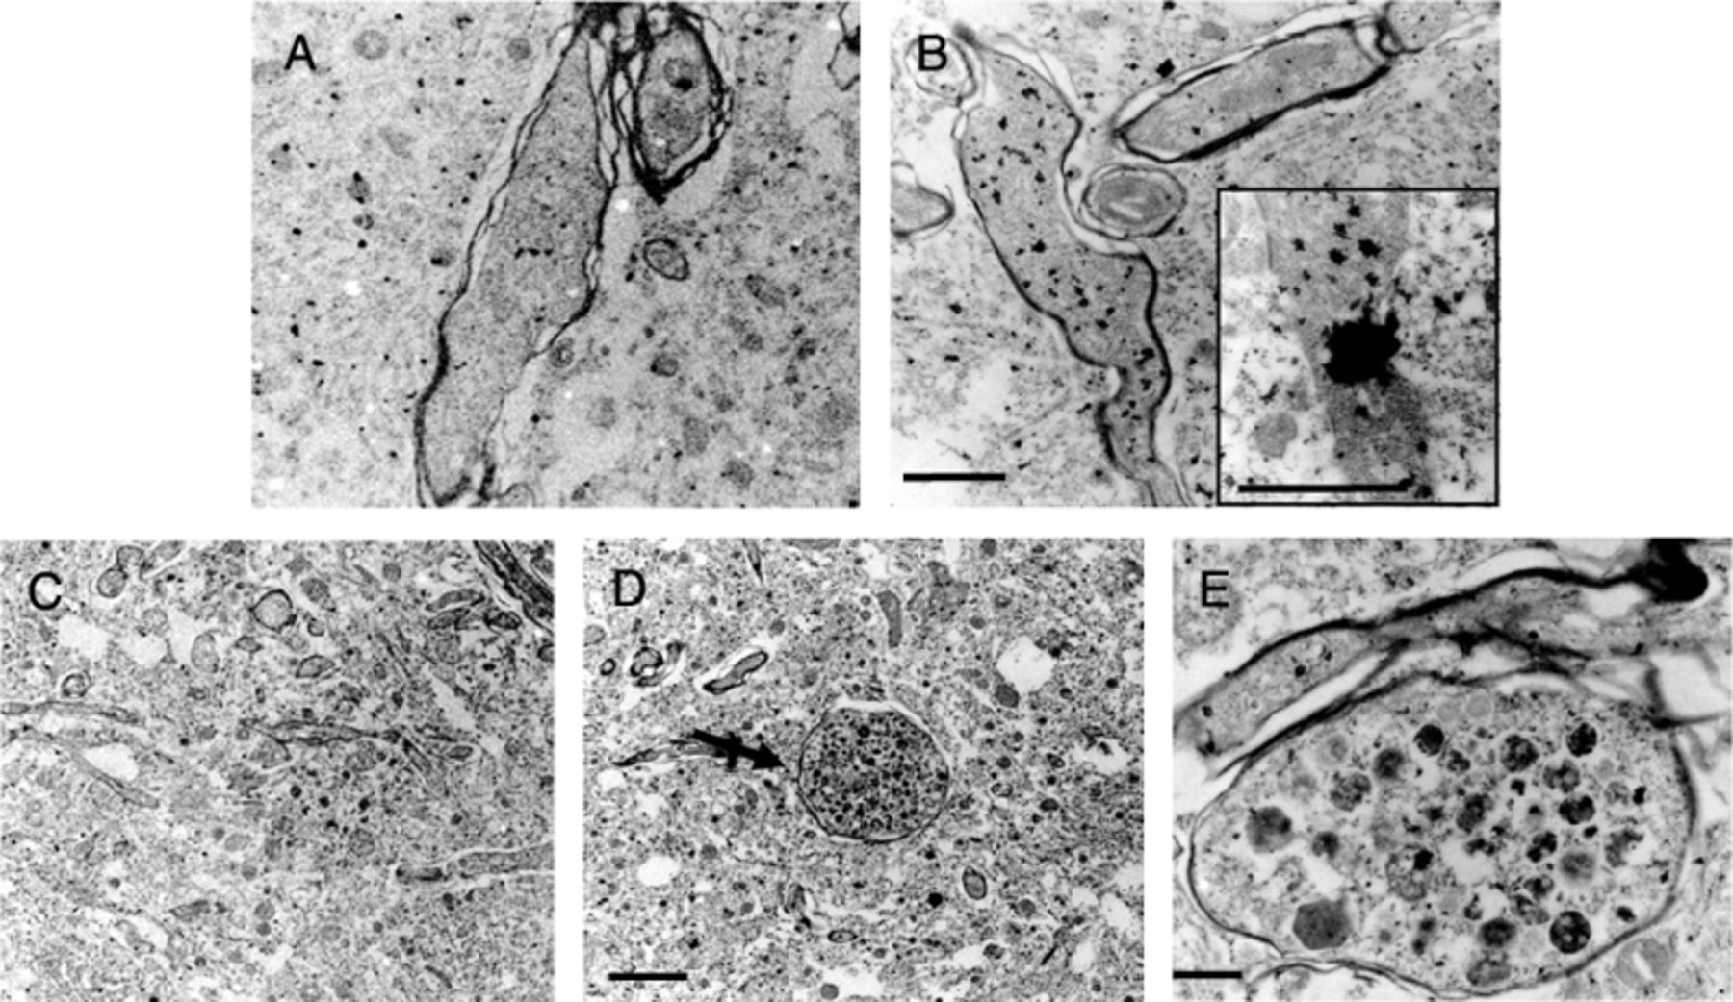
FIGURE 3. Immunoelectron microscopy (IEM) images of α-synuclein accumulation within dystrophic neurites. Tissue punches ...
Notes:
FIGURE 3. Immunoelectron microscopy (IEM) images of α-synuclein accumulation within dystrophic neurites. Tissue punches of the ventral midbrain of monkeys treated with saline or 1-methyl-4-phenyl-1,2,3,6-tetrahydropyridine (MPTP) were processed for IEM with an anti-α-synuclein antibody. (A, B) Representative electron micrographs show increased α-synuclein immunolabeling (black particles) within myelinated (B) and unmyelinated (B; inset) neurites in the MPTP-treated monkey compared with the control (A). (C, D) Representative electron micrographs show normal tissue architecture in a control (C) and an enlarged dystrophic axon in an MPTP-injected animal (D; arrow). (E) At higher magnification, accumulation of α-synuclein (black particles) is more evident within a dystrophic axon in an MPTP-treated monkey. Scale bar = (B) 1 μm (A, B). Scale bar = (inset) 1 μm. Scale bar = (D) 4 μm (C, D). Scale bar = (E) 1 μm.
Unless provided in the caption above, the following copyright applies to the content of this slide: Copyright © 2008 by the American Association of Neuropathologists, Inc.

Slide 4
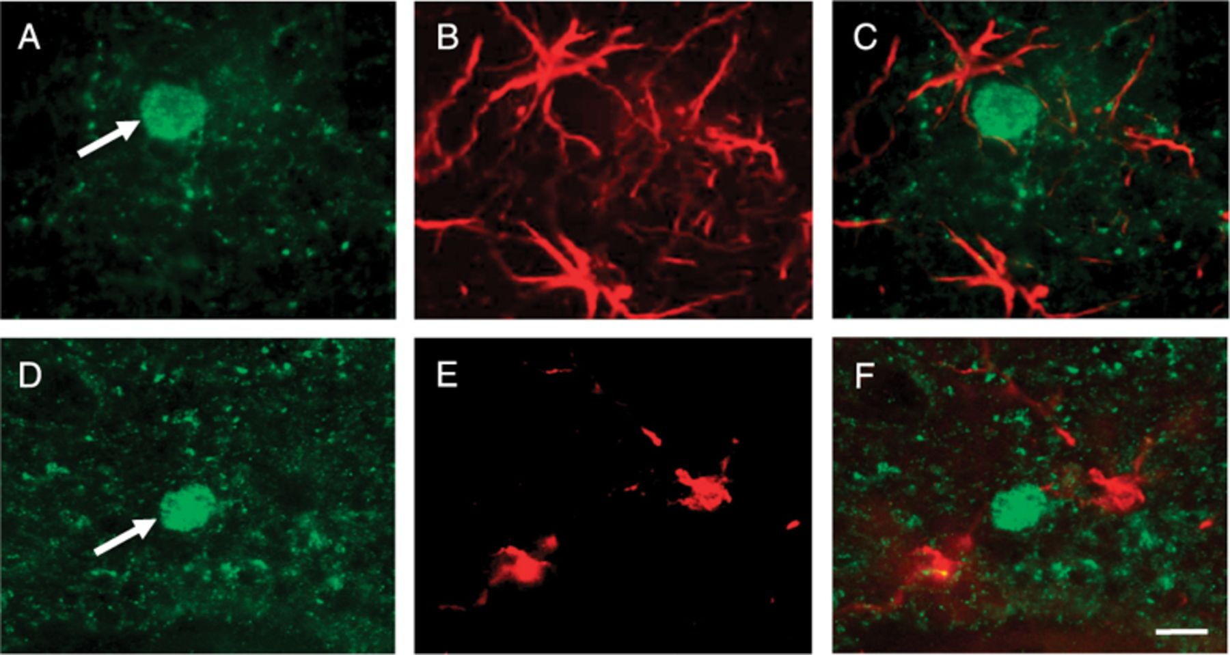
FIGURE 4. α-Synuclein does not colocalize with astrocytic or microglial markers. (A-C) A representative section of the ...
Notes:
FIGURE 4. α-Synuclein does not colocalize with astrocytic or microglial markers. (A-C) A representative section of the ventral midbrain from a monkey injected once with 1-methyl-4-phenyl-1,2,3,6-tetrahydropyridine (MPTP) and killed 4 weeks later was colabeled with anti-α-synuclein (A) and anti-GFAP (an astrocytic marker; B). The arrow in (A) indicates an enlarged dystrophic axon positively stained for α-synuclein. The merged image (C) shows lack of α-synuclein immunoreactivity within astrocytes. (D-F) A representative section of the ventral midbrain from an MPTP-treated monkey was colabeled with anti-α-synuclein (D) and anti-ionizing calcium-binding adaptor molecule 1 (a microglial marker; E). The arrow in (D) indicates an enlarged α-synuclein-immunoreactive axon. The merged image (F) shows lack of α-synuclein and ionizing calcium-binding adaptor molecule 1 colocalization. Scale bar = (F) 10 μm (A-F).
Unless provided in the caption above, the following copyright applies to the content of this slide: Copyright © 2008 by the American Association of Neuropathologists, Inc.

Slide 5
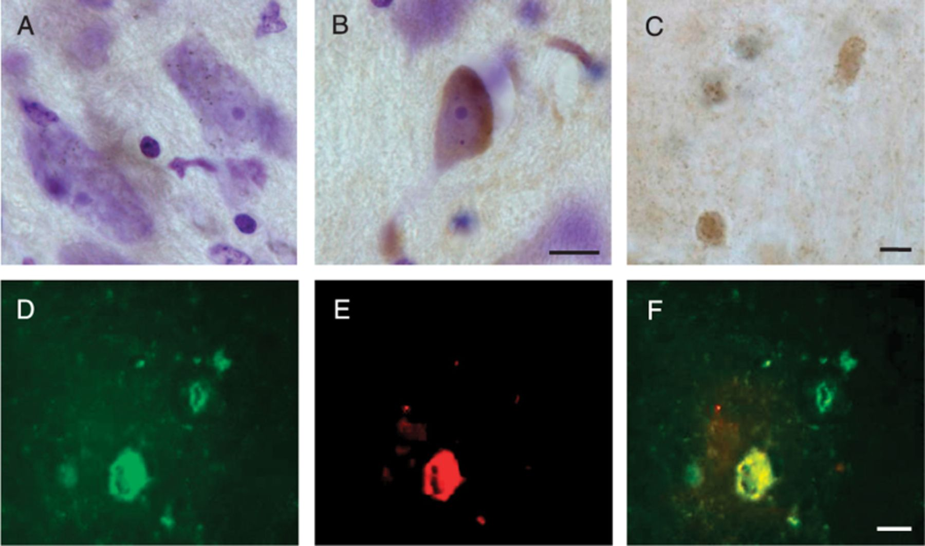
FIGURE 5. Nitrated α-synuclein within nigral dopaminergic cell bodies and dystrophic axons of ...
Notes:
FIGURE 5. Nitrated α-synuclein within nigral dopaminergic cell bodies and dystrophic axons of 1-methyl-4-phenyl-1,2,3,6-tetrahydropyridine (MFTP)-treated monkeys. Squirrel monkeys received a single subcutaneous injection of either saline or MPTP and were killed 4 weeks later. (A-C) Representative midbrain sections from a control (A) and an MPTP-treated (B, C) animal were immunostained with anti-nitrated α-synuclein and counterstained with cresyl violet (purple). Immunoreactivity for nitrated α-synuclein (brown) is shown within a neuromelanin-containing nigral neuron (B) and dystrophic neurites (C) after MPTP treatment. (D-F) A representative midbrain section from an MPTP-treated animal was processed for confocal microscopy. Tissue was dual-labeled with anti-α-synuclein (D) and anti-nitrated α-synuclein (E) antibodies. The merged image (F) shows that α-synuclein is nitrated in some, but not all, dystrophic neurites. Scale bar = (B) 10 μm (A, B). Scale bar = (C) 10 μm. Scale bar = (F) 10 μm (D-F).
Unless provided in the caption above, the following copyright applies to the content of this slide: Copyright © 2008 by the American Association of Neuropathologists, Inc.

Slide 6
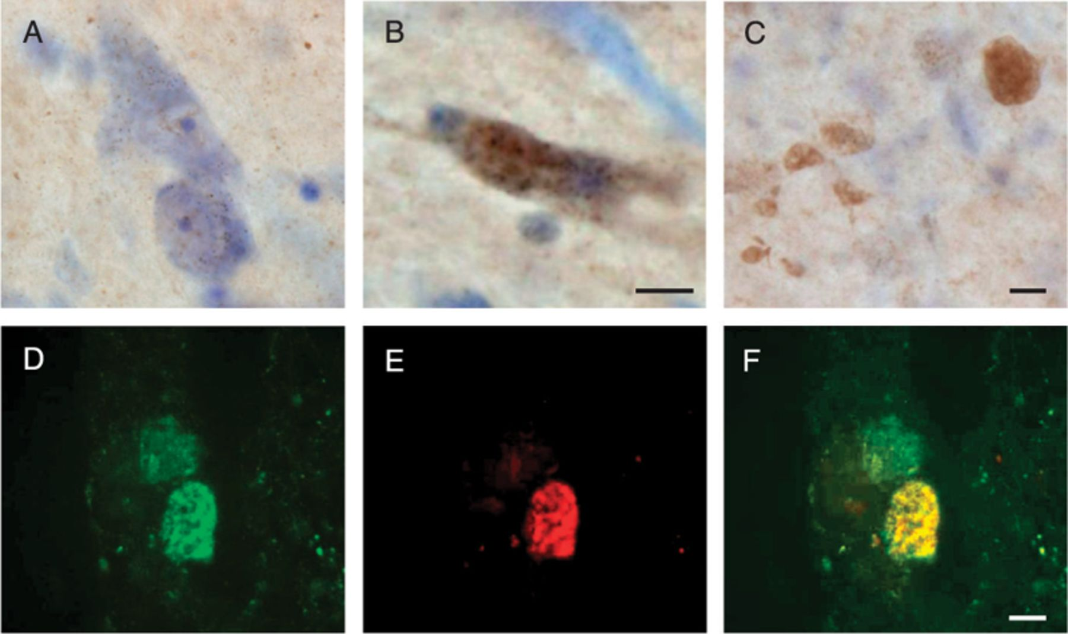
FIGURE 6. Phosphorylated α-synuclein within nigral dopaminergic cell bodies and axonal profiles of ...
Notes:
FIGURE 6. Phosphorylated α-synuclein within nigral dopaminergic cell bodies and axonal profiles of 1-methyl-4-phenyl-1,2,3,6-tetrahydropyridine (MPTP)-exposed monkeys. Squirrel monkeys received a single subcutaneous injection of either saline or MPTP and were killed 4 weeks later. (A-C) Representative midbrain sections from a control (A) and an MPTP-treated (B, C) animal were immunostained with an anti-phospho-Ser 129 α-synuclein antibody and counterstained with cresyl violet (purple). Immunoreactivity for phospho-Ser 129 α-synuclein (brown) is shown within a neuromelanin-containing nigral neuron (B) and dystrophic neurites (C) after MPTP treatment. (D-F) A representative midbrain section from an MPTP-treated animal was processed for confocal microscopy. Tissue was dual-labeled with anti-α-synuclein (D) and anti-phospho-Ser 129 α-synuclein (E) antibodies. The merged image (F) shows that α-synuclein is phosphorylated at Ser129 in some but not all dystrophic neurites. Scale bar = (B) 10 μm (A, B). Scale bar = (C) 10 μm. Scale bar = (F) 10 μm (D-F).
Unless provided in the caption above, the following copyright applies to the content of this slide: Copyright © 2008 by the American Association of Neuropathologists, Inc.

Slide 7
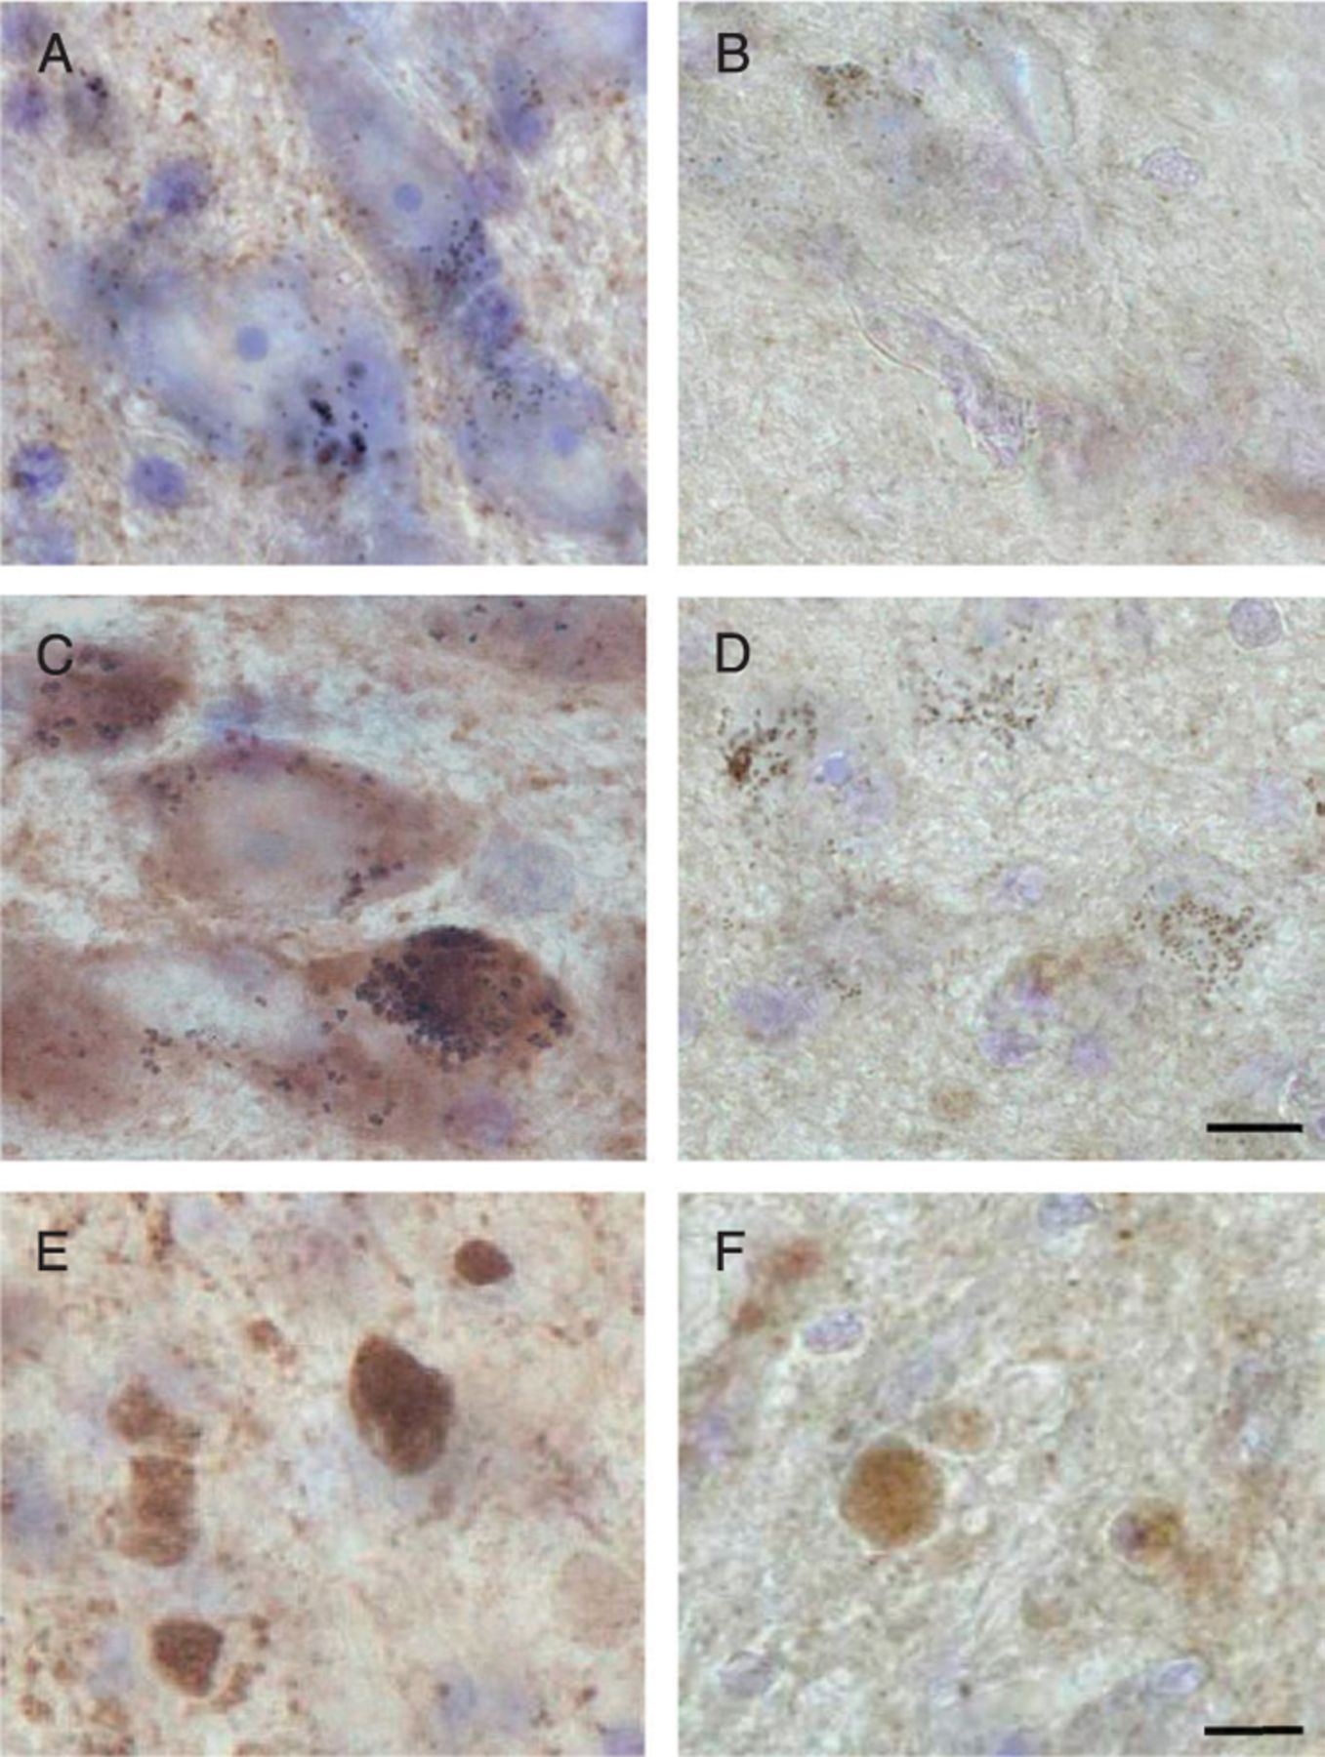
FIGURE 7. Proteinase K-resistant axonal pathology in 1-methyl-4-phenyl-1,2,3,6-tetrahydropyridine (MPTP)-exposed ...
Notes:
FIGURE 7. Proteinase K-resistant axonal pathology in 1-methyl-4-phenyl-1,2,3,6-tetrahydropyridine (MPTP)-exposed monkeys. Squirrel monkeys received a single subcutaneous injection of either saline or MPTP and were killed 4 weeks later. Representative midbrain sections from a saline- (A, B) and an MPTP-treated (C-F) animal were incubated in either buffer (A, C, E) or proteinase K (B, D, F). Sections were subsequently immunostained with an antibody against α-synuclein (brown) and counterstained with cresyl violet (purple). The robust immunoreactivity observed within nigral cell bodies of the MPTP-exposed animal (C) was removed by proteinase K digestion, leaving only neuromelanin granules (black) (D). A subset of dystrophic axons in the MPTP-treated monkey retained α-synuclein immunoreactivity even after proteinase K treatment (F). Scale bar = (D) 10 μm (A-D). Scale bar = (F) 10 μm (E, F).
Unless provided in the caption above, the following copyright applies to the content of this slide: Copyright © 2008 by the American Association of Neuropathologists, Inc.

