Slide 1
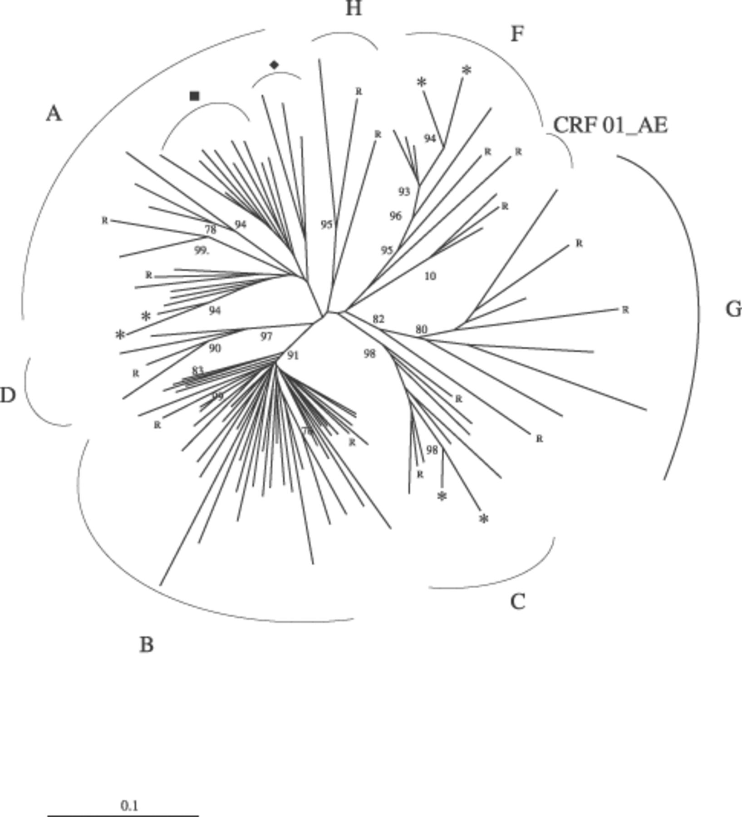
Figure 1 Phylogenetic analysis based on alignments of the sequences of 330 nucleotides from the env region of 92 HIV-1 ...
Notes:
Figure 1 Phylogenetic analysis based on alignments of the sequences of 330 nucleotides from the env region of 92 HIV-1 isolates from Western Brittany and reference strains representing 10 genetic subtypes. The neighbour-joining tree was built using the Kimura two-parameter method of estimating genetic distance. Branch lengths are drawn to scale (the scale bar represents 10% nucleotide divergence). Numbers at nodes of the tree indicate the bootstrap values (numbers higher than 75% are shown) obtained from 1000 replicates. The following reference strains were included in the phylogenetic analysis: A1.SE.94.SE7253, A2.CY.94.94CY017.41, D.CD.83.NDK, B.US.90.WEAU160, B.FR.83.HXB2, C.ET.86.ETH2220, C.BR.92.92BR025, J.SE.93.SE7887, G.BE.96.DRCBL, G.NG.92.92NG083, 01_AE.CF.90.90CF11697, F2.CM.95.MP255, F1.FR.96.MP411, K.CD.97.EQTB11C, H.CF.90.90CF056. R: reference strains, ■: CRF02_AG BLAST matching strains, ♦: CRF 11_CPX BLAST matching strains, *: strains with an epidemiological link.
Unless provided in the caption above, the following copyright applies to the content of this slide: © 2002 Federation of European Microbiological Societies.

