Slide 1
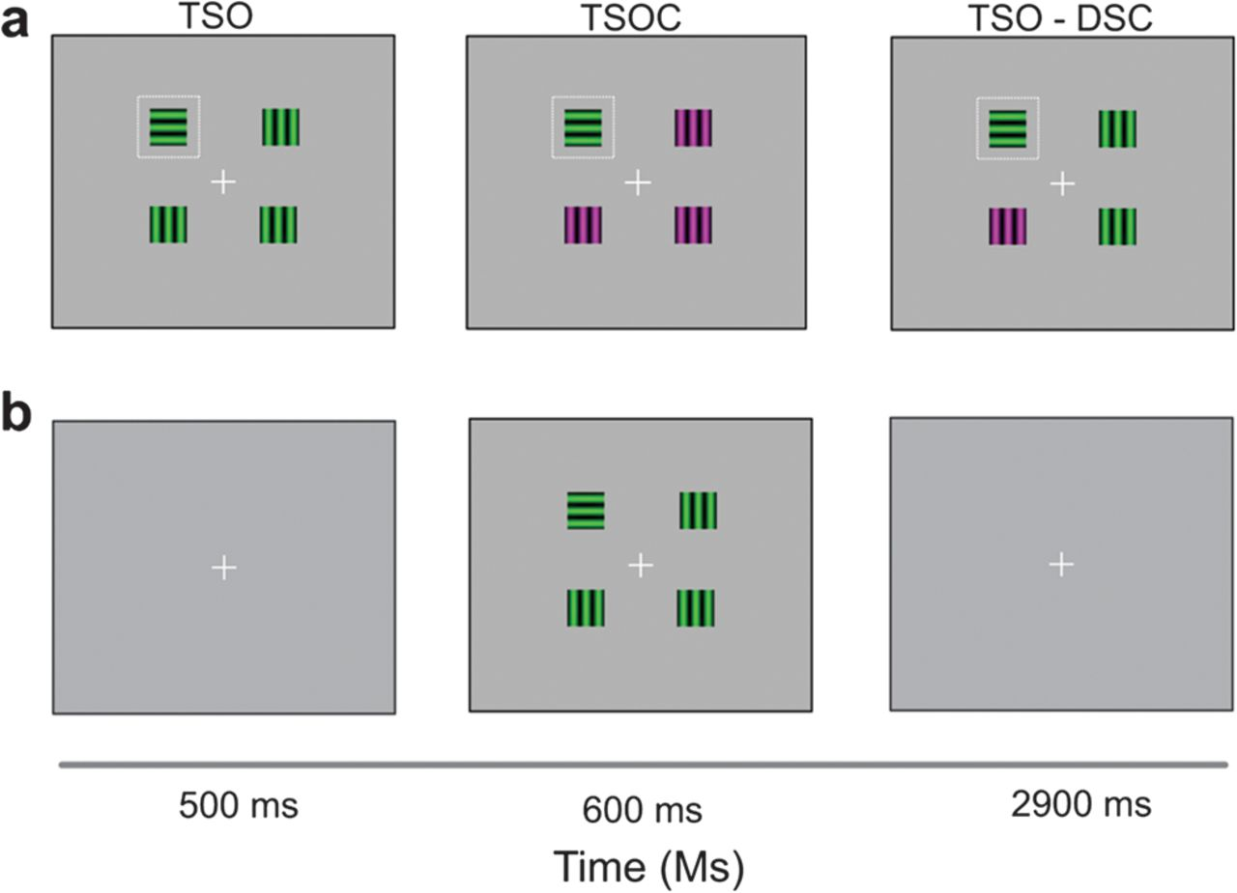
Figure 1. Experimental design. (a) We manipulated bottom-up saliency and top-down control in a visual search task. ...
Notes:
Figure 1. Experimental design. (a) We manipulated bottom-up saliency and top-down control in a visual search task. Bottom-up saliency of the target was manipulated by altering the distractors. The stimulus display contained a target that was either 1) singleton in orientation (TSO), 2) singleton in both orientation and color (TSOC), or 3) singleton in orientation but also contained a highly salient distractor singleton in a task-irrelevant dimension, that is, color (TSO-DSC). Top-down guidance was manipulated by presenting conditions either in a mixed or in a blocked design. (b) Trial design. In every trial, a fixation cross was presented (500 ms), followed by the stimulus display (600 ms) and then replaced by a question mark (2900 ms). Subjects had to localize a horizontal grating as quickly as possible—highlighted in the figure with a dotted white square.
Unless provided in the caption above, the following copyright applies to the content of this slide: © The Author 2012. Published by Oxford University Press. All rights reserved. For permissions, please e-mail: journals.permissions@oup.com

Slide 2
Figure 2. Behavioral results (a) Mean RTs (Ln) per experimental condition. Dark gray bars correspond to the blocked ...
Notes:
Figure 2. Behavioral results (a) Mean RTs (Ln) per experimental condition. Dark gray bars correspond to the blocked condition and light gray bars to the mixed condition. Error bars represent standard error of the mean. (b) Index of facilitation and index of interference. Condition TSOC showed facilitation in the blocked and mixed condition. In line with an effect of top-down control, facilitation was higher for the blocked. Condition TSO-DSC showed interference only when top-down control is reduced (mixed condition). Top-down abolished the detrimental effect of a salient color distractor, as no interference was observed in the blocked condition (for back-transformed reaction times to milliseconds, see Supplementary Fig. 2).
Unless provided in the caption above, the following copyright applies to the content of this slide: © The Author 2012. Published by Oxford University Press. All rights reserved. For permissions, please e-mail: journals.permissions@oup.com

Slide 3
Figure 3. Imaging results. Deconvolved time courses for target-related activity (black lines) and distractor-related ...
Notes:
Figure 3. Imaging results. Deconvolved time courses for target-related activity (black lines) and distractor-related activity (gray lines) in areas V1, V2, V3, and hV4 averaged across subjects. Note that differences between target and distractor activity are present in all visual areas (correlates of saliency) and that differentiation increases as a function of visual area.
Unless provided in the caption above, the following copyright applies to the content of this slide: © The Author 2012. Published by Oxford University Press. All rights reserved. For permissions, please e-mail: journals.permissions@oup.com

Slide 4
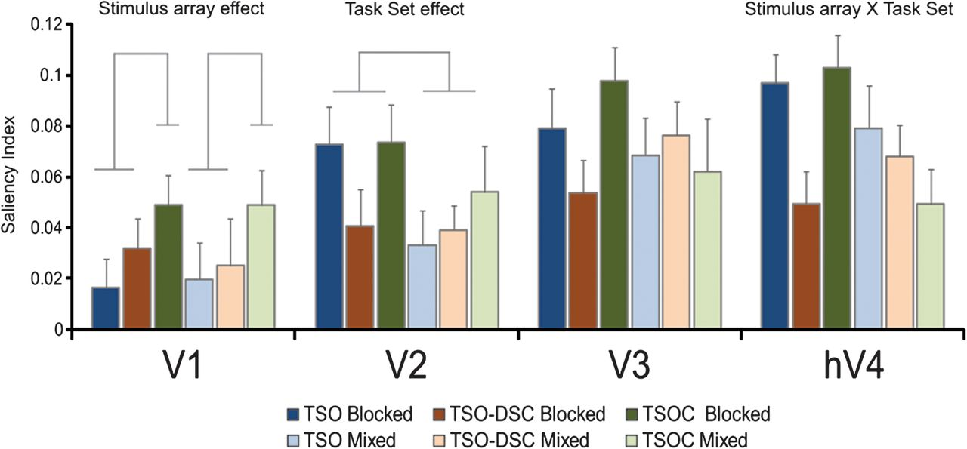
Figure 4. Index of saliency: ROIs (visual cortex). Parameters estimate for the conditions of interest in V1, V2, V3, ...
Notes:
Figure 4. Index of saliency: ROIs (visual cortex). Parameters estimate for the conditions of interest in V1, V2, V3, and hV4. Parameters estimate at the observed peak (points 3–4) of the group-averaged hemodynamic response function for target and distractor activity were extracted and then subtracted to create an index of differential activation (SI) per condition and visual area. Note that factors modulating saliency differ across the visual hierarchy: An effect of stimulus array was evident in V1, while V2 activity differed for task set. In hV4, we observed an interaction between stimulus array and task set. Note that no effect of stimulus array is observed in the blocked nor in the mixed condition in area V2 and V3 (all P > 0.14, all η2 < 0.11). We note nonetheless that areas V2 and hV4 display a similar BOLD signal pattern for the blocked trials that is indeed congruent with top-down modulations but only area hV4 showed a significant interaction.
Unless provided in the caption above, the following copyright applies to the content of this slide: © The Author 2012. Published by Oxford University Press. All rights reserved. For permissions, please e-mail: journals.permissions@oup.com

Slide 5
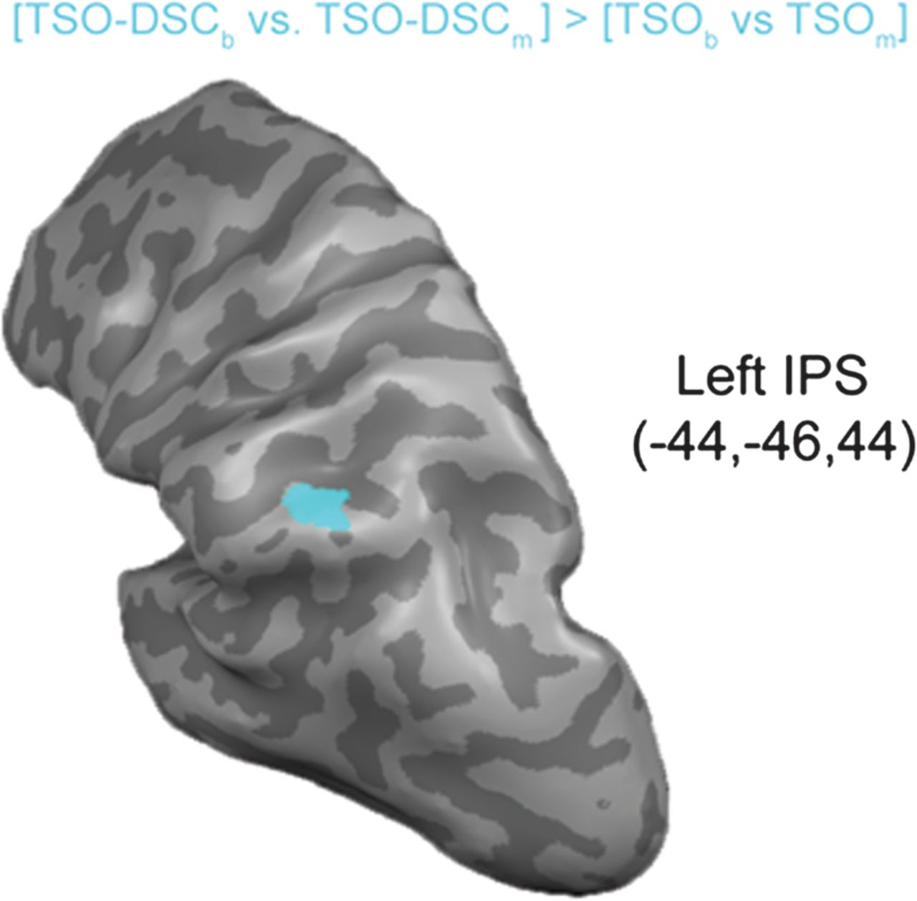
Figure 5. Top-down control in the presence of salient irrelevant distractors. The suppression of an irrelevant ...
Notes:
Figure 5. Top-down control in the presence of salient irrelevant distractors. The suppression of an irrelevant distractor activated the left IPS as measured by the contrast (TSO-DSC(blocked) vs. TSO-DSC(mixed)) > (TSO(blocked) vs. TSO(mixed)).
Unless provided in the caption above, the following copyright applies to the content of this slide: © The Author 2012. Published by Oxford University Press. All rights reserved. For permissions, please e-mail: journals.permissions@oup.com

Slide 6
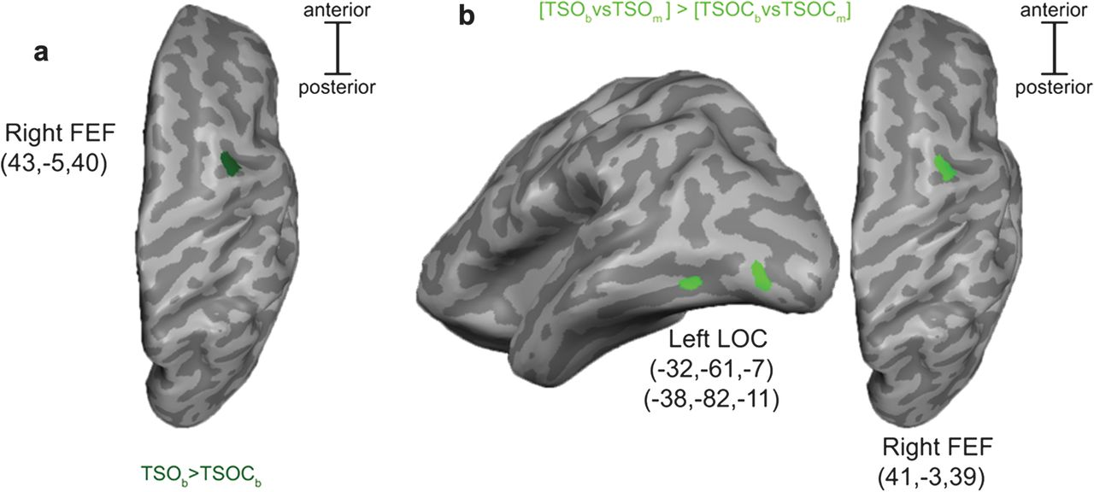
Figure 6. Top-down control in efficient visual search. (a) Top-down control in efficient search activated the right FEF ...
Notes:
Figure 6. Top-down control in efficient visual search. (a) Top-down control in efficient search activated the right FEF as measured by the contrast TSO(blocked) versus TSOC(blocked). (b) Enhancing the saliency of target stimuli activated 2 lateral occipital regions and the right FEF as revealed by the contrast (TSO(blocked) vs. TSO(mixed)) > (TSOC(blocked) vs. TSOC(mixed)).
Unless provided in the caption above, the following copyright applies to the content of this slide: © The Author 2012. Published by Oxford University Press. All rights reserved. For permissions, please e-mail: journals.permissions@oup.com

Slide 7
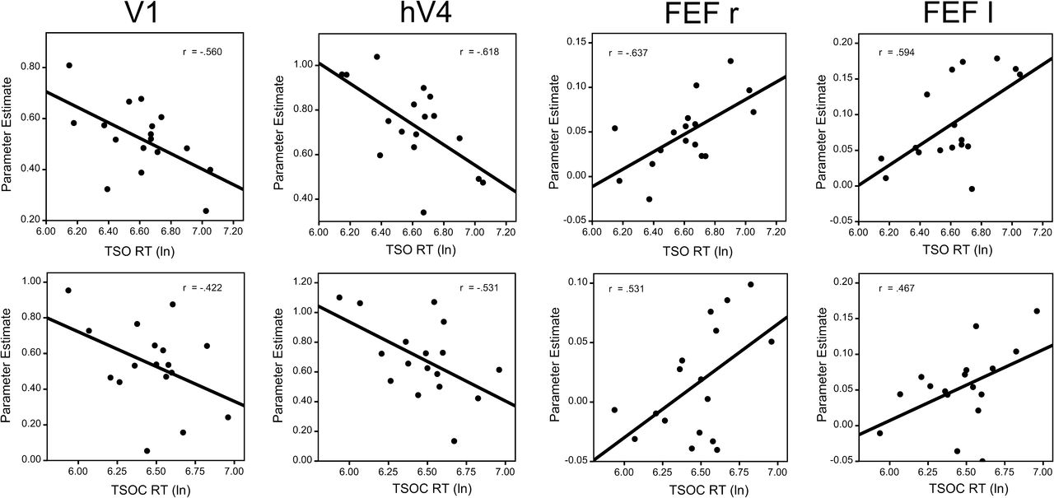
Figure 7. Neurobehavioral correlations. Pearson correlations between RT and BOLD Response were found in V1 (TSO, P = ...
Notes:
Figure 7. Neurobehavioral correlations. Pearson correlations between RT and BOLD Response were found in V1 (TSO, P = 0.019; TSOC, P = 0.091), hV4 (TSO, P = 0.008; TSOC, P = 0.028), and right FEF (TSO, P = 0.006; TSOC, P = 0.028). For completion also correlations in left FEF are shown (TSO, P = 0.012; TSOC, P = 0.059). Note that across subjects activity in hV4 is inversely correlated with right FEF for TSO and TSOC condition (TSO R = −0.453, P = 0.034; TSOC R = −0.468, P = 0.029 one sided) (data not shown).
Unless provided in the caption above, the following copyright applies to the content of this slide: © The Author 2012. Published by Oxford University Press. All rights reserved. For permissions, please e-mail: journals.permissions@oup.com

