Slide 1
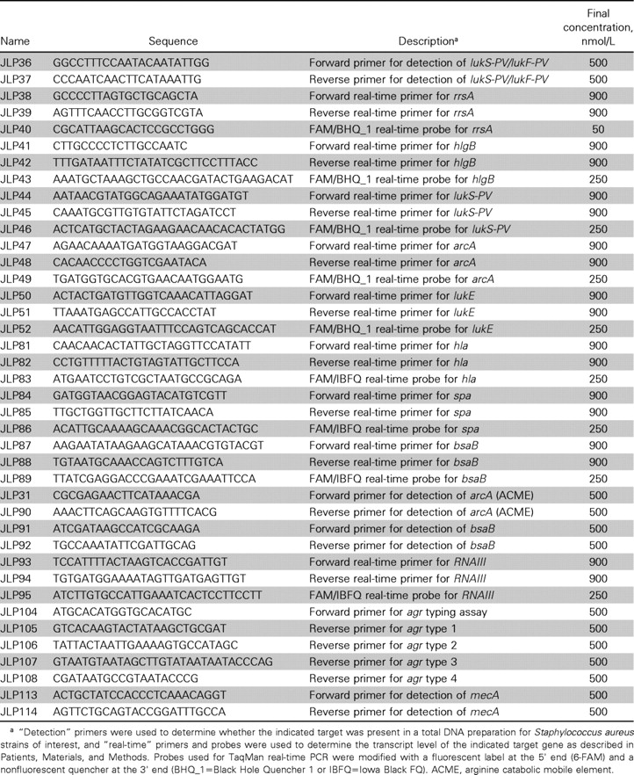
SUPPLEMENTARY TABLE 2. Primers used in this study
Notes:
SUPPLEMENTARY TABLE 2. Primers used in this study
Unless provided in the caption above, the following copyright applies to the content of this slide: © 2009 by the Infectious Diseases Society of America

Slide 2
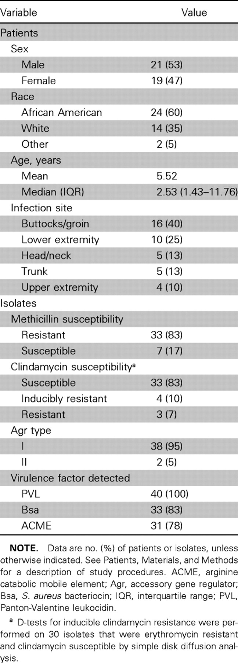
Table 3.
Notes:
Table 3.
Unless provided in the caption above, the following copyright applies to the content of this slide: © 2009 by the Infectious Diseases Society of America

Slide 3
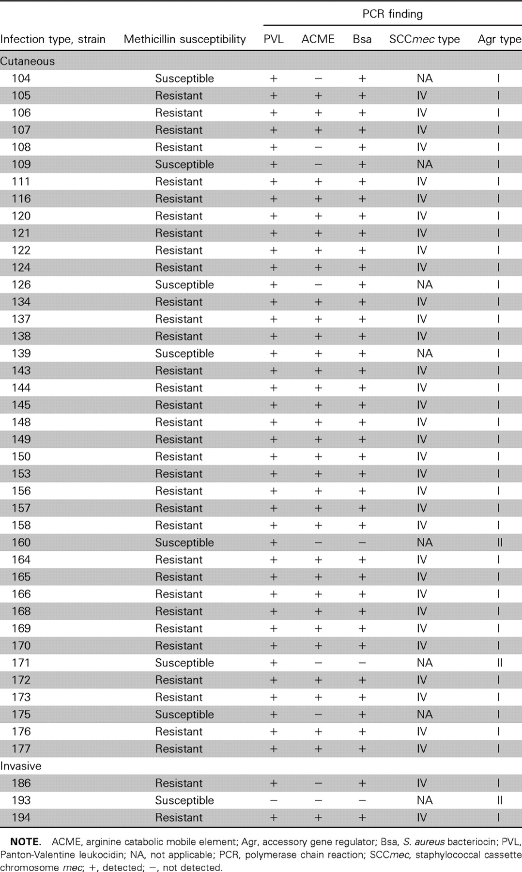
SUPPLEMENTARY TABLE 4. Strains used in this study
Notes:
SUPPLEMENTARY TABLE 4. Strains used in this study
Unless provided in the caption above, the following copyright applies to the content of this slide: © 2009 by the Infectious Diseases Society of America

Slide 4
TABLE 1. Antibiotic susceptibilities of 43 study isolates
Notes:
TABLE 1. Antibiotic susceptibilities of 43 study isolates
Unless provided in the caption above, the following copyright applies to the content of this slide: © 2009 by the Infectious Diseases Society of America

Slide 5
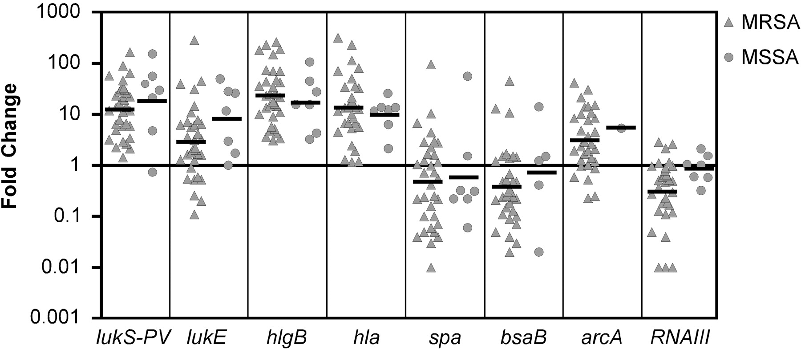
Figure 1. Expression of virulence genes in human cutaneous infection due to methicillin-resistant Staphylococcus aureus ...
Notes:
Figure 1. Expression of virulence genes in human cutaneous infection due to methicillin-resistant Staphylococcus aureus (MRSA) and methicillinsusceptible S. aureus (MSSA). Data represent the fold change in normalized transcript levels for each gene in material collected from cutaneous abscesses, relative to the corresponding S. aureus strains grown aerobically to the early phase of stationary growth in tryptic soy broth. Data, including geometric mean values (bars), are for each of the 40 cutaneous strains described in table 3. Error bars were generally obscured by the symbol and were omitted for clarity. Differences in transcript levels between these 2 groups were not statistically significant. The difference between the cutaneous samples and the stationary samples were statistically significant for all genes except spa (P < .01). See Patients, Materials, and Methods for a description of study procedures.
Unless provided in the caption above, the following copyright applies to the content of this slide: © 2009 by the Infectious Diseases Society of America

Slide 6
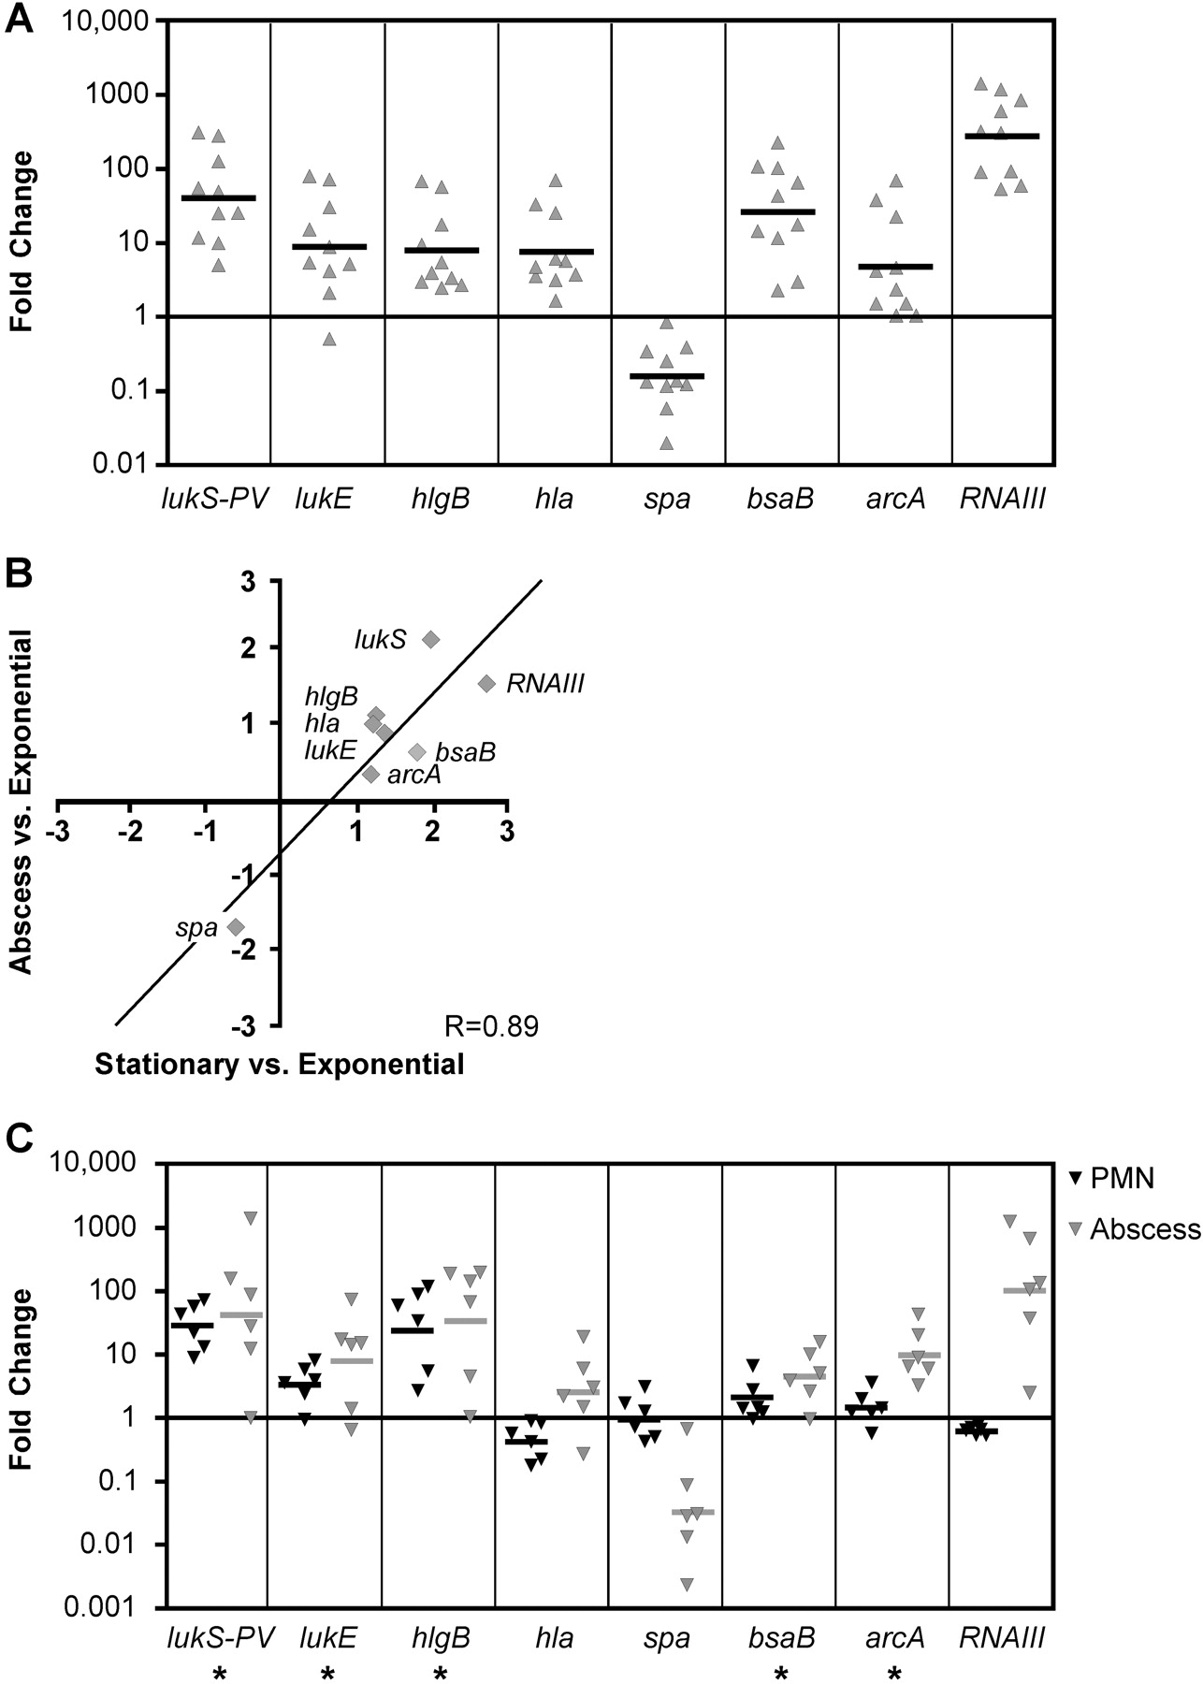
Figure 2. Comparison of gene expression profiles between Staphylococcus aureus from human cutaneous infection, during ...
Notes:
Figure 2. Comparison of gene expression profiles between Staphylococcus aureus from human cutaneous infection, during the stationary-growth phase in vitro, and during encounter with polymorphonuclear leukocytes (PMNs) in vitro. A, Fold-change in transcript levels for each gene in a subset of the S. aureus clinical isolates shown in figure 1 grown aerobically to early stationary phase in tryptic soy broth (▴), relative to the levels in bacteria grown aerobically to the mid- exponential growth phase in tryptic soy broth. Ten representative strains were chosen for this analysis; geometric mean values are indicated by bars. Differences between stationary-phase samples and exponential-phase samples were statistically significant for all genes (P < .002). B, Log-transformed average fold-change in target gene expression for strains in panel A grown to the stationary phase (x-axis) or in human cutaneous abscesses (y-axis), relative to mid- exponential phase expression. There is a significant correlation between the tissue and stationary-phase expression profiles (R = 0.89; P < .003). C, Fold change in expression in cutaneous abscesses and corresponding strains during in vitro encounter with human PMNs, relative to expression of each gene in media-only control conditions (RPMI). Five representative strains were chosen for this analysis; geometric mean values are indicated by bars. The majority of genes showed a similar direction of differential regulation (asterisks), but there was a poor correlation between the tissue and PMN expression profiles (R = 0.44). See Patients, Materials, and Methods for a description of study procedures.
Unless provided in the caption above, the following copyright applies to the content of this slide: © 2009 by the Infectious Diseases Society of America

Slide 7
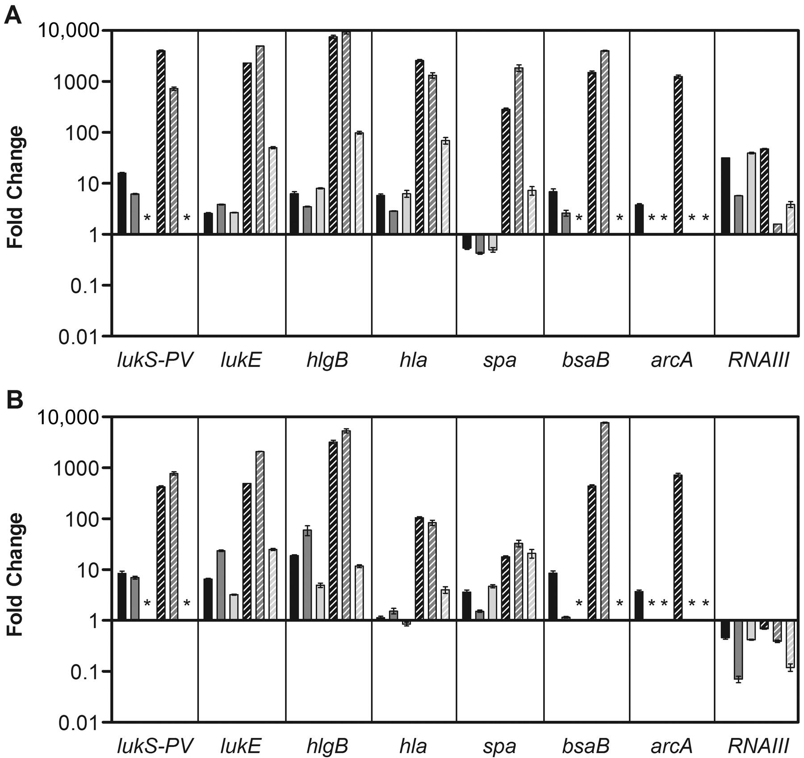
Figure 3. Expression of virulence genes during invasive human Staphylococcus aureus infection. A, Fold-change in ...
Notes:
Figure 3. Expression of virulence genes during invasive human Staphylococcus aureus infection. A, Fold-change in transcript levels for each gene in material collected from invasive human subperiosteal abscesses (striped bars) and corresponding S. aureus strains grown aerobically to the early phase of stationary growth in tryptic soy broth (solid bars), relative to strains grown aerobically to mid- exponential growth phase in tryptic soy broth. Asterisks indicate the absence of the gene. The difference between the invasive abscess samples and the stationary phase samples was statistically significant for all genes except that encoding RNAIII (P < .05). B, Fold change in expression in invasive abscesses (striped bars) and corresponding strains during an in vitro encounter with human polymorphonuclear leukocytes (PMNs; solid bars), relative to expression of each gene in media-only control conditions (RPMI). Asterisks indicate the absence of the gene. There was a significant correlation between the invasive abscess profile and the PMN profile for all 3 strains (R = 0.86, 0.79, and 0.90; P < .01). See Patients, Materials, and Methods for a description of study procedures.
Unless provided in the caption above, the following copyright applies to the content of this slide: © 2009 by the Infectious Diseases Society of America

Slide 8
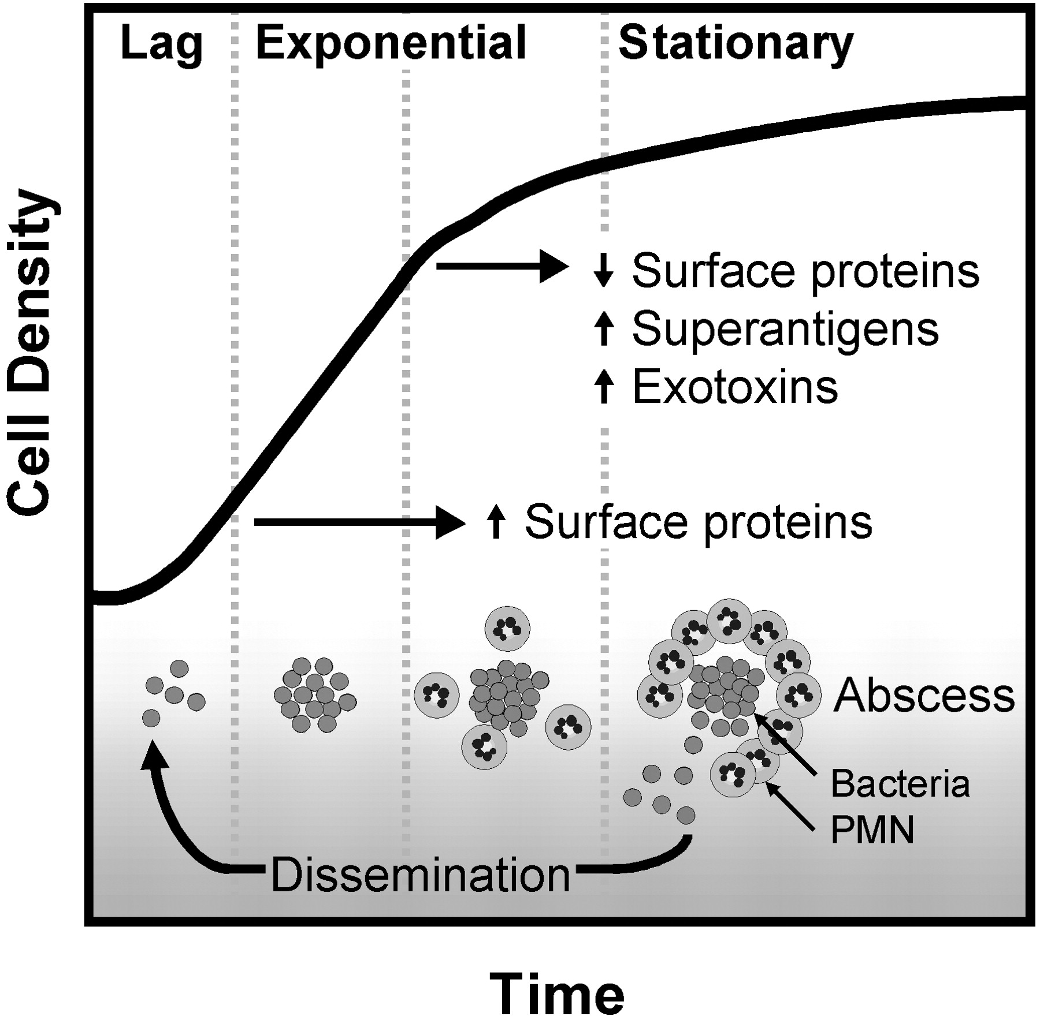
Figure 4. Relationship between growth phase and disease progression with regard to virulence gene expression.
Notes:
Figure 4. Relationship between growth phase and disease progression with regard to virulence gene expression.
Unless provided in the caption above, the following copyright applies to the content of this slide: © 2009 by the Infectious Diseases Society of America

