Slide 1
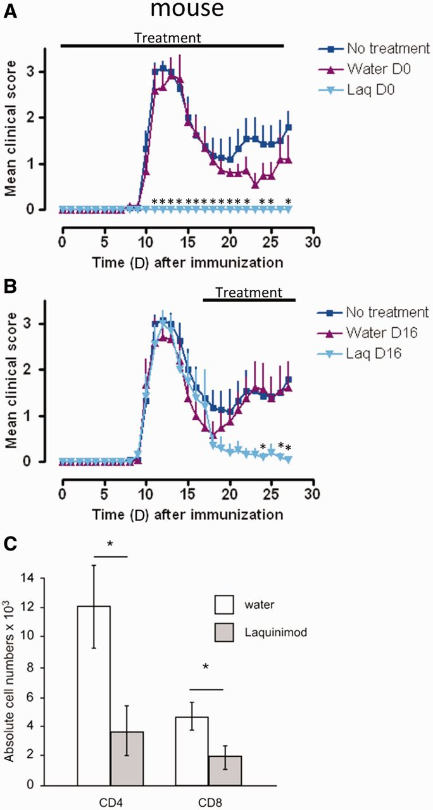
Figure 1 Laquinimod effectively blocks induction and relapse in EAE and reduces CNS T cell infiltration. (A) ...
Notes:
Figure 1 Laquinimod effectively blocks induction and relapse in EAE and reduces CNS T cell infiltration. (A) Preventive treatment of mice with laquinimod suppresses the clinical signs of disease in SJL/J mice immunized with PLP139-151. (B) Therapeutic treatment of SJL/J mice immunized with PLP139-151 from Day 16 after immunization with laquinimod ameliorates clinical disease. (C) PLP139-151 immunized SJL/J mice received laquinimod as a therapeutic treatment (started at Day 16). At Day 28 CNS-infiltrating CD4+ and CD8+ T cells were isolated, analysed by flow cytometry and absolute numbers were calculated. Shown are representatives of two individual experiments. The graphs show the mean score ± SEM of six mice per group. *P < 0.05 water versus laquinimod treatment. Laq = laquinimod.
Unless provided in the caption above, the following copyright applies to the content of this slide: © The Author (2013). Published by Oxford University Press on behalf of the Guarantors of Brain. All rights reserved. For Permissions, please email: journals.permissions@oup.com

Slide 2
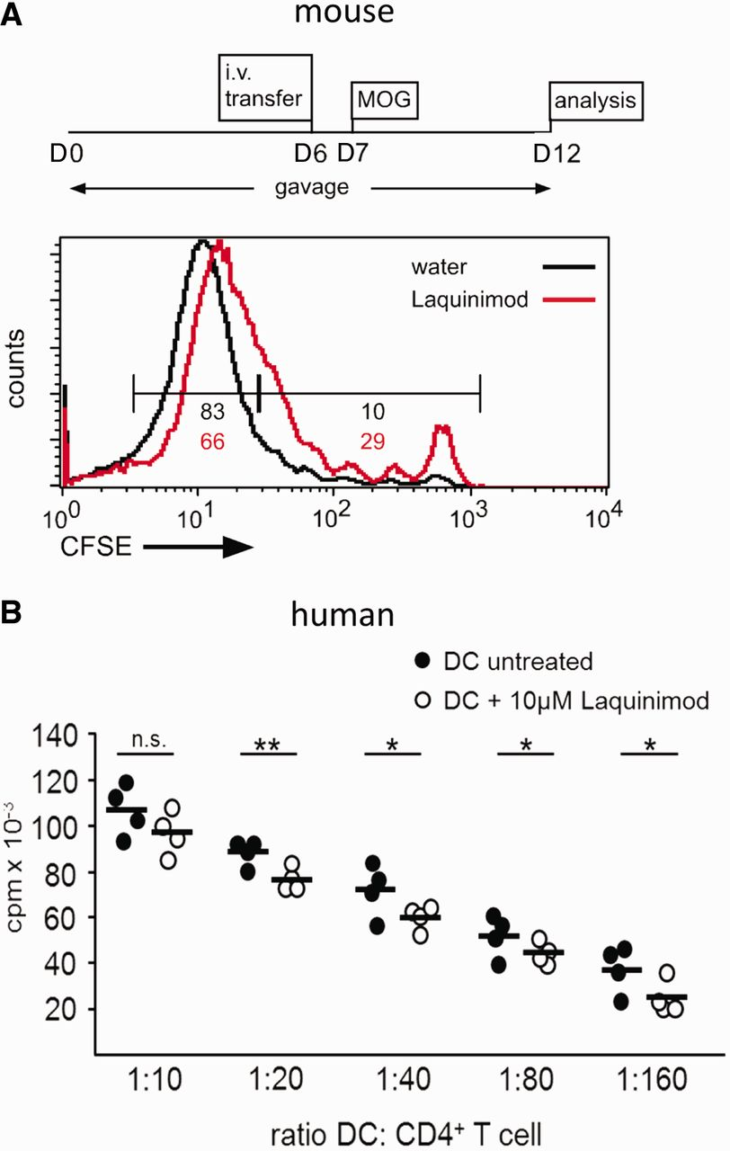
Figure 2 Laquinimod negatively influences T cell proliferative capacity of dendritic cells. (A) CFSE-labelled ...
Notes:
Figure 2 Laquinimod negatively influences T cell proliferative capacity of dendritic cells. (A) CFSE-labelled 2D2+ CD4+ T cells were transferred intravenously (i.v.) into either water- or laquinimod-treated C57BL/6 mice that received a MOG35–55 immunization 1 day later. Proliferation of transferred T cells was analysed by flow cytometry 5 days after immunization. MOG-specific transferred T cells in laquinimod-pretreated mice failed to proliferate as well as their counterparts in water-treated control mice. The graph shows one representative mouse per group of two independent experiments (B) Human monocyte-derived dendritic cell/T cell proliferation assay. CFSE = carboxyfluorescein succinimidyl ester; cpm = counts per minute; DC = dendritic cell. *P < 0.05, **P < 0.01.
Unless provided in the caption above, the following copyright applies to the content of this slide: © The Author (2013). Published by Oxford University Press on behalf of the Guarantors of Brain. All rights reserved. For Permissions, please email: journals.permissions@oup.com

Slide 3
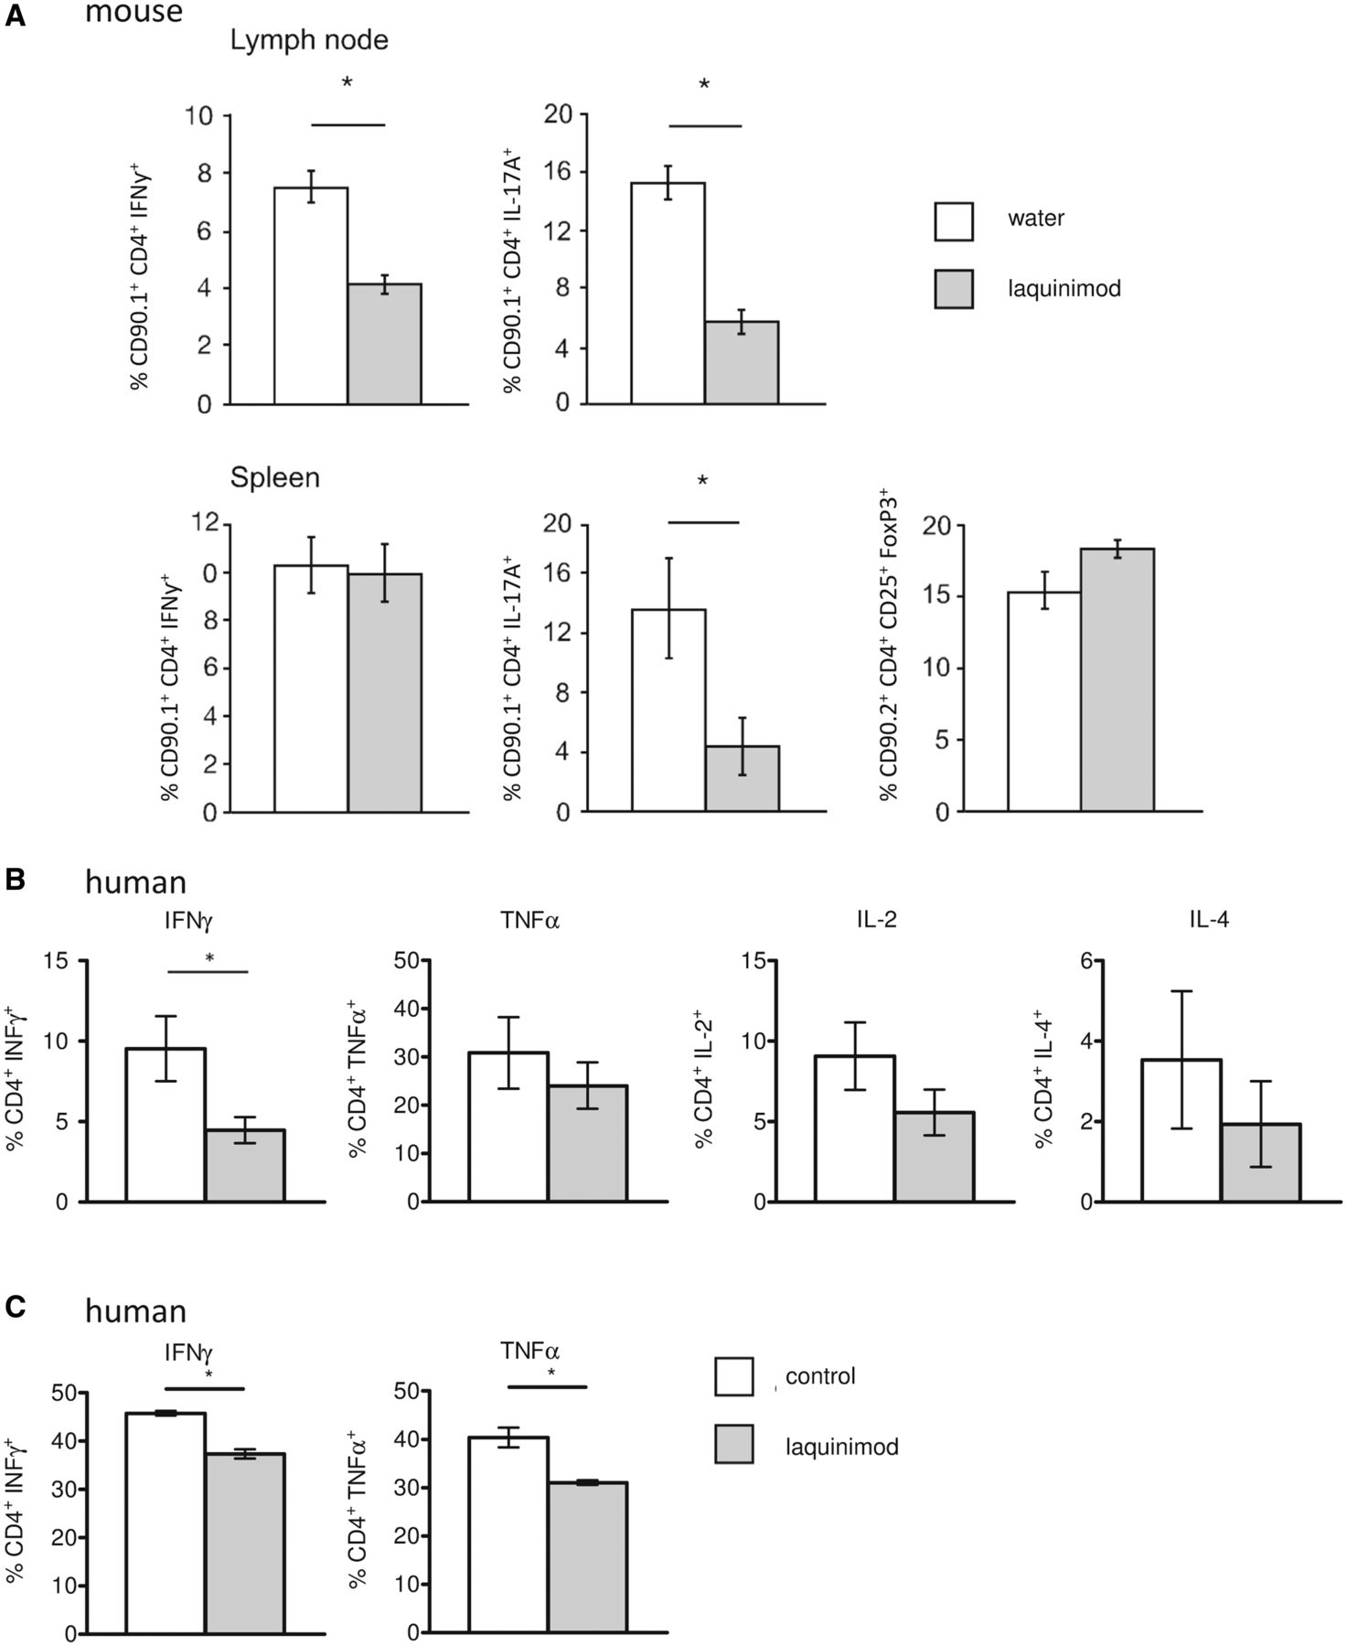
Figure 3 Laquinimod modulates T cell differentiation. (A) Peripheral lymphoid organ MOG-specific T cell populations ...
Notes:
Figure 3 Laquinimod modulates T cell differentiation. (A) Peripheral lymphoid organ MOG-specific T cell populations from either water- or laquinimod-treated MOG35–55 immunized mice were analysed by flow cytometry. Cells were stained with CD90.1, CD4, CD25 and intracellularly with IFNγ (Th1), IL-17A (Th17) or FoxP3 (regulatory T cell). Th1 and Th17 populations were significantly reduced, while the regulatory T cell population was increased in laquinimod-treated mice compared with water-treated mice. (B) Laquinimod-treated monocyte-derived dendritic cells were co-cultured with naïve allogenic T cells, which led to a modified T helper cell differentiation with significantly reduced IFNγ-producing T cells. Detection of cytokine production of naïve T cells primed with allogeneic mature dendritic cells at a dendritic cell/T cell ratio of 1:10 by intracellular flow cytometric analysis and gating on lymphocytes. (C) Antigen-specific restimulation of autologous MBP85-99-specific T cells with MBP85-99-pulsed laquinimod-treated monocyte-derived dendritic cells led to a modified T helper cell activation with significantly reduced IFNγ- and TNFα-producing T cells. Values represent means ± SEM (n = 3), *P < 0.05.
Unless provided in the caption above, the following copyright applies to the content of this slide: © The Author (2013). Published by Oxford University Press on behalf of the Guarantors of Brain. All rights reserved. For Permissions, please email: journals.permissions@oup.com

Slide 4
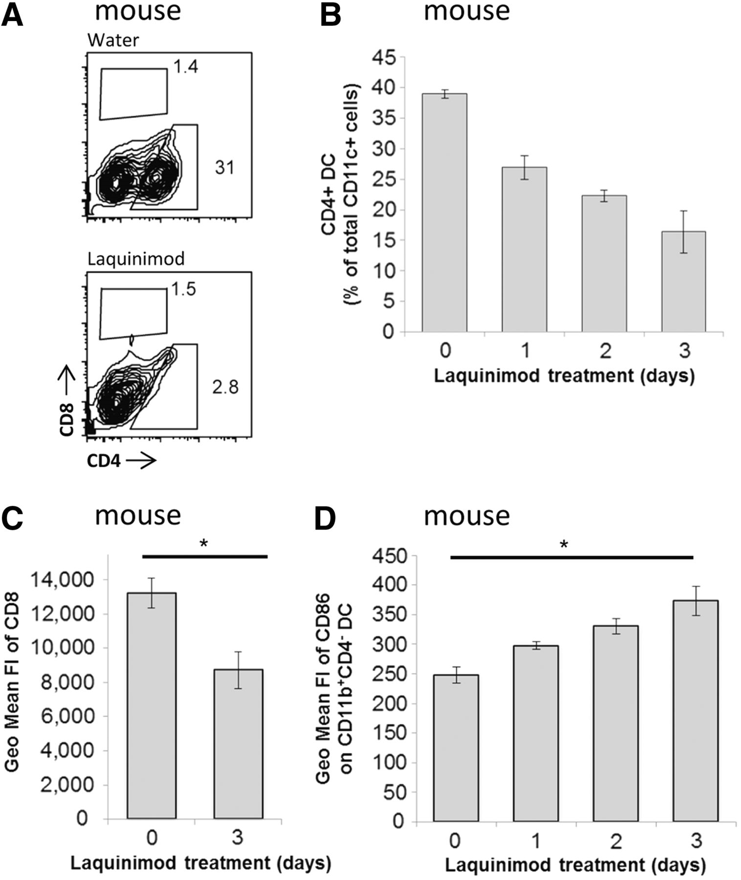
Figure 4 Laquinimod treatment affects dendritic cells. (A) Mice were treated daily with water or laquinimod as ...
Notes:
Figure 4 Laquinimod treatment affects dendritic cells. (A) Mice were treated daily with water or laquinimod as described. Flow cytometric analysis of splenic dendritic cells (CD11chigh) from laquinimod-treated compared with water-treated control mice revealed a reduction of the CD4+ dendritic cell population, whereas the CD8+ dendritic cell population showed a slight, yet insignificant increase. (B) Kinetics of splenic CD4+ dendritic cell depletion upon laquinimod treatment. (C) Mean fluorescence intensity of CD8 on CD11c+CD8+ dendritic cells after 3 days of laquinimod treatment. (D) Kinetic of mean fluorescence intensity (FI) of CD86 on CD11c+CD11b+CD4- dendritic cells upon laquinimod treatment in the mouse. Values represent means ± SEM (n = 3), *P < 0.05; DC = dendritic cell.
Unless provided in the caption above, the following copyright applies to the content of this slide: © The Author (2013). Published by Oxford University Press on behalf of the Guarantors of Brain. All rights reserved. For Permissions, please email: journals.permissions@oup.com

Slide 5
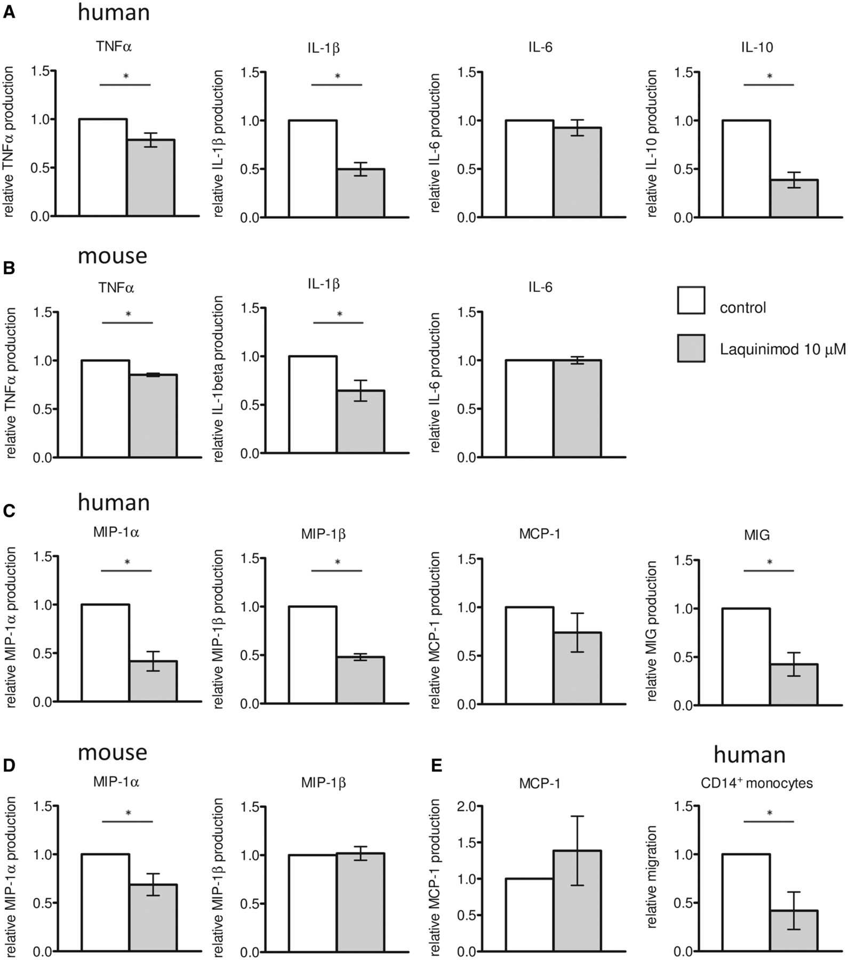
Figure 5 Cytokine and chemokine production by murine and human dendritic cells. Mature dendritic cells were generated ...
Notes:
Figure 5 Cytokine and chemokine production by murine and human dendritic cells. Mature dendritic cells were generated by treatment with 10 µM laquinimod, their supernatants collected and cytokines (A and B) and chemokines (C and D) measured from mature monocyte-derived dendritic cell cultures (A and C) or mature bone marrow-derived dendritic cell cultures (B and D). The experimental results were summarized as mean values of relative cytokine and chemokine production ± SEM (n ≥ 3), *P < 0.05. (E) Migration of human CD14+ monocytes in response to chemokine production of human mature dendritic cells.
Unless provided in the caption above, the following copyright applies to the content of this slide: © The Author (2013). Published by Oxford University Press on behalf of the Guarantors of Brain. All rights reserved. For Permissions, please email: journals.permissions@oup.com

Slide 6
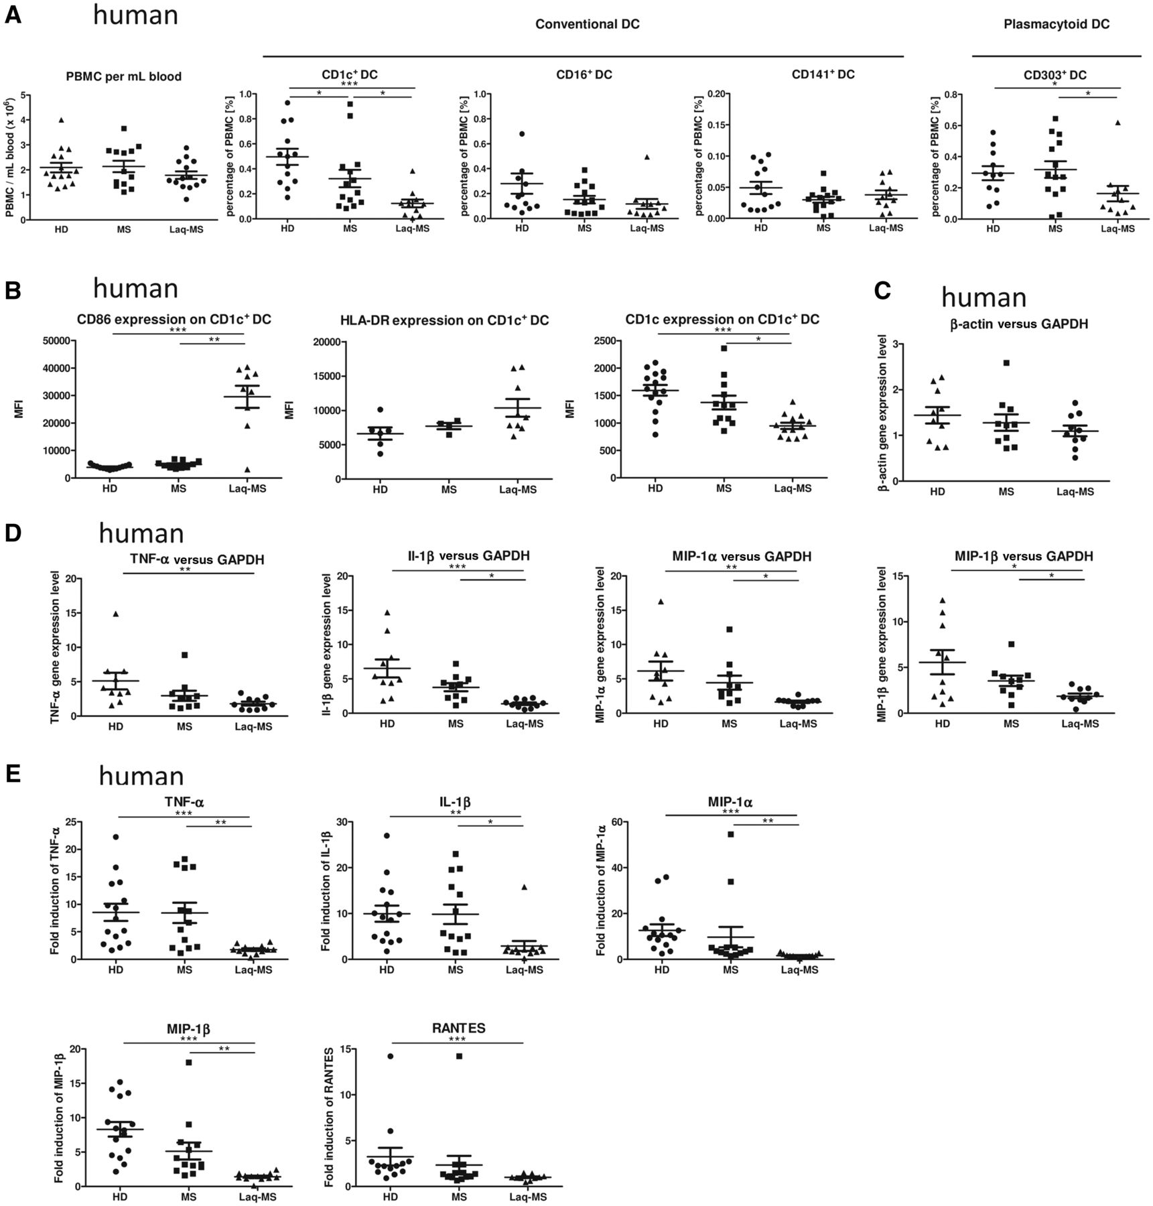
Figure 6 Laquinimod affects dendritic cell function in patients with multiple sclerosis. (A) Comparison of the ...
Notes:
Figure 6 Laquinimod affects dendritic cell function in patients with multiple sclerosis. (A) Comparison of the absolute number of human peripheral blood mononuclear cells per millilitre of whole blood and comparison of peripheral blood percentages of the conventional dendritic cells: CD1c+, CD16+ and CD141+ dendritic cells, and CD303+ plasmacytoid dendritic cells. Mean values ± SEM are shown, (n ≥ 13). (B) Laquinimod significantly increases CD86 surface expression assessed by flow cytometry on isolated CD1c+ cells, whereas HLA-DR expression remains unchanged. The CD1c surface expression on these cells was significantly decreased. Mean values ± SEM are shown (n ≥ 13), ***P < 0.001. (C) Relative β-actin expression normalized to GAPDH expression in CD1c+ cells was not significantly different between the groups in our experiment conditions, thus rendering them suitable as housekeeping genes. Data are shown as mean ± SEM (n = 10). (D) Gene expression level of cytokines (TNFα, IL-1β) and chemokines (MIP-1α, MIP-1β) in isolated conventional CD1c+ cells following stimulation with lipopolysaccharide after 4 h. The experimental results represent the fold induction of the gene expression after stimulation with lipopolysaccharide normalized to GAPDH expression and are expressed as mean ± SEM (n = 10). (E) The supernatants of CD1c+ cells cultured with or without lipopolysaccharide for 24 h were collected and concentrations of cytokines (TNFα, IL-1β) and chemokines (MIP-1α, MIP-1β, RANTES) were determined with FlowCytomix. The experimental results represent the fold induction of protein secretion after stimulation with lipopolysaccharide. Mean values ± SEM are shown (n ≥ 10), *P < 0.05, **P < 0.01, ***P < 0.001. DC = dendritic cells.
Unless provided in the caption above, the following copyright applies to the content of this slide: © The Author (2013). Published by Oxford University Press on behalf of the Guarantors of Brain. All rights reserved. For Permissions, please email: journals.permissions@oup.com

Slide 7
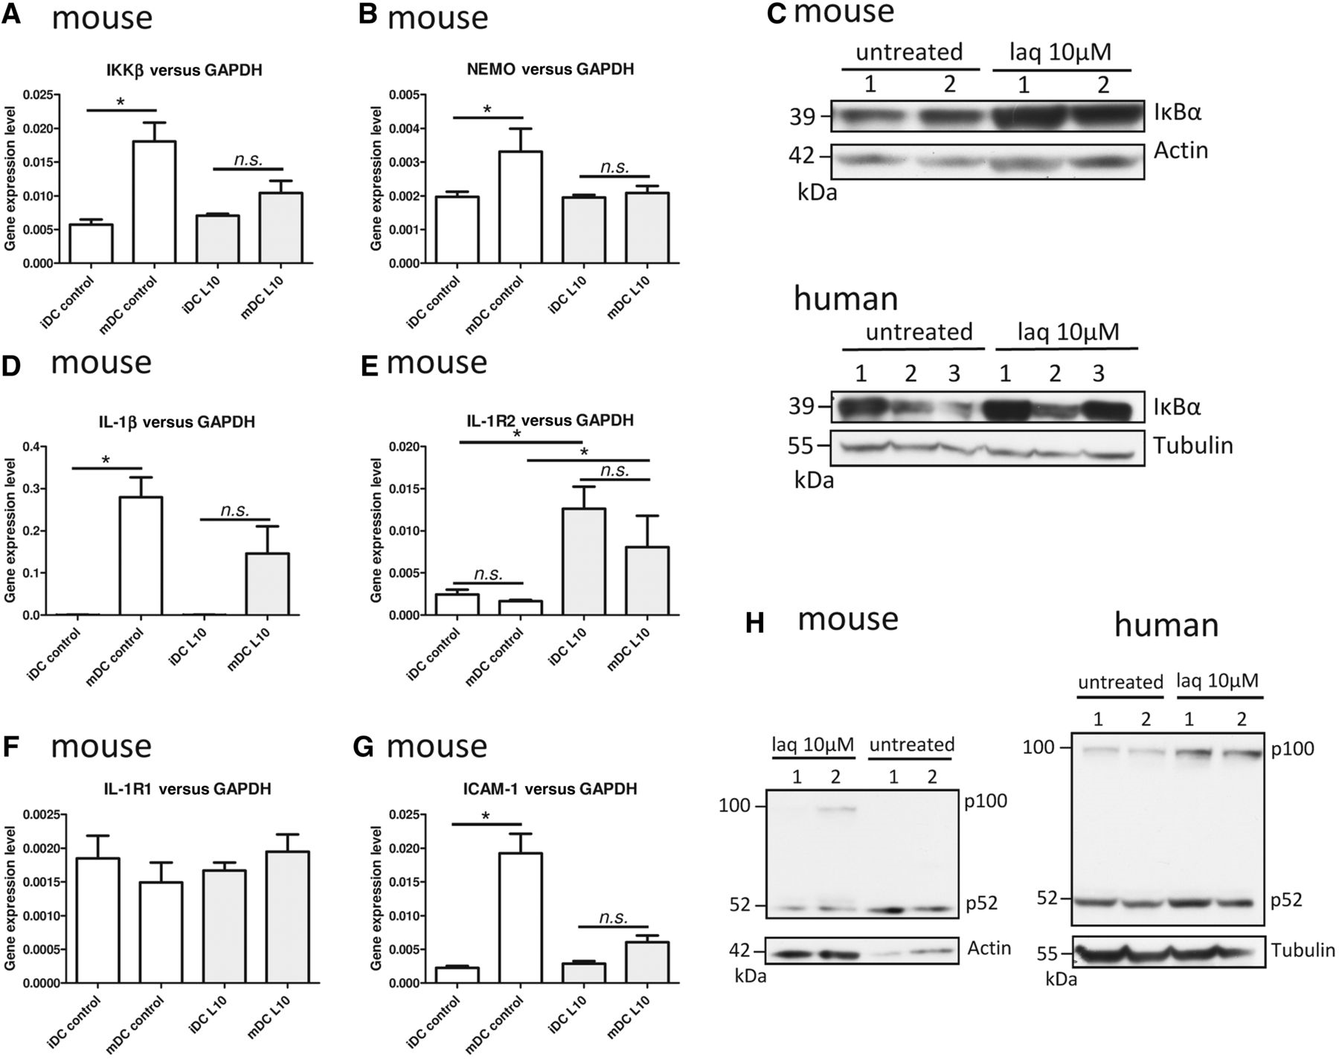
Figure 7 Laquinimod impairs the NF-κB pathway in dendritic cells. (A) Gene expression level of IKKβ and (B) NEMO in ...
Notes:
Figure 7 Laquinimod impairs the NF-κB pathway in dendritic cells. (A) Gene expression level of IKKβ and (B) NEMO in bone marrow-derived dendritic cells treated or not with 10 µM laquinimod (laq). (C) Western blot analysis of IκBα in cytosolic protein lysates of bone marrow- or monocyte-derived dendritic cells treated or not with 10 µM laquinimod. (D) Gene expression level of IL-1β, (E) IL-1R2, (F) IL-1R1 and (G) ICAM-1 in bone marrow-derived dendritic cells treated or not with 10 µM laquinimod. (H) Western blot analysis of p100 processing to p52 in cytosolic protein lysates of bone marrow- or monocyte-derived dendritic cells treated or not with 10 µM laquinimod. Quantitative PCR data are expressed as mean ± SEM (n = 4 independent cultures). *P < 0.05, **P < 0.01, ***P < 0.001.
Unless provided in the caption above, the following copyright applies to the content of this slide: © The Author (2013). Published by Oxford University Press on behalf of the Guarantors of Brain. All rights reserved. For Permissions, please email: journals.permissions@oup.com

Slide 8
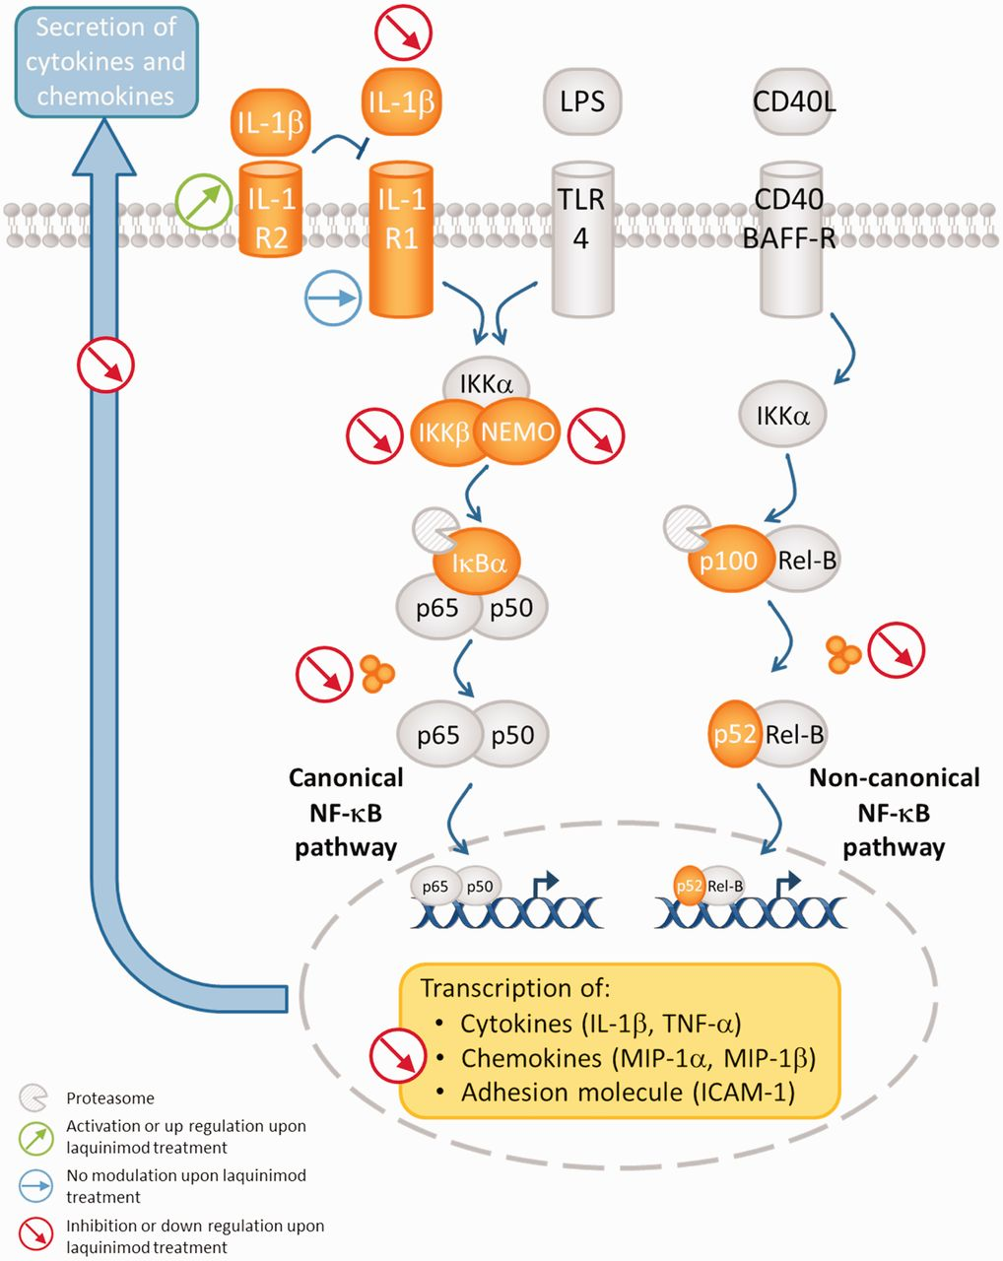
Figure 8 Schematic representation of laquinimod activity on dendritic cells. Upon laquinimod treatment, canonical and ...
Notes:
Figure 8 Schematic representation of laquinimod activity on dendritic cells. Upon laquinimod treatment, canonical and non-canonical NF-κB pathways are impaired in dendritic cells matured with lipopolysaccharide. These modifications lead to a decreased transcription of chemokines and cytokines.
Unless provided in the caption above, the following copyright applies to the content of this slide: © The Author (2013). Published by Oxford University Press on behalf of the Guarantors of Brain. All rights reserved. For Permissions, please email: journals.permissions@oup.com

