Slide 1
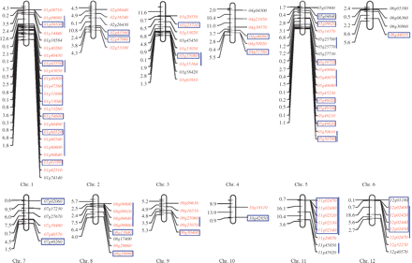
Fig. 1 Distribution of WRKY genes and detection of duplicated genes in rice chromosomes. Genes located in whole ...
Notes:
Fig. 1 Distribution of WRKY genes and detection of duplicated genes in rice chromosomes. Genes located in whole genome duplicated regions are highlighted in red. Blue outlined boxes represent fragmentally duplicated genes. Tandemly duplicated genes are indicated with vertical blue lines. The number on the left of each chromosome represents the physical position (Mb) of mapped genes. The penultimate number shows the physical distance to the last gene. The rest may be reduced by analogy.
Unless provided in the caption above, the following copyright applies to the content of this slide: © The Author 2008. Published by Oxford University Press on behalf of Japanese Society of Plant Physiologists. All rights reserved. For permissions, please email: journals.permissions@oxfordjournals.org

Slide 2
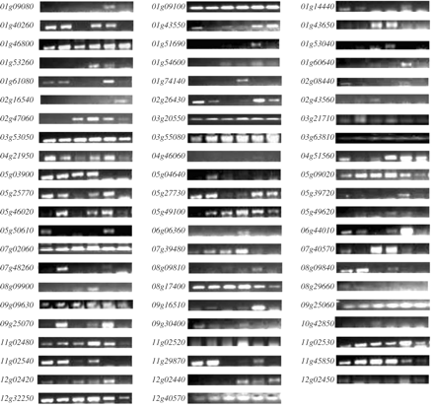
Fig. 2 Expression profiles of WRKY genes in various tissues shown by RT–PCR analyses. Six amplified bands from left ...
Notes:
Fig. 2 Expression profiles of WRKY genes in various tissues shown by RT–PCR analyses. Six amplified bands from left to right for each WRKY gene represent amplified products from young leaves, mature leaves, young panicles, mature panicles, young roots and mature roots.
Unless provided in the caption above, the following copyright applies to the content of this slide: © The Author 2008. Published by Oxford University Press on behalf of Japanese Society of Plant Physiologists. All rights reserved. For permissions, please email: journals.permissions@oxfordjournals.org

Slide 3
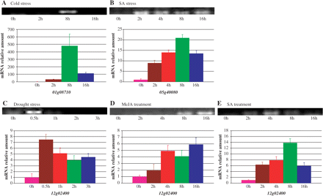
Fig. 3 Expression patterns of three stress-induced WRKY genes. In A–E, the top panel shows the RT–PCR result and the ...
Notes:
Fig. 3 Expression patterns of three stress-induced WRKY genes. In A–E, the top panel shows the RT–PCR result and the bottom panel shows the corresponding real-time PCR result. The relative amount of mRNA (y-axis) was calculated as described in Materials and Methods. Thr rice ACTIN 1 (OsAct1) gene was used as an internal control to normalize the data. (A) Expression patterns of the WRKY gene 01g08710 under cold growth conditions. The pink, vermeil, green and blue bars indicate the relative amount of mRNA at 0, 2, 8 and 16 h, respectively, after the cold treatment. (B) Expression profiles of the WRKY gene 05g40080 under SA treatment. (C–E) Transcript profiles of the WRKY gene 12g02400 under drought, MeJA and SA treatment, respectively. The pink, vermeil, red, green and blue bars in B–E indicates the relative amount of mRNA detected 0, 0.5, 1, 2 and 3 h, respectively, after drought treatment, and 0, 2, 4, 8 and 16 h after MeJA or SA treatments.
Unless provided in the caption above, the following copyright applies to the content of this slide: © The Author 2008. Published by Oxford University Press on behalf of Japanese Society of Plant Physiologists. All rights reserved. For permissions, please email: journals.permissions@oxfordjournals.org

Slide 4
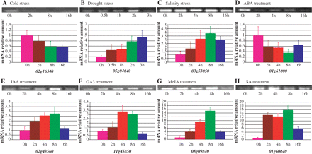
Fig. 4 A comparison of the expression patterns shown by RT–PCR and real-time PCR analyses under eight different ...
Notes:
Fig. 4 A comparison of the expression patterns shown by RT–PCR and real-time PCR analyses under eight different stresses. In A–H, the top panel indicates the RT–PCR result and the bottom panel shows the corresponding real-time PCR result. The relative amount of mRNA (y-axis) was calculated according to the description in Materials and Methods. A rice ACTIN 1 (OsAct1) gene was used as an internal control to normalize the data. (A) Expression patterns under cold growth conditions. The pink, vermeil, green and blue bars indicated the relative amount of mRNA detected 0, 2, 8 and 16 h, respectively, after the cold treatment. (B–H) Expression profiles under drought, salinity, ABA, IAA, GA3, MeJA and SA, respectively. The pink, vermeil, red, green and blue bars indicated the relative amount of mRNA detected 0, 0.5, 1, 2 and 3 h, respectively, after the PEG treatment, and 0, 2, 4, 8 and 16 h after salinity or various hormone treatments.
Unless provided in the caption above, the following copyright applies to the content of this slide: © The Author 2008. Published by Oxford University Press on behalf of Japanese Society of Plant Physiologists. All rights reserved. For permissions, please email: journals.permissions@oxfordjournals.org

Slide 5
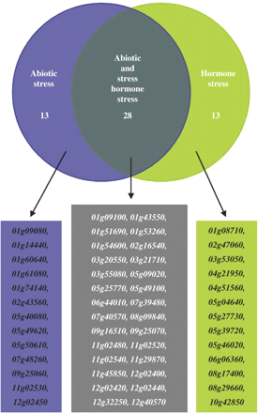
Fig. 8 Summary of expression analyses of 54 stress-regulated WRKY genes under both abiotic and various hormone ...
Notes:
Fig. 8 Summary of expression analyses of 54 stress-regulated WRKY genes under both abiotic and various hormone treatments. (A) Venn diagram showing the classification of genes inducible by abiotic or hormone treatments based on real-time PCR analyses. Inducible genes were classified into three groups, i.e. regulated by only abiotic stress (shaded in blue), by only various hormones (shaded in gray) and by both abiotic and hormone combinations (shaded in green). (B) A list of the genes of the three groups identified in (A).
Unless provided in the caption above, the following copyright applies to the content of this slide: © The Author 2008. Published by Oxford University Press on behalf of Japanese Society of Plant Physiologists. All rights reserved. For permissions, please email: journals.permissions@oxfordjournals.org

Slide 6
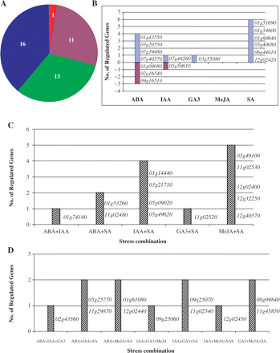
Fig. 7 Summary of expression analyses of WRKY genes under various hormone treatments. (A) A pie diagram showing the ...
Notes:
Fig. 7 Summary of expression analyses of WRKY genes under various hormone treatments. (A) A pie diagram showing the numbers of genes regulated by a single hormone (shaded in blue), two hormones (green), three hormones (vermeil) and four hormones (red). (B) List of genes regulated by only one of the five hormones. Blue bars indicate the numbers of genes up-regulated by the hormone, and the corresponding genes are listed in the right of the column. Vermeil bars indicate the numbers of genes down-regulated by the hormone. Corresponding genes are also listed in the right of the column. (C) and (D) List of genes regulated by three and four hormones, respectively. Shaded bars in (C) and (D) indicate the numbers of genes up-regulated by three and four hormone combinations. Corresponding genes are listed in the right of this column.
Unless provided in the caption above, the following copyright applies to the content of this slide: © The Author 2008. Published by Oxford University Press on behalf of Japanese Society of Plant Physiologists. All rights reserved. For permissions, please email: journals.permissions@oxfordjournals.org

Slide 7
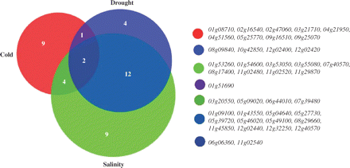
Fig. 6 Summary of the expression analyses of WRKY genes under cold, drought and salinity treatment. (A) Venn diagram ...
Notes:
Fig. 6 Summary of the expression analyses of WRKY genes under cold, drought and salinity treatment. (A) Venn diagram showing the classification of genes inducible by cold, drought and salinity stresses based on real-time PCR analyses. The inducible genes were classified into various groups showing the numbers with one or more stress-inducible genes. (B) List of the genes in the various groups identified in (A).
Unless provided in the caption above, the following copyright applies to the content of this slide: © The Author 2008. Published by Oxford University Press on behalf of Japanese Society of Plant Physiologists. All rights reserved. For permissions, please email: journals.permissions@oxfordjournals.org

Slide 8
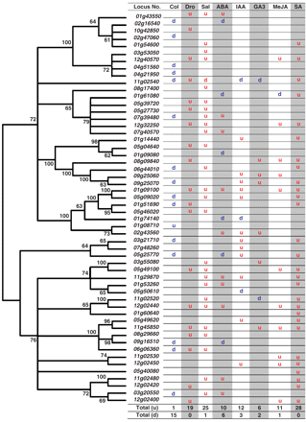
Fig. 5 Phylogenetic tree of rice WRKY members and their expression profiles under stressed conditions. (A) A ...
Notes:
Fig. 5 Phylogenetic tree of rice WRKY members and their expression profiles under stressed conditions. (A) A neighbor-joining bootstrap consensus tree of 54 stress-regulated WRKY members. The amino acid sequence of only one WRKY domain (the C-terminal domain was selected if two domains were detected) was used for the phylogenetic tree construction. (B) Expression patterns of 54 WRKY genes under abiotic (cold, drought and salinity) and various hormone (ABA, IAA, GA3, MeJA and SA) treatments. The results were from two biologically replicated real-time PCR analyses. The blue ‘d’ indicates that the corresponding gene was significantly down-regulated by t-test under a stress treatment. The red ‘u’ indicates up-regulation by t-test. Col, cold; Dro, drought; Sal, salinity.
Unless provided in the caption above, the following copyright applies to the content of this slide: © The Author 2008. Published by Oxford University Press on behalf of Japanese Society of Plant Physiologists. All rights reserved. For permissions, please email: journals.permissions@oxfordjournals.org

