Slide 1
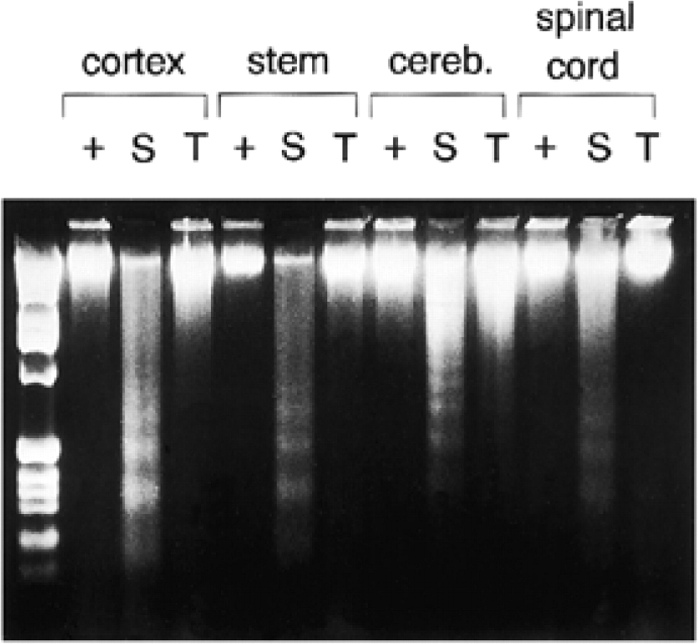
Figure 1 DNA laddering in tissues from wild-type (+), Hexb^{−/−} (S, Sandhoff) and Hexa^{−/−} (T, ...
Notes:
Figure 1 DNA laddering in tissues from wild-type (+), Hexb−/− (S, Sandhoff) and Hexa−/− (T, Tay-Sachs) mice. Two micrograms of DNA from the indicated tissues were subjected to electrophoresis on a 2% agarose gel and stained with ethidium bromide. Stem, brain stem; cereb., cerebellum. The lane at the left of the panel contains the 1 kb DNA ladder.
Unless provided in the caption above, the following copyright applies to the content of this slide: © 1997 Oxford University Press

Slide 2
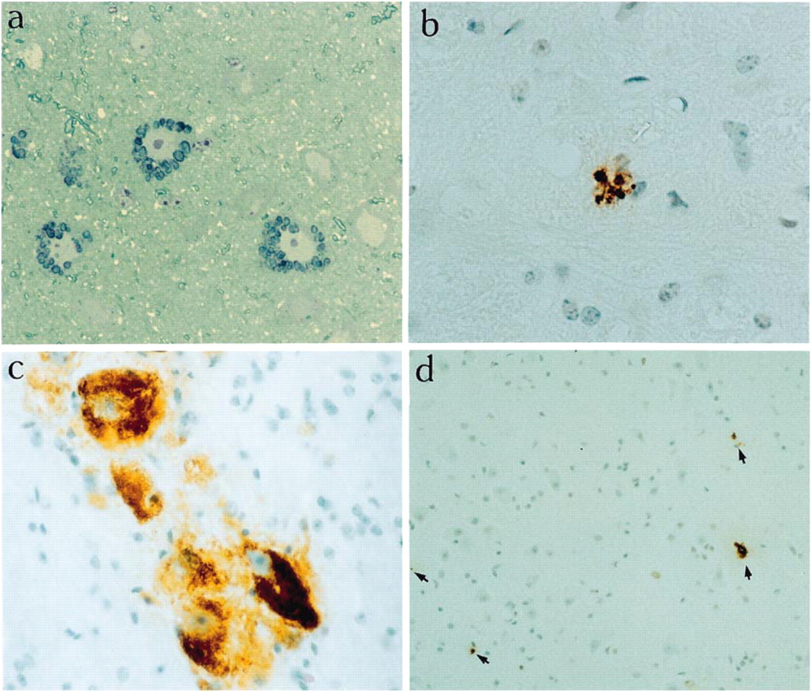
Figure 2 Apoptosis, G_{M2} ganglioside accumulation and lysosomal swelling in mouse tissue sections. (a) ...
Notes:
Figure 2 Apoptosis, GM2 ganglioside accumulation and lysosomal swelling in mouse tissue sections. (a) Toluidine blue staining of a semithin section of neurons from cerebral cortex of a Hexa−/− mouse showing swollen lysosomes surrounding the nucleus, 630× (b) Formation of apoptotic bodies in the brain stem of a Hexb−/− mouse detected by in situ end-labelling of DNA, 630× (c) Anterior horn cells of spinal cord from a Hexb−/− mouse showing accumulated GM2 ganglioside detected with anti-GM2 monoclonal antibody, 630× (d) Apoptotic cells (arrows) from the grey matter of the spinal cord of a Hexb−/− mouse detected by in situ end-labelling of DNA, 200×
Unless provided in the caption above, the following copyright applies to the content of this slide: © 1997 Oxford University Press

Slide 3
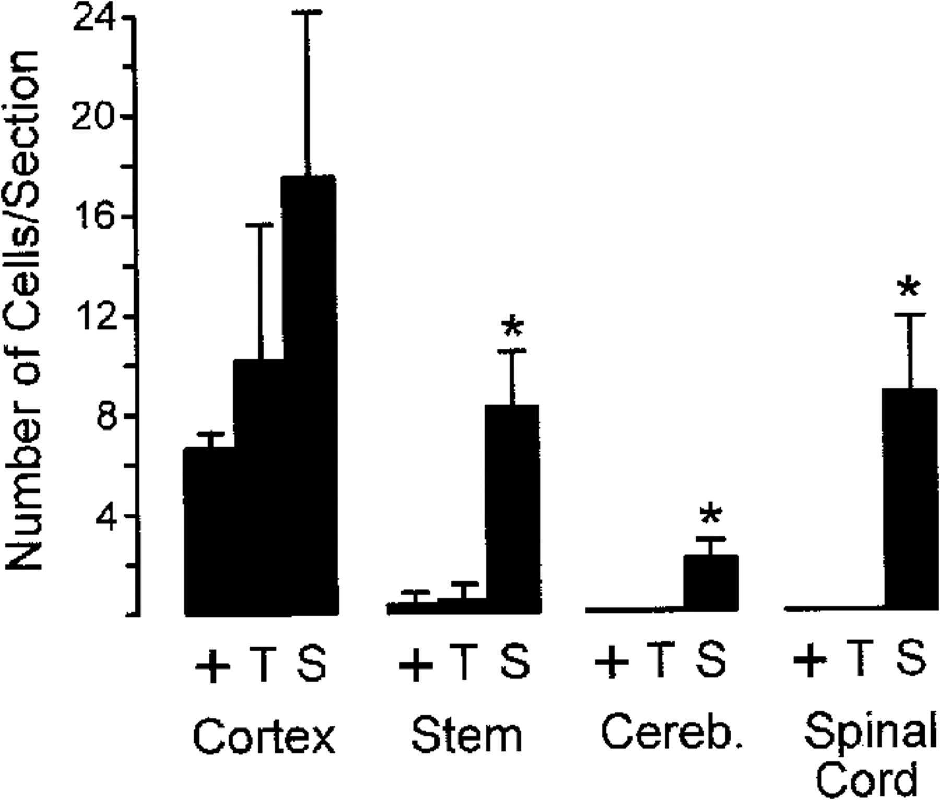
Figure 3 Distribution of positively stained ‘apoptotic’ cells in cerebral cortex, brain stem, cerebellum (cereb.) and ...
Notes:
Figure 3 Distribution of positively stained ‘apoptotic’ cells in cerebral cortex, brain stem, cerebellum (cereb.) and spinal cord. Whole sections were counted from three contiguous sections in control (shown as +, including three homozygous wild-type and three heterozygous mice), Hexa−/− (T) and Hexb−/− (S) mice. Results are given as no. positive cells/section ± SEM (*P ≤ 0.05). The + and T values for cerebellum and spinal cord are 0.
Unless provided in the caption above, the following copyright applies to the content of this slide: © 1997 Oxford University Press

Slide 4
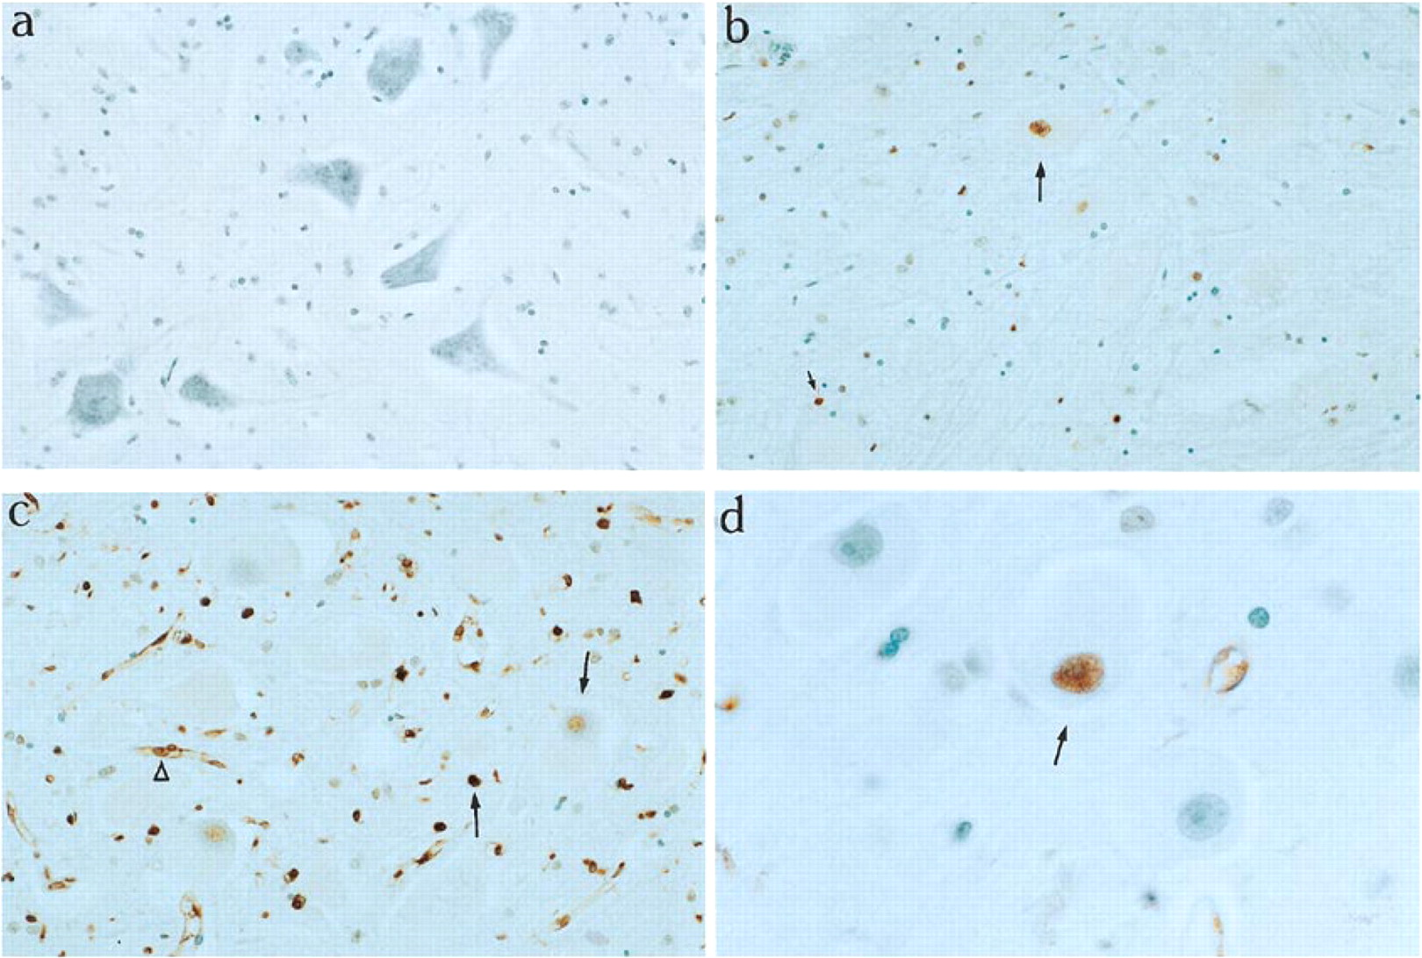
Figure 4 In situ DNA end-labelling of spinal cord sections showing the region of anterior horn cells from autopsy ...
Notes:
Figure 4 In situ DNA end-labelling of spinal cord sections showing the region of anterior horn cells from autopsy samples of human Tay-Sachs and Sandhoff disease cases. (a) Control, 200×; (b) Tay-Sachs disease with arrows indicating examples of apoptotic cells, 200×; (c) Sandhoff disease showing extensive pattern of apoptotic cells with arrows showing apoptotic cells at different stages and open arrowhead showing stained vascular pericyte, 200×; (d) Sandhoff disease with arrow indicating anterior horn cell with positively stained nucleus, 400×
Unless provided in the caption above, the following copyright applies to the content of this slide: © 1997 Oxford University Press

Slide 5
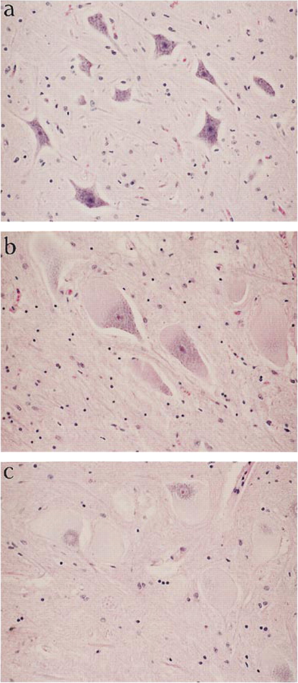
Figure 5 Haematoxylin and eosin staining of spinal cord sections from human control (a), Tay-Sachs (b) and Sandhoff ...
Notes:
Figure 5 Haematoxylin and eosin staining of spinal cord sections from human control (a), Tay-Sachs (b) and Sandhoff disease (c) cases, 200× Note distended anterior horn neurons in (b) and (c) compared with (a).
Unless provided in the caption above, the following copyright applies to the content of this slide: © 1997 Oxford University Press

