Slide 1
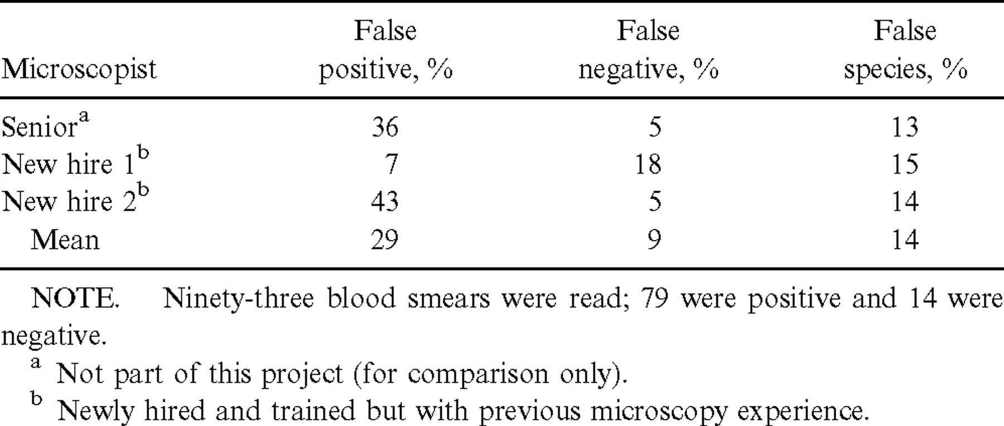
Table 1 Test results for newly hired and trained field microscopists, compared with results for an expert reference ...
Notes:
Table 1 Test results for newly hired and trained field microscopists, compared with results for an expert reference microscopist
Unless provided in the caption above, the following copyright applies to the content of this slide: © 2002 by the Infectious Diseases Society of America

Slide 2
Table 2 Results of the initial, expert, and final microscopy diagnoses in a malaria-prevention clinical trial and ...
Notes:
Table 2 Results of the initial, expert, and final microscopy diagnoses in a malaria-prevention clinical trial and corresponding results based on polymerase chain reaction (PCR)
Unless provided in the caption above, the following copyright applies to the content of this slide: © 2002 by the Infectious Diseases Society of America

Slide 3
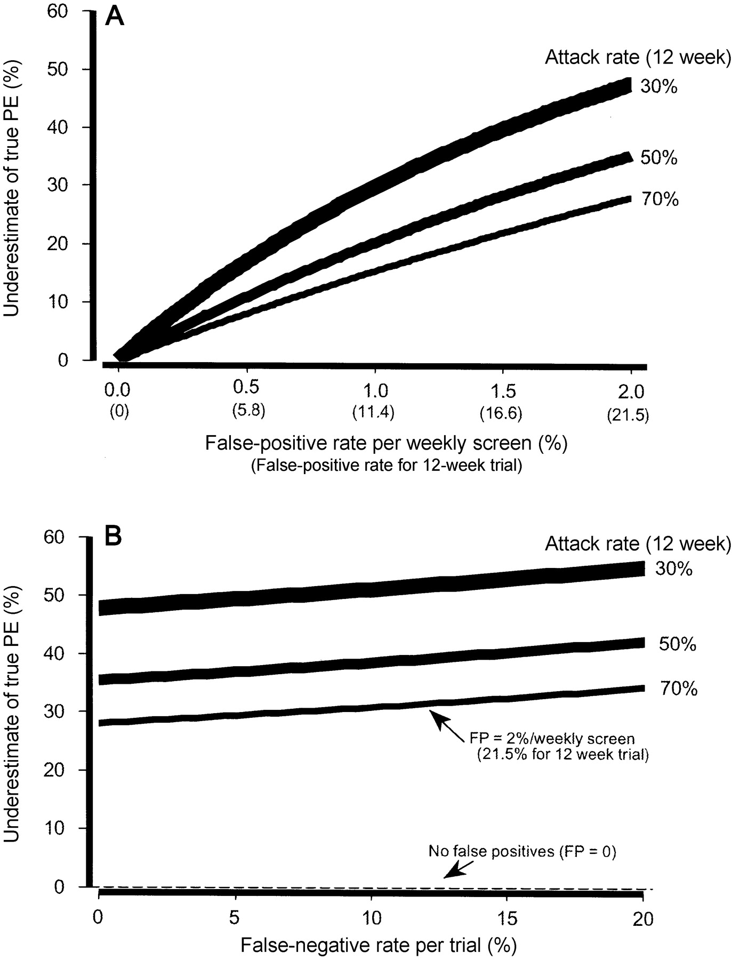
Figure 1 A The underestimate of the true protective efficacy (PE) caused by false-positive (FP) malaria smears in a ...
Notes:
Figure 1 A The underestimate of the true protective efficacy (PE) caused by false-positive (FP) malaria smears in a 12-week malaria-prevention trial with routine weekly collection. Note that 0.5% FP smears (99.5% specificity) cause the PE to be underestimated by 7%–15%. As shown, the underestimate varies with the malaria attack rate. B The underestimate of the true PE caused by false-negative malaria smears in a 12-week malaria-prevention trial with routine weekly collection. Note that false-negative smears have no effect on PE estimates when no false-positive results occur. A slight effect is seen with false-negative results at the varying malaria attack rates when false-positive results are present
Unless provided in the caption above, the following copyright applies to the content of this slide: © 2002 by the Infectious Diseases Society of America

Slide 4
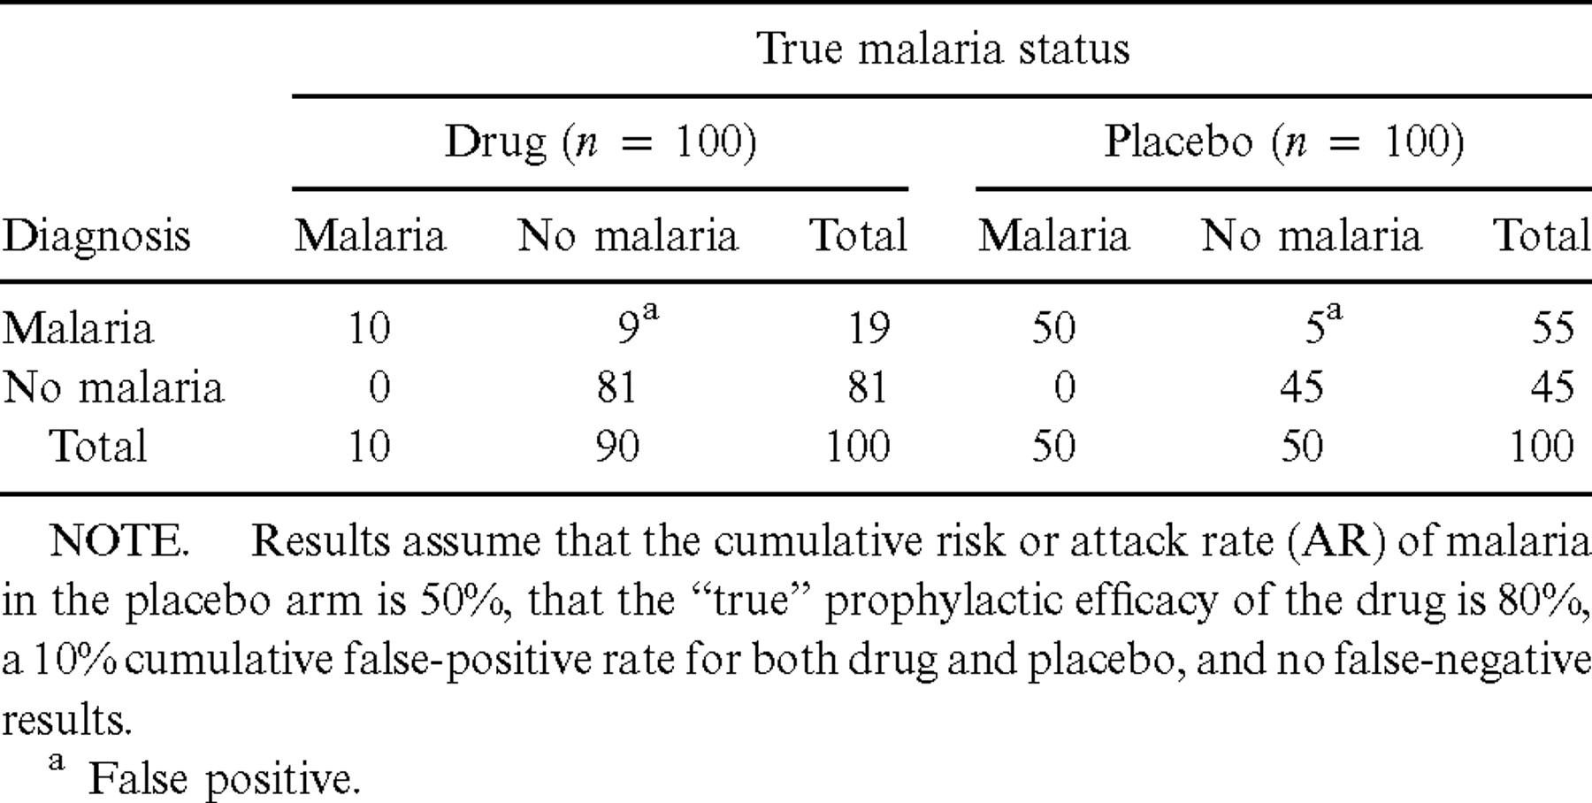
Table A1 Summary of expected results by true malaria status, diagnosis, and drug arm in a 12-week field trial ...
Notes:
Table A1 Summary of expected results by true malaria status, diagnosis, and drug arm in a 12-week field trial comparing an antimalarial drug with placebo
Unless provided in the caption above, the following copyright applies to the content of this slide: © 2002 by the Infectious Diseases Society of America

Slide 5
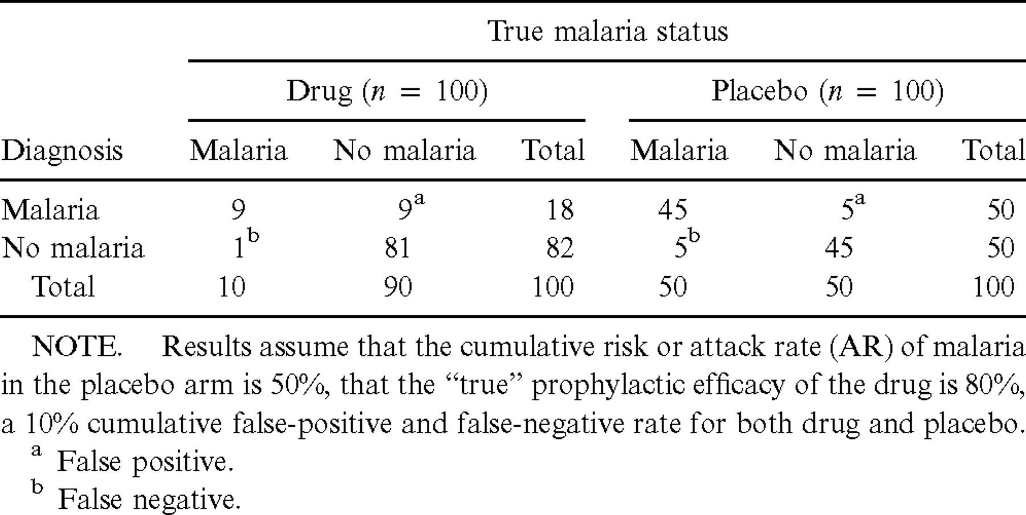
Table A2 Summary of expected results by true malaria status, diagnosis, and drug arm in a 12-week field trial ...
Notes:
Table A2 Summary of expected results by true malaria status, diagnosis, and drug arm in a 12-week field trial comparing an antimalarial drug with placebo
Unless provided in the caption above, the following copyright applies to the content of this slide: © 2002 by the Infectious Diseases Society of America

Slide 6
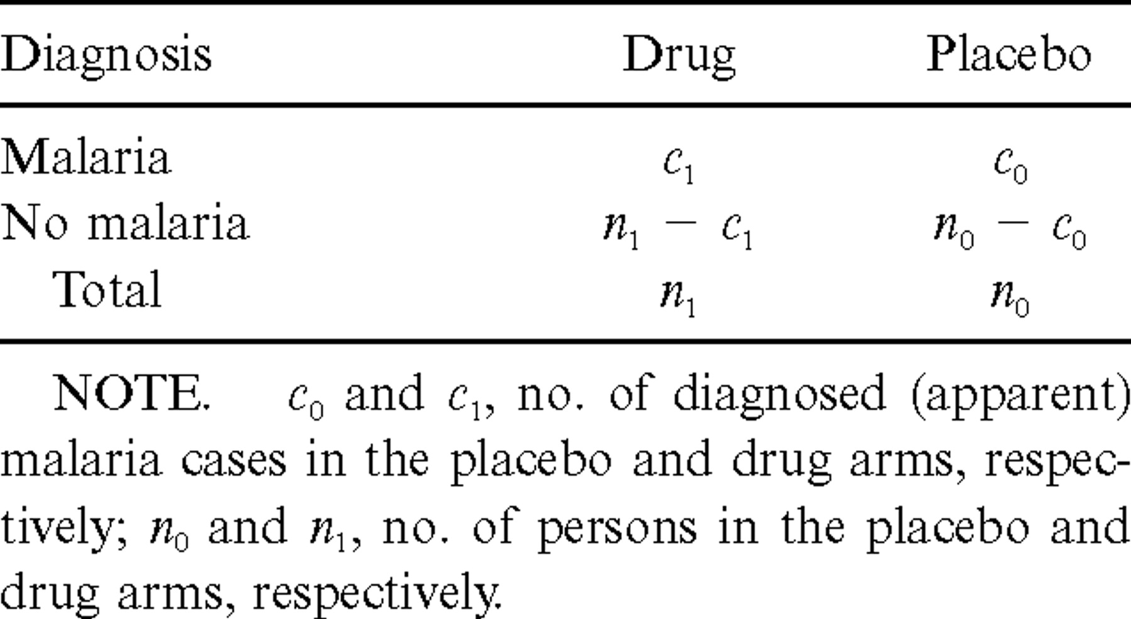
Table A3 Symbolic representation of the outcomes from a randomized placebo-controlled trial of an antimalarial drug
Notes:
Table A3 Symbolic representation of the outcomes from a randomized placebo-controlled trial of an antimalarial drug
Unless provided in the caption above, the following copyright applies to the content of this slide: © 2002 by the Infectious Diseases Society of America

