Slide 1
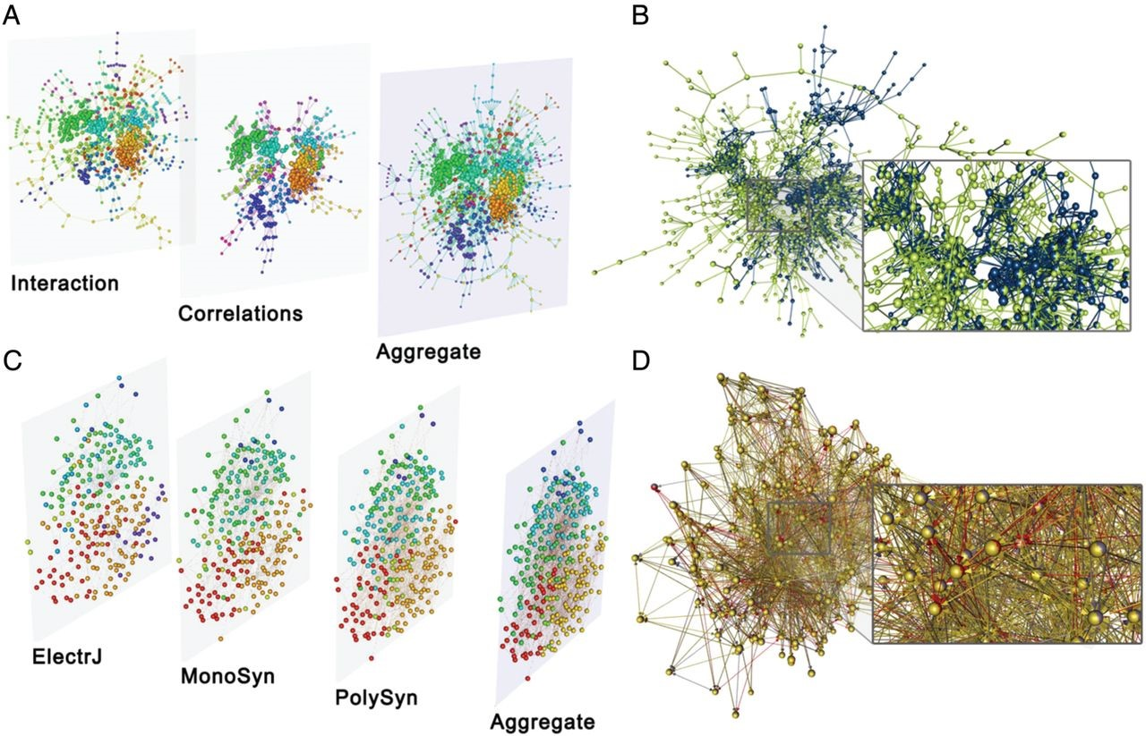
Fig. 1. Multilayer representations of genetic and neuronal networks. (A) Multilayer representation, in which the ...
Notes:
Fig. 1. Multilayer representations of genetic and neuronal networks. (A) Multilayer representation, in which the layers correspond to an interaction network of genes in S. cerevisiae (which was obtained via a synthetic genetic-array methodology) and a correlation-based network in which genes with similar interaction profiles are connected to each other. [The data come from Ref. [26].] In the third layer, we show an aggregated network. In this visualization, the colour of the nodes is their module assignment from multilayer community detection (see the text for further details). (B). Representation of the same network as an edge-coloured multigraph. (C) Multilayer and (D) edge-coloured-multigraph representations of the C. elegans connectome, where layers correspond to different synaptic junctions: electric (‘ElectrJ’), chemical monadic (‘MonoSyn’) and polyadic (‘PolySyn’). [The data come from Ref. [24].] In (B) and (D), we colour the nodes according to the layer to which they belong. If a node is part of multiple layers simultaneously, then we use an equal distribution of the corresponding colours for the node.
Unless provided in the caption above, the following copyright applies to the content of this slide: © The Authors 2014. Published by Oxford University Press.This is an Open Access article distributed under the terms of the Creative Commons Attribution License (http://creativecommons.org/licenses/by/4.0/), which permits unrestricted reuse distribution and reproduction in any medium, provided the original work is properly cited.

Slide 2
Fig. 2. Multilayer networks embedded in geographical regions. (A) Network of European airports, where each layer ...
Notes:
Fig. 2. Multilayer networks embedded in geographical regions. (A) Network of European airports, where each layer represents a different airline [51]. (B) Network of mobility and communication in the Ivory Coast, where nodes are geographical districts [63]. We used muxViz to visualize these data sets. [A colour version of this figure is available online.]
Unless provided in the caption above, the following copyright applies to the content of this slide: © The Authors 2014. Published by Oxford University Press.This is an Open Access article distributed under the terms of the Creative Commons Attribution License (http://creativecommons.org/licenses/by/4.0/), which permits unrestricted reuse distribution and reproduction in any medium, provided the original work is properly cited.

Slide 3
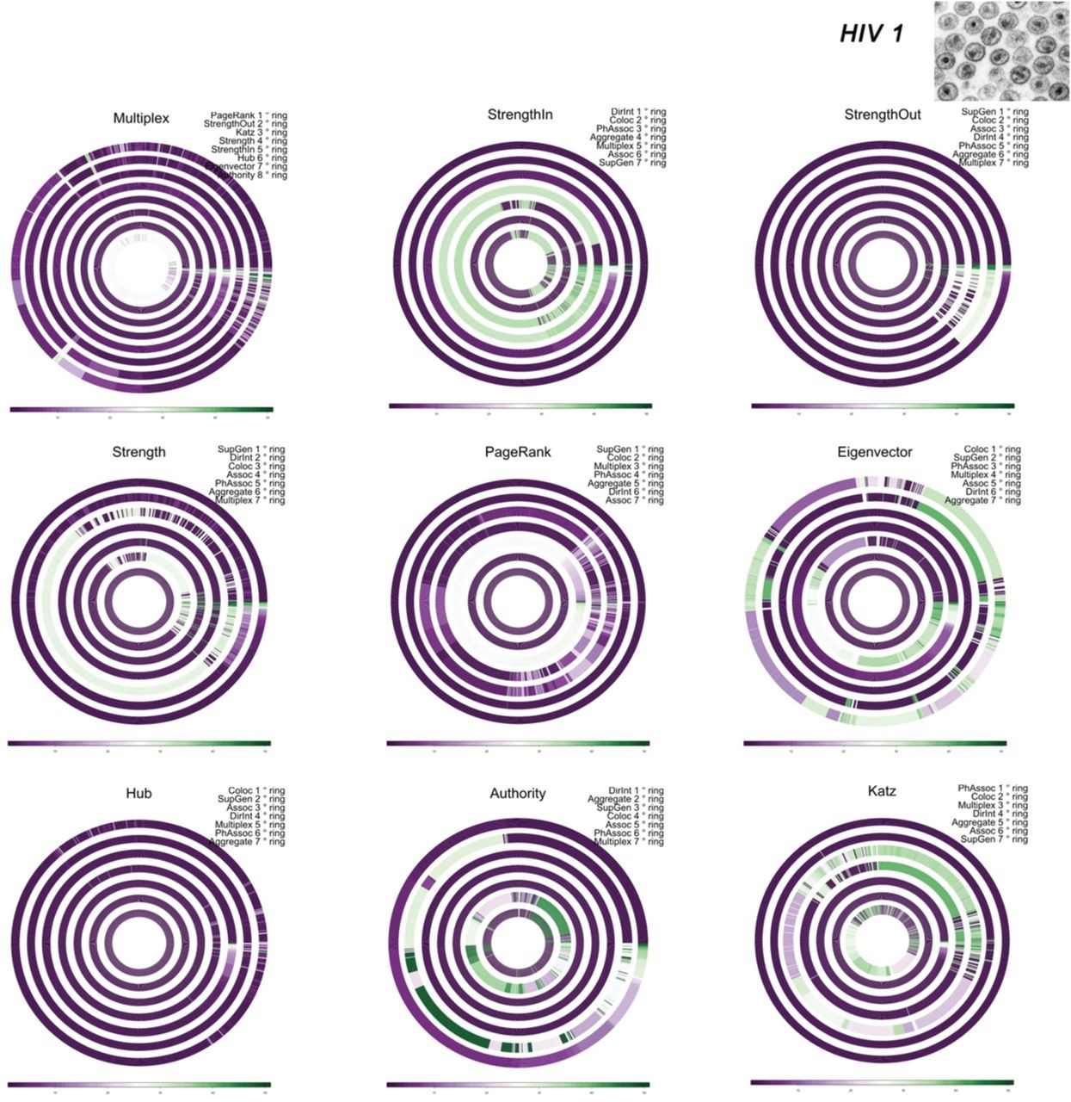
Fig. 10. Multilayer analysis (annular plots) of HIV-1 genetic-interaction network. See Section 3.1 for details about ...
Notes:
Fig. 10. Multilayer analysis (annular plots) of HIV-1 genetic-interaction network. See Section 3.1 for details about each panel. [A colour version of this figure is available online.]
Unless provided in the caption above, the following copyright applies to the content of this slide: © The Authors 2014. Published by Oxford University Press.This is an Open Access article distributed under the terms of the Creative Commons Attribution License (http://creativecommons.org/licenses/by/4.0/), which permits unrestricted reuse distribution and reproduction in any medium, provided the original work is properly cited.

Slide 4
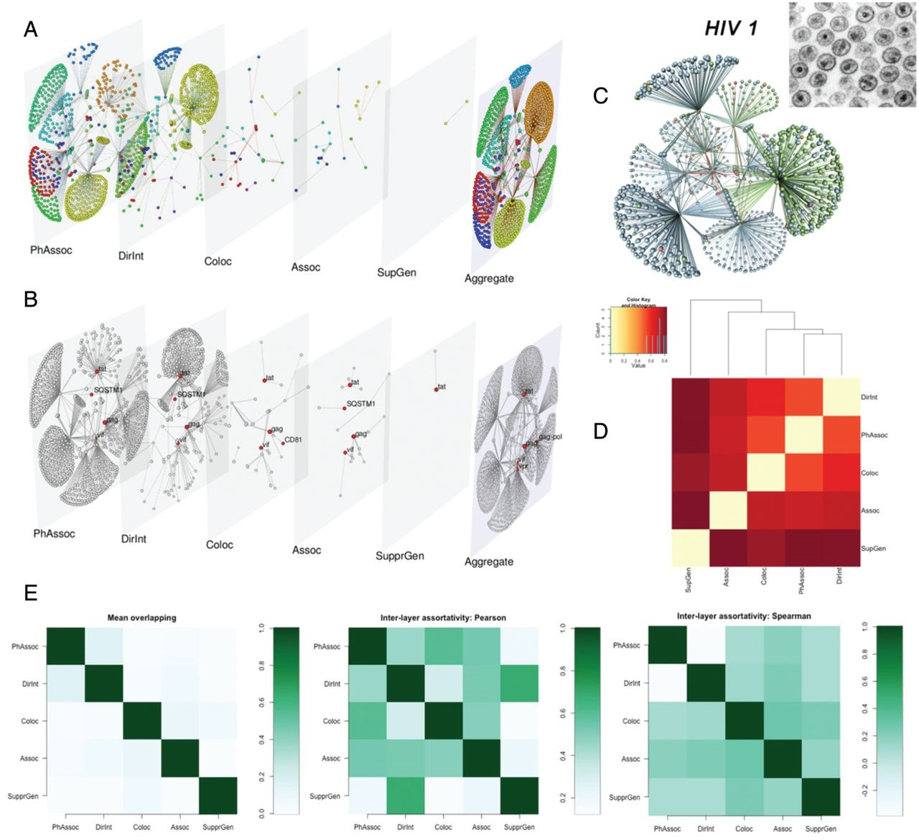
Fig. 9. Multilayer analysis of HIV-1 genetic-interaction network. See Section 3.1 for details about each panel. [A ...
Notes:
Fig. 9. Multilayer analysis of HIV-1 genetic-interaction network. See Section 3.1 for details about each panel. [A colour version of this figure is available online.]
Unless provided in the caption above, the following copyright applies to the content of this slide: © The Authors 2014. Published by Oxford University Press.This is an Open Access article distributed under the terms of the Creative Commons Attribution License (http://creativecommons.org/licenses/by/4.0/), which permits unrestricted reuse distribution and reproduction in any medium, provided the original work is properly cited.

Slide 5
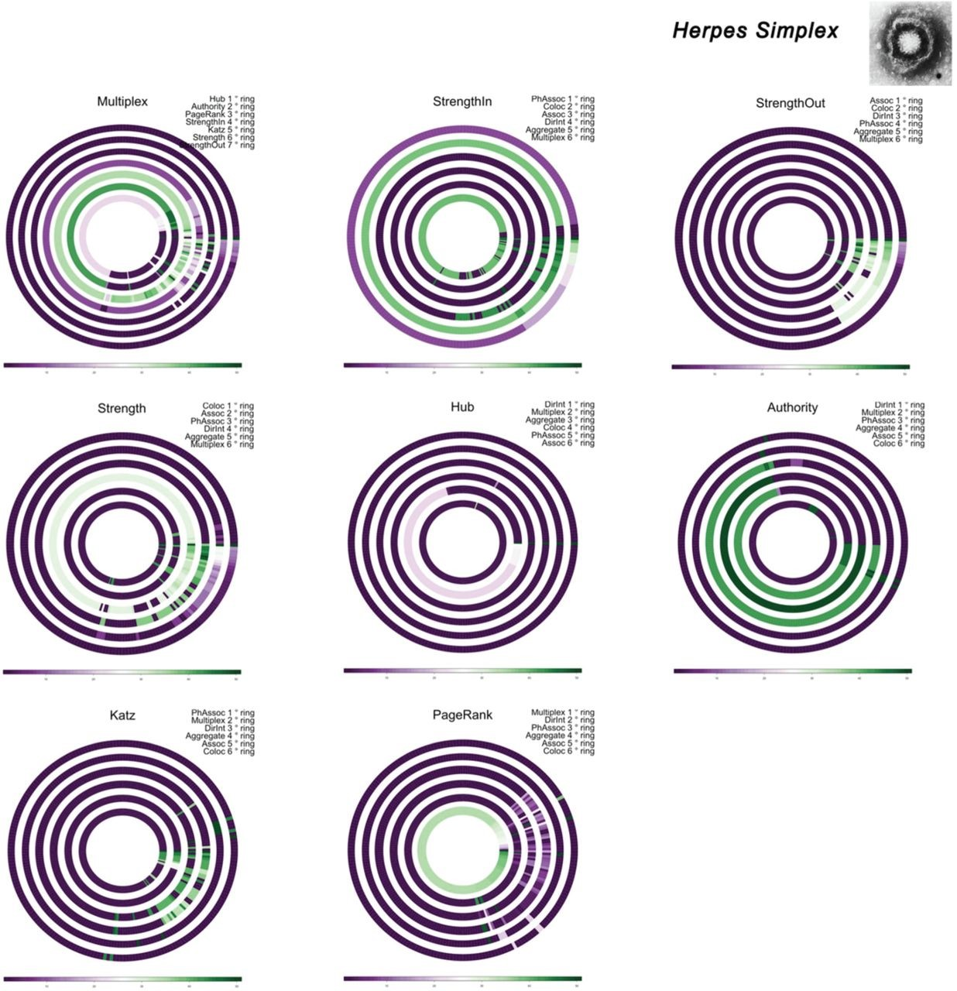
Fig. 8. Multilayer analysis (annular plots) of H. simplex genetic-interaction network. See Section 3.1 for details ...
Notes:
Fig. 8. Multilayer analysis (annular plots) of H. simplex genetic-interaction network. See Section 3.1 for details about each panel. Note that we do not show eigenvector centrality because one layer consists of a directed acyclic graph (for which eigenvector centrality is unilluminating [1]). [A colour version of this figure is available online.]
Unless provided in the caption above, the following copyright applies to the content of this slide: © The Authors 2014. Published by Oxford University Press.This is an Open Access article distributed under the terms of the Creative Commons Attribution License (http://creativecommons.org/licenses/by/4.0/), which permits unrestricted reuse distribution and reproduction in any medium, provided the original work is properly cited.

Slide 6
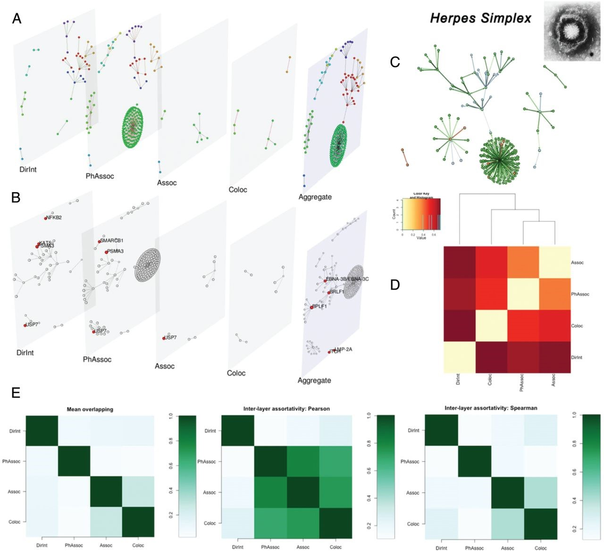
Fig. 7. Multilayer analysis of H. simplex genetic-interaction network. See Section 3.1 for details about each panel. ...
Notes:
Fig. 7. Multilayer analysis of H. simplex genetic-interaction network. See Section 3.1 for details about each panel. [A colour version of this figure is available online.]
Unless provided in the caption above, the following copyright applies to the content of this slide: © The Authors 2014. Published by Oxford University Press.This is an Open Access article distributed under the terms of the Creative Commons Attribution License (http://creativecommons.org/licenses/by/4.0/), which permits unrestricted reuse distribution and reproduction in any medium, provided the original work is properly cited.

Slide 7
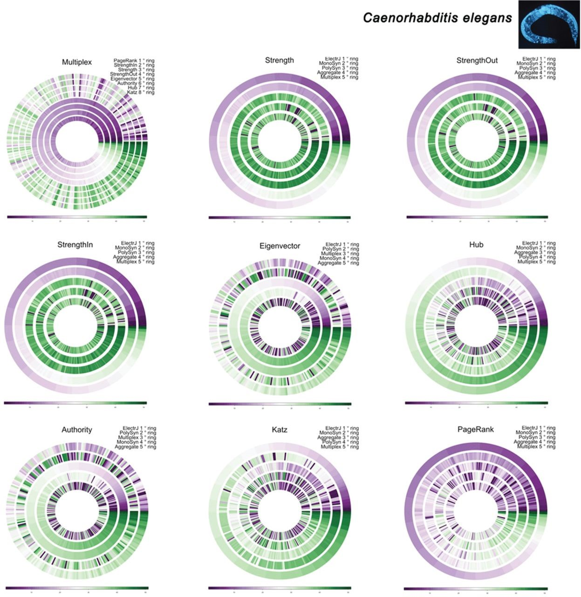
Fig. 6. Multilayer analysis (annular plots) of C. elegans connectome. See Section 3.1 for details about each panel. ...
Notes:
Fig. 6. Multilayer analysis (annular plots) of C. elegans connectome. See Section 3.1 for details about each panel. [A colour version of this figure is available online.]
Unless provided in the caption above, the following copyright applies to the content of this slide: © The Authors 2014. Published by Oxford University Press.This is an Open Access article distributed under the terms of the Creative Commons Attribution License (http://creativecommons.org/licenses/by/4.0/), which permits unrestricted reuse distribution and reproduction in any medium, provided the original work is properly cited.

Slide 8
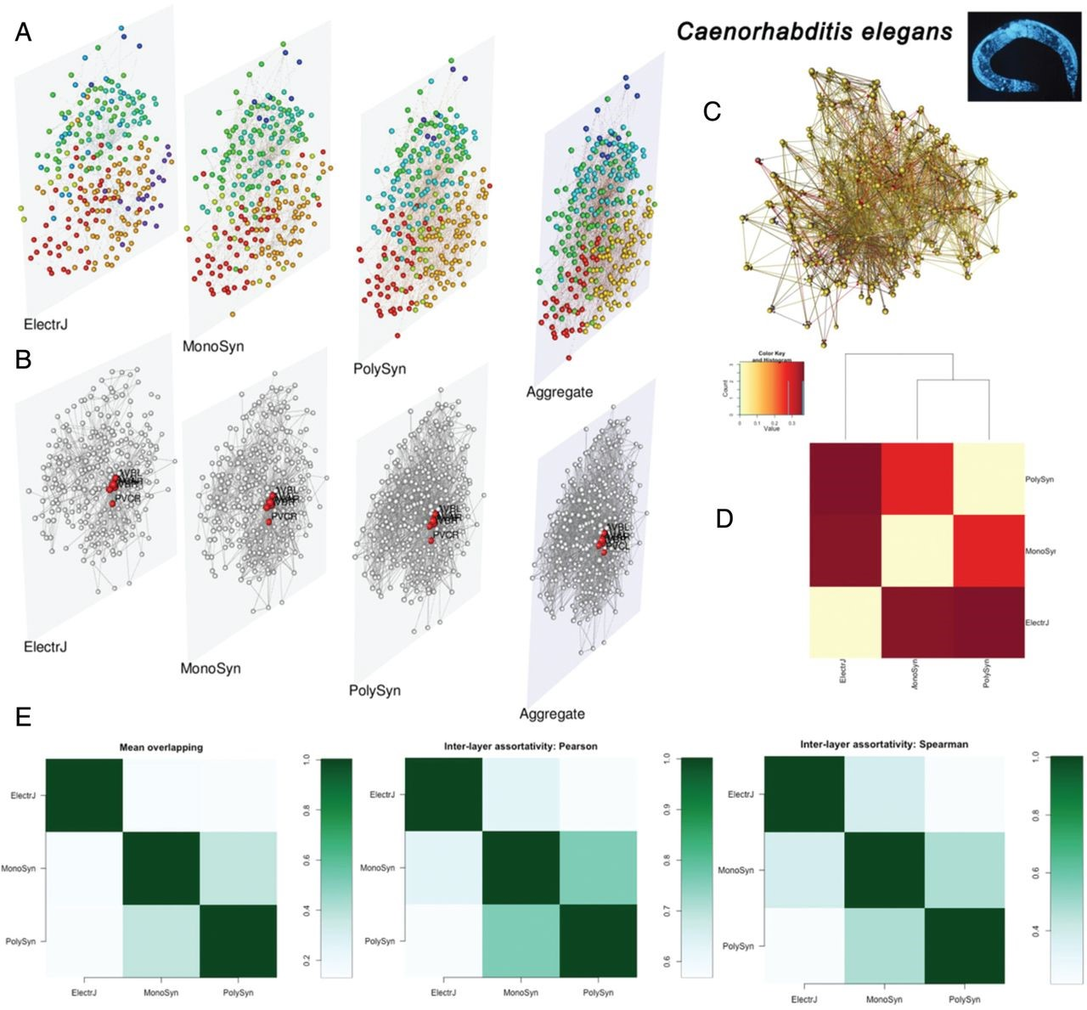
Fig. 5. Multilayer analysis of C. elegans connectome. See Section 3.1 for details about each panel. [A colour version ...
Notes:
Fig. 5. Multilayer analysis of C. elegans connectome. See Section 3.1 for details about each panel. [A colour version of this figure is available online.]
Unless provided in the caption above, the following copyright applies to the content of this slide: © The Authors 2014. Published by Oxford University Press.This is an Open Access article distributed under the terms of the Creative Commons Attribution License (http://creativecommons.org/licenses/by/4.0/), which permits unrestricted reuse distribution and reproduction in any medium, provided the original work is properly cited.

Slide 9
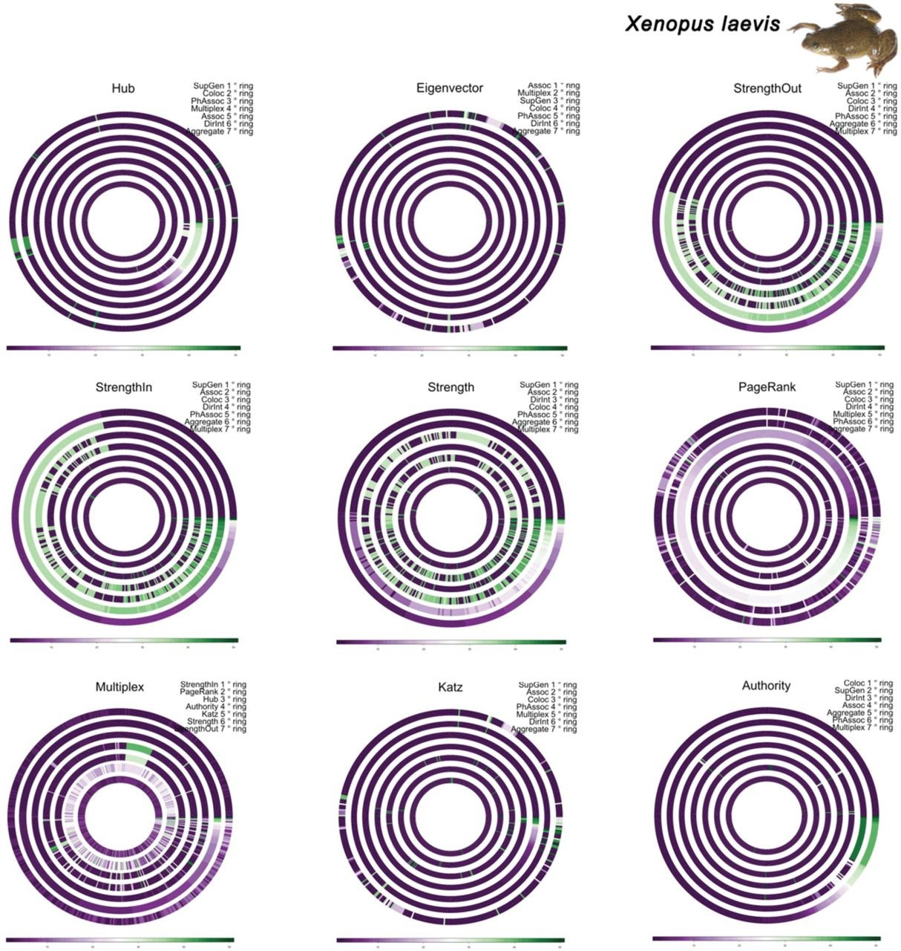
Fig. 4. Multilayer analysis (annular plots) of X. laevis genetic-interaction network. See Section 3.1 for details ...
Notes:
Fig. 4. Multilayer analysis (annular plots) of X. laevis genetic-interaction network. See Section 3.1 for details about each panel.
Unless provided in the caption above, the following copyright applies to the content of this slide: © The Authors 2014. Published by Oxford University Press.This is an Open Access article distributed under the terms of the Creative Commons Attribution License (http://creativecommons.org/licenses/by/4.0/), which permits unrestricted reuse distribution and reproduction in any medium, provided the original work is properly cited.

Slide 10
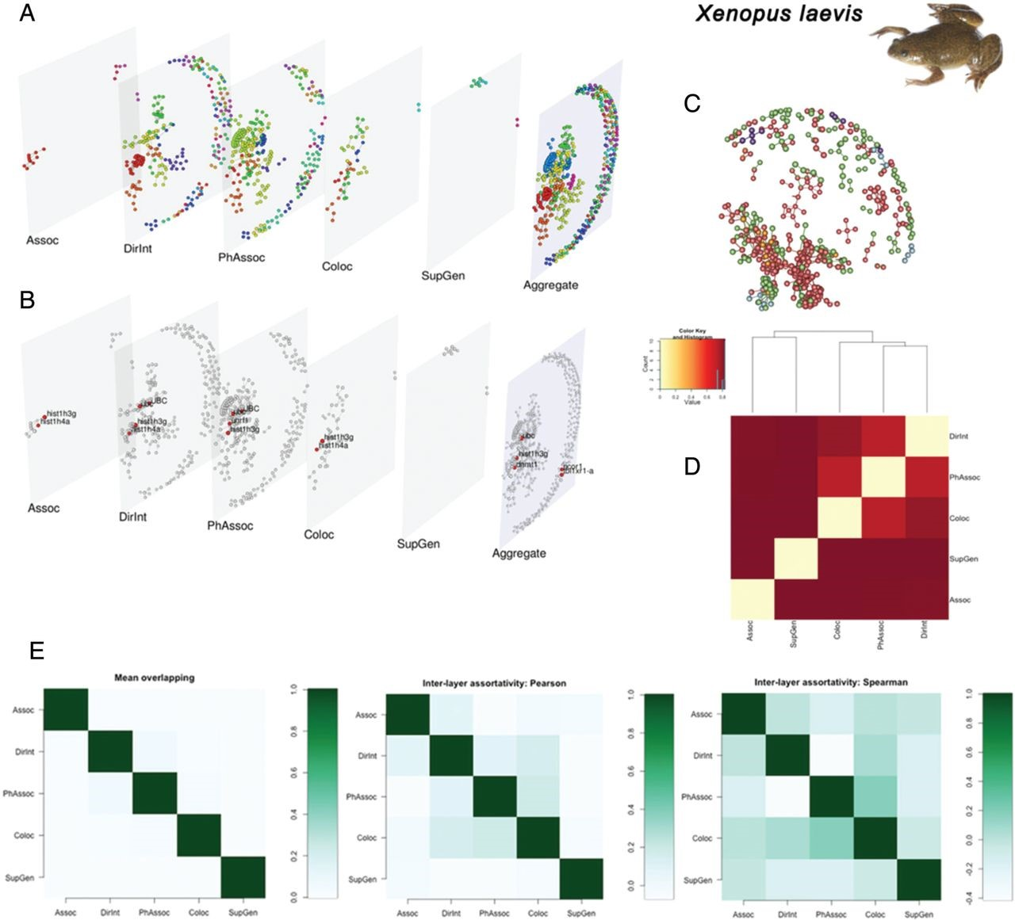
Fig. 3. Multilayer analysis of X. laevis genetic-interaction network. See Section 3.1 for details about each panel. ...
Notes:
Fig. 3. Multilayer analysis of X. laevis genetic-interaction network. See Section 3.1 for details about each panel. [In this figure and all subsequent figures, we have purposely kept font sizes at muxViz's default level rather than increasing them.]
Unless provided in the caption above, the following copyright applies to the content of this slide: © The Authors 2014. Published by Oxford University Press.This is an Open Access article distributed under the terms of the Creative Commons Attribution License (http://creativecommons.org/licenses/by/4.0/), which permits unrestricted reuse distribution and reproduction in any medium, provided the original work is properly cited.

