Slide 1
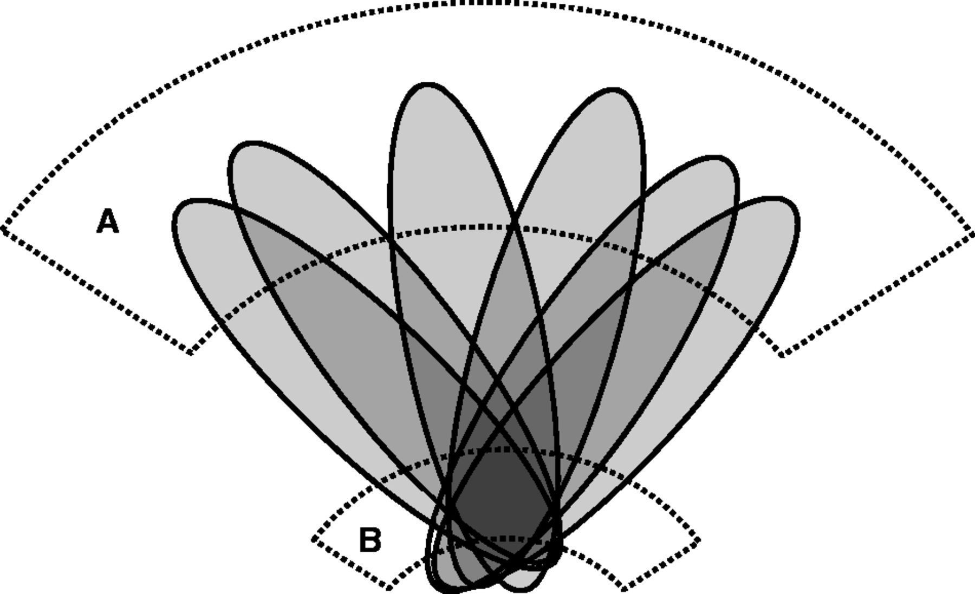
Figure 1 Illustration of how stereotyped patterns of brain damage (schematized in grey) across a set of patients can ...
Notes:
Figure 1 Illustration of how stereotyped patterns of brain damage (schematized in grey) across a set of patients can hypothetically mislocalize damage of any part of critical area A (in dotted lines) to the non-critical area B (in dotted lines). This will happen whenever the spatial variability of damage to a non-critical area is less for the group or factor of interest than for the critical area. Such stereotypy of damage—a hidden deep structure in the data—may occur where the lesions follow a consistent non-neural architecture, as is the case with vascular lesions.
Unless provided in the caption above, the following copyright applies to the content of this slide: © The Author (2014). Published by Oxford University Press on behalf of the Guarantors of Brain.This is an Open Access article distributed under the terms of the Creative Commons Attribution License (http://creativecommons.org/licenses/by/3.0/), which permits unrestricted reuse, distribution, and reproduction in any medium, provided the original work is properly cited.

Slide 2
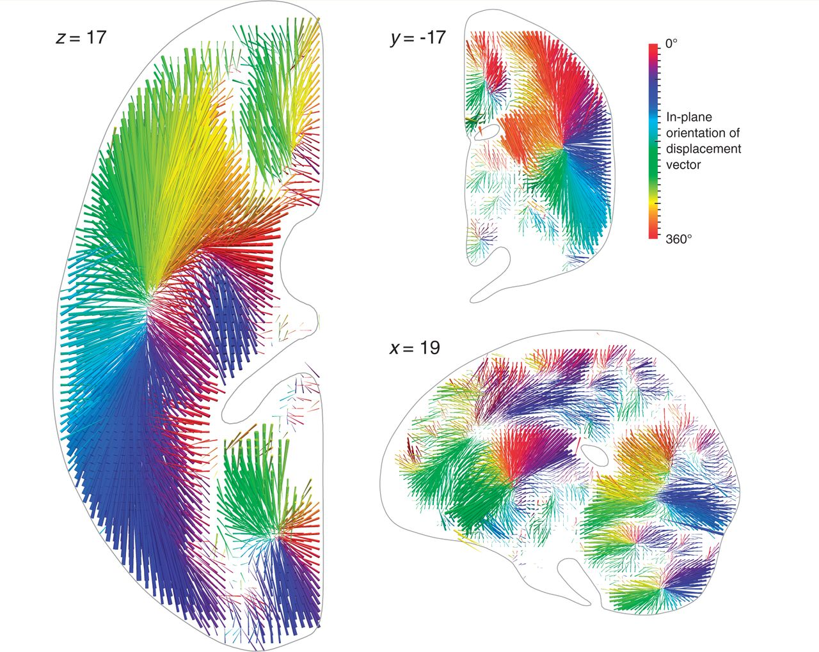
Figure 2 Three-dimensional vector plot of the direction (colour map) and magnitude (length of arrow) of ...
Notes:
Figure 2 Three-dimensional vector plot of the direction (colour map) and magnitude (length of arrow) of mislocalization at adequately sampled voxels within three representative planes (left axial, top coronal, bottom sagittal), based on a sample of 581 acute stroke lesions, normalized into standard stereotactic space and mirrored onto one hemisphere (see ‘Materials and methods’ section for details). The value at each voxel was calculated by labelling the stack of 581 lesioned volumes as being ‘affected’ or ‘unaffected’ depending on whether or not that voxel fell within the lesion in each volume, running a standard voxel-wise Fisher’s exact test-based mass-univariate analysis on the two groups, and identifying the centre of mass of the resultant significant cluster, identified by the asymptotic P-value thresholded at a Bonferroni corrected P < 0.01. This procedure was performed at all voxels hit more than three times in the data set. Each arrow points from the true location of a voxel in the brain to the location where the mass-univariate model erroneously places it. The colour map corresponds to the orientation of this error vector in the visualized plane. Note that the mislocalization tends to follow the organization of the vascular tree, with clusters corresponding to the branches of the middle cerebral, anterior cerebral, and posterior circulations. See ‘Materials and methods’ section for details. See Supplementary material for manipulable 3D versions of these images.
Unless provided in the caption above, the following copyright applies to the content of this slide: © The Author (2014). Published by Oxford University Press on behalf of the Guarantors of Brain.This is an Open Access article distributed under the terms of the Creative Commons Attribution License (http://creativecommons.org/licenses/by/3.0/), which permits unrestricted reuse, distribution, and reproduction in any medium, provided the original work is properly cited.

Slide 3
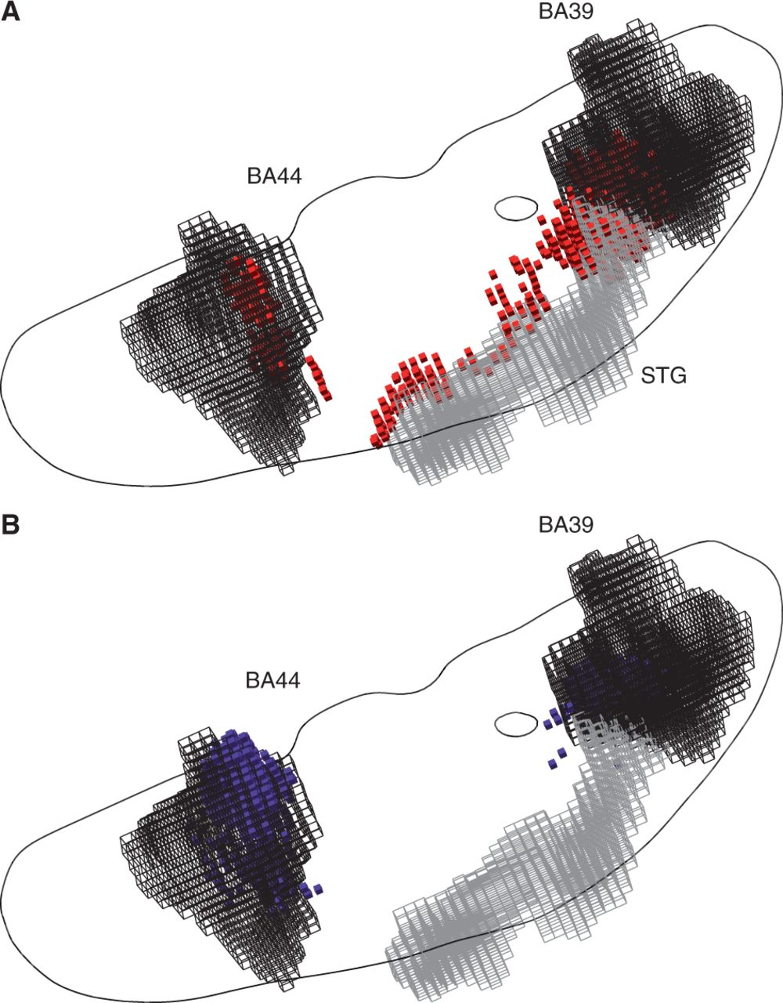
Figure 3 (A) Three-dimensional plots of the voxels identified as significantly associated with a hypothetical ...
Notes:
Figure 3 (A) Three-dimensional plots of the voxels identified as significantly associated with a hypothetical deficit—given damage to either BA 39 or BA 44 at ≥20% of the volume of either—by a voxel-wise mass-univariate analysis of the sample of 581 acute stroke lesions (red cubic glyphs). As before, Fisher’s exact test was used, thresholded at a level such that the volume of surviving voxels equalled 20% of the volume of BA 39 and BA 44 (each area is shown as a black wireframe). Note that the centre of mass of the significantly associated region falls in neither Brodmann area, but in the region of the superior temporal gyrus (STG, grey wireframe). See ‘Materials and methods’ section for details. In grey is an outline of an axial slice traversing BA 44 and BA 39, shown here purely to give an indication of the relative position of the two areas in the axial plane. (B) Three-dimensional plots of the voxels identified as heavily weighted in the classification process—given damage to either BA 39 or BA 44 at ≥20% of their total volume—by a high-dimensional multivariate analysis of the sample of 581 acute stroke lesions based on a linear support vector machine (blue cubic glyphs). The voxels shown are thresholded so as to yield the same number of surviving voxels as in the mass univariate analysis depicted in A. Note that the mislocalization observed with the mass-univariate approach is no longer seen. See ‘Materials and methods’ section for details. See Supplementary material for manipulable 3D versions of these images.
Unless provided in the caption above, the following copyright applies to the content of this slide: © The Author (2014). Published by Oxford University Press on behalf of the Guarantors of Brain.This is an Open Access article distributed under the terms of the Creative Commons Attribution License (http://creativecommons.org/licenses/by/3.0/), which permits unrestricted reuse, distribution, and reproduction in any medium, provided the original work is properly cited.

Slide 4
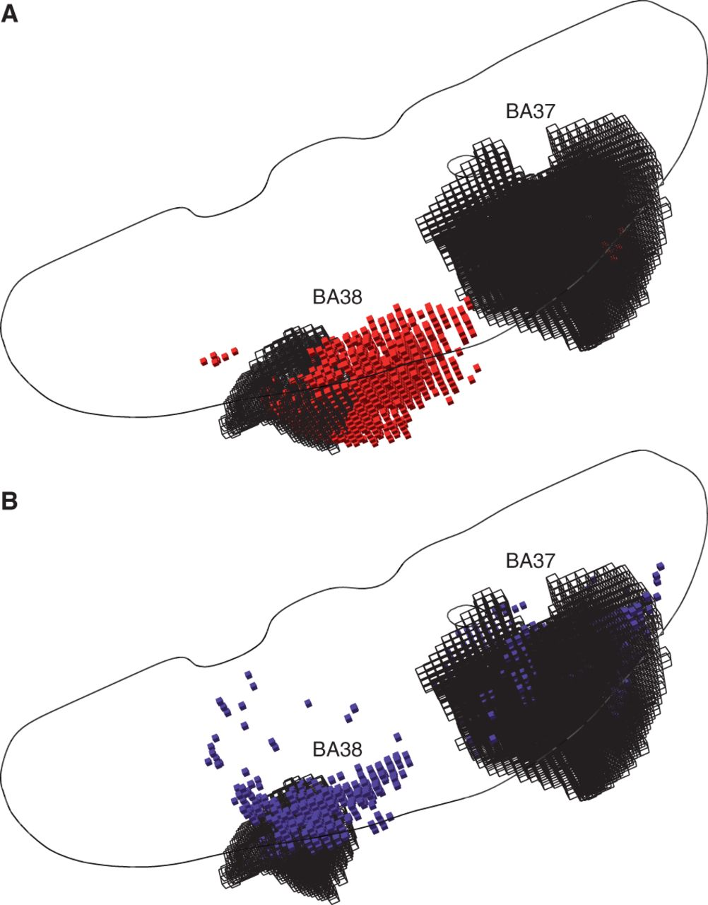
Figure 4 (A) Three-dimensional plots of the voxels identified as significantly associated with a hypothetical ...
Notes:
Figure 4 (A) Three-dimensional plots of the voxels identified as significantly associated with a hypothetical deficit—given damage to either BA 37 or BA 38 at ≥20% of the volume of either—by a voxel-wise mass-univariate analysis of the sample of 581 acute stroke lesions (red cubic glyphs). As before, Fisher’s exact test was used, thresholded at a level such that the volume of surviving voxels equalled 20% of the volume of BA 37 and BA 38 (each area is shown as a black wireframe). Note that the centre of mass of the significantly associated region falls in neither Brodmann area. See ‘Materials and methods’ for details. In grey is an outline of an axial slice as in Fig. 3, shown here purely to give an indication of the relative position of the two areas in the axial plane. (B) Three-dimensional plots of the voxels identified as heavily weighted in the classification process—given damage to either BA 37 or BA 38 at ≥20% of their total volume—by a high–dimensional multivariate analysis of the sample of 581 acute stroke lesions based on a linear support vector machine (blue cubic glyphs). The voxels shown are thresholded so as to yield the same number of surviving voxels as in the mass univariate analysis depicted in A. Note that the mislocalization observed with the mass-univariate approach is much less pronounced. See ‘Materials and methods’ section for details. See Supplementary material for manipulable 3D versions of these images.
Unless provided in the caption above, the following copyright applies to the content of this slide: © The Author (2014). Published by Oxford University Press on behalf of the Guarantors of Brain.This is an Open Access article distributed under the terms of the Creative Commons Attribution License (http://creativecommons.org/licenses/by/3.0/), which permits unrestricted reuse, distribution, and reproduction in any medium, provided the original work is properly cited.

