Slide 1
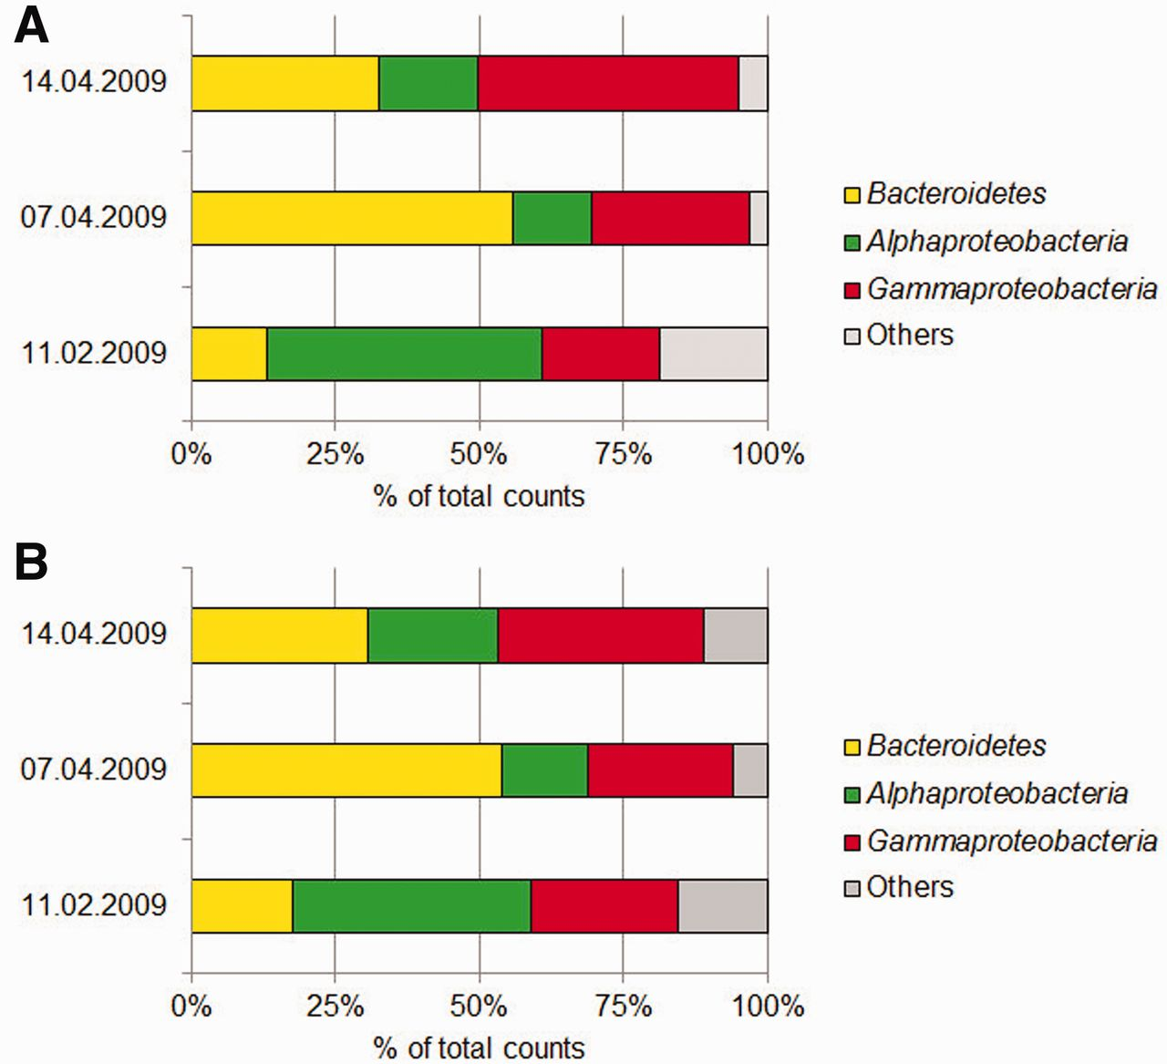
Figure 1. Taxonomic distribution of 16S rRNA gene sequences gained from a time series of three different surface water ...
Notes:
Figure 1. Taxonomic distribution of 16S rRNA gene sequences gained from a time series of three different surface water samples at Helgoland Roads in the North Sea, (A) 16S pyrotags generated from PCR and sequenced with Roche’s 454 pyrosequencing (relative abundance, percentage of total counts) (B) 16S sequences gained from metagenome studies (relative abundance, percentage of total counts).
Unless provided in the caption above, the following copyright applies to the content of this slide: © The Author(s) 2012. Published by Oxford University Press.This is an Open Access article distributed under the terms of the Creative Commons Attribution License (http://creativecommons.org/licenses/by-nc/3.0/), which permits non-commercial reuse, distribution, and reproduction in any medium, provided the original work is properly cited. For commercial re-use, please contact journals.permissions@oup.com.

