Slide 1
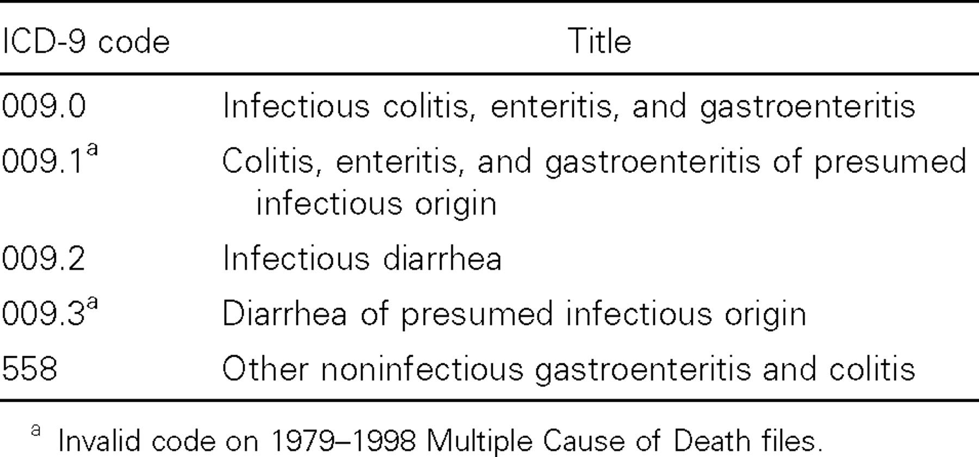
Table 1 International Classification of Diseases, Ninth Revision (ICD-9) codes for gastroenteritis of unknown ...
Notes:
Table 1 International Classification of Diseases, Ninth Revision (ICD-9) codes for gastroenteritis of unknown etiology
Unless provided in the caption above, the following copyright applies to the content of this slide:

Slide 2
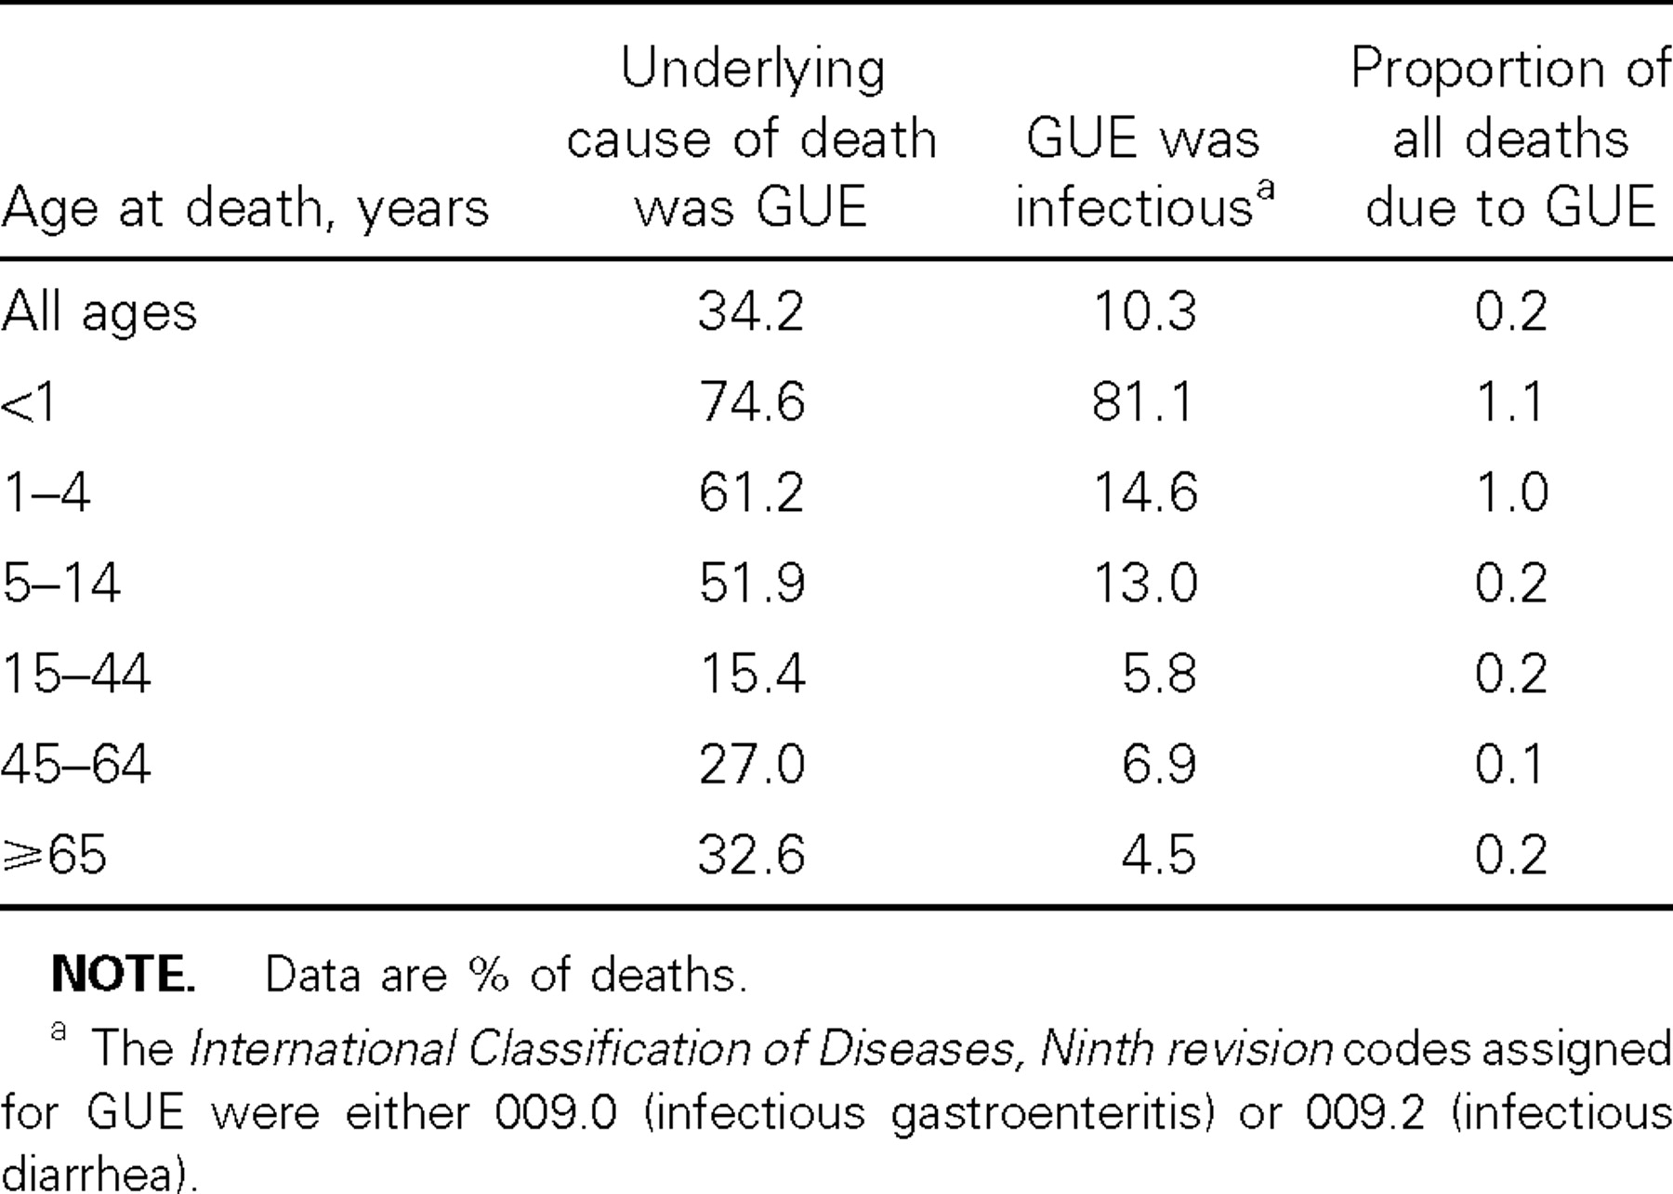
Table 2 Characteristics of deaths due to gastroenteritis of unknown etiology (GUE), by age group, United States, ...
Notes:
Table 2 Characteristics of deaths due to gastroenteritis of unknown etiology (GUE), by age group, United States, 1995–1997
Unless provided in the caption above, the following copyright applies to the content of this slide:

Slide 3
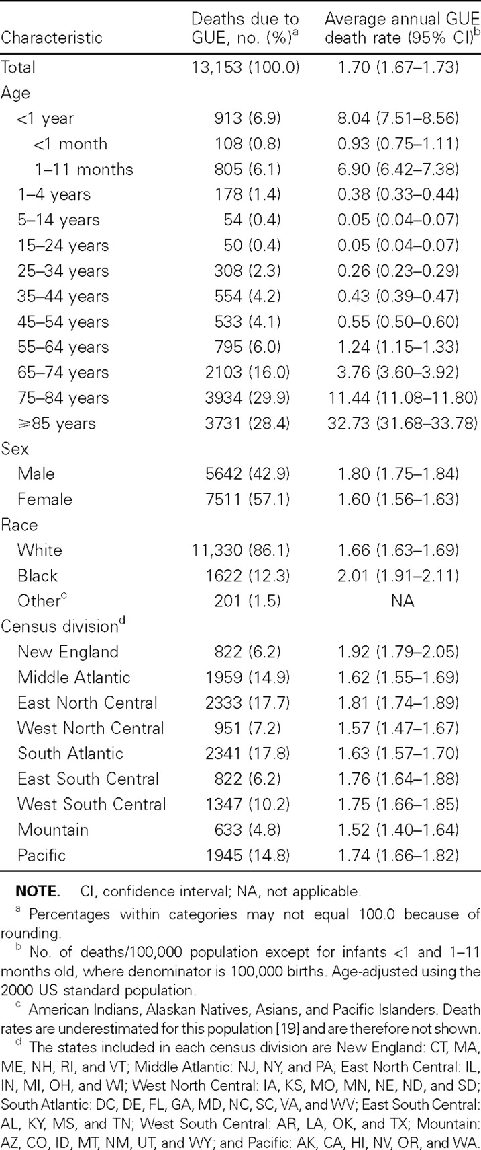
Table 3 Distribution of deaths due to gastroenteritis of unknown etiology (GUE) and average annual GUE death rate, ...
Notes:
Table 3 Distribution of deaths due to gastroenteritis of unknown etiology (GUE) and average annual GUE death rate, United States, 1995–1997
Unless provided in the caption above, the following copyright applies to the content of this slide:

Slide 4
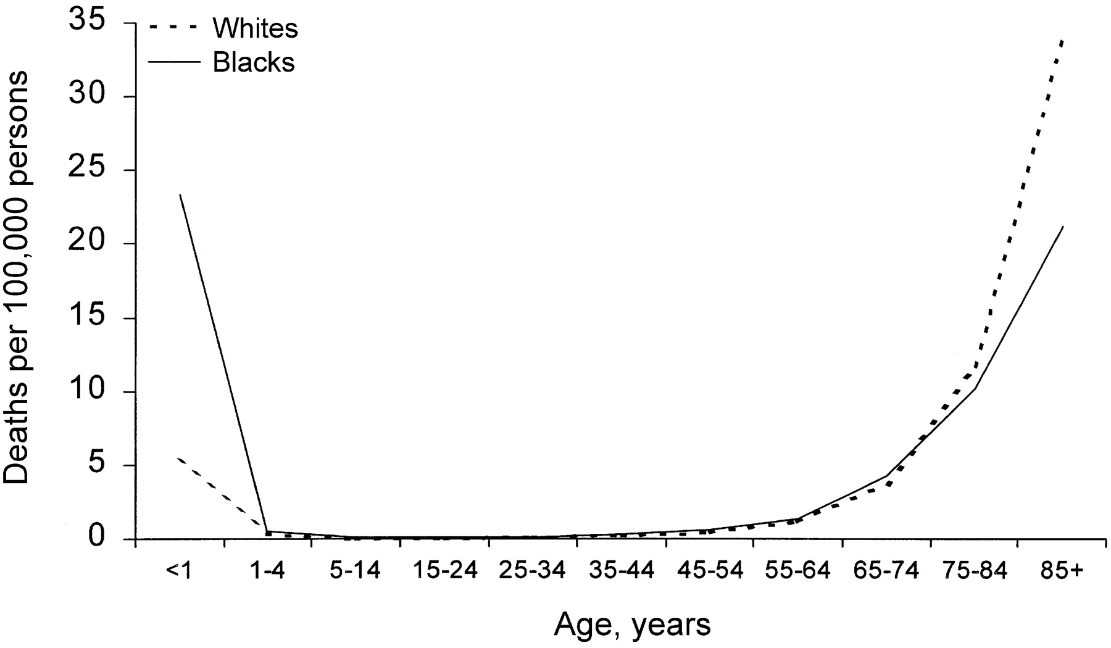
Figure 1 Average annual death rate for gastroenteritis of unknown etiology, excluding decedents with human ...
Notes:
Figure 1 Average annual death rate for gastroenteritis of unknown etiology, excluding decedents with human immunodeficiency virus/AIDS, by age group, United States, 1995–1997
Unless provided in the caption above, the following copyright applies to the content of this slide:

Slide 5
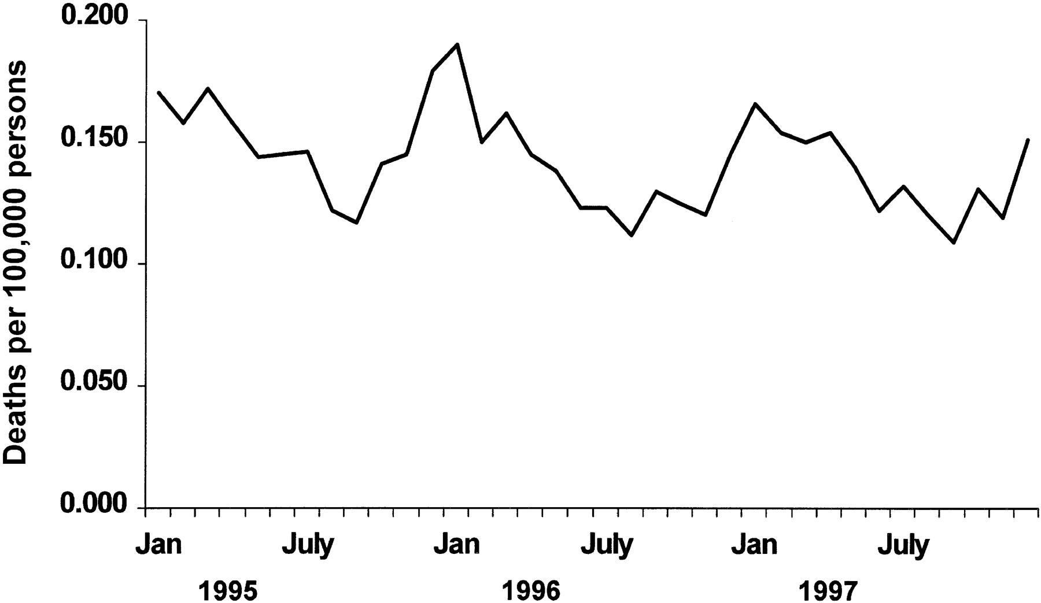
Figure 2 Monthly age-adjusted death rate for gastroenteritis of unknown etiology, United States, 1995–1997
Notes:
Figure 2 Monthly age-adjusted death rate for gastroenteritis of unknown etiology, United States, 1995–1997
Unless provided in the caption above, the following copyright applies to the content of this slide:

Slide 6
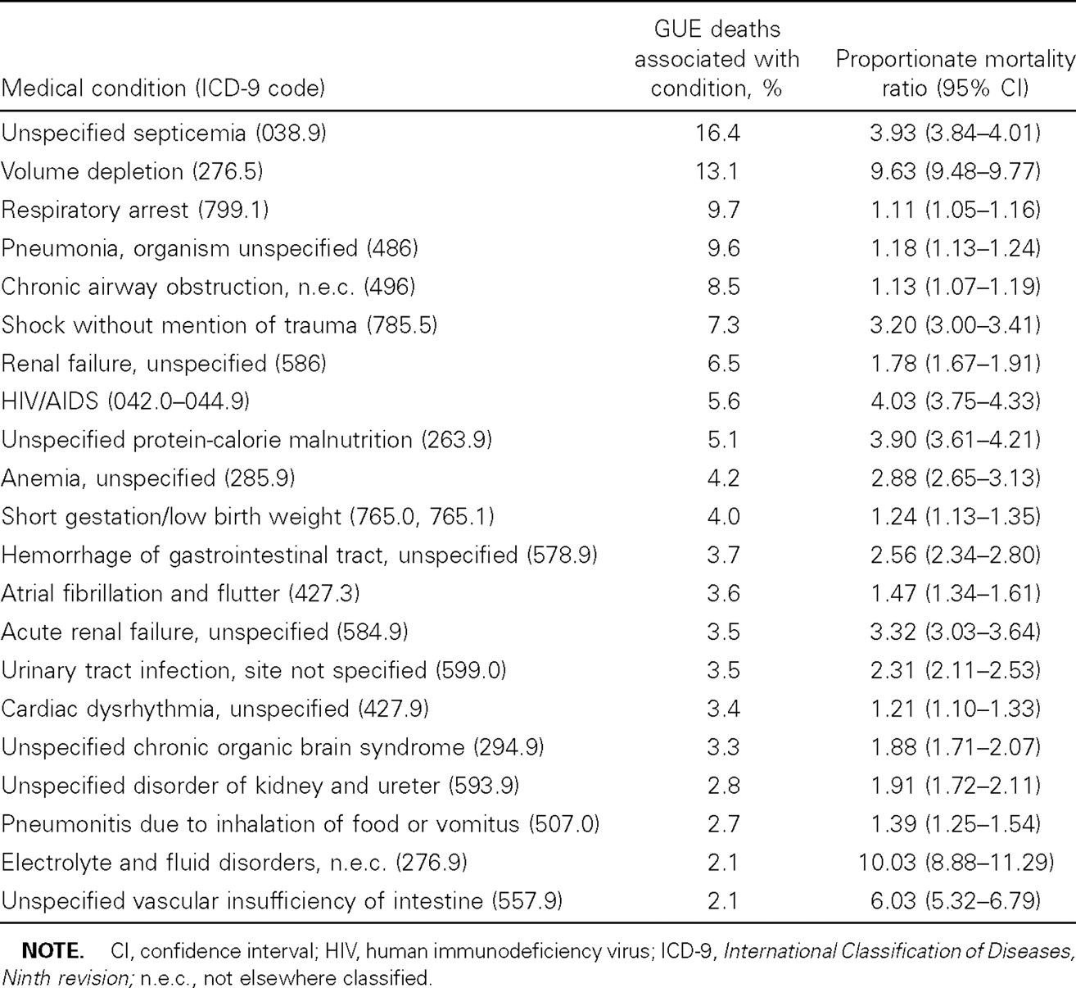
Table 4 Medical conditions associated with ⩾2% of deaths due to gastroenteritis of unknown etiology (GUE), United ...
Notes:
Table 4 Medical conditions associated with ⩾2% of deaths due to gastroenteritis of unknown etiology (GUE), United States, 1995–1997
Unless provided in the caption above, the following copyright applies to the content of this slide:

Slide 7
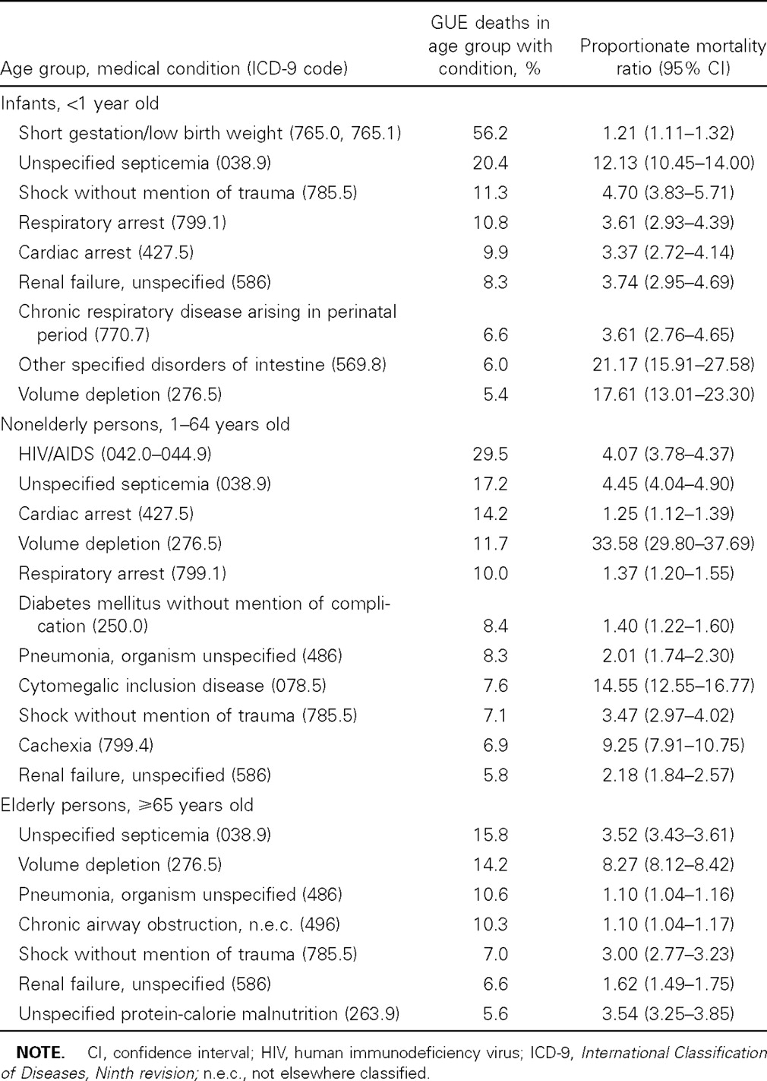
Table 5 Medical conditions associated with ⩾5% of deaths due to gastroenteritis of unknown etiology (GUE) in ...
Notes:
Table 5 Medical conditions associated with ⩾5% of deaths due to gastroenteritis of unknown etiology (GUE) in specified age group, United States, 1995–1997
Unless provided in the caption above, the following copyright applies to the content of this slide:

