Slide 1
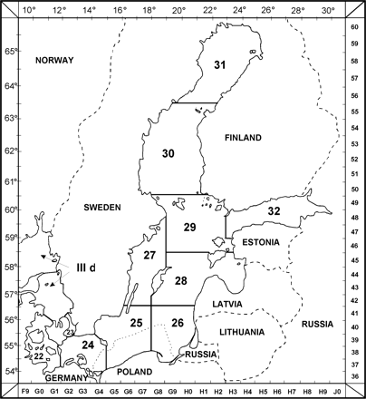
Figure 1. Map of the ICES subdivisions in the Baltic Sea.
Notes:
Figure 1. Map of the ICES subdivisions in the Baltic Sea.
Unless provided in the caption above, the following copyright applies to the content of this slide: © 2012 International Council for the Exploration of the Sea. Published by Oxford University Press. All rights reserved. For Permissions, please email: journals.permissions@oup.com

Slide 2
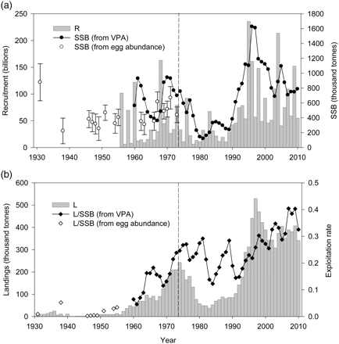
Figure 2. (a) Sprat spawning-stock biomass (SSB) and recruitment (R; numbers at age 1) in SDs 22–32 estimated from the ...
Notes:
Figure 2. (a) Sprat spawning-stock biomass (SSB) and recruitment (R; numbers at age 1) in SDs 22–32 estimated from the analytical assessment (VPA); and the estimates of SSB based on egg abundance. The error bars represent 0.95 confidence intervals of the SSB, predicted from a linear regression with the average egg abundance as a predictor variable. (b) International sprat landings (L) in the Baltic Sea (Hammer et al., 2008, and updates from the Baltic Assessment Working Group) together with the estimated exploitation rate (landings divided by SSB). The vertical broken lines separate the period covered by ICES assessments (from 1974 onwards) from the historical estimates produced in this study.
Unless provided in the caption above, the following copyright applies to the content of this slide: © 2012 International Council for the Exploration of the Sea. Published by Oxford University Press. All rights reserved. For Permissions, please email: journals.permissions@oup.com

Slide 3
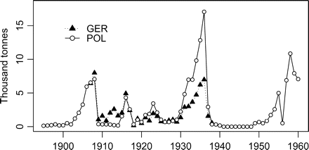
Figure 3. Baltic sprat landings by Germany (SD 22–26; data from the annual national report series Jahresbericht über ...
Notes:
Figure 3. Baltic sprat landings by Germany (SD 22–26; data from the annual national report series Jahresbericht über die Deutsche Fischerei) and Poland (SD 26; Laszczynski et al., 1964; Elwertowski, 1979).
Unless provided in the caption above, the following copyright applies to the content of this slide: © 2012 International Council for the Exploration of the Sea. Published by Oxford University Press. All rights reserved. For Permissions, please email: journals.permissions@oup.com

Slide 4
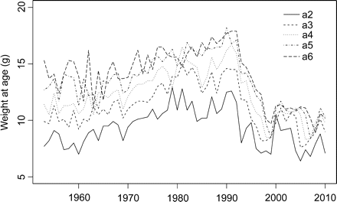
Figure 4. Annual mean weight of sprat in the Baltic Sea (SDs 22–32) for age groups 2–6.
Notes:
Figure 4. Annual mean weight of sprat in the Baltic Sea (SDs 22–32) for age groups 2–6.
Unless provided in the caption above, the following copyright applies to the content of this slide: © 2012 International Council for the Exploration of the Sea. Published by Oxford University Press. All rights reserved. For Permissions, please email: journals.permissions@oup.com

Slide 5
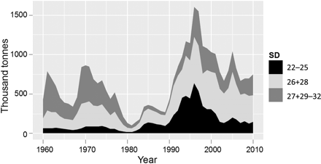
Figure 5. The spawning-stock biomass of sprat estimated from the area-disaggregated assessments for SDs 22–25, 26 and ...
Notes:
Figure 5. The spawning-stock biomass of sprat estimated from the area-disaggregated assessments for SDs 22–25, 26 and 28, and 27 + 29–32.
Unless provided in the caption above, the following copyright applies to the content of this slide: © 2012 International Council for the Exploration of the Sea. Published by Oxford University Press. All rights reserved. For Permissions, please email: journals.permissions@oup.com

