Slide 1
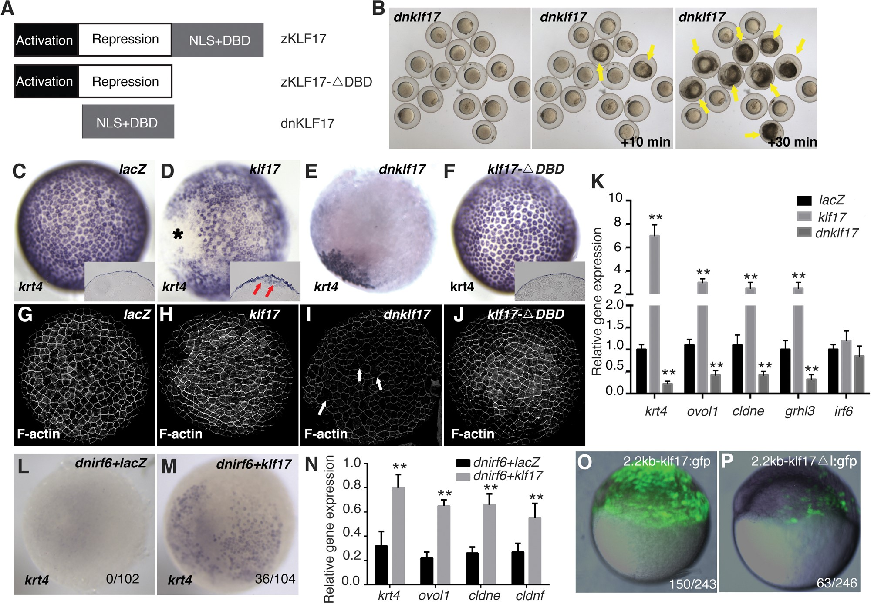
Figure 1. KLF17 is an effector of IRF6 during differentiation of the embryonic zebrafish periderm. (A) Schematic of ...
Notes:
Figure 1. KLF17 is an effector of IRF6 during differentiation of the embryonic zebrafish periderm. (A) Schematic of wild-type zebrafish Klf17 and of the variants used in this study. (B) Representative images of embryos injected at the 1-2 cell stage with RNA encoding dominant-negative Klf17 (dnklf17) shown at 6 hpf and at the indicated intervals later. Yellow arrows indicate rupture of the embryos. (C–J) Dorsal views of wild-type embryos injected at the one to two cell stage with the indicated mRNA construct, fixed at 5 hpf and processed to reveal (C–F) krt4 expression or (G–J) polymerized actin (phalloidin stain) (C–F, insets): cross-sections revealing that krt4 expression is confined to the superficial cell layer except in (F), where it is also observed in deep cells in a mosaic pattern, arrows. Asterisk in (F) indicates the ventral side of embryos. In (H) dnklf17-injected embryos, the overall level of phalloidin stain is lower than that in other groups, and there are occasional gaps in it, arrowheads. (Embryos dead at 6 hpf over number injected: lacZ, 2/89, dnklf17, 56/85, klf17-△DBD, 4/82, klf17, 6/84.) (K) Quantitation of periderm markers in dnklf17- and klf17-injected embryos (5 hpf), as assessed by qRT–PCR. Asterisks indicate statistical significance compared with the lacZ-injected control groups: *P < 0.05 and **P < 0.01. (L and M) Dorsal views of wild-type embryos injected with RNA encoding dominant-negative IRF6 (L) alone or (M) together with klf17 mRNA. Numbers at bottom right represent the ratio of unruptured/total injected embryos. (N) Quantitation of rescue of periderm markers by klf17 in dnirf6-injected embryos. Asterisks indicate statistical significance compared with the control group: **P < 0.01. (O and P) Representative images of GFP expression in transient transgenic zebrafish embryos injected with (O) the intact klf17 promoter and (P) one that lacks IRF6 binding sites (ΔI). The number at the bottom right represents the ratio of embryos with five or more GFP-periderm positive cells over the total number of injected embryos.
Unless provided in the caption above, the following copyright applies to the content of this slide: © The Author 2015. Published by Oxford University Press.This is an Open Access article distributed under the terms of the Creative Commons Attribution Non-Commercial License (http://creativecommons.org/licenses/by-nc/4.0/), which permits non-commercial re-use, distribution, and reproduction in any medium, provided the original work is properly cited. For commercial re-use, please contact journals.permissions@oup.com

Slide 2
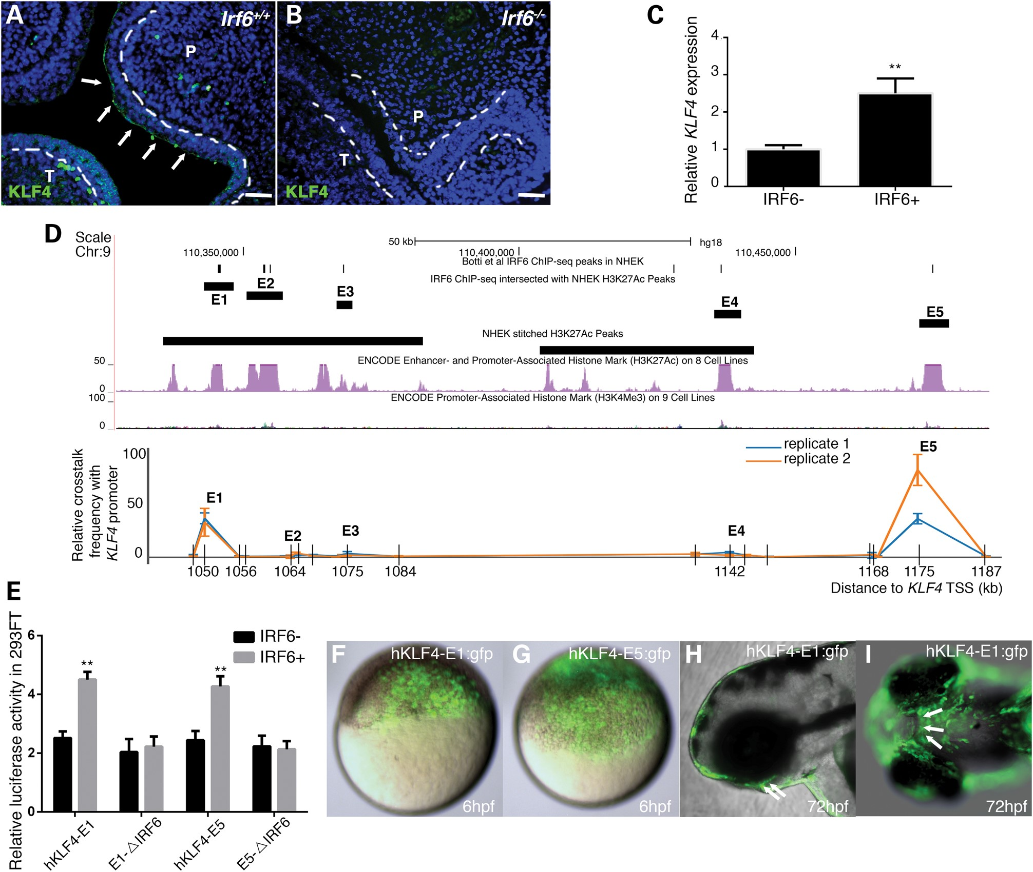
Figure 2. IRF6 directly promotes the expression of KLF4 through binding to super-enhancers of KLF4. (A and B) ...
Notes:
Figure 2. IRF6 directly promotes the expression of KLF4 through binding to super-enhancers of KLF4. (A and B) Representative image of anti-KLF4 immunofluorescence (green) and nuclear DNA (DAPI, blue) in coronal section of mouse E14.5 head of (A) wild-type (Irf6+/+) and (B) Irf6-null mice (Irf6−/−). Arrowheads, immunoreactivity in oral periderm in wild-types, absent from mutants. P, palate shelf; T, tongue. Bar, 50 µm. (C) Quantitation of KLF4 mRNA in oral epithelial cell line without and with over-expressed human IRF6. Asterisks indicate statistical significance compared with control plasmid-transfected group: **P < 0.01. (D) Quantitative chromosome configuration capture (3C) experiment with the anchoring (i.e. bait) primer in the promoter of KLF4. Upper panel: UCSC Genome Browser view of hKLF4 E1-E5, peaks of IRF6 binding according to ChIP-seq and positions of two NHEK super-enhancers 1000 kb downstream of the KLF4 TSS. Lower panel: results of chromatin conformation capture experiment in human oral epithelial cell line confirming physical crosstalk between KLF4-E1 and -E5 with KLF4 promoter. Grids in x-axis represent each EcoRI restriction site. (E) Dual luciferase reporter assays for KLF4 activity in 293FT cells validate that IRF6 can bind to the putative IRF6 binding sites in hKLF4-E1 and -E5 and increase their activities. Asterisks indicate statistical significance compared with the luciferase activity of empty luciferase reporter co-transfected with IRF6 plasmid: **P < 0.01. (F–H) Lateral or (I) ventral epifluorescence views of live, wild-type zebrafish embryos at the indicated stage, previously injected with the indicated reporter construct. Arrowheads, GFP expression in internal, oral epithelium cells.
Unless provided in the caption above, the following copyright applies to the content of this slide: © The Author 2015. Published by Oxford University Press.This is an Open Access article distributed under the terms of the Creative Commons Attribution Non-Commercial License (http://creativecommons.org/licenses/by-nc/4.0/), which permits non-commercial re-use, distribution, and reproduction in any medium, provided the original work is properly cited. For commercial re-use, please contact journals.permissions@oup.com

Slide 3
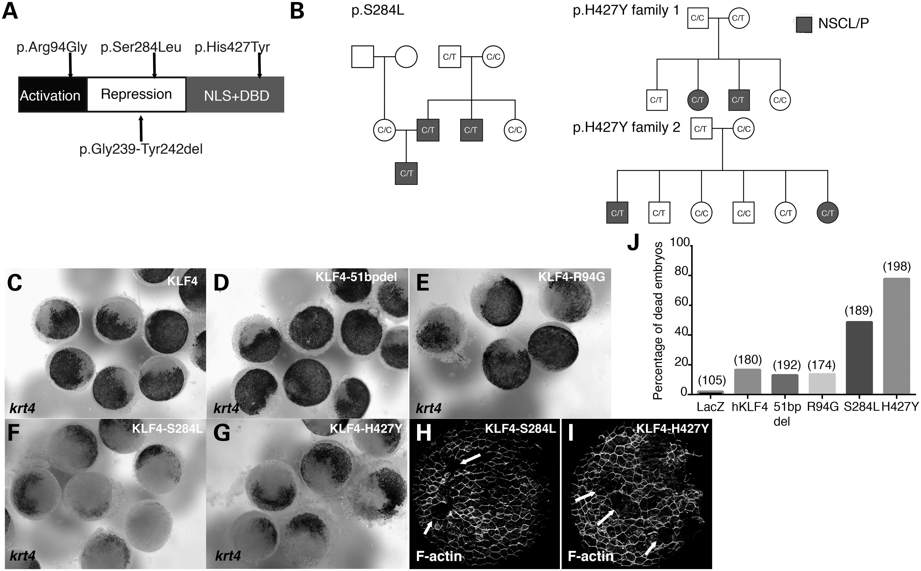
Figure 3. Rare NSCL/P alleles of KLF4 disrupt development of the zebrafish periderm. (A) Schematic representation of ...
Notes:
Figure 3. Rare NSCL/P alleles of KLF4 disrupt development of the zebrafish periderm. (A) Schematic representation of KLF4 protein. Positions of the rare, patient-derived variants predicted to be damaging by PolyPhen and SIFT are indicated above, and that of the common variant is indicated below. (B) Pedigrees of families with KLF4 p.S284L and p.H427Y variants. (C–I) Dorsal views of embryos, injected with the indicated mRNA and fixed at 5 hpf and processed to reveal (C–G) krt4 expression or (H and I) phalloidin stain. Arrows indicate periderm lacking phalloidin stain. (J) Quantification of embryos that died around 6 hpf when injected with the indicated mRNA. The numbers in parentheses indicate the total number of embryos for each group.
Unless provided in the caption above, the following copyright applies to the content of this slide: © The Author 2015. Published by Oxford University Press.This is an Open Access article distributed under the terms of the Creative Commons Attribution Non-Commercial License (http://creativecommons.org/licenses/by-nc/4.0/), which permits non-commercial re-use, distribution, and reproduction in any medium, provided the original work is properly cited. For commercial re-use, please contact journals.permissions@oup.com

