Slide 1
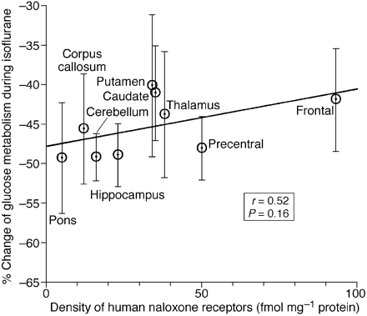
Fig 6 Regression plot showing a positive trend exists between the regional metabolic reductions occurring ...
Notes:
Fig 6 Regression plot showing a positive trend exists between the regional metabolic reductions occurring during isoflurane anaesthesia and the known regional opiate ([3H]naloxone) receptor densities. Note that the direction of the correlation is opposite of that shown for propofol in Figure 5.
Unless provided in the caption above, the following copyright applies to the content of this slide:

Slide 2
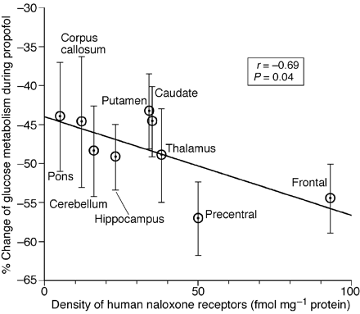
Fig 5 Regression plot showing a significant negative relationship between the regional metabolic reductions ...
Notes:
Fig 5 Regression plot showing a significant negative relationship between the regional metabolic reductions occurring during propofol anaesthesia and the known regional opiate ([3H]naloxone) receptor densities.
Unless provided in the caption above, the following copyright applies to the content of this slide:

Slide 3
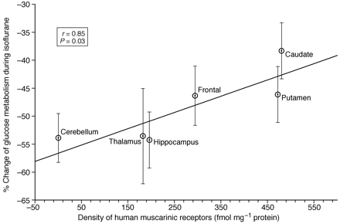
Fig 4 Regression plot showing a significant relationship between the regional metabolic reductions occurring ...
Notes:
Fig 4 Regression plot showing a significant relationship between the regional metabolic reductions occurring during isoflurane anaesthesia in humans and the known regional muscarinic acetylcholine ([3H]quinuclidinyl benzilate) receptor densities.
Unless provided in the caption above, the following copyright applies to the content of this slide:

Slide 4
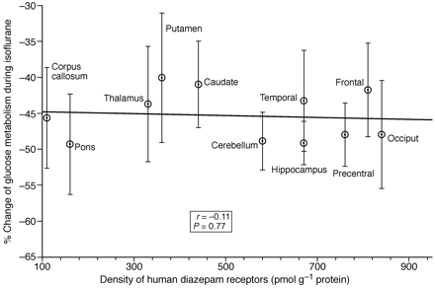
Fig 3 Regression plot showing an apparent lack of a significant relationship between the regional metabolic ...
Notes:
Fig 3 Regression plot showing an apparent lack of a significant relationship between the regional metabolic reductions occurring during isoflurane anaesthesia in humans and the known regional benzodiazepine ([3H]diazepam) receptor densities. These data do not directly support a GABAA complex mediated mechanism for the production of the anaesthetic state associated with isoflurane.
Unless provided in the caption above, the following copyright applies to the content of this slide:

Slide 5
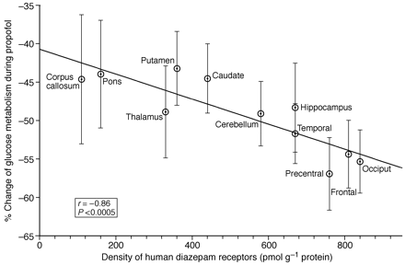
Fig 2 Regression plot showing a significant linear relationship between the regional metabolic reductions ...
Notes:
Fig 2 Regression plot showing a significant linear relationship between the regional metabolic reductions occurring during propofol anaesthesia in humans and the known regional benzodiazepine ([3H]diazepam) receptor densities. The figure shows that brain metabolism during propofol anaesthesia decreases more in those brain regions that have more benzodiazepine receptors. The line through the data is the regression line.
Unless provided in the caption above, the following copyright applies to the content of this slide:

Slide 6
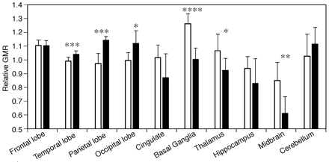
Fig 1 Brain regions where relative glucose metabolic rate values differ significantly between the i.v. ...
Notes:
Fig 1 Brain regions where relative glucose metabolic rate values differ significantly between the i.v. anaesthetic agent propofol (n=8), a presumed GABA agonist (white bars) and the inhalation anaesthetic agent isoflurane (n=5; dark bars). Data are mean (sd). *P<0.05; **P<0.01; ***P<0.001; ****P<0.0001.
Unless provided in the caption above, the following copyright applies to the content of this slide:

