Slide 1
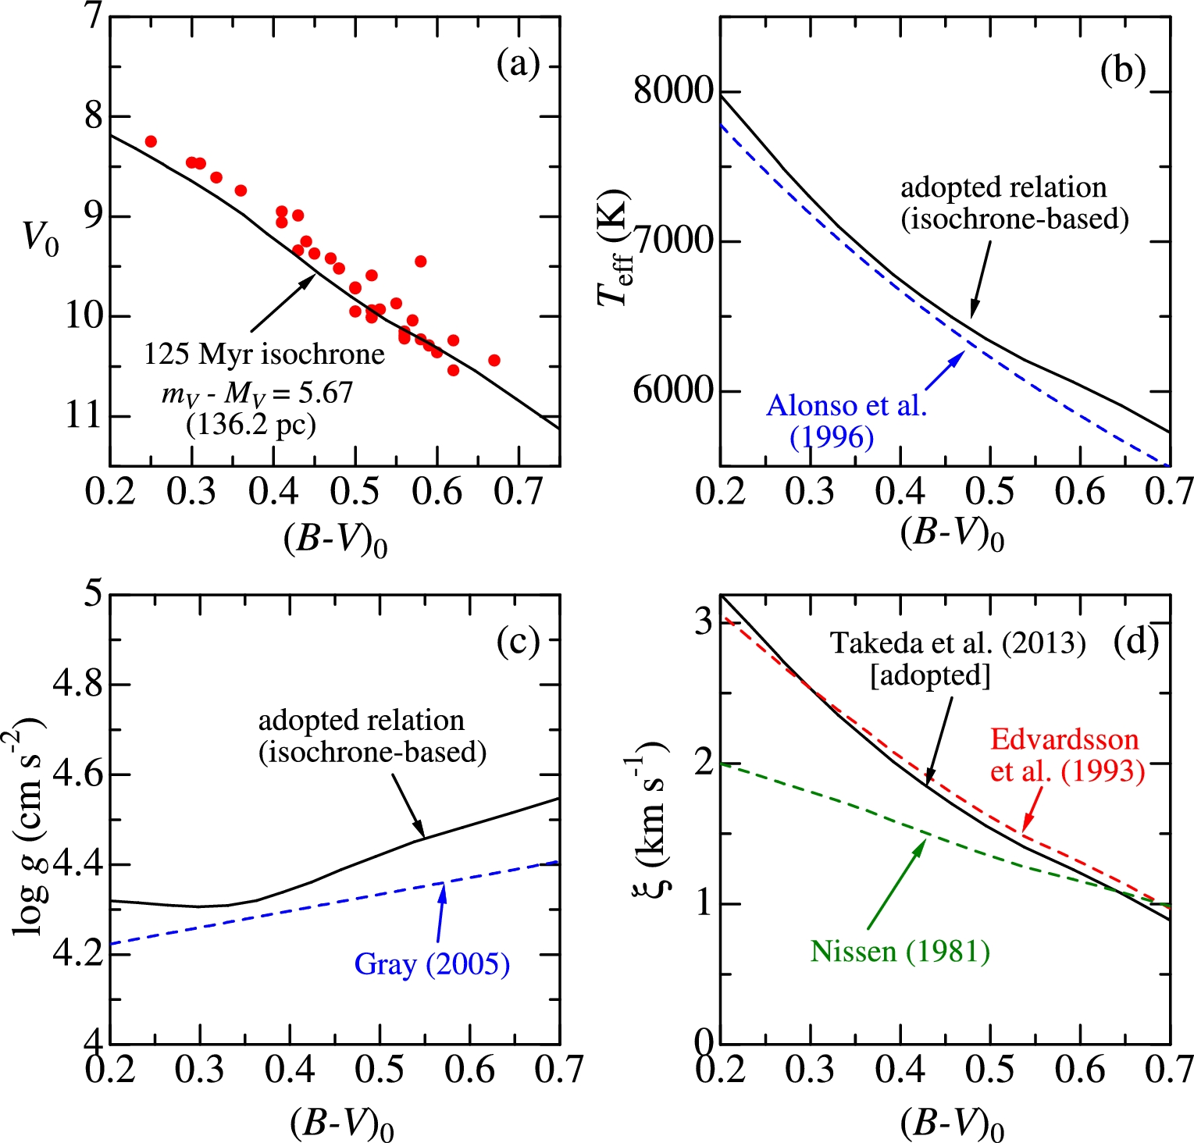
Fig. 1. (a) Solid lines: Theoretical PARSEC isochrone (Bressan et al. 2012, 2013) of solar-metallicity corresponding ...
Notes:
Fig. 1. (a) Solid lines: Theoretical PARSEC isochrone (Bressan et al. 2012, 2013) of solar-metallicity corresponding to the age of 125 Myr, which was converted from the absolute to apparent magnitude scale by using the Pleiades distance of 136.2 pc (Melis et al. 2014). Symbols: V0 vs. (B − V)0 diagram of the program stars, where the interstellar reddening effect was corrected by assuming EB − V = AV/3.1 = 0.03. (b) Isochrone-based Teff vs. (B − V)0 relation adopted for the Pleiades stars (solid line) compared with Alonso et al.'s (1996) empirical calibration for the case of [Fe/H] = 0 (dashed line). (c) Isochrone-based log g vs. (B − V)0 relation adopted for the Pleiades stars (solid lines), compared with Gray's (2005) empirical relation for dwarfs [log g = 4.15 + 0.368(B − V)0; dashed line]. (d) Adopted ξ vs. (B − V)0 relation corresponding to the empirical ξ(Teff, log g) formula derived in Paper I (solid line), compared with those of Edvardsson et al. (1993) and Nissen (1981) (dashed lines). (Color online)
Unless provided in the caption above, the following copyright applies to the content of this slide: © The Author 2016. Published by Oxford University Press on behalf of the Astronomical Society of Japan. All rights reserved. For Permissions, please email: journals.permissions@oup.com

Slide 2
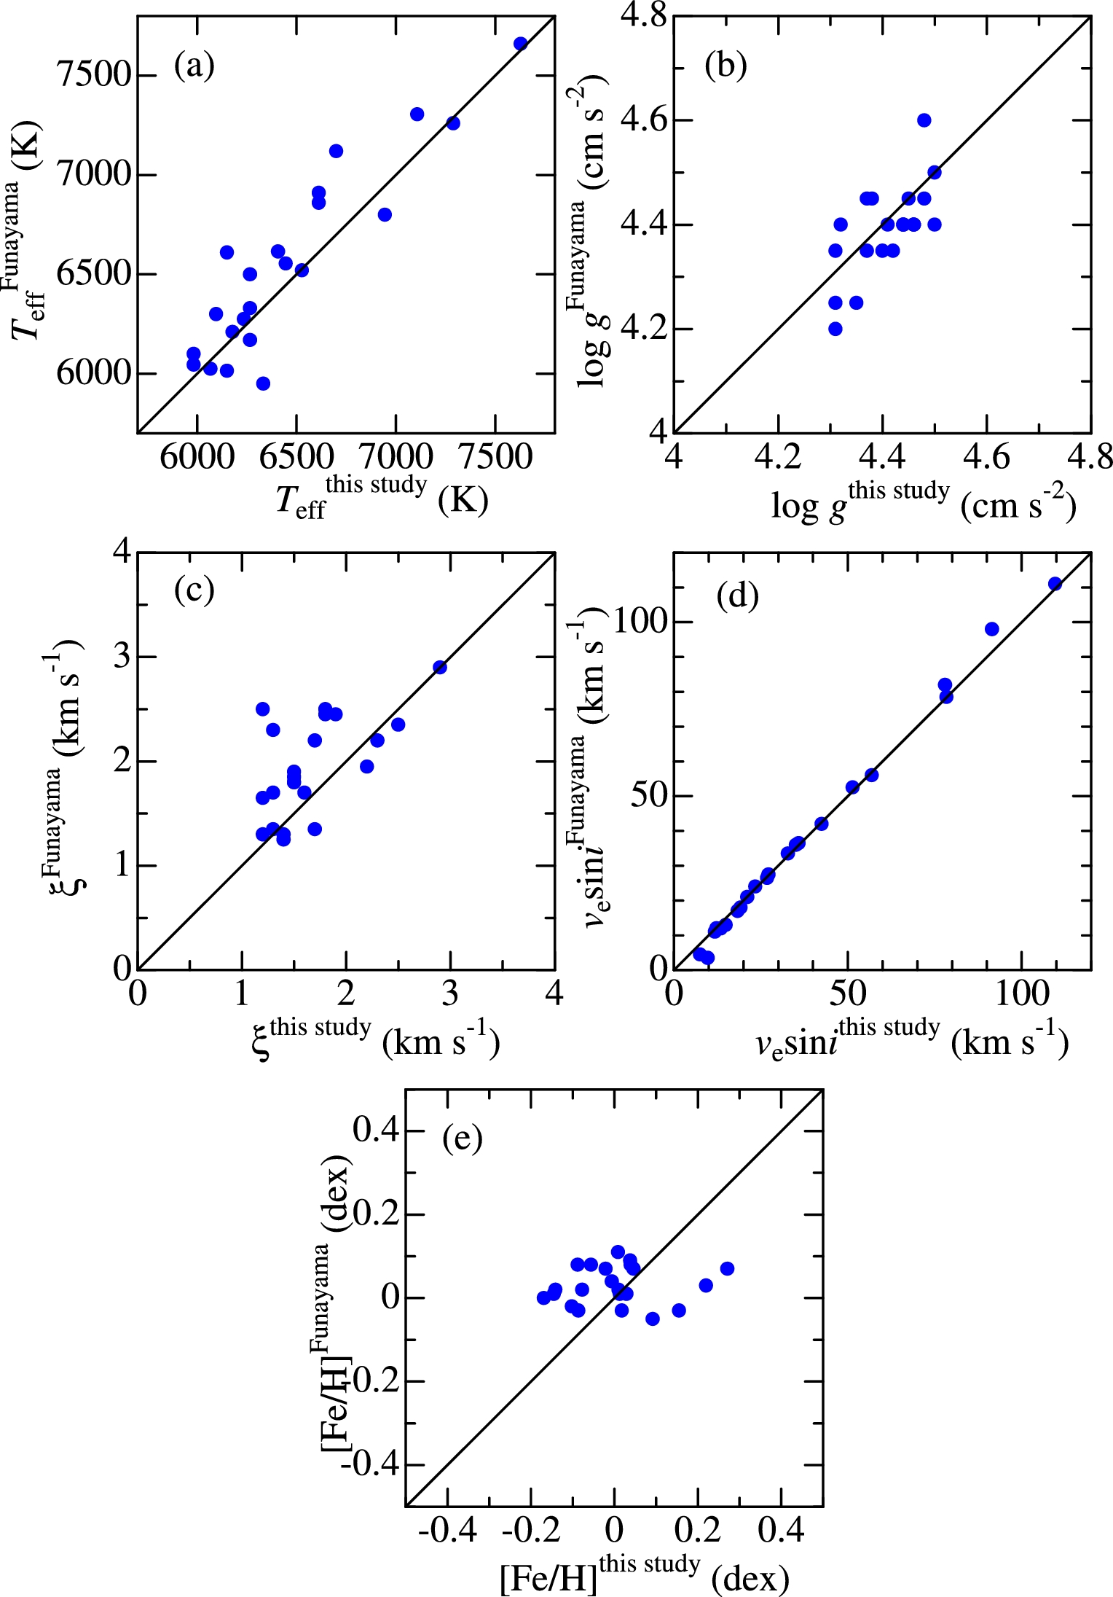
Fig. 2. Comparison of the parameters adopted in this study (as given in table 2) with those derived spectroscopically ...
Notes:
Fig. 2. Comparison of the parameters adopted in this study (as given in table 2) with those derived spectroscopically by Funayama et al. (2009). (a) Teff, (b) log g, (c) ξ, (d) vesin i, and (e) [Fe/H]. (Color online)
Unless provided in the caption above, the following copyright applies to the content of this slide: © The Author 2016. Published by Oxford University Press on behalf of the Astronomical Society of Japan. All rights reserved. For Permissions, please email: journals.permissions@oup.com

Slide 3
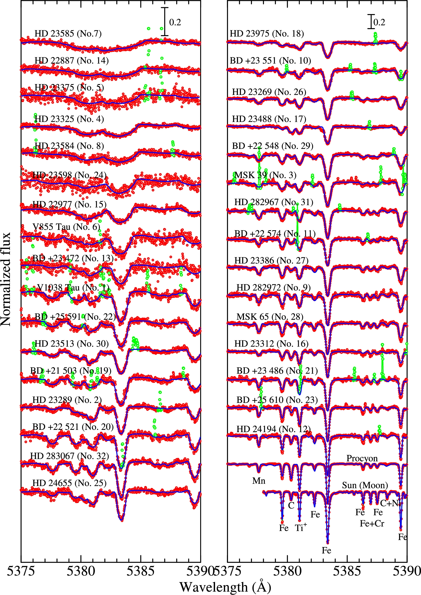
Fig. 3. Synthetic spectrum fitting for the 32 program stars (as well as Procyon and the Sun/Moon) at the 5375–5390 Å ...
Notes:
Fig. 3. Synthetic spectrum fitting for the 32 program stars (as well as Procyon and the Sun/Moon) at the 5375–5390 Å region, which was accomplished by adjusting the abundances of C, Ti, Mn, and Fe along with the macrobroadening parameter (vesin i). The best-fitting theoretical spectra are shown by blue solid lines, while the observed data are plotted using red symbols (those that were masked/disregarded in the fitting are highlighted in green). In each panel, the spectra are arranged in order of descending of vesin i (cf. table 2), and an appropriate offset (0.2, left panel; 0.4 right panel) is applied to each spectrum relative to the adjacent one. Note that the vertical scale in the left-had panel is twice as magnified as that of the right-hand panel. The wavelength scale is adjusted to the laboratory frame by correcting the radial-velocity shift. (Color online)
Unless provided in the caption above, the following copyright applies to the content of this slide: © The Author 2016. Published by Oxford University Press on behalf of the Astronomical Society of Japan. All rights reserved. For Permissions, please email: journals.permissions@oup.com

Slide 4
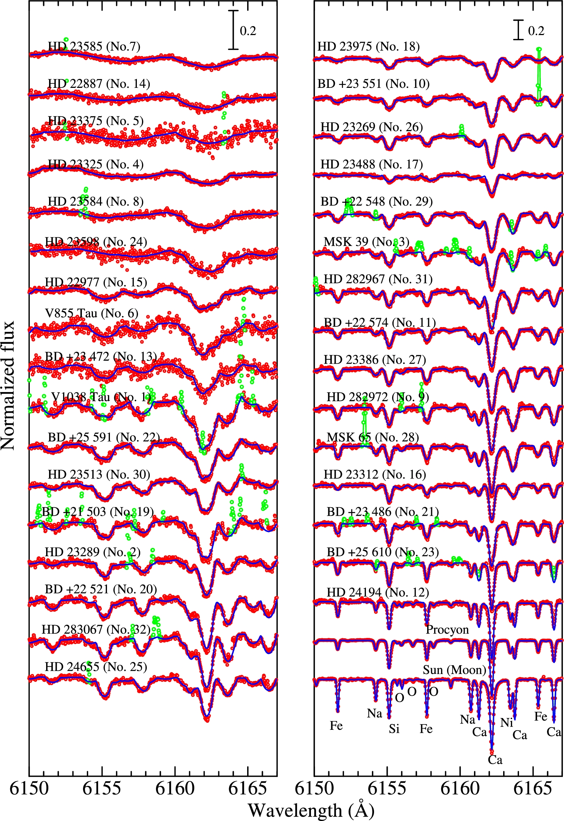
Fig. 4. Synthetic spectrum fitting for the 32 program stars (as well as Procyon and the Sun/Moon) at the 6150–6167 Å ...
Notes:
Fig. 4. Synthetic spectrum fitting for the 32 program stars (as well as Procyon and the Sun/Moon) at the 6150–6167 Å region, which was accomplished by adjusting the abundances of O, Na, Si, Ca, Fe, and Ni along with the macrobroadening parameter (vesin i). Otherwise, the same as in figure 3. (Color online)
Unless provided in the caption above, the following copyright applies to the content of this slide: © The Author 2016. Published by Oxford University Press on behalf of the Astronomical Society of Japan. All rights reserved. For Permissions, please email: journals.permissions@oup.com

Slide 5
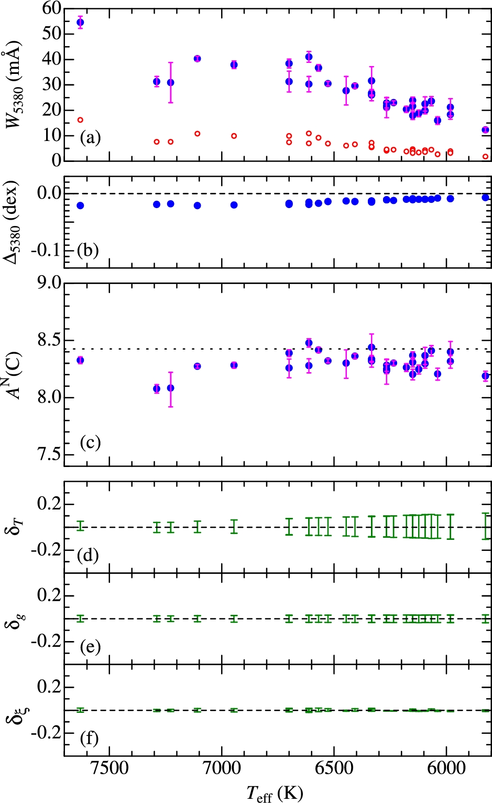
Fig. 5. C i 5380-related quantities plotted against T_{eff}. (a) W₅₃₈₀ (equivalent width of the ...
Notes:
Fig. 5. C i 5380-related quantities plotted against Teff. (a) W5380 (equivalent width of the C i 5380.325 line [filled symbols] and the C i 5380.227 line [open symbols] inversely computed with the abundance solution derived from fitting), (b) Δ5380 (non-LTE correction for the C i 5380.325 line), (c) AN(C) (non-LTE abundance derived from W5380.325), (d) δT ± (abundance changes in response to Teff variations by ± 200 K), (e) δg ± (abundance changes in response to log g variations by ± 0.1 dex), and (f) δξ ± and (abundance change in response to ξ variations by ± 0.5 km s−1). The signs of δ terms concerning the variations of Teff, log g, and ξ are δT + < 0, δT − > 0, δg + > 0, δg − < 0, δξ + < 0, and δξ − > 0. The error bars attached to each of the symbols in panels (a) and (c) denote the S/N-related uncertainties in equivalent widths (± δW) estimated by Cayrel's (1988) relation and the corresponding abundance errors (δW + and δW −), respectively. Note that the ordinate scale of panel (b) is five times as expanded as that of panels (c)–(f). The dotted line in panel (c) denotes the reference solar C abundance of 8.43 (cf. subsection 4.3). (Color online)
Unless provided in the caption above, the following copyright applies to the content of this slide: © The Author 2016. Published by Oxford University Press on behalf of the Astronomical Society of Japan. All rights reserved. For Permissions, please email: journals.permissions@oup.com

Slide 6
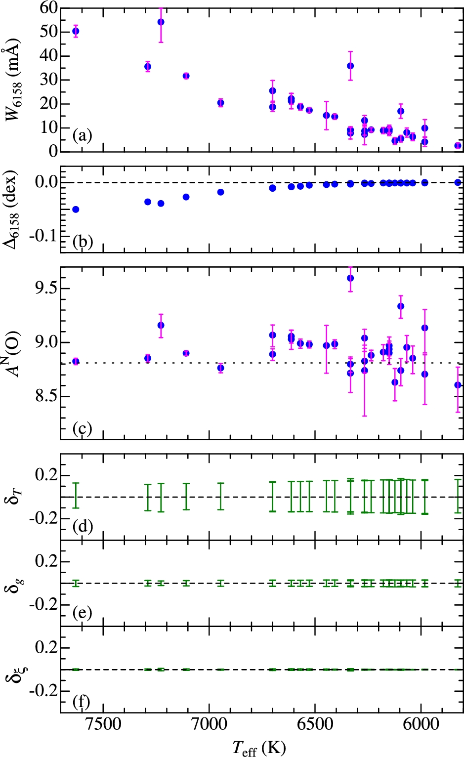
Fig. 6. O i 6158-related quantities plotted against T_{eff}. (a) W₆₁₅₈ (equivalent width of the ...
Notes:
Fig. 6. O i 6158-related quantities plotted against Teff. (a) W6158 (equivalent width of the O i 6158 line (comprising three components) inversely computed with the abundance solution derived from fitting), (b) Δ6158 (non-LTE correction for O i 6158), (c) AN(O) (non-LTE abundance derived from W6158), (d) δT ± (abundance changes in response to Teff variations by ± 200 K), (e) δg ± (abundance changes in response to log g variations by ±0.1 dex), and (f) δξ ± (abundance change in response to ξ variations by ± 0.5 km s−1). The dotted line in panel (c) denotes the reference solar O abundance of 8.81 (cf. footnote 8). Otherwise, the same as in figure 5. (Color online)
Unless provided in the caption above, the following copyright applies to the content of this slide: © The Author 2016. Published by Oxford University Press on behalf of the Astronomical Society of Japan. All rights reserved. For Permissions, please email: journals.permissions@oup.com

Slide 7
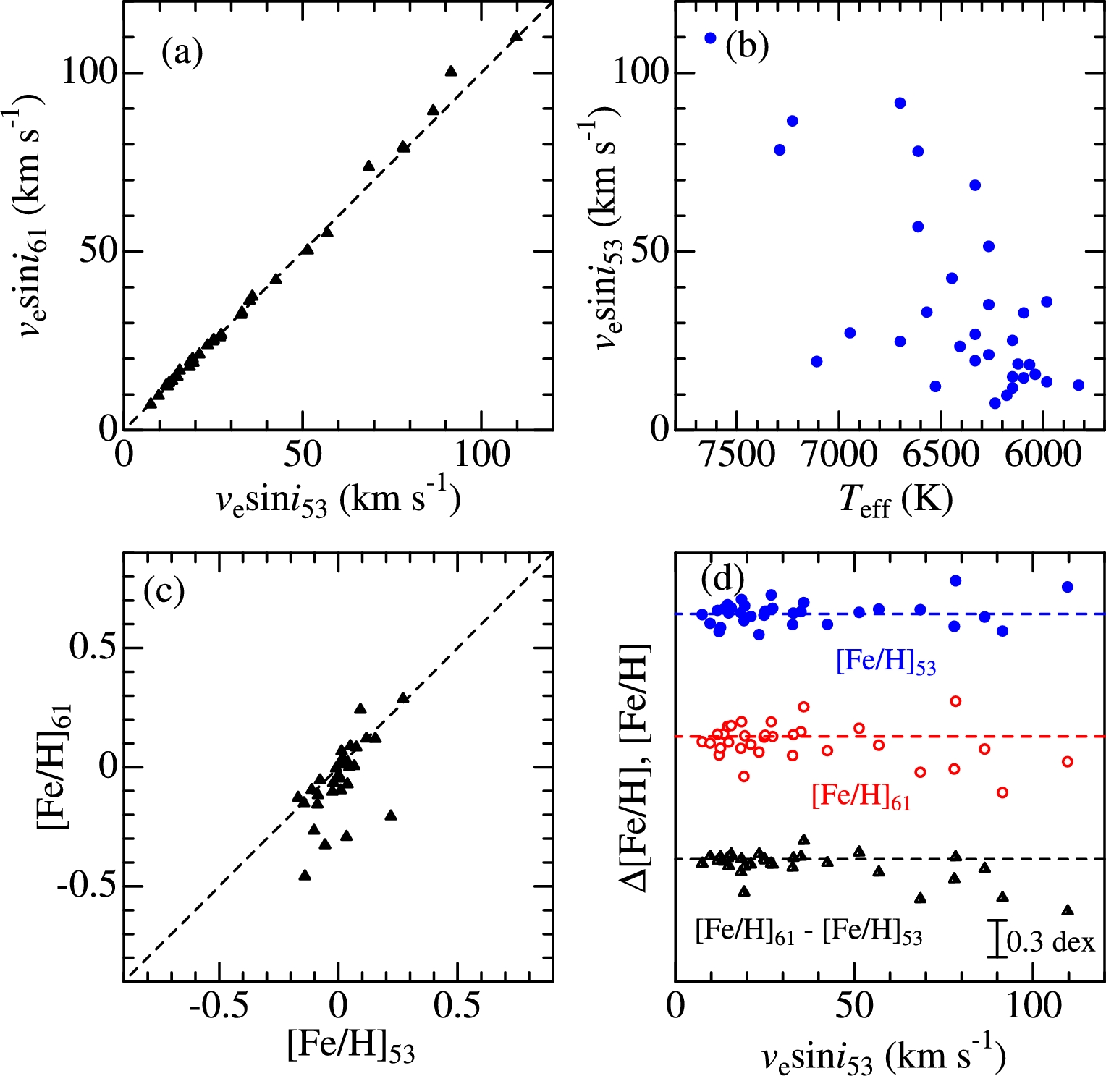
Fig. 7. (a) Comparison of the v_{e}sin i values derived from 5375–5390 Å fitting ...
Notes:
Fig. 7. (a) Comparison of the vesin i values derived from 5375–5390 Å fitting (vesin i53; abscissa) with those from 6150–6167 Å fitting (vesin i61; ordinate). (b) vesin i53 values plotted against Teff. (c) Comparison of the [Fe/H] values derived from 5375–5390 Å fitting ([Fe/H]53; abscissa) with those from 6150–6167 Å fitting ([Fe/H]61; ordinate). (d) [Fe/H]53 (upper), [Fe/H]61 (middle), and their difference ([Fe/H]61 − [Fe/H]53; lower) plotted against vesin i53. The horizontal dashed lines indicate the zero position for each case. (Color online)
Unless provided in the caption above, the following copyright applies to the content of this slide: © The Author 2016. Published by Oxford University Press on behalf of the Astronomical Society of Japan. All rights reserved. For Permissions, please email: journals.permissions@oup.com

Slide 8
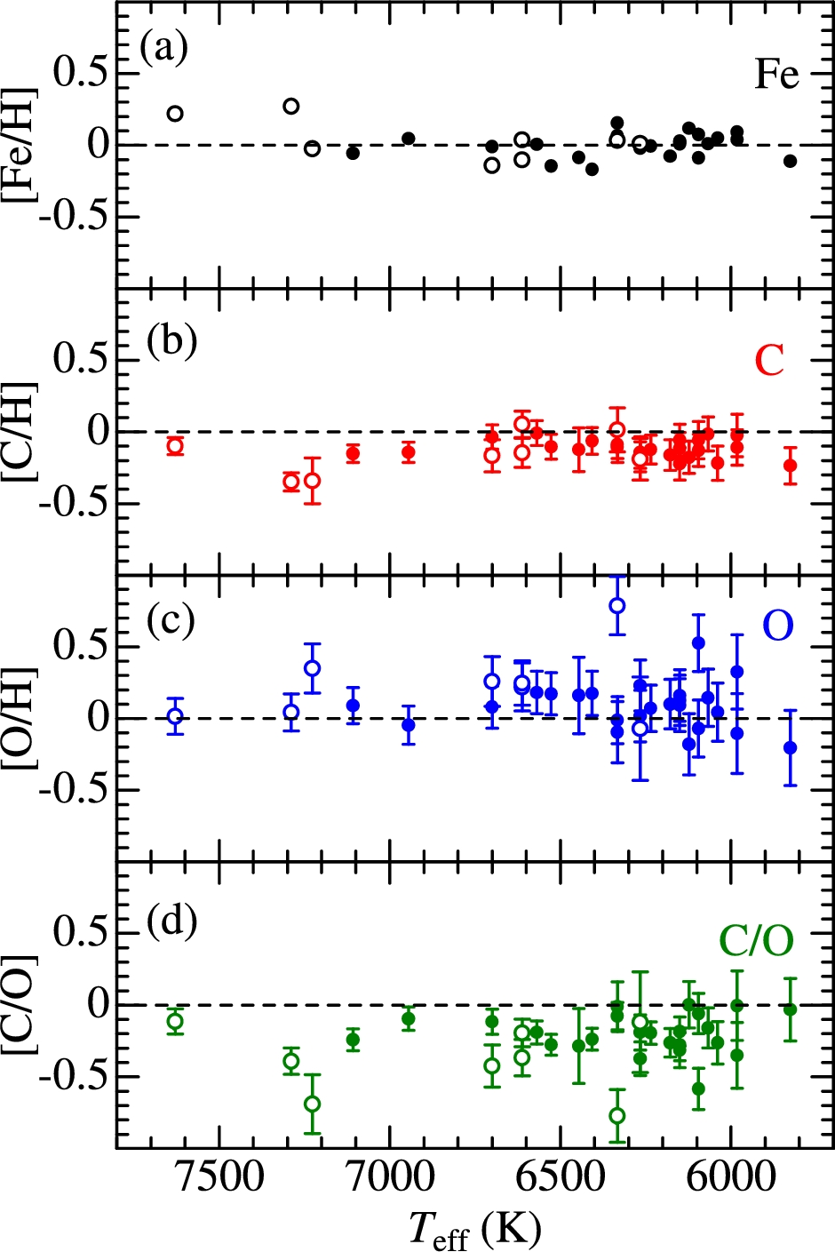
Fig. 8. Logarithmic relative abundances plotted against T_{eff}. (a) [Fe/H], (b) [C/H], (c) [O/H], and (d) ...
Notes:
Fig. 8. Logarithmic relative abundances plotted against Teff. (a) [Fe/H], (b) [C/H], (c) [O/H], and (d) [C/O] (≡ [C/H] − [O/H]), based on the data presented in table 2. Filled circles denote stars with vesin i < 50 km s−1, while open circles correspond to those with vesin i > 50 km s−1. The error bar (± δTgξW) attached to each symbol in panels (b) and (c) is defined in terms of the quantities introduced in subsection 4.2 (cf. the caption in figure 5) as $\delta _{Tg\xi W} \equiv \sqrt{\delta _{T}^{2} + \delta _{g}^{2} + \delta _{\xi }^{2} + \delta _{W}^{2}}$, where δT ≡ (|δT +| + |δT −|)/2, δg ≡ (|δg +| + |δg −|)/2, δξ ≡ (|δξ +| + |δξ −|)/2, and δW ≡ (|δW +| + |δW −)|/2. Meanwhile, the error bar (± ΔTgξW) in panel (d) is defined differently (because C/O ratio is concerned and parameter sensitivity tends to be canceled) as: $\Delta _{Tg\xi W} \equiv \sqrt{(\delta ^{\rm C/O}_{T})^{2} + (\delta ^{\rm C/O}_{g})^{2} + (\delta ^{\rm C/O}_{\xi })^{2} + (\delta ^{\rm C}_{W})^{2} + (\delta ^{\rm O}_{W})^{2}}$, where $\delta ^{\rm C/O}_{T} \equiv (|\delta ^{\rm C}_{T+}-\delta ^{\rm O}_{T+}|+|\delta ^{\rm C}_{T-}-\delta ^{\rm O}_{T-}|)/2$, $\delta ^{\rm C/O}_{g} \equiv (|\delta ^{\rm C}_{g+}-\delta ^{\rm O}_{g+}|+|\delta ^{\rm C}_{g-}-\delta ^{\rm O}_{g-}|)/2$, and $\delta ^{\rm C/O}_{\xi } \equiv (|\delta ^{\rm C}_{\xi +}-\delta ^{\rm O}_{\xi +}|+|\delta ^{\rm C}_{\xi -}-\delta ^{\rm O}_{\xi -}|)/2$. (Color online)
Unless provided in the caption above, the following copyright applies to the content of this slide: © The Author 2016. Published by Oxford University Press on behalf of the Astronomical Society of Japan. All rights reserved. For Permissions, please email: journals.permissions@oup.com

Slide 9
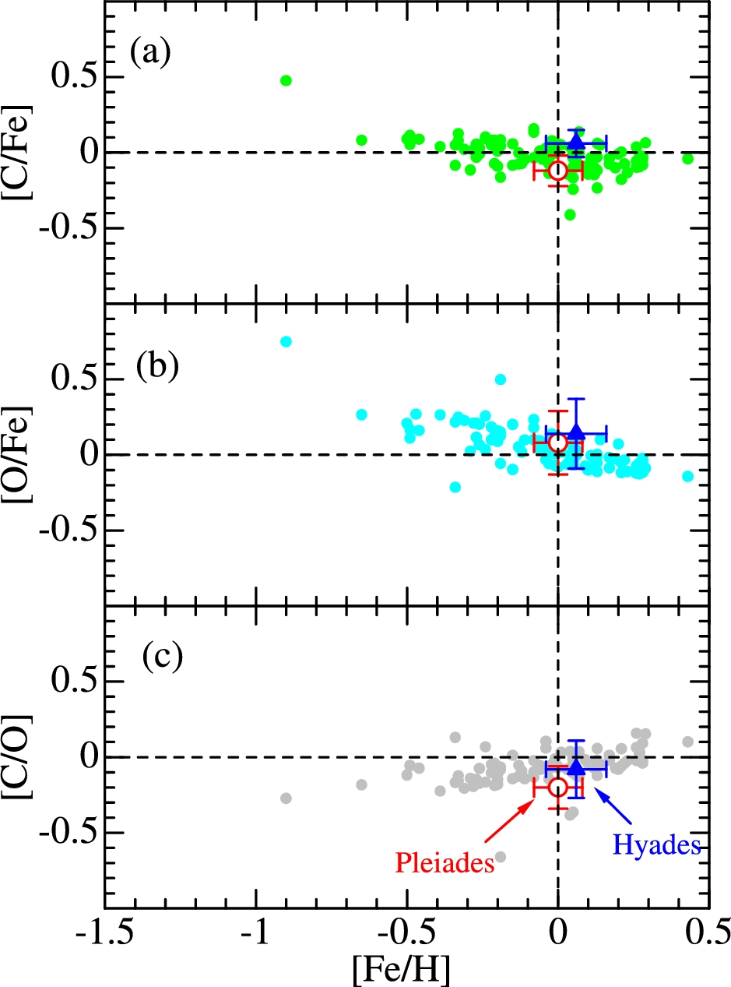
Fig. 9. Distributions of [C/Fe] (panel a), [O/Fe] (panel b), and [C/O] (panel c) plotted against [Fe/H] for Pleiades ...
Notes:
Fig. 9. Distributions of [C/Fe] (panel a), [O/Fe] (panel b), and [C/O] (panel c) plotted against [Fe/H] for Pleiades stars (mean; large open circle; from this study), Hyades stars (mean; large filled triangle; from Paper I) and field F–G stars (small filled circles; from Takeda & Honda 2005). In order to make the three data sets as consistent with each other as possible, the data selections were made according to the following conditions: Pleiades data; stars for vesin i < 50 km s−1, Hyades data; stars for Teff > 5800 K, and field-star data; stars for Teff > 5800 K (only data based on C i 5380 and O i 6158 lines were used). The error bars attached to Pleiades and Hyades data denote the standard deviations. (Color online)
Unless provided in the caption above, the following copyright applies to the content of this slide: © The Author 2016. Published by Oxford University Press on behalf of the Astronomical Society of Japan. All rights reserved. For Permissions, please email: journals.permissions@oup.com

Slide 10
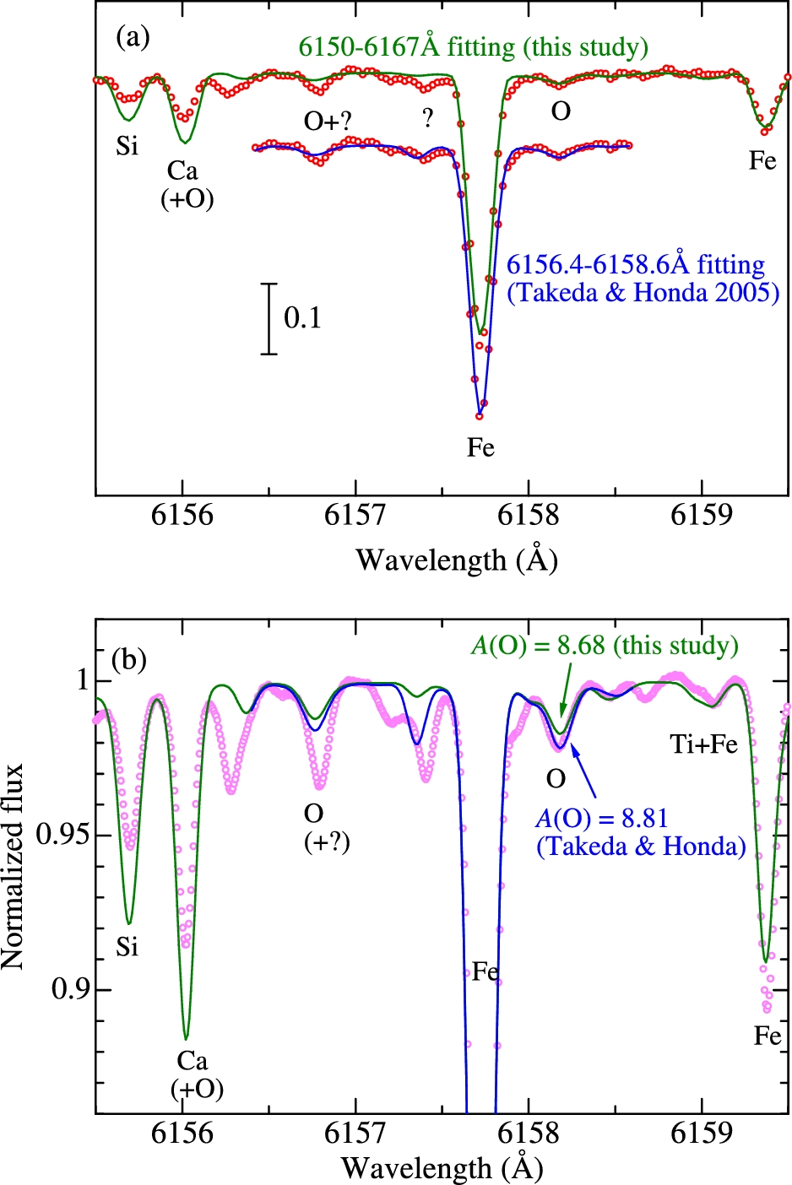
Fig. 10. (a) Comparison of two spectrum fittings in the region of O i 6156–8 lines for solar O abundance determination ...
Notes:
Fig. 10. (a) Comparison of two spectrum fittings in the region of O i 6156–8 lines for solar O abundance determination done in this study (wide 6150–6167 Å region) and in Takeda and Honda (2005) (narrow 6156.4–6158.6 Å region with adjusted strengths of Ti lines to reproduce the 6157.4 Å feature), where open circles and lines represent the Moon spectrum (Takeda et al. 2005a) and the fitted theoretical spectra, respectively. (b) Simulated solar spectra (lines) corresponding to the abundance solutions derived in this study and in Takeda and Honda (2005) (convolved with a Gaussian function with an e-folding width of 2.5 km s−1) in comparison of Kurucz et al.'s (1984) solar flux spectrum (its continuum position is slightly raised, by 0.5%, in order to match the theoretical spectra). (Color online)
Unless provided in the caption above, the following copyright applies to the content of this slide: © The Author 2016. Published by Oxford University Press on behalf of the Astronomical Society of Japan. All rights reserved. For Permissions, please email: journals.permissions@oup.com

Slide 11
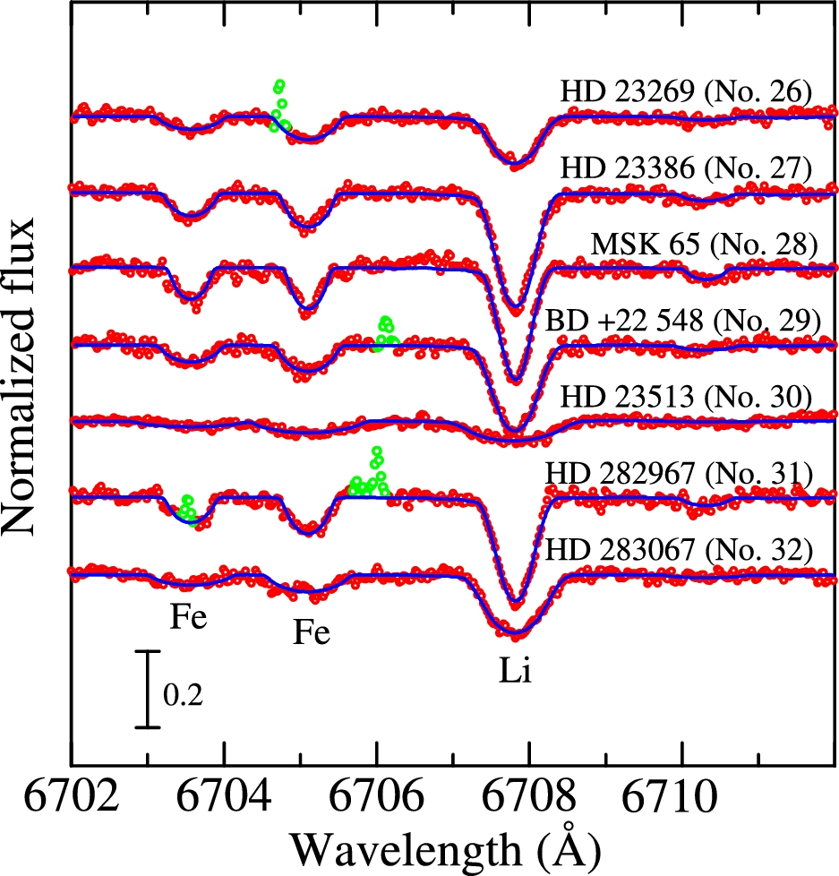
Fig. 11. Synthetic spectrum-fitting at the 6702–6712 Å region for seven stars, for which spectra at the Li i 6708 line ...
Notes:
Fig. 11. Synthetic spectrum-fitting at the 6702–6712 Å region for seven stars, for which spectra at the Li i 6708 line are available (i.e., GAOES data in the 2015–2016 season; cf. table 1). The best fit was accomplished by adjusting the abundances of Li and Fe along with the macrobroadening parameter (vesin i). The spectra are arranged according to the object number (cf. table 1). An appropriate offset of 0.2 is applied to each spectrum relative to the adjacent one. Otherwise, the same as in figure 3. (Color online)
Unless provided in the caption above, the following copyright applies to the content of this slide: © The Author 2016. Published by Oxford University Press on behalf of the Astronomical Society of Japan. All rights reserved. For Permissions, please email: journals.permissions@oup.com

