Slide 1
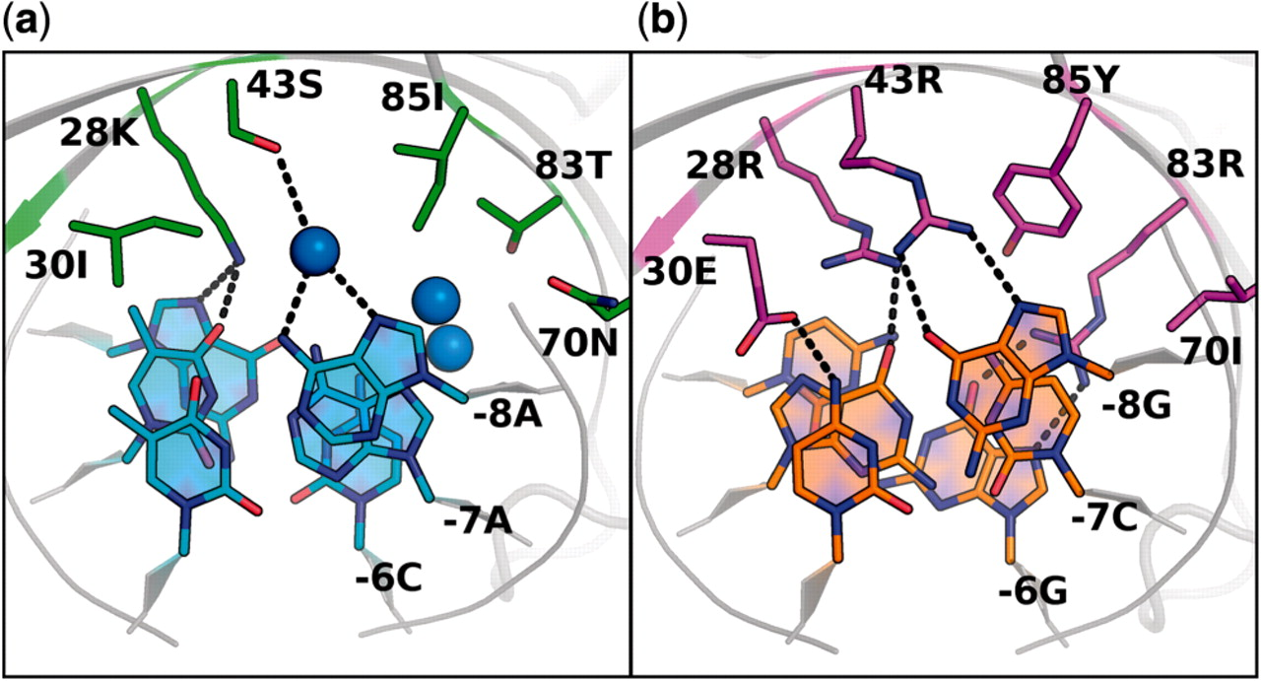
Figure 1. Amino acid base interactions in wild-type and designed complexes. The interactions between amino acid ...
Notes:
Figure 1. Amino acid base interactions in wild-type and designed complexes. The interactions between amino acid residues 28, 30, 43, 70, 83, 85 and DNA bases −8, −7, −6 are shown. Blue spheres are crystallographic water molecules. Dashed lines depict selected hydrogen-bonding interactions. (a) Wild-type I-MsoI interactions observed in the original crystal structure (pdb: 1M5X). (b) Predicted model of computationally designed interactions between novel amino acids and DNA bases for the I-MsoI ‘GCG’ design.
Unless provided in the caption above, the following copyright applies to the content of this slide: © The Author(s) 2010. Published by Oxford University Press.This is an Open Access article distributed under the terms of the Creative Commons Attribution Non-Commercial License (http://creativecommons.org/licenses/by-nc/2.5), which permits unrestricted non-commercial use, distribution, and reproduction in any medium, provided the original work is properly cited.

Slide 2
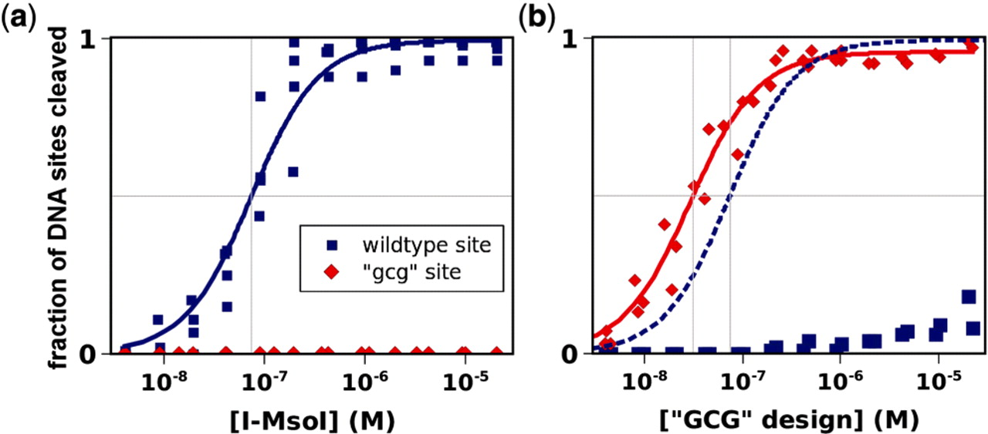
Figure 2. Complete switch of activity and specificity for three novel adjacent base pairs by computational design of ...
Notes:
Figure 2. Complete switch of activity and specificity for three novel adjacent base pairs by computational design of I-MsoI. The cleavage of either the wild-type site (blue) or the designed ‘gcg’ site (red) is plotted as a function of the endonuclease concentrations of wild-type I-MsoI (a) and the I-MsoI ‘GCG’ design (b). Data are densitometric measurements of ethidium bromide-stained agarose-electrophoresed DNA cleavage products. The data were fit to determine the endonuclease concentrations that correspond to half-maximal cleavage (EC50, gray lines). In (b), the best fit to the wild-type data in (a) is shown in dashed lines for comparison.
Unless provided in the caption above, the following copyright applies to the content of this slide: © The Author(s) 2010. Published by Oxford University Press.This is an Open Access article distributed under the terms of the Creative Commons Attribution Non-Commercial License (http://creativecommons.org/licenses/by-nc/2.5), which permits unrestricted non-commercial use, distribution, and reproduction in any medium, provided the original work is properly cited.

Slide 3
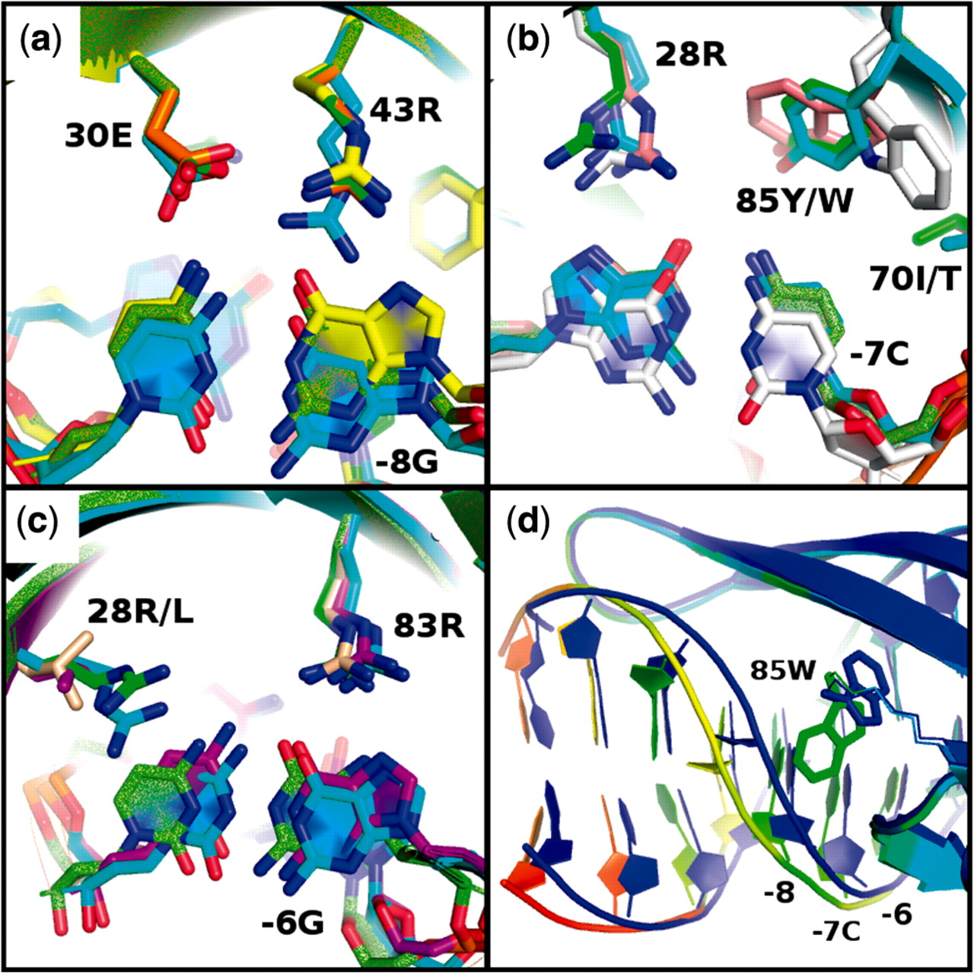
Figure 3. Comparison of designed and crystallographically observed interactions. (a–c) the crystal structure of the ...
Notes:
Figure 3. Comparison of designed and crystallographically observed interactions. (a–c) the crystal structure of the triple-base pair I-MsoI ‘GCG’ design (cyan) is aligned with the designed model (green) and with the crystal structures and designed models of each single-base pair design: (a) I-MsoI ‘−8G’ (X-ray: yellow, model: orange), (b) I-MsoI ‘−7C’ (X-ray: white, model: pink), (c) I-MsoI ‘−6G’ (X-ray: purple, model: beige). (d) A conformational shift in the DNA backbone is observed near Trp85 in the I-MsoI ‘−7C’ crystal structure (colored by increasing B-factor from light blue to red), compared to the designed model (dark blue).
Unless provided in the caption above, the following copyright applies to the content of this slide: © The Author(s) 2010. Published by Oxford University Press.This is an Open Access article distributed under the terms of the Creative Commons Attribution Non-Commercial License (http://creativecommons.org/licenses/by-nc/2.5), which permits unrestricted non-commercial use, distribution, and reproduction in any medium, provided the original work is properly cited.

Slide 4
Figure 4. Designed specific cleavage activity for an asymmetric four-base pair cluster. In vitro cleavage of wild-type ...
Notes:
Figure 4. Designed specific cleavage activity for an asymmetric four-base pair cluster. In vitro cleavage of wild-type (blue) and asymmetric ‘tgcg’ (red) DNA sites by monomerized I-MsoI (mMsoI) endonuclease designs. (a) wild-type mMsoI endonuclease, (b) N-terminal mMsoI ‘GCG’ design, (c) N-terminal mMsoI ‘TGCG’ design. Dashed lines in (b and c) represent the mMsoI trace from (a). Data are densitometric measurements of ethidium bromide-stained agarose-electrophoresed DNA cleavage products (Supplementary Figure S5).
Unless provided in the caption above, the following copyright applies to the content of this slide: © The Author(s) 2010. Published by Oxford University Press.This is an Open Access article distributed under the terms of the Creative Commons Attribution Non-Commercial License (http://creativecommons.org/licenses/by-nc/2.5), which permits unrestricted non-commercial use, distribution, and reproduction in any medium, provided the original work is properly cited.

