Slide 1
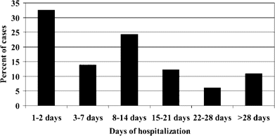
Figure 1 Time, in days, to onset of candidal bloodstream infection after hospital admission in 230 hospitalized ...
Notes:
Figure 1 Time, in days, to onset of candidal bloodstream infection after hospital admission in 230 hospitalized patients with candidemia. Patients who had bloodstream infections within 1–2 days after hospital admission were transferred from another hospital.
Unless provided in the caption above, the following copyright applies to the content of this slide: © 2006 by the Infectious Diseases Society of America

Slide 2
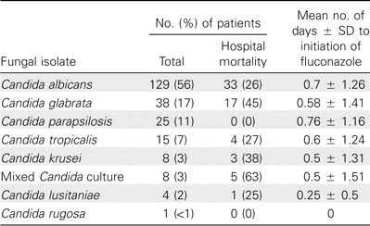
Table 1 Yeast isolates from patients with candidemia.
Notes:
Table 1 Yeast isolates from patients with candidemia.
Unless provided in the caption above, the following copyright applies to the content of this slide: © 2006 by the Infectious Diseases Society of America

Slide 3
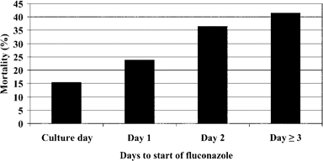
Figure 2 Relationship between hospital mortality and the number of days to initiation of fluconazole therapy. We ...
Notes:
Figure 2 Relationship between hospital mortality and the number of days to initiation of fluconazole therapy. We calculated the days to the start of fluconazole therapy by subtracting the start date of fluconazole therapy from the culture date of the first blood sample positive for yeast (P = .0009 for trend, using the Mantel-Haenszel χ2 test).
Unless provided in the caption above, the following copyright applies to the content of this slide: © 2006 by the Infectious Diseases Society of America

Slide 4
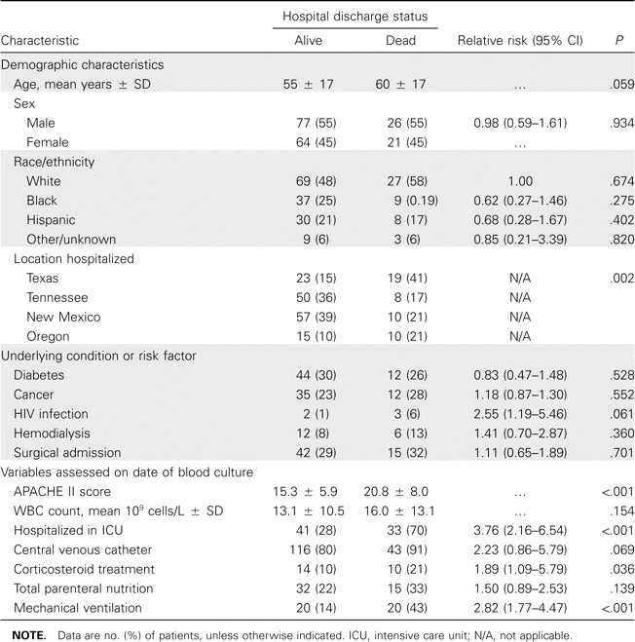
Table 2 Characteristics of 192 patients with candidemia and their relationship to hospital mortality.
Notes:
Table 2 Characteristics of 192 patients with candidemia and their relationship to hospital mortality.
Unless provided in the caption above, the following copyright applies to the content of this slide: © 2006 by the Infectious Diseases Society of America

Slide 5
Table 3 Multivariate model of independent risk factors for hospital mortality.
Notes:
Table 3 Multivariate model of independent risk factors for hospital mortality.
Unless provided in the caption above, the following copyright applies to the content of this slide: © 2006 by the Infectious Diseases Society of America

Slide 6
Table 4 Duration of hospitalization and length of intensive care unit stay in relation to time to initiation of ...
Notes:
Table 4 Duration of hospitalization and length of intensive care unit stay in relation to time to initiation of fluconazole and discharge status.
Unless provided in the caption above, the following copyright applies to the content of this slide: © 2006 by the Infectious Diseases Society of America

