Slide 1
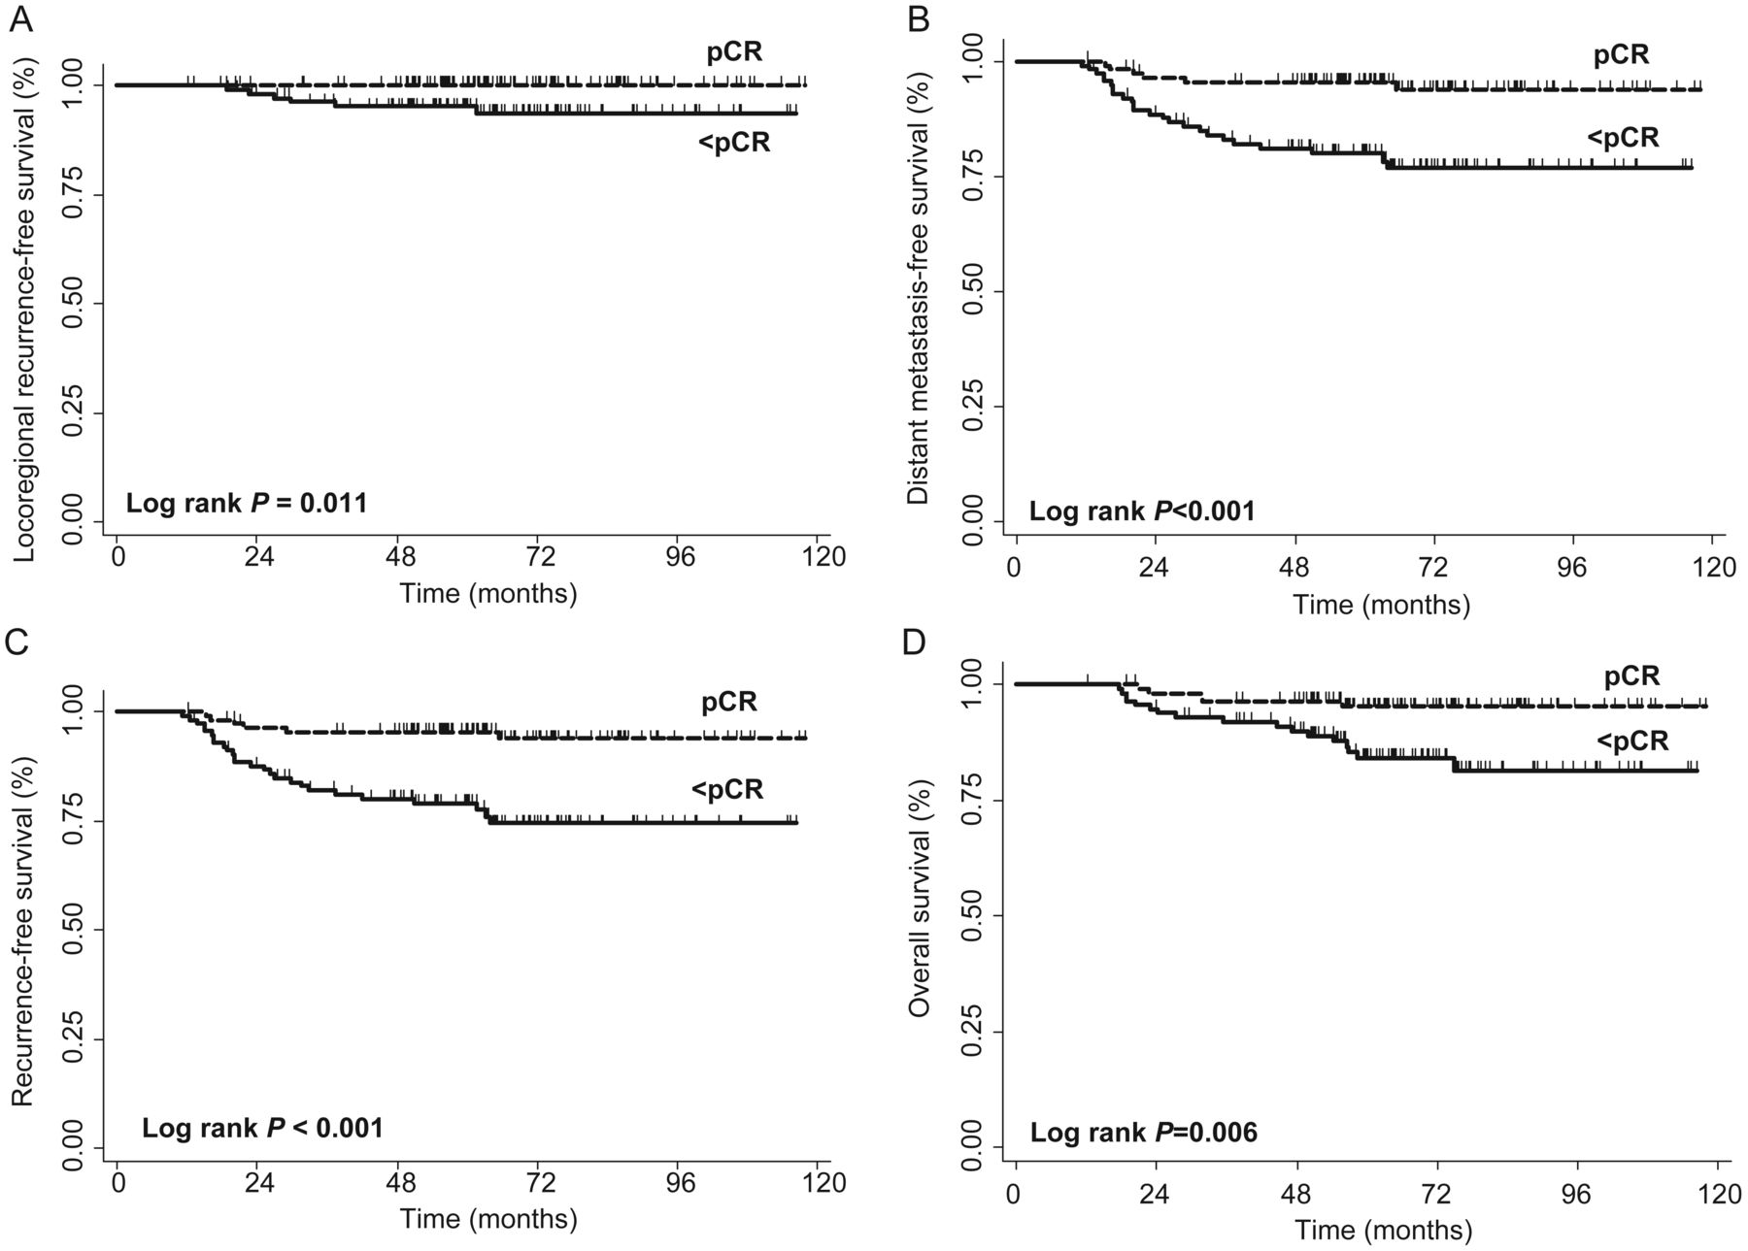
Figure 1. Kaplan–Meier curves of (A) locoregional recurrence-free, (B) distant metastasis-free, (C) recurrence-free, ...
Notes:
Figure 1. Kaplan–Meier curves of (A) locoregional recurrence-free, (B) distant metastasis-free, (C) recurrence-free, and (D) overall survival outcomes among patients achieving a pathologic complete response (pCR) versus less than a pCR.
Unless provided in the caption above, the following copyright applies to the content of this slide: © The Author 2013. Published by Oxford University Press on behalf of the European Society for Medical Oncology. All rights reserved. For permissions, please email: journals.permissions@oup.com.

Slide 2
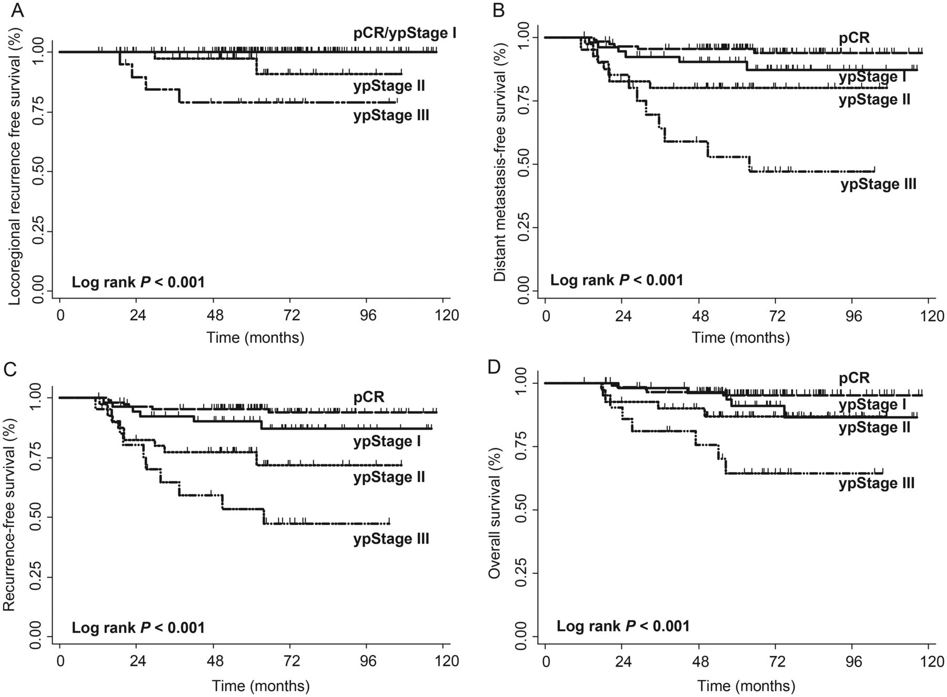
Figure 2. Kaplan–Meier curves of (A) locoregional recurrence-free, (B) distant metastasis-free, (C) recurrence-free, ...
Notes:
Figure 2. Kaplan–Meier curves of (A) locoregional recurrence-free, (B) distant metastasis-free, (C) recurrence-free, and (D) overall survival outcomes among pathologic stage groups (pCR, yp stage I–III).
Unless provided in the caption above, the following copyright applies to the content of this slide: © The Author 2013. Published by Oxford University Press on behalf of the European Society for Medical Oncology. All rights reserved. For permissions, please email: journals.permissions@oup.com.

