Slide 1
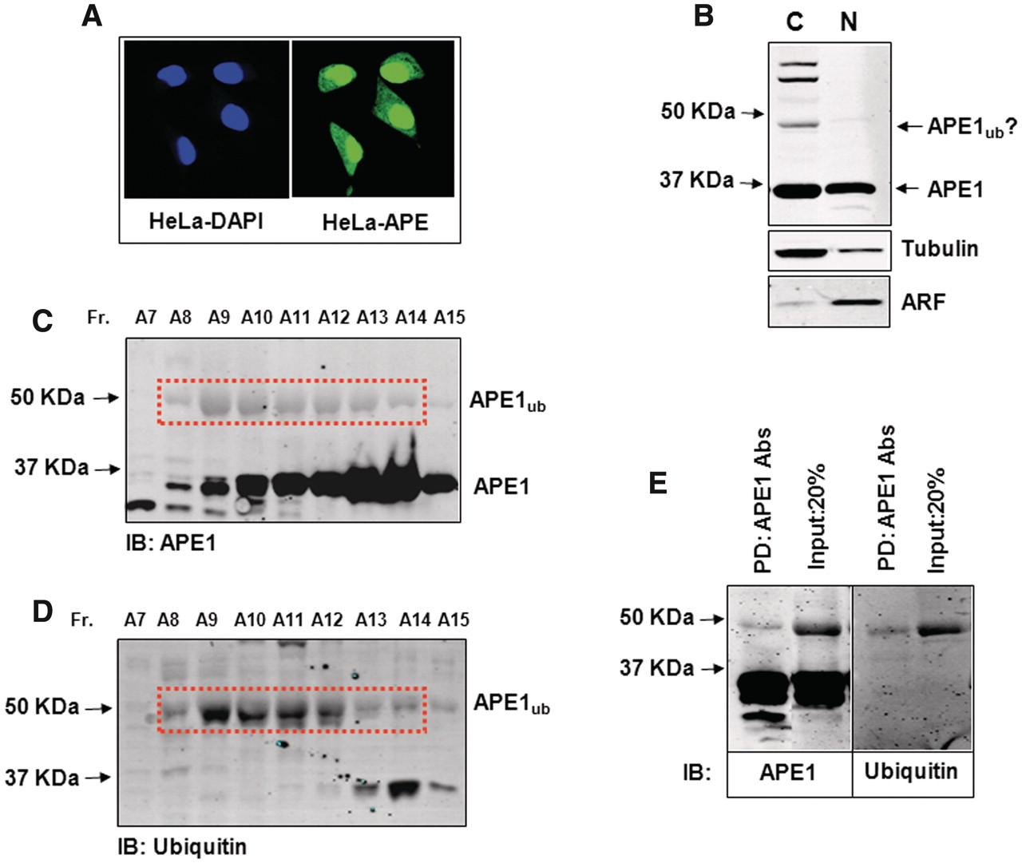
Figure 1. Purification of ubiquitylated APE1 from human cells. ( A ) HeLa cells were fixed and immunostained with DAPI ...
Notes:
Figure 1. Purification of ubiquitylated APE1 from human cells. ( A ) HeLa cells were fixed and immunostained with DAPI and APE1 antibodies demonstrating cytoplasmic and nuclear localization of APE1. ( B ) Cytoplasmic and nuclear fractions prepared from HeLa cells were analysed by 10% SDS–PAGE and immunoblotting using the indicated antibodies. Three bands cross-reacting with APE1 antibodies, in addition to the 36 kDa native form of APE1, were present in the cytoplasmic fraction and were predicted to be ubiquitylated APE1. ( C and D ) Analysis of Mono-S chromatography fractions purified from HeLa cells analysed by 10% SDS–PAGE and immunoblotting using either (C) APE1 or ( D ) ubiquitin antibodies. ( E ) The peak monoubiquitylated APE1 containing Mono-S fraction (A9) was immunodepleted using APE1 antibodies and the pull-down was then analysed by 10% SDS–PAGE and immunoblotting using either APE1 (left panel) or ubiquitin (right panel) antibodies. Molecular weight markers are indicated on the left hand side of appropriate figures and the positions of monoubiquitylated APE1 (APE1 ub ) are shown.
Unless provided in the caption above, the following copyright applies to the content of this slide: © The Author(s) 2011. Published by Oxford University Press.This is an Open Access article distributed under the terms of the Creative Commons Attribution Non-Commercial License (http://creativecommons.org/licenses/by-nc/3.0), which permits unrestricted non-commercial use, distribution, and reproduction in any medium, provided the original work is properly cited.

Slide 2
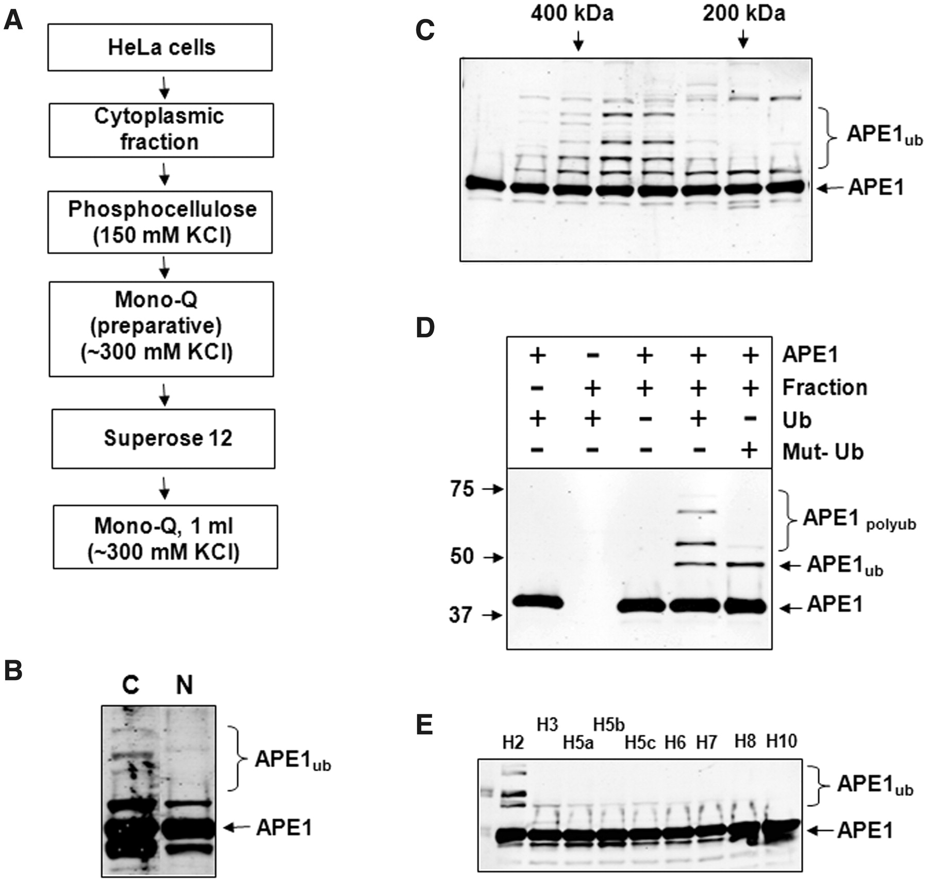
Figure 2. Purification of the E3 ubiquitin ligase for APE1. ( A ) Purification scheme for the isolation of the E3 ...
Notes:
Figure 2. Purification of the E3 ubiquitin ligase for APE1. ( A ) Purification scheme for the isolation of the E3 ubiquitin ligase for APE1 from HeLa cells. ( B ) Cytoplasmic and nuclear fractions (8 µg) were prepared from HeLa cells and analysed for in vitro ubiquitylation activity for APE1 (2.8 pmol) in the presence of E1 (0.7 pmol), ubiquitin (0.6 nmol) and various E2 enzymes (9.5 pmol). Reactions were separated by 10% SDS–PAGE and analysed by immunoblotting using APE1 antibodies. The major ubiquitylation activity against APE1 can be observed in the cytoplasmic fraction. ( C ) In vitro ubiquitylation of APE1 (2.8 pmol) by Superose 12 fractions purified from HeLa cells in the presence of E1 (0.7 pmol), ubiquitin (0.6 nmol) and various E2 enzymes (9.5 pmol). Reactions were separated by 10% SDS–PAGE and analysed by immunoblotting using APE1 antibodies. E3 ubiquitin ligase activity for APE1 corresponds to a protein of molecular weight between 200 and 400 kDa. ( D ) In vitro ubiquitylation of APE1 (2.8 pmol) by an active fraction purified from HeLa cells in the presence of E1 (0.7 pmol), various E2 enzymes (9.5 pmol) and ubiquitin (Ub; 0.6 nmol) or mutant ubiquitin (Mut-Ub) unable to form polyubiquitin chains. ( E ) In vitro ubiquitylation of APE1 (2.8 pmol) by an active fraction purified from HeLa cells in the presence of E1 (0.7 pmol), ubiquitin (Ub; 0.6 nmol) and various E2 enzymes (9.5 pmol each). Reactions (D and E) were separated by 10% SDS–PAGE and analysed by immunoblotting using APE1 antibodies. Molecular weight markers are indicated on the left hand side of appropriate figures and the positions of ubiquitylated APE1 (APE1 ub ) are shown.
Unless provided in the caption above, the following copyright applies to the content of this slide: © The Author(s) 2011. Published by Oxford University Press.This is an Open Access article distributed under the terms of the Creative Commons Attribution Non-Commercial License (http://creativecommons.org/licenses/by-nc/3.0), which permits unrestricted non-commercial use, distribution, and reproduction in any medium, provided the original work is properly cited.

Slide 3
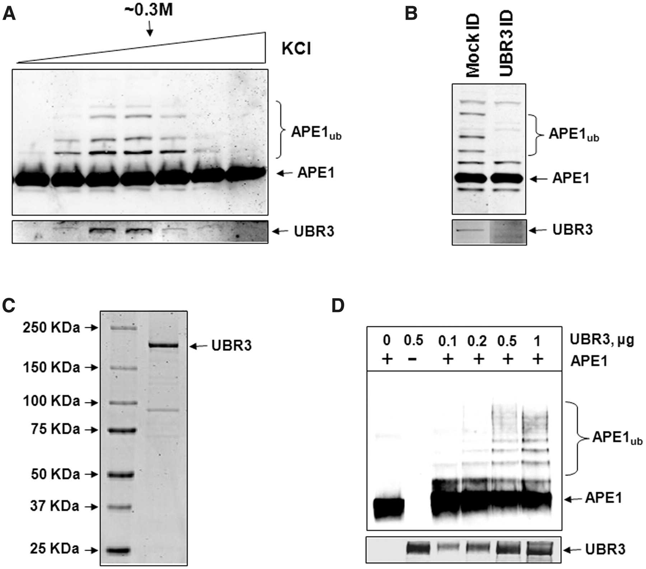
Figure 3. UBR3 is the E3 ubiquitin ligase for APE1. ( A ) In vitro ubiquitylation of APE1 (2.8 pmol) by the final ...
Notes:
Figure 3. UBR3 is the E3 ubiquitin ligase for APE1. ( A ) In vitro ubiquitylation of APE1 (2.8 pmol) by the final Mono-Q chromatography fractions purified from HeLa cells in the presence of E1 (0.7 pmol), UbcH2 (10.5 pmol) and ubiquitin (0.6 nmol) were analysed by 10% SDS–PAGE and immunoblotting using APE1 antibodies. Fractions containing APE1 ubiquitylation activity were shown to correlate with the presence of UBR3 protein detected by immunoblotting (lower panel). ( B ) The peak APE1 ubiquitylation activity containing fraction from the final Mono-Q chromatography was mock immunodepleted and immunodepleted with UBR3 antibodies. The fraction was subsequently analysed for in vitro ubiquitylation of APE1 (2.8 pmol) in the presence of E1 (0.7 pmol), UbcH2 (10.5 pmol) and ubiquitin (0.6 nmol) by 10% SDS–PAGE and immunoblotting using APE1 antibodies (upper panel). Furthermore, the pull-down was analysed by 10% SDS–PAGE and immunoblotting using UBR3 antibodies (lower panel). ( C ) N-terminal Flag-tagged mouse UBR3 was expressed in S. cerevisiae , purified and analysed by 4–12% SDS–PAGE and Coomassie staining. ( D ) Purified Flag-tagged mouse UBR3 was analysed for in vitro ubiquitylation of APE1 (2.8 pmol) in the presence of E1 (0.7 pmol), UbcH2 (10.5 pmol) and ubiquitin (0.6 nmol) by 10% SDS–PAGE and immunoblotting using APE1 antibodies and UBR3 antibodies (lower panel). Molecular weight markers are indicated on the left hand side of appropriate figures and the positions of ubiquitylated APE1 (APE1 ub ) are shown.
Unless provided in the caption above, the following copyright applies to the content of this slide: © The Author(s) 2011. Published by Oxford University Press.This is an Open Access article distributed under the terms of the Creative Commons Attribution Non-Commercial License (http://creativecommons.org/licenses/by-nc/3.0), which permits unrestricted non-commercial use, distribution, and reproduction in any medium, provided the original work is properly cited.

Slide 4
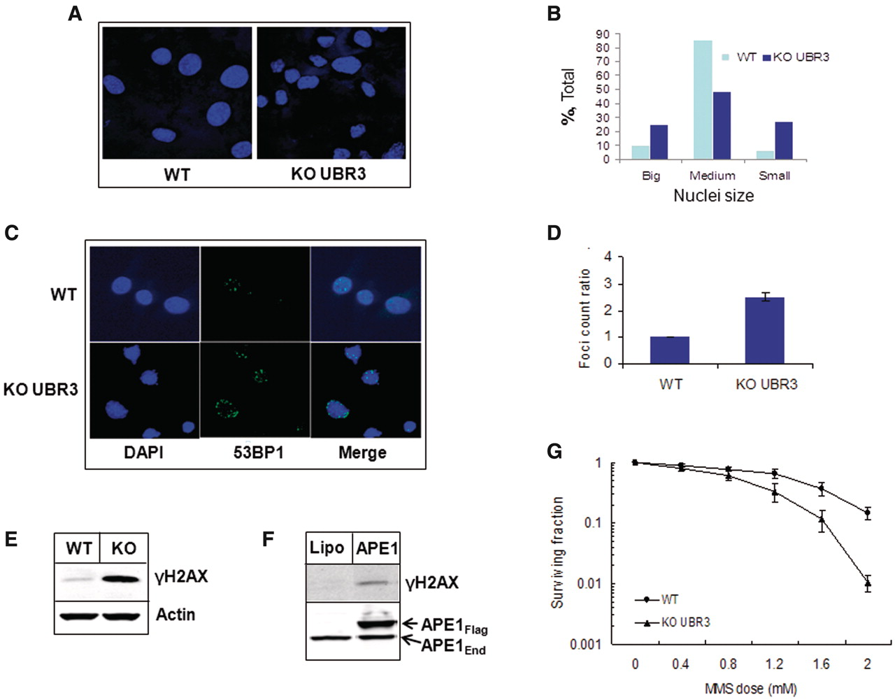
Figure 6. Cells from Ubr3 -knockout mice are genetically instable. (A and C) MEFs from wild-type and Ubr3 -knockout ...
Notes:
Figure 6. Cells from Ubr3 -knockout mice are genetically instable. (A and C) MEFs from wild-type and Ubr3 -knockout mice were fixed and immunostained with the indicated antibodies and stained with DAPI. ( B ) Graphic presentation of nuclei size distribution in wild-type and Ubr3 -knockout fibroblasts (500 cell nuclei were evaluated). ( D ) Graphic representation of 53BP1 foci ratios calculated from three individual slides (53BP1 foci were counted from 100 cells/slide). ( E ) Whole-cell extracts from MEFs from wild-type (WT) and Ubr3 -knockout (KO) mice were prepared and analysed by 10% SDS–PAGE and immunoblotting using the indicated antibodies. ( F ) HeLa cells were grown on 10-cm 2 dishes for 24 h to 70–80% confluency and then transfected with human Flag-tagged APE1 (APE1 Flag ) expression plasmid. After 24 h cells were pelleted by centrifugation, whole cell extracts were prepared and analysed by 10% SDS–PAGE and western blotting with the antibodies indicated. ( G ) MEFs from wild-type and Ubr3 -knockout mice were grown on 10-cm 2 dishes in triplicate and treated with the indicated concentrations of MMS for 45 min and colonies allowed to grow for 7 days. The graph represents the mean surviving fraction normalized against the untreated controls from three independent experiments and the standard errors are shown.
Unless provided in the caption above, the following copyright applies to the content of this slide: © The Author(s) 2011. Published by Oxford University Press.This is an Open Access article distributed under the terms of the Creative Commons Attribution Non-Commercial License (http://creativecommons.org/licenses/by-nc/3.0), which permits unrestricted non-commercial use, distribution, and reproduction in any medium, provided the original work is properly cited.

Slide 5
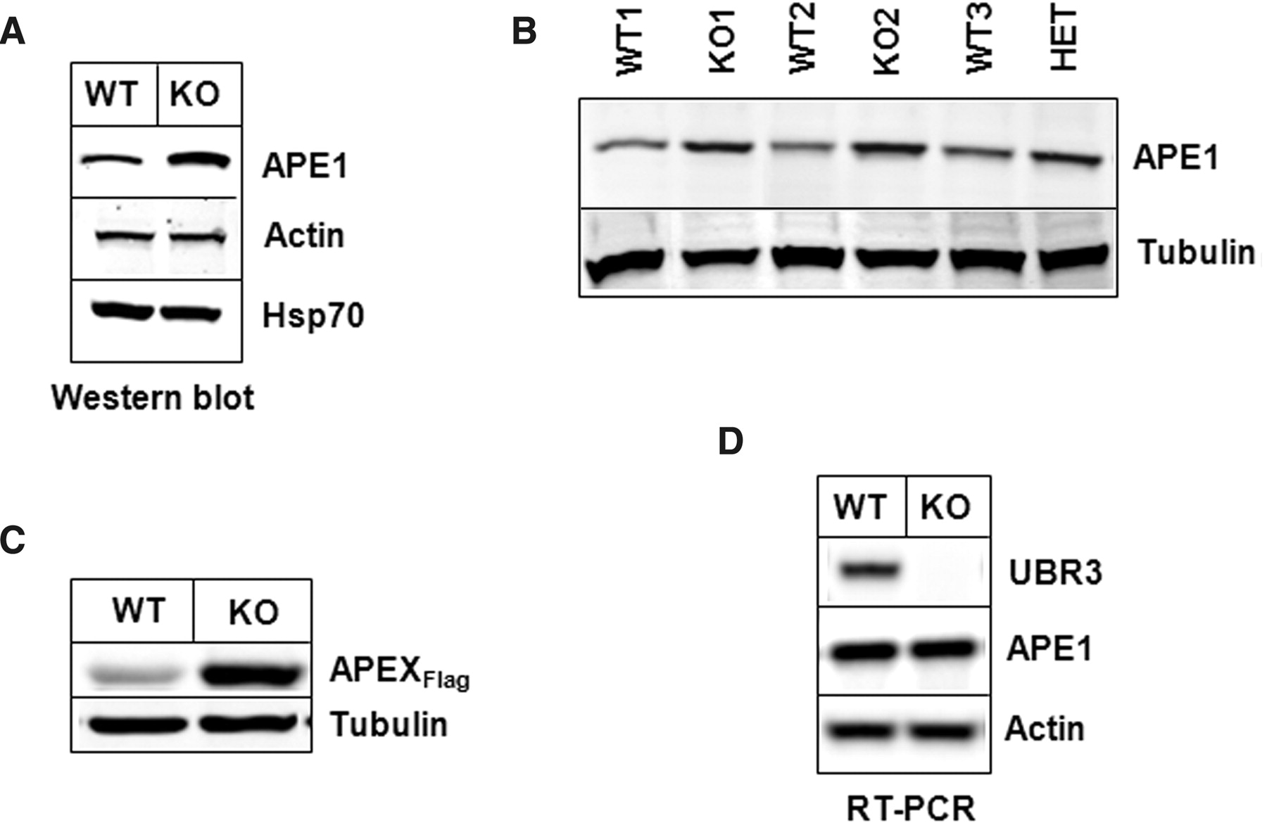
Figure 5. Cells from Ubr3 -knockout mice contain elevated levels of APE1 protein. ( A and B ) Whole cell extracts from ...
Notes:
Figure 5. Cells from Ubr3 -knockout mice contain elevated levels of APE1 protein. ( A and B ) Whole cell extracts from MEFs from several wild-type (WT), Ubr3 -knockout (KO) and heterozygous mice (HET) were prepared and analysed by 10% SDS–PAGE and immunoblotting using the indicated antibodies ( C ) Wild-type and Ubr3 -knockout MEFs cells were grown on 10-cm 2 dishes for 24 h to 70–80% confluency and then transfected with equal amounts of mouse Flag-tagged APE1 (APEX Flag ) expression plasmid. After 24 h, cells were pelleted by centrifugation, whole cell extracts were prepared and analysed by 10% SDS–PAGE and western blotting with the antibodies indicated. ( D ) RNA was prepared from wild-type and Ubr3 -knockout MEFs and the levels of APE1, UBR3 and actin mRNA analysed by RT–PCR.
Unless provided in the caption above, the following copyright applies to the content of this slide: © The Author(s) 2011. Published by Oxford University Press.This is an Open Access article distributed under the terms of the Creative Commons Attribution Non-Commercial License (http://creativecommons.org/licenses/by-nc/3.0), which permits unrestricted non-commercial use, distribution, and reproduction in any medium, provided the original work is properly cited.

Slide 6
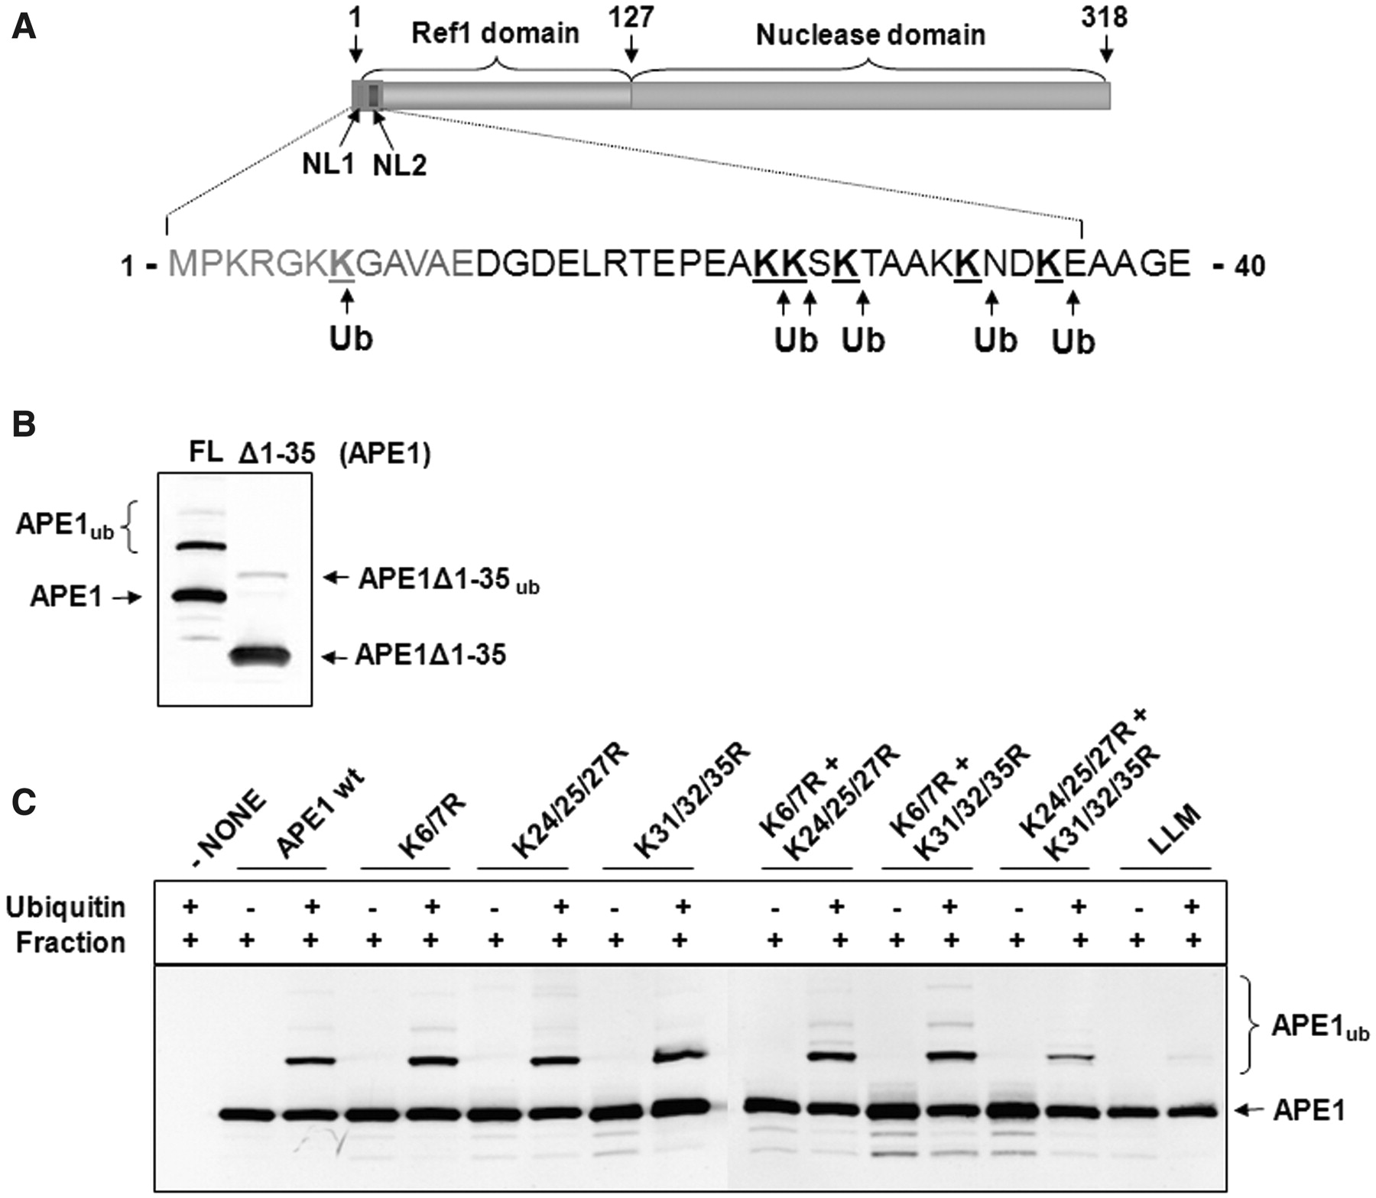
Figure 4. Identification of UBR3 ubiquitylation sites within APE1. ( A ) Schematic diagram of the protein structure of ...
Notes:
Figure 4. Identification of UBR3 ubiquitylation sites within APE1. ( A ) Schematic diagram of the protein structure of APE1 showing the nuclear localization sequences (NL1 and NL2), Ref-1 domain and nuclease domain. Major sites (K7/K24/K25/K27/K32/K35) of ubiquitylation by UBR3 identified by mass spectrometry are shown. ( B ) An N-terminal truncation of APE1 lacking the first 35 amino acids (APE1Δ1-35) was analysed for in vitro ubiquitylation, in comparison to full length protein (FL), by an active fraction purified from HeLa cells in the presence of E1 (0.7 pmol), UbcH2 (10.5 pmol) and ubiquitin (0.6 nmol) by 10% SDS–PAGE and immunoblotting using APE1 antibodies. ( C ) Wild-type protein (WT) and APE1 mutants, in which the indicated lysines were mutated to arginines, were analysed for in vitro ubiquitylation by an active fraction purified from HeLa cells in the presence of E1 (0.7 pmol), UbcH2 (10.5 pmol) and ubiquitin (0.6 nmol) by 10% SDS–PAGE and immunoblotting using APE1 antibodies.
Unless provided in the caption above, the following copyright applies to the content of this slide: © The Author(s) 2011. Published by Oxford University Press.This is an Open Access article distributed under the terms of the Creative Commons Attribution Non-Commercial License (http://creativecommons.org/licenses/by-nc/3.0), which permits unrestricted non-commercial use, distribution, and reproduction in any medium, provided the original work is properly cited.

