Slide 1
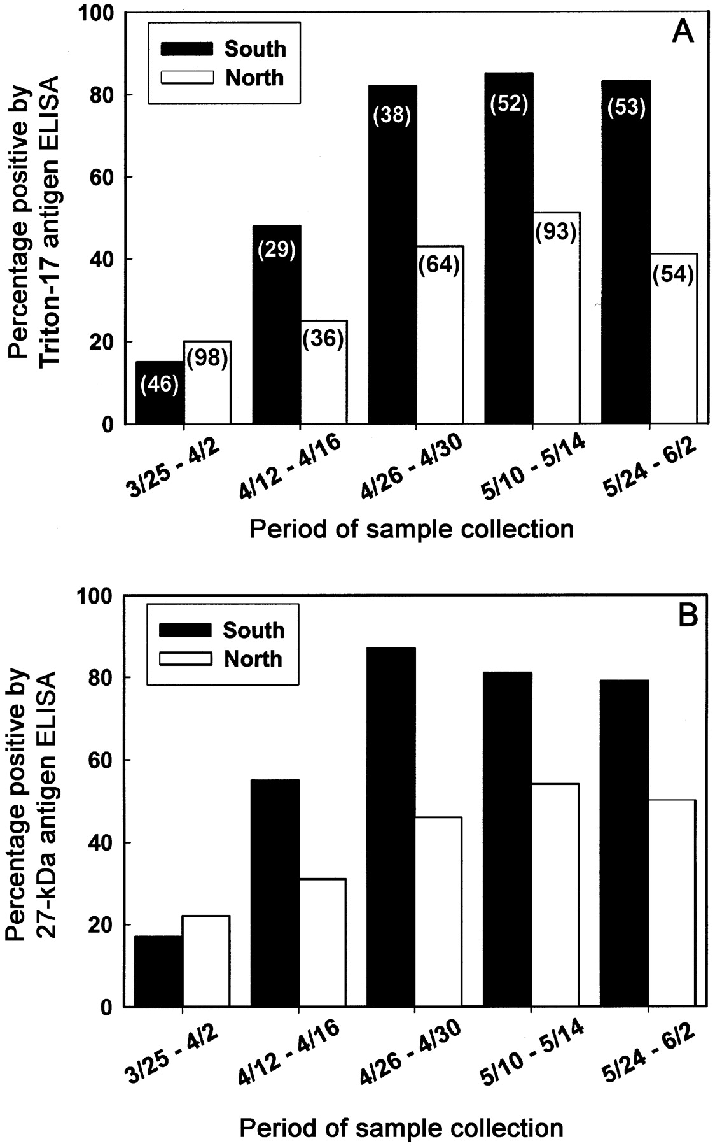
Figure 1 Prevalence of positive antibody responses to the Triton-17 (A) and recombinant 27-kDa (B) Cryptosporidium ...
Notes:
Figure 1 Prevalence of positive antibody responses to the Triton-17 (A) and recombinant 27-kDa (B) Cryptosporidium parvum antigens among children residing in southern and northern Milwaukee. The nos. of available specimens in each subset are indicated in parentheses on the respective bars in A. Significant differences (P<.05) in the prevalence of positive antibody responses to the Triton-17 and 27-kDa C. parvum antigens between children from northern and southern Milwaukee were observed from the week of 26 April through the week of 24 May (including 31 May to 2 June) 1993
Unless provided in the caption above, the following copyright applies to the content of this slide: © 2001 by the Infectious Diseases Society of America

Slide 2
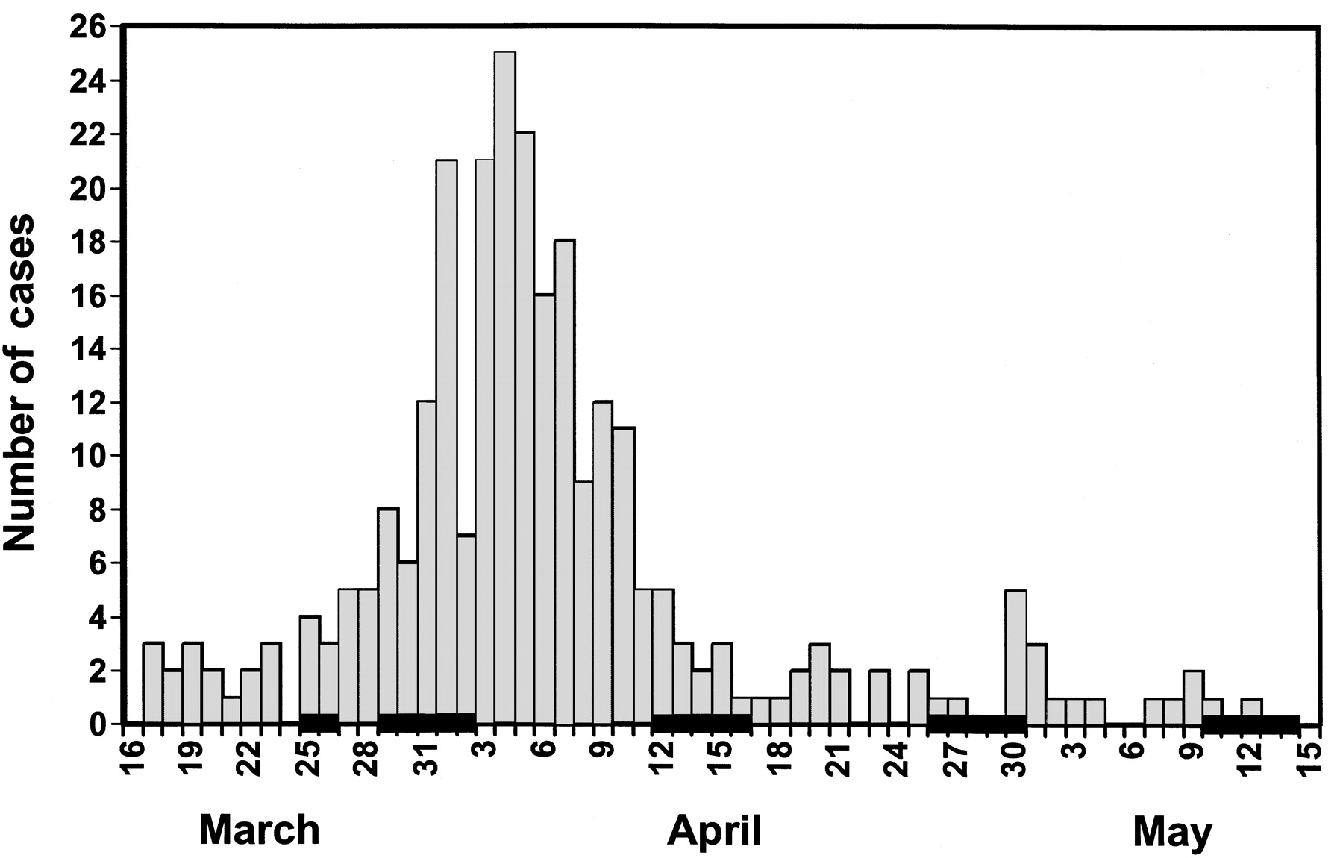
Figure 2 Onset date of illness for all laboratory-confirmed cases of cryptosporidiosis (adults and children; n=270) ...
Notes:
Figure 2 Onset date of illness for all laboratory-confirmed cases of cryptosporidiosis (adults and children; n=270) from the greater Milwaukee area between 16 March and 15 May 1993. Bars on the X-axis indicate the dates of collection of the residual blood lead specimens used in this study: week 1, 29 March to 2 April; week 3, 12–16 April; week 5, 26–30 April; and week 7, 10–14 May. Specimens collected on 25 and 26 March were combined with those collected between 29 March and 2 April (week 1). No laboratory data were available for the week 9 period of collection (24–29 May, including May 31 to June 2)
Unless provided in the caption above, the following copyright applies to the content of this slide: © 2001 by the Infectious Diseases Society of America

Slide 3
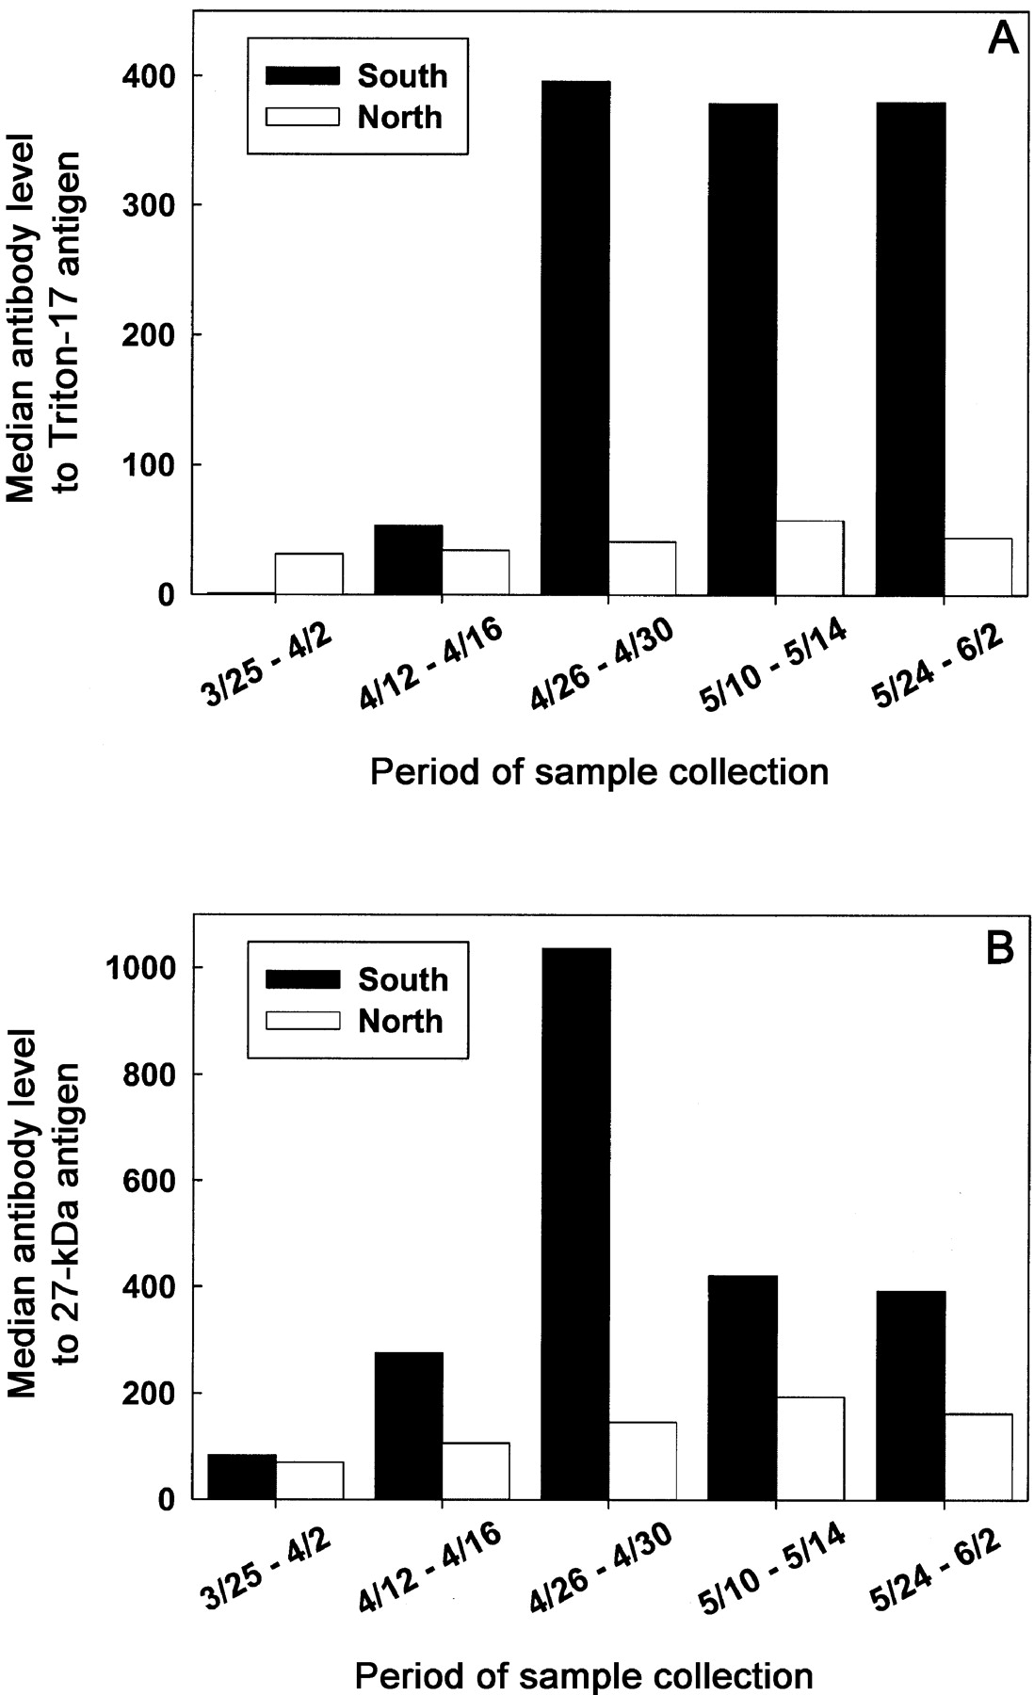
Figure 3 Comparison of median IgG antibody reactivity to the Triton-17 (A) and 27-kDa (B) Cryptosporidium parvum ...
Notes:
Figure 3 Comparison of median IgG antibody reactivity to the Triton-17 (A) and 27-kDa (B) Cryptosporidium parvum antigens for children residing in southern and northern Milwaukee. Nos. of samples are the same as those shown in figure 1A. Significant differences (P<.05, Kruskal-Wallis test) in median IgG antibody responses between children residing in southern and northern Milwaukee were observed from the week of 26 April through the week of 24 May (including 31 May to 2 June) 1993
Unless provided in the caption above, the following copyright applies to the content of this slide: © 2001 by the Infectious Diseases Society of America

Slide 4
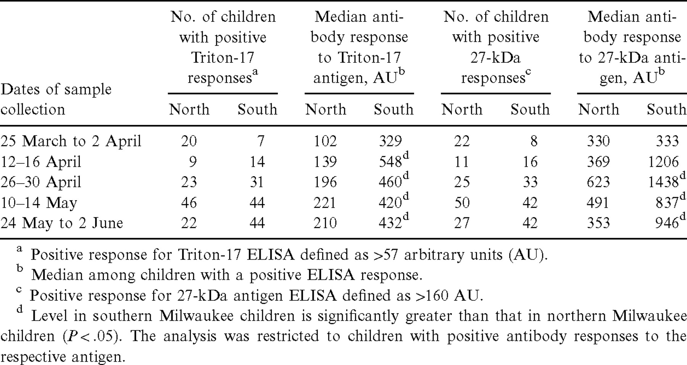
Table 1 Median antibody response to the Triton-17 and 27-kDa Cryptosporidium parvum antigens among antibody-positive ...
Notes:
Table 1 Median antibody response to the Triton-17 and 27-kDa Cryptosporidium parvum antigens among antibody-positive children in 1993 in Milwaukee
Unless provided in the caption above, the following copyright applies to the content of this slide: © 2001 by the Infectious Diseases Society of America

