Slide 1
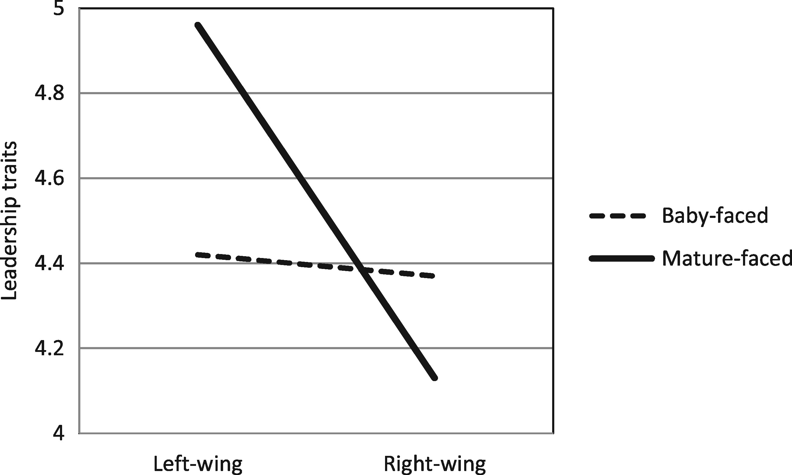
Figure 1 The impact of facial features and the candidate’s political attitudes on his or her leadership traits
Notes:
Figure 1 The impact of facial features and the candidate’s political attitudes on his or her leadership traits
Unless provided in the caption above, the following copyright applies to the content of this slide: © The Author 2017. Published by Oxford University Press on behalf of The World Association for Public Opinion Research. All rights reserved.This article is published and distributed under the terms of the Oxford University Press, Standard Journals Publication Model (https://academic.oup.com/journals/pages/about_us/legal/notices)

