Slide 1
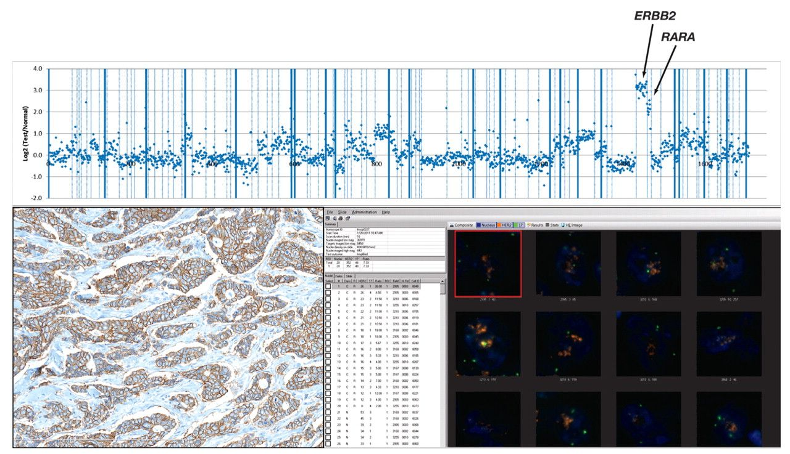
Image 1 HER2 gene amplification in breast cancer detected by next-generation sequencing (NGS). In this surgically ...
Notes:
Image 1 HER2 gene amplification in breast cancer detected by next-generation sequencing (NGS). In this surgically resected recurrent invasive duct carcinoma of the breast, NGS found an 8.6-fold amplification of the HER2 gene and a 4.6-fold amplification of the RARA gene. Fluorescence in situ hybridization (FISH) testing of this specimen (not shown) revealed an average HER2 copy number of 11.6. Immunohistochemical staining of this tumor was strongly 3+, as seen at the lower left (HercepTest [DAKO, Carpinteria, CA], ×100), and the HER2 gene amplification for this case detected by FISH (Abbott-Vysis PathVysion [Abbott Molecular, Downers Grove, IL], ×400) using the Ikoniscope automated fluorescence digital imaging system (Ikonisys, New Haven, CT) is seen at the lower right. Sanger and other types of traditional DNA sequencing do not detect alterations in gene copy number. NGS was performed using the Illumina HiSeq2000 System (Illumina, San Diego, CA) for 182 oncogenes, tumor suppressor genes, and drug-metabolizing enzymes from formalin-fixed paraffin embedded (FFPE) specimens. FFPE sections of 20-μm total thickness were obtained, and extracted DNA was subjected to hybrid capture and paired-end sequencing featuring high-coverage sequence (median, 300-fold coverage) of 2,574 exons encompassing the 182 genes. bp, base pairs.
Unless provided in the caption above, the following copyright applies to the content of this slide: © American Society for Clinical Pathology

Slide 2
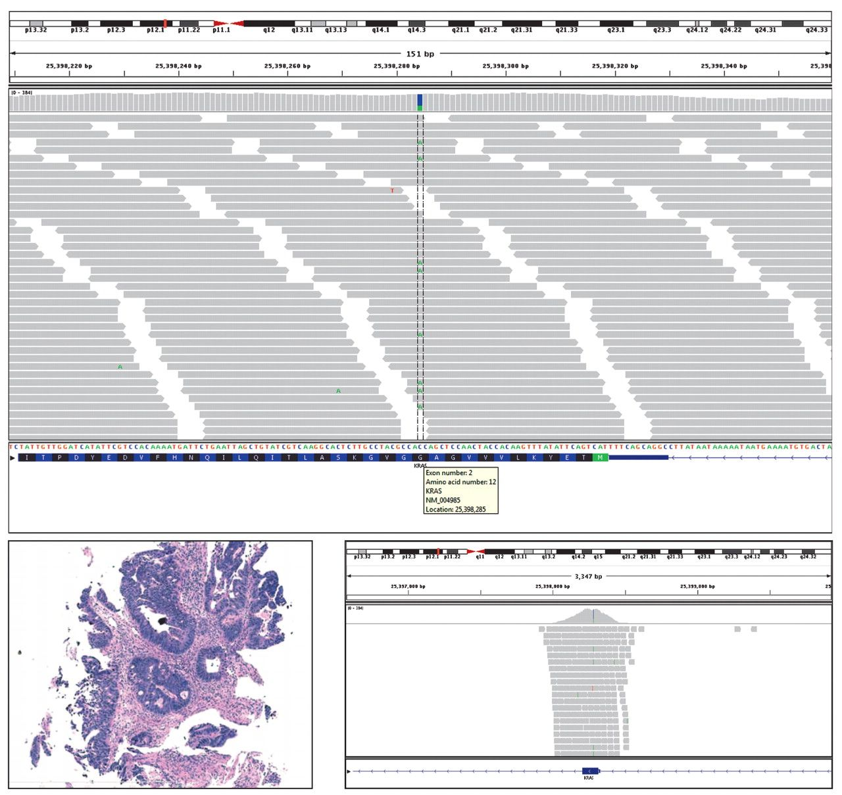
Image 2 KRAS mutation in colorectal cancer (CRC) detected by next-generation sequencing (NGS). With NGS, this ...
Notes:
Image 2 KRAS mutation in colorectal cancer (CRC) detected by next-generation sequencing (NGS). With NGS, this endoscopic biopsy of a deeply invasive CRC is shown to have a KRAS point mutation at codon 12 of the second exon of the KRAS gene located on chromosome 12 where a thymidine (T) has substituted for a G (glycine). This is known as the KRAS G12V mutation and has been linked to deregulation of cell cycle, apoptosis, and nitrogen metabolism. CRC cases with a G12V KRAS mutation have been associated with resistance to treatment with anti–epidermal growth factor receptor antibodies (cetuximab and panitumumab).22–24 The biopsy of this deeply invasive CRC in a 52-year-old man, pathologic stage pT2pN2pMx, is shown in the lower left (H&E, ×200). Detail of the NGS detection of the mutation is seen at the lower right. NGS was performed using the Illumina HiSeq2000 System (Illumina, San Diego, CA) for 182 oncogenes, tumor suppressor genes, and drug-metabolizing enzymes from formalin-fixed, paraffin-embedded (FFPE) specimens. FFPE sections of 20-μm total thickness were obtained, and extracted DNA was subjected to hybrid capture and paired-end sequencing featuring high-coverage sequence (median, 300-fold coverage) of 2,574 exons encompassing the 182 genes. bp, base pairs.
Unless provided in the caption above, the following copyright applies to the content of this slide: © American Society for Clinical Pathology

Slide 3
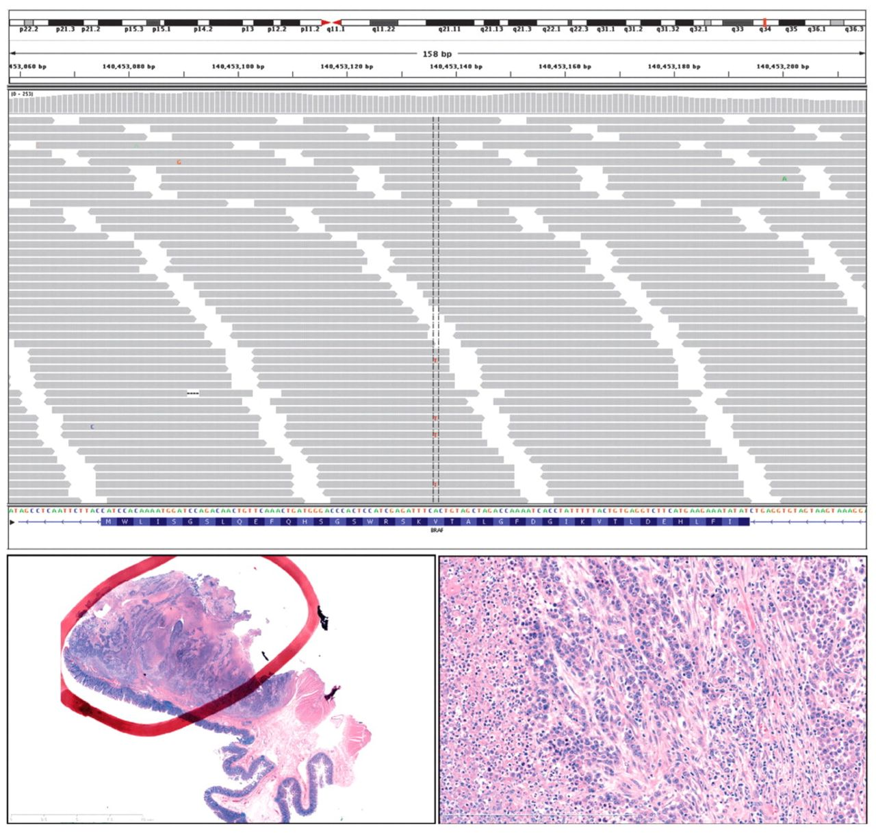
Image 3 BRAF V600E mutation in colorectal cancer (CRC) detected by next-generation sequencing (NGS). In this ...
Notes:
Image 3 BRAF V600E mutation in colorectal cancer (CRC) detected by next-generation sequencing (NGS). In this surgically resected undifferentiated carcinoma of the colon, sequence analysis by NGS revealed a wild-type KRAS sequence and a V600E point mutation in the BRAF gene. The BRAF mutation was detected in 13% of the extracted DNA at a sequencing depth of 184 (sequencing depth equals the average number of nucleotides contributing to a portion of NGS-based DNA sequence assembly). At the lower left, the scanning power view shows that a significant amount on nonneoplastic colon tissue was present in the sample submitted for NGS. To guard against the possibility of a dilutional effect on the total DNA extracted, the specimen was enriched for tumoral DNA by removing the tissue within the paraffin block not within the red circle before thick sectioning and subsequent DNA extraction. At the lower right, the highly necrotic, poorly differentiated histologic features of this resected pT3pN1pMx primary CRC are shown (H&E, ×10). Although BRAF mutation status has also been used as a negative selector for anti–epidermal growth factor receptor antibody therapy in CRC, recent evidence suggests that, rather than being a specific marker of resistance to these drugs, the BRAF mutation status imparts an overall negative prognosis for these tumors, which are generally resistant to all types of therapy.25–29 NGS was performed using the Illumina HiSeq2000 System (Illumina, San Diego, CA) for 182 oncogenes, tumor suppressor genes, and drug-metabolizing enzymes from formalin-fixed, paraffin-embedded (FFPE) specimens. FFPE sections of 20-μm total thickness were obtained, and extracted DNA was subjected to hybrid capture and paired-end sequencing featuring high-coverage sequence (median, 300-fold coverage) of 2,574 exons encompassing the 182 genes. bp, base pairs.
Unless provided in the caption above, the following copyright applies to the content of this slide: © American Society for Clinical Pathology

Slide 4
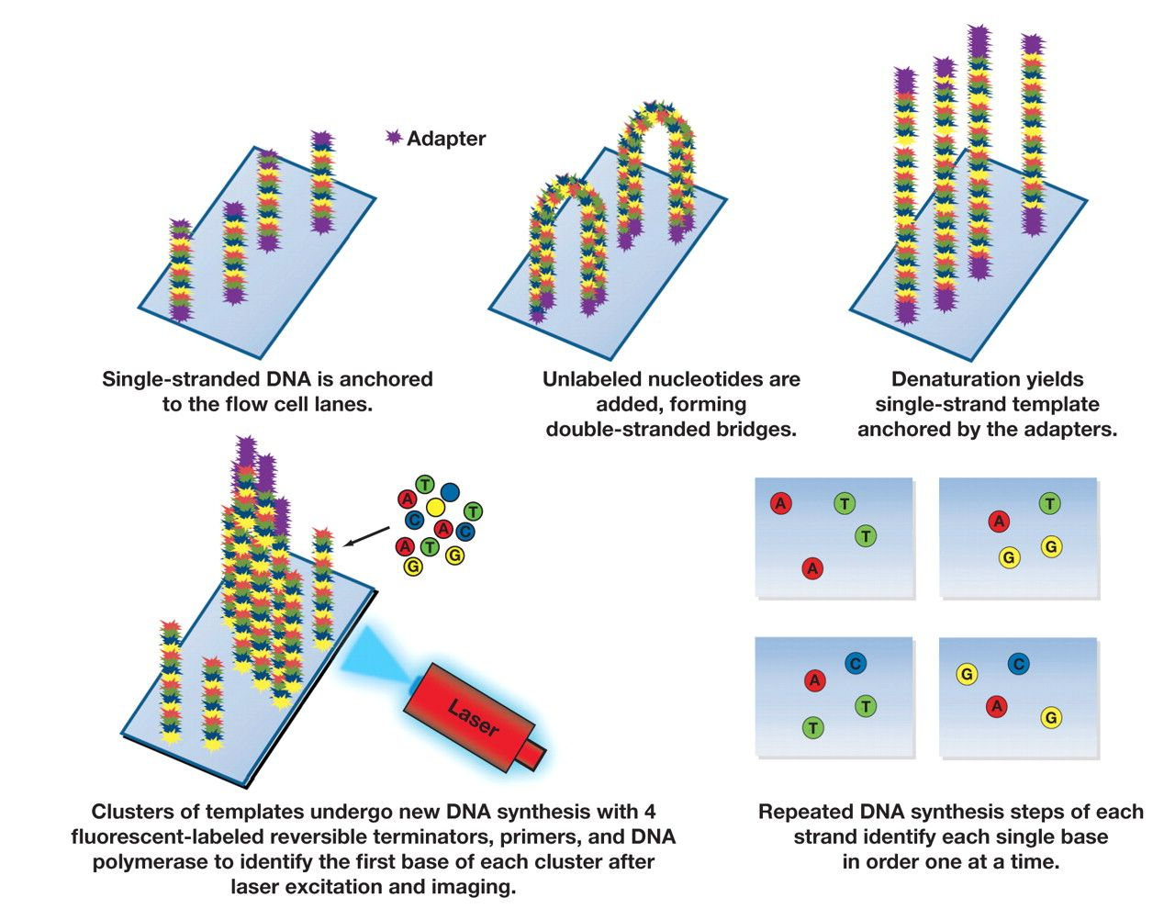
Figure 1 Schematic diagram of the Illumina sequence by synthesis next-generation sequencing platform.
Notes:
Figure 1 Schematic diagram of the Illumina sequence by synthesis next-generation sequencing platform.
Unless provided in the caption above, the following copyright applies to the content of this slide: © American Society for Clinical Pathology

Slide 5
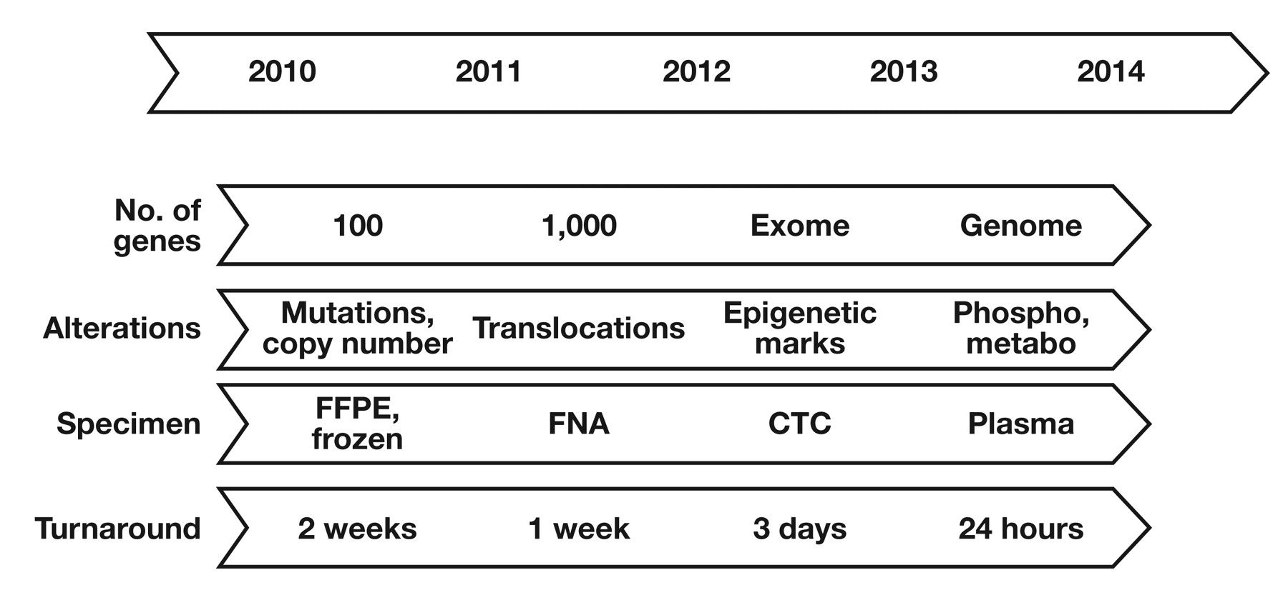
Figure 2 Anticipated future development of next-generation sequencing. CTC, circulating tumor cells; FFPE, ...
Notes:
Figure 2 Anticipated future development of next-generation sequencing. CTC, circulating tumor cells; FFPE, formalin-fixed, paraffin-embedded; FNA, fine-needle aspiration; metabo, functional status of drug metabolism pathways; phospho, phosphorylation or activation of cell surface receptors.
Unless provided in the caption above, the following copyright applies to the content of this slide: © American Society for Clinical Pathology

