Slide 1
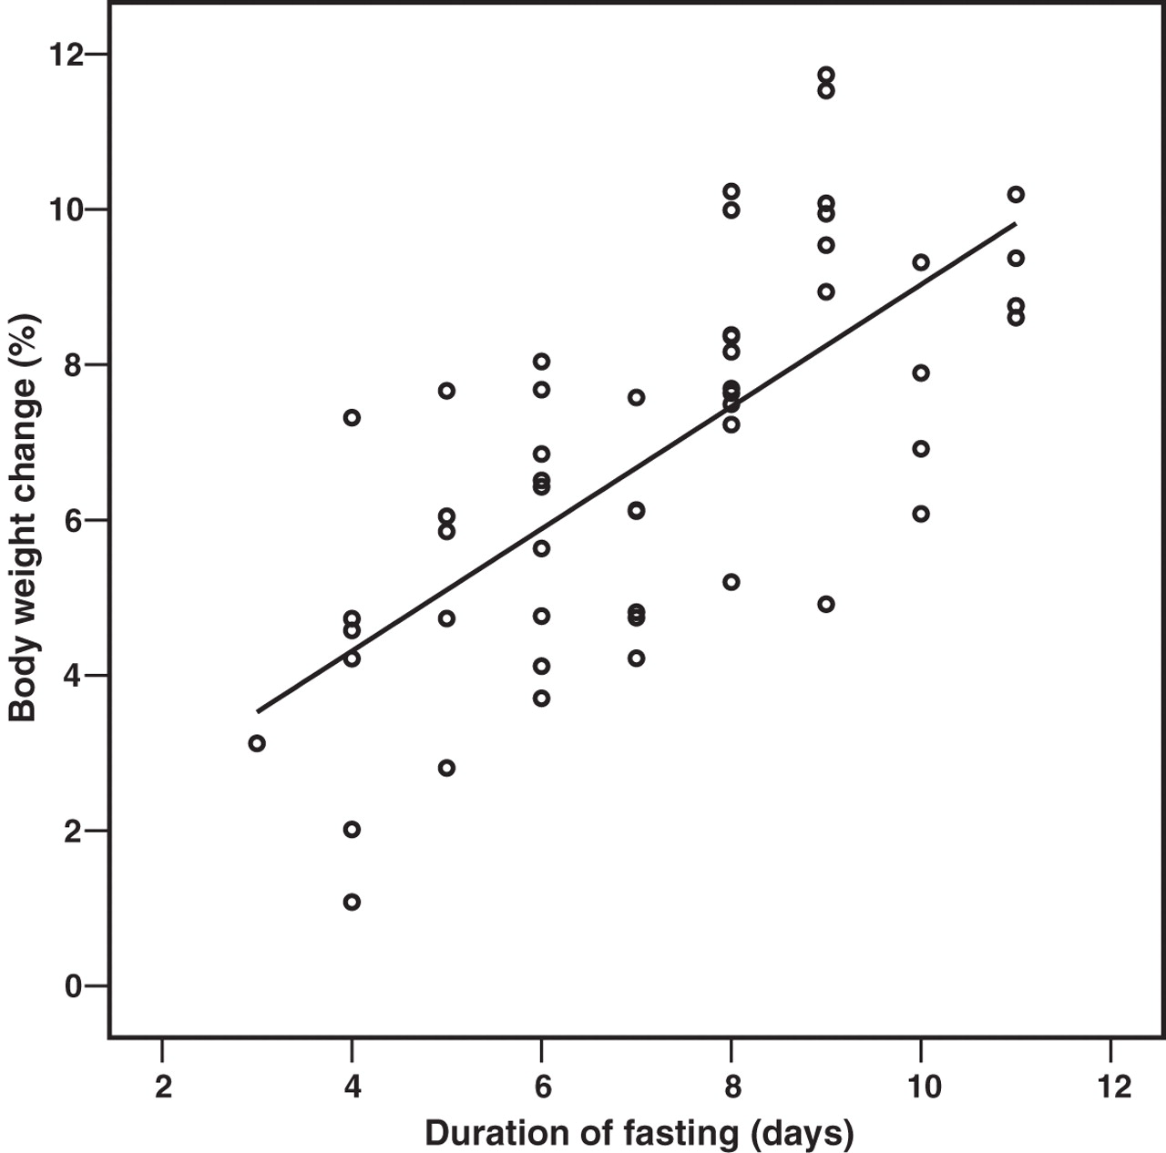
Fig. 1. Correlation of body weight change (%) and fasting duration (days) (Pearson's correlation coefficient r = ...
Notes:
Fig. 1. Correlation of body weight change (%) and fasting duration (days) (Pearson's correlation coefficient r = 0.70, n = 52, P < 0.01).
Unless provided in the caption above, the following copyright applies to the content of this slide: © The Author 2006. Published by Oxford University Press. All rights reserved. For Permissions, please email: journals.permissions@oxfordjournals.org

Slide 2
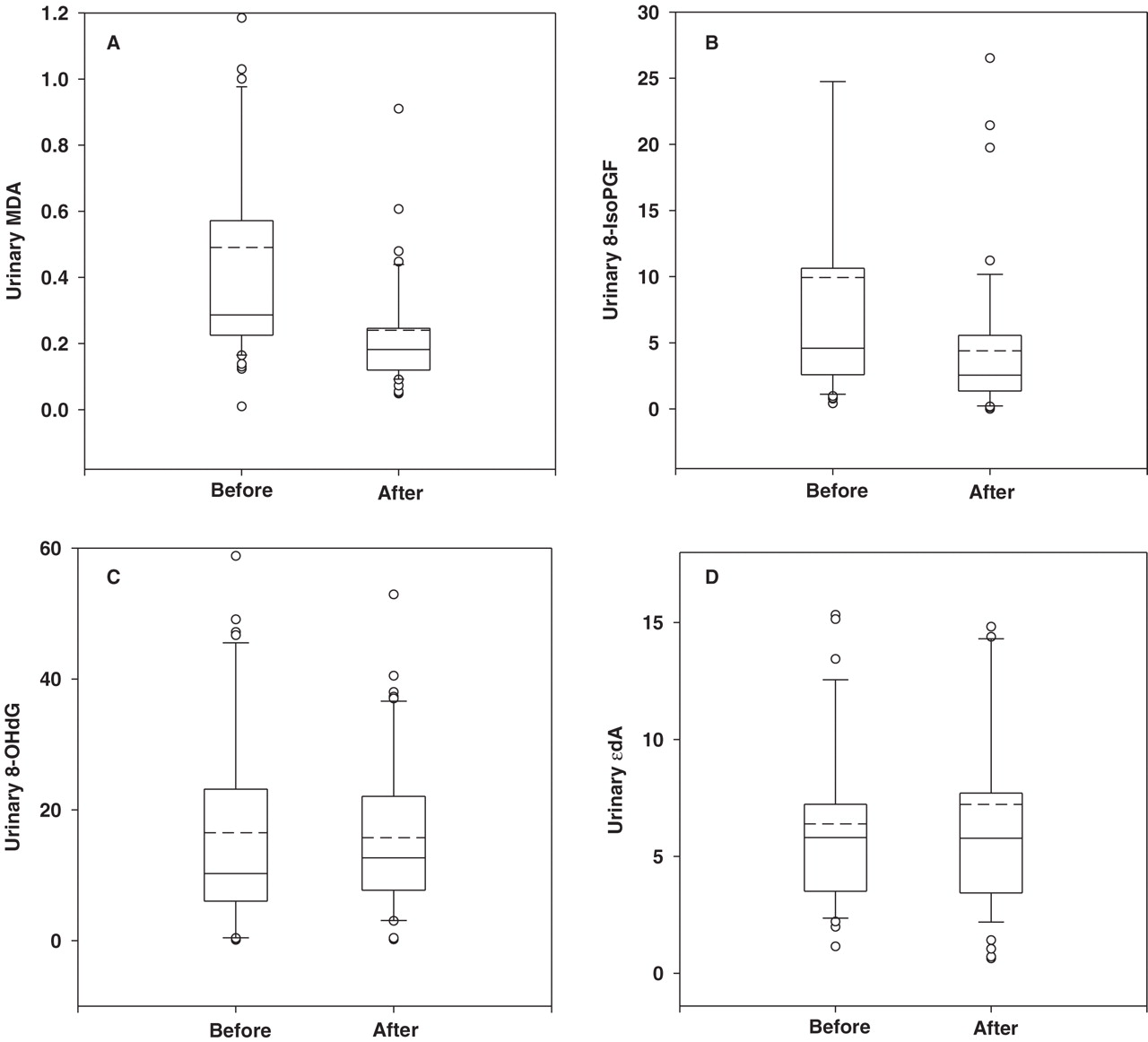
Fig. 2. Urinary biomarkers of oxidative stress before and after fasting (solid bar: the median; dotted bar: mean; ...
Notes:
Fig. 2. Urinary biomarkers of oxidative stress before and after fasting (solid bar: the median; dotted bar: mean; whiskers: the minimum and maximum; boxes: the first and third quartiles; dot: outlier). A: Urinary MDA (mg/g creatinine), B: Urinary 8-IsoPGF (mg/g creatinine), C: Urinary 8-OHdG (mg/g creatinine), D: Urinary ϵdA (f mol/μmol creatinine)
Unless provided in the caption above, the following copyright applies to the content of this slide: © The Author 2006. Published by Oxford University Press. All rights reserved. For Permissions, please email: journals.permissions@oxfordjournals.org

