Slide 1
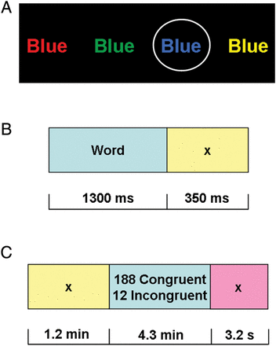
Figure 1. fMRI Stroop color-word task. Subjects pressed for ink color as quickly and accurately as possible ...
Notes:
Figure 1. fMRI Stroop color-word task. Subjects pressed for ink color as quickly and accurately as possible (performance was recorded throughout). fMRI response to conflict trials (all incongruent), error trials (all error), and their interaction were each compared with active baselines (all congruent trials, all correct trials, and congruent correct trials, respectively). (A) Examples of color words: the circled (blue) stimulus is congruent; all others are incongruent. (B) Individual trial, comprised of a 1300-ms color-word stimulus and 350-ms interstimulus interval. (C) Individual run, comprised 200 individual trials and a 3200-ms interval to separate runs.
Unless provided in the caption above, the following copyright applies to the content of this slide: © The Author 2012. Published by Oxford University Press. All rights reserved. For Permissions, please e-mail: journals.permissions@oup.com

Slide 2
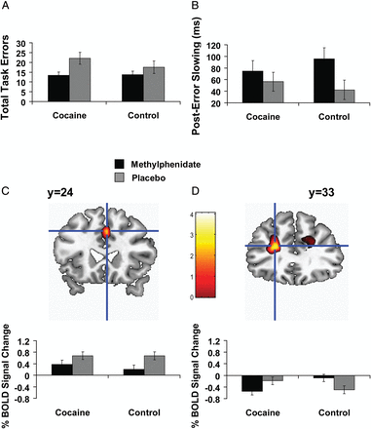
Figure 2. The impact of oral methylphenidate (20 mg) on brain and behavior during the Stroop color-word task in 15 ...
Notes:
Figure 2. The impact of oral methylphenidate (20 mg) on brain and behavior during the Stroop color-word task in 15 healthy individuals and 16 individuals addicted to cocaine. Compared with placebo, and in all subjects, methylphenidate (A) decreased task-related errors, (B) increased posterror slowing, and (C) decreased right dorsal anterior cingulate cortex (dACC) response to the contrast error > correct. (D) There was also a medication × group interaction in the left DLPFC (lower error > correct DLPFC response during MPH in the cocaine subjects, but lower error > correct DLPFC response during placebo in the controls; note that the correct congruent baseline means that BOLD response below zero does not necessarily indicate deactivations as also indicated in Methods). For (C) and (D), Figure shows mean percent blood-oxygen-level-dependent (BOLD) signal change during methylphenidate and placebo, with associated means and standard errors separately for cocaine subjects and control subjects. For display purposes, Figure activations are thresholded at P < 0.005 voxel-level uncorrected. Anatomical images are presented in neurological convention (L = L).
Unless provided in the caption above, the following copyright applies to the content of this slide: © The Author 2012. Published by Oxford University Press. All rights reserved. For Permissions, please e-mail: journals.permissions@oup.com

