Slide 1
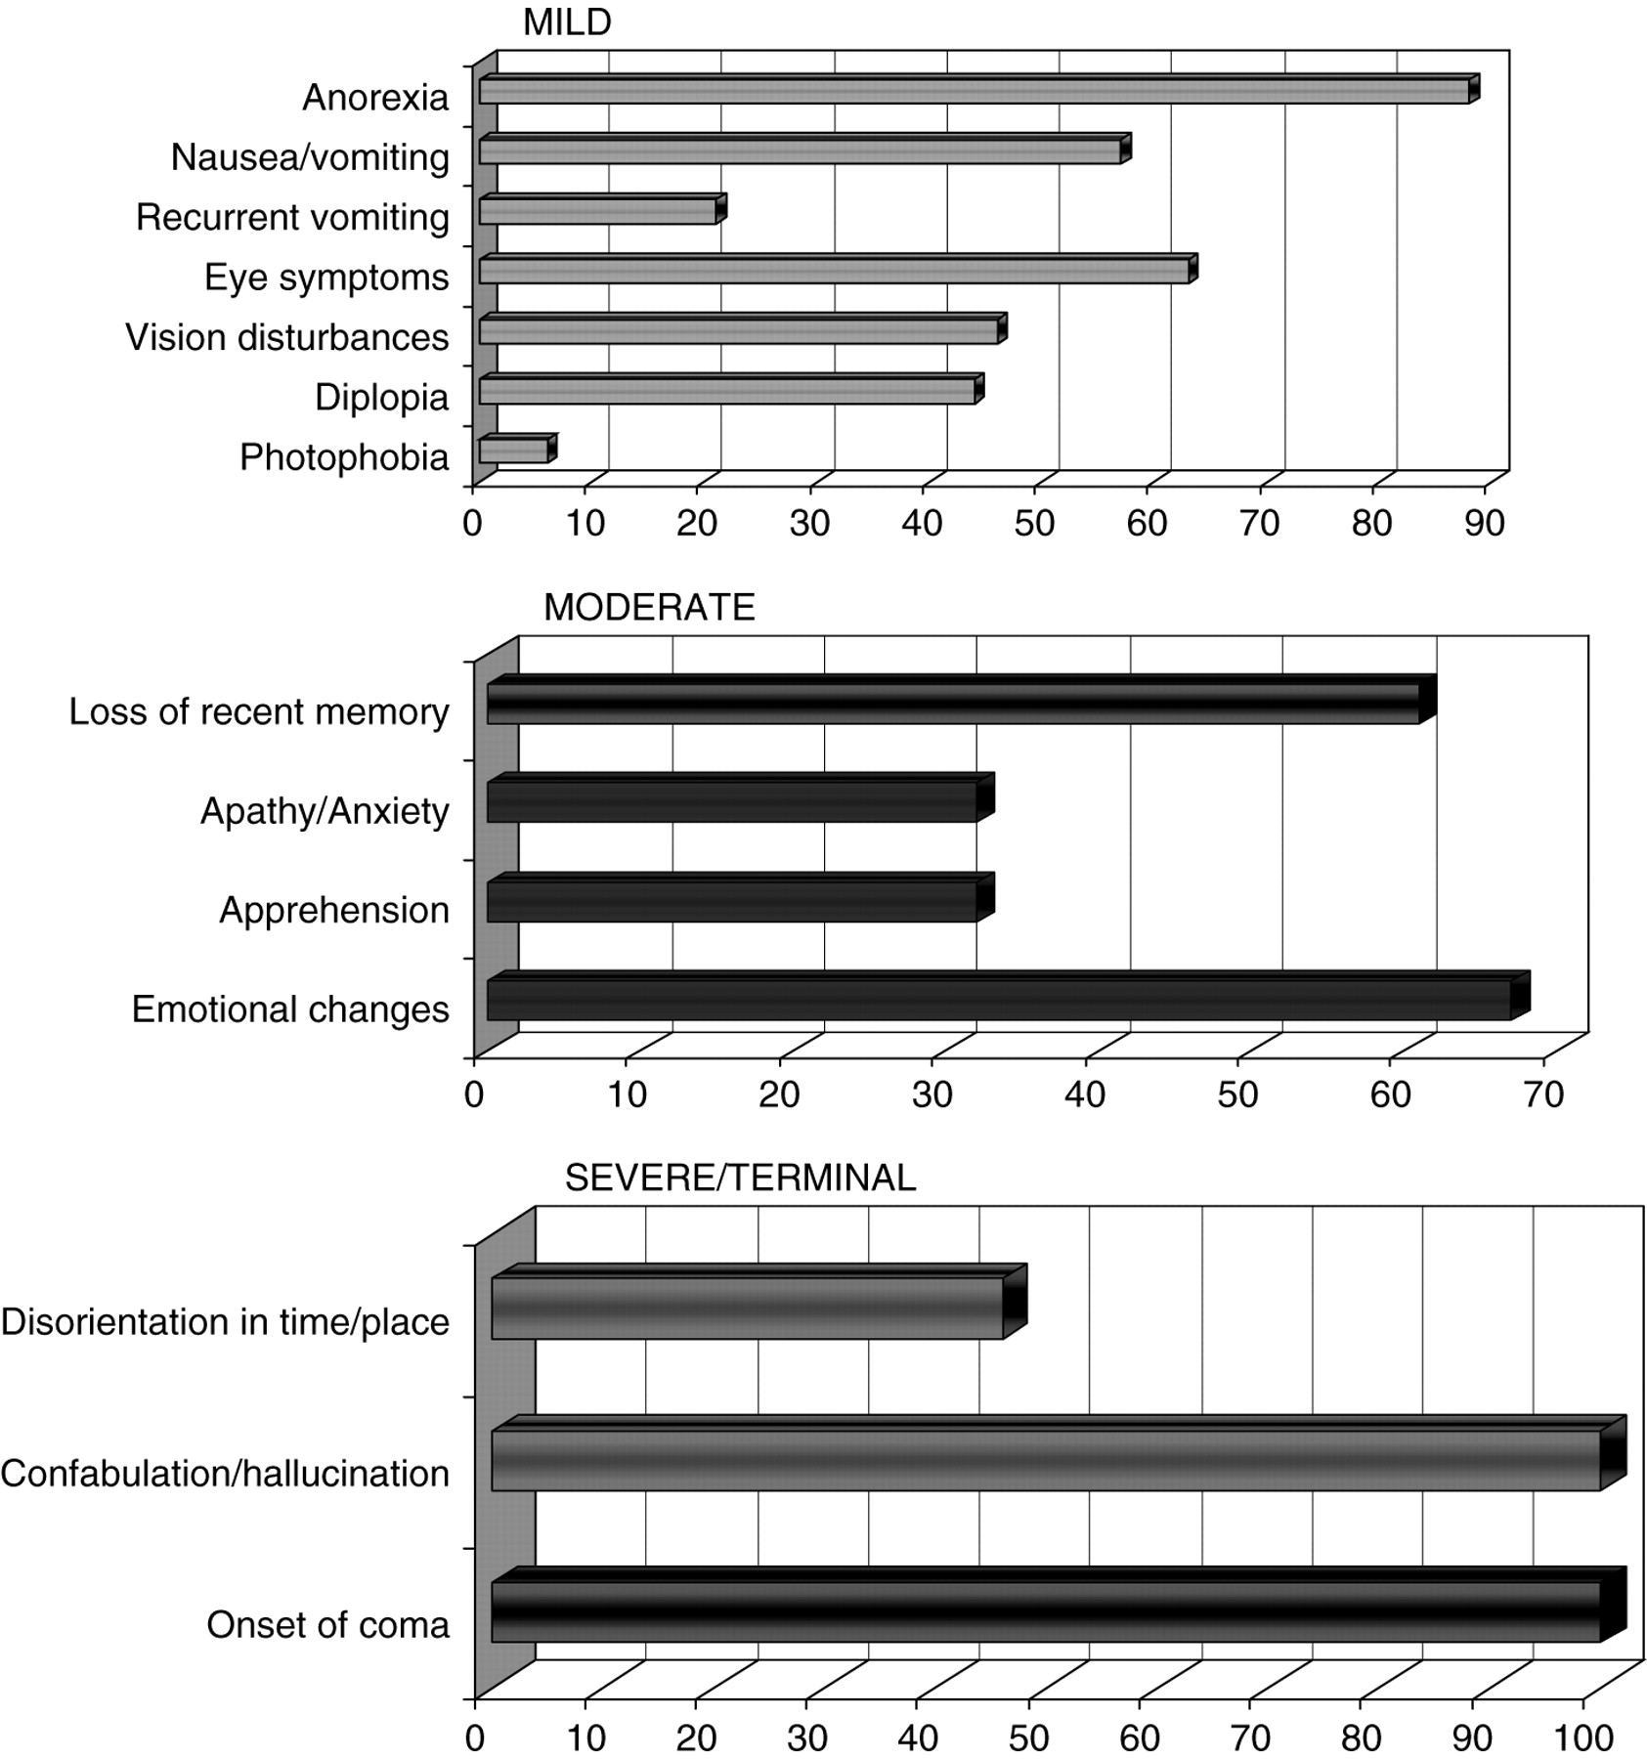
Fig. 1 Development of signs/symptoms in non-alcohol related Wernicke's encephalopathy.
Notes:
Fig. 1 Development of signs/symptoms in non-alcohol related Wernicke's encephalopathy.
Unless provided in the caption above, the following copyright applies to the content of this slide: Copyright © The Author 2007. Published by Oxford University Press on behalf of the Medical Council on Alcohol.

