Slide 1
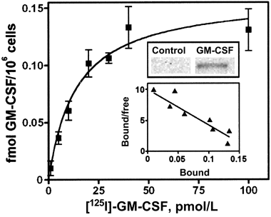
Figure 1. Characterization of granulocyte macrophagecolony-stimulating factor (GM-CSF) receptors in THP-1 cells. Main ...
Notes:
Figure 1. Characterization of granulocyte macrophagecolony-stimulating factor (GM-CSF) receptors in THP-1 cells. Main graph, binding of [125I]-GMCSF to cells at 4°C (2 h). Nonspecific binding (measured in the presence of a 100-fold excess of unlabeled GM-CSF) has been subtracted. Data are means of 3 determinations ± SD. These experiments were performed twice, with very similar results. Lower inset, Same values, presented as a Scatchard plot (R2 = .953). Upper inset, phosphorylation of STAT5 in cells exposed to GM-CSF. Cells were incubated for 24 h at concentrations of 5–40 ng/mL/h at 37°C with 5l–40 ng/mL GM-CSF (only the result obtained at 20 ng/mL is shown, because this concentration was used for most of the subsequent experiments). Cell lysates were analyzed byWestern blot, using an antiphospho-STAT5 antibody. The migration distance of the band corresponds to an estimated molecular weight of 90 kDa.
Unless provided in the caption above, the following copyright applies to the content of this slide: © 2004 by the Infectious Diseases Society of America

Slide 2
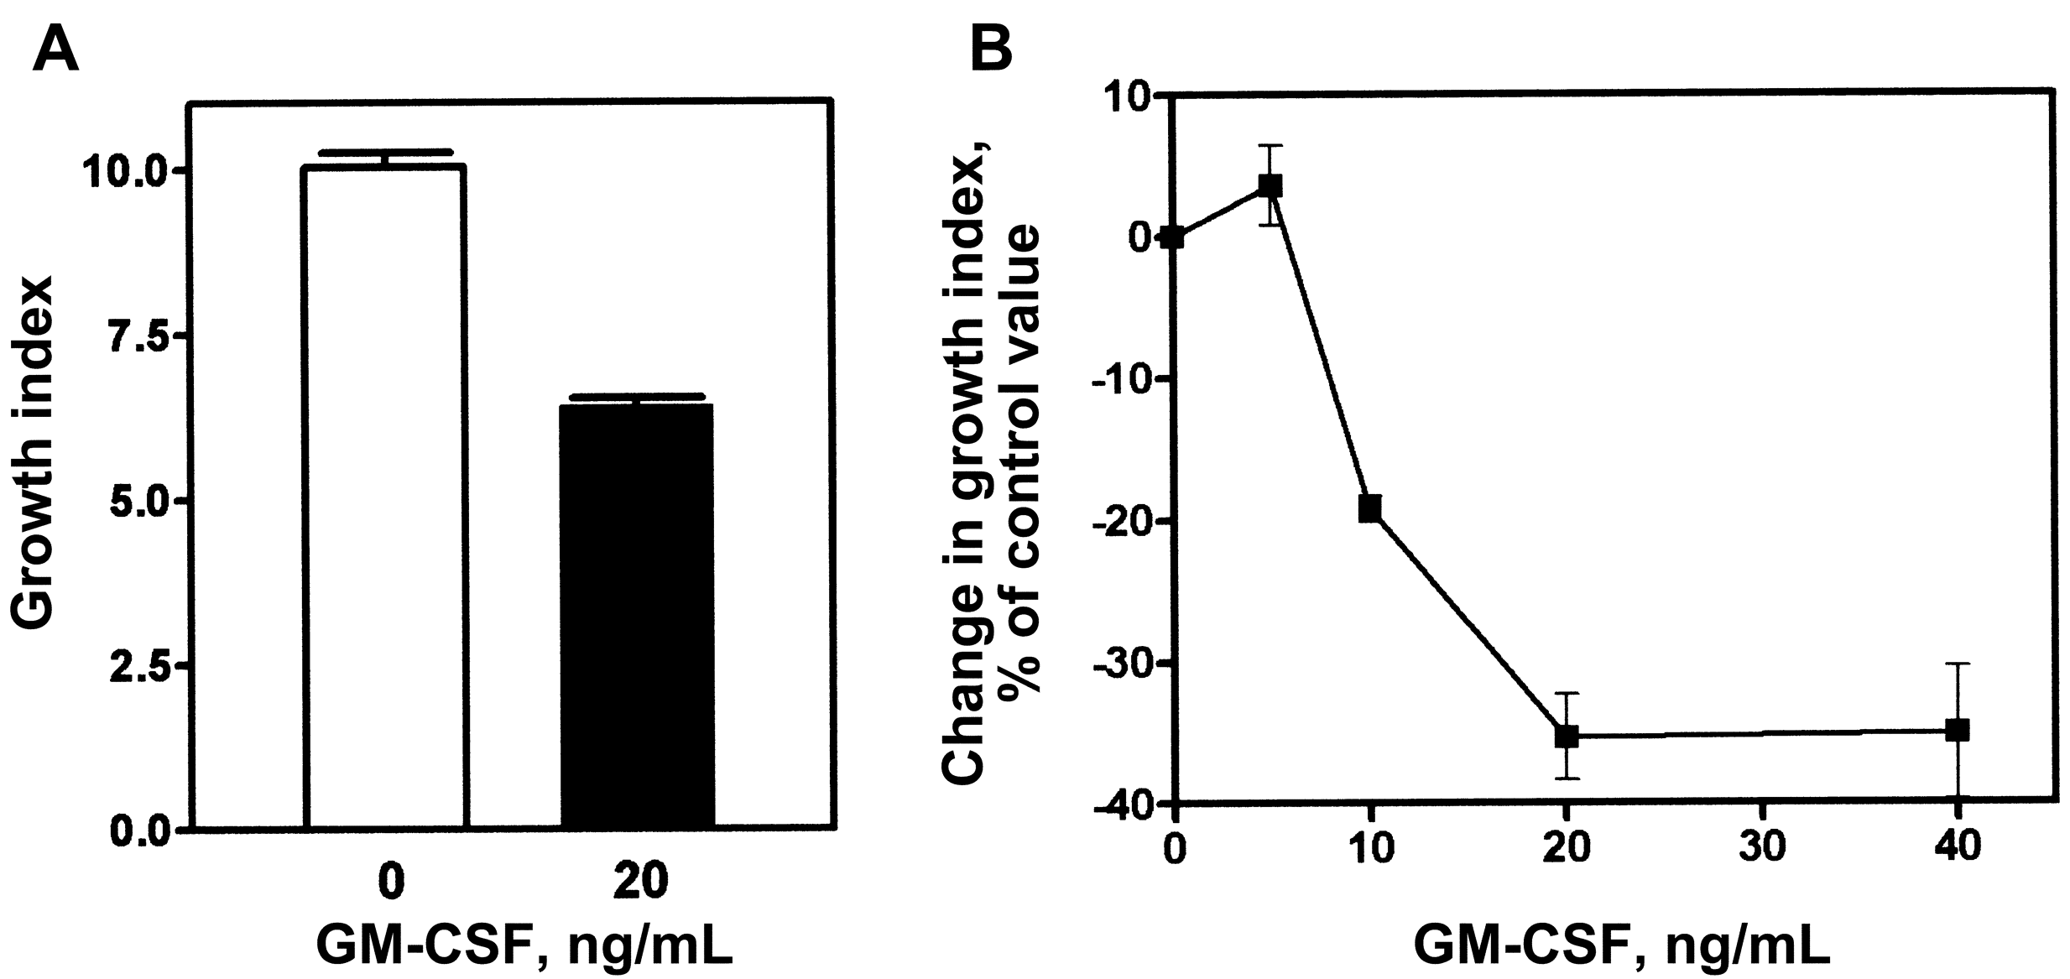
Figure 2. Influence of granulocyte macrophage colony-stimulating factor (GM-CSF) on the intracellular growth of ...
Notes:
Figure 2. Influence of granulocyte macrophage colony-stimulating factor (GM-CSF) on the intracellular growth of Listeria monocytogenes in THP-1 macrophages. A, Control cells (no GM-CSF) or cells exposed to GM-CSF, which were incubated for 24 h at 37°C before infection with L. monocytogenes and further intracellular growth (5 h) in the absence of GM-CSF. The growth index is defined as the ratio of the no. of colony-forming units (cfu)/mg cell protein collected from cells at the end of the 5-h incubation time to the no. of cfu/mg cell protein observed after phagocytosis and washing of the extracellular bacteria (time, 0 h). Each value is the mean (±SE) of 6 independent experiments, with each sample assayed in triplicate. B, Cells exposed to increasing concentrations of GM-CSF (24 h, 37°C) before being challenged for L. monocytogenes infection, as in the experiments shown in panel A. Each value is the mean (±SE) of 3 independent experiments, with each sample being assayed in triplicate.
Unless provided in the caption above, the following copyright applies to the content of this slide: © 2004 by the Infectious Diseases Society of America

Slide 3
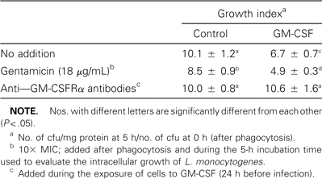
Table 1. Influence of gentamicin and anti-granulocyte macrophage colony-stimulating factor receptor (GM-CSFRα) ...
Notes:
Table 1. Influence of gentamicin and anti-granulocyte macrophage colony-stimulating factor receptor (GM-CSFRα) antibodies on the activity of GM-CSF toward the intracellular growth of Listeria monocytogenes.
Unless provided in the caption above, the following copyright applies to the content of this slide: © 2004 by the Infectious Diseases Society of America

Slide 4
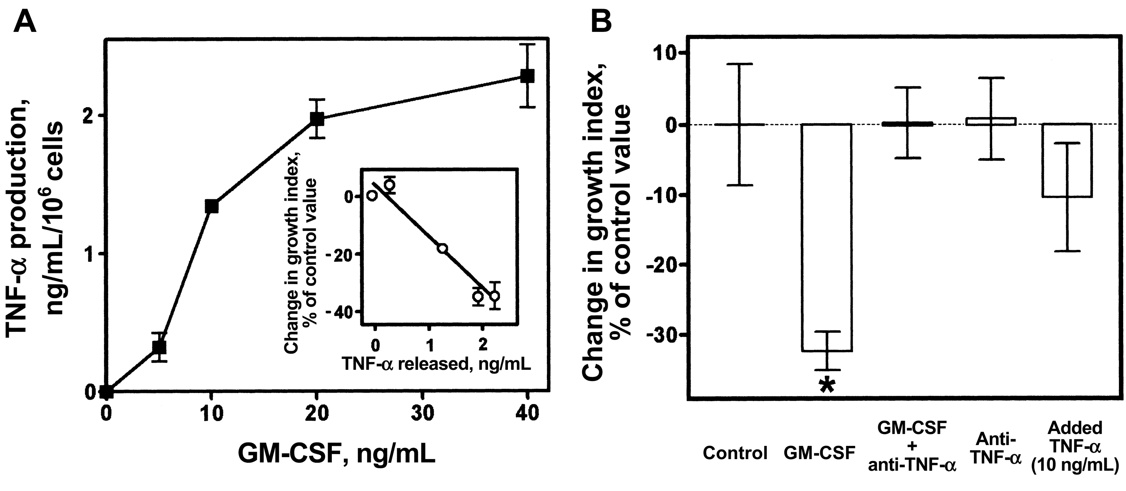
Figure 3. Secretion and role of tumor necrosis factor (TNF)-α in the impairment of growth of Listeria monocytogenes ...
Notes:
Figure 3. Secretion and role of tumor necrosis factor (TNF)-α in the impairment of growth of Listeria monocytogenes induced by granulocyte macrophage colony-stimulating factor (GM-CSF) in THP-1 cells. A, Release of TNF-α in the culture medium after a 24-h incubation at 37°C in the presence of increasing concentrations of GM-CSF. Data are means (±SD) of 3 determinations. The experiment was performed twice, with very similar results. Inset, Correlation between the release of TNF-α on exposure to GM-CSF (main graph) and impairment of the growth of L. monocytogenes (figure 2B). B, Influence of GMC-SF (20 ng/mL), GM-CSF (20 ng/mL) plus anti-TNF-α antibodies (2 µg/mL), anti-TNF-α antibodies (2 µg/mL), or added TNF-α (10 ng/mL) on the intracellular growth of L. monocytogenes. Experiments were conducted as described in figure 2 (see caption for the definition of the growth index). Data are means (±SD) of 3 determinations. Differences between groups were assessed by use of Student's t test (*P < .05). These experiments were performed twice, with very similar results.
Unless provided in the caption above, the following copyright applies to the content of this slide: © 2004 by the Infectious Diseases Society of America

Slide 5
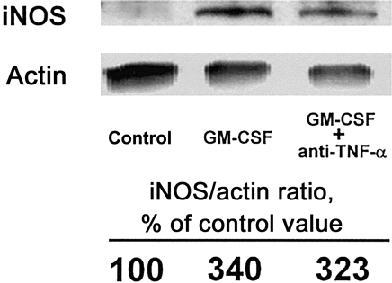
Figure 4. Expression of inducible nitric oxide synthase (iNOS) and of actin in control THP-1 cells and in cells exposed ...
Notes:
Figure 4. Expression of inducible nitric oxide synthase (iNOS) and of actin in control THP-1 cells and in cells exposed for 24 h at 37°C to granulocyte macrophage colony-stimulating factor (GM-CSF; 20 ng/ mL) or GM-CSF (20 ng/mL) plus anti-tumor necrosis factor (TNF)-α antibodies (2 µg/mL), as evidenced by Western blot analysis of cell lysates using anti iNOS and anti-actin antibodies, respectively. The migration distance of the bands corresponds to an estimated molecular weight of 118 (iNOS) and 47 (actin) kDa, respectively. The figures show the results of a photodensitometric scanning of the films in which the ratio of the iNOS to actin bands in each sample is expressed as the percentage of the value found in control cells.
Unless provided in the caption above, the following copyright applies to the content of this slide: © 2004 by the Infectious Diseases Society of America

Slide 6
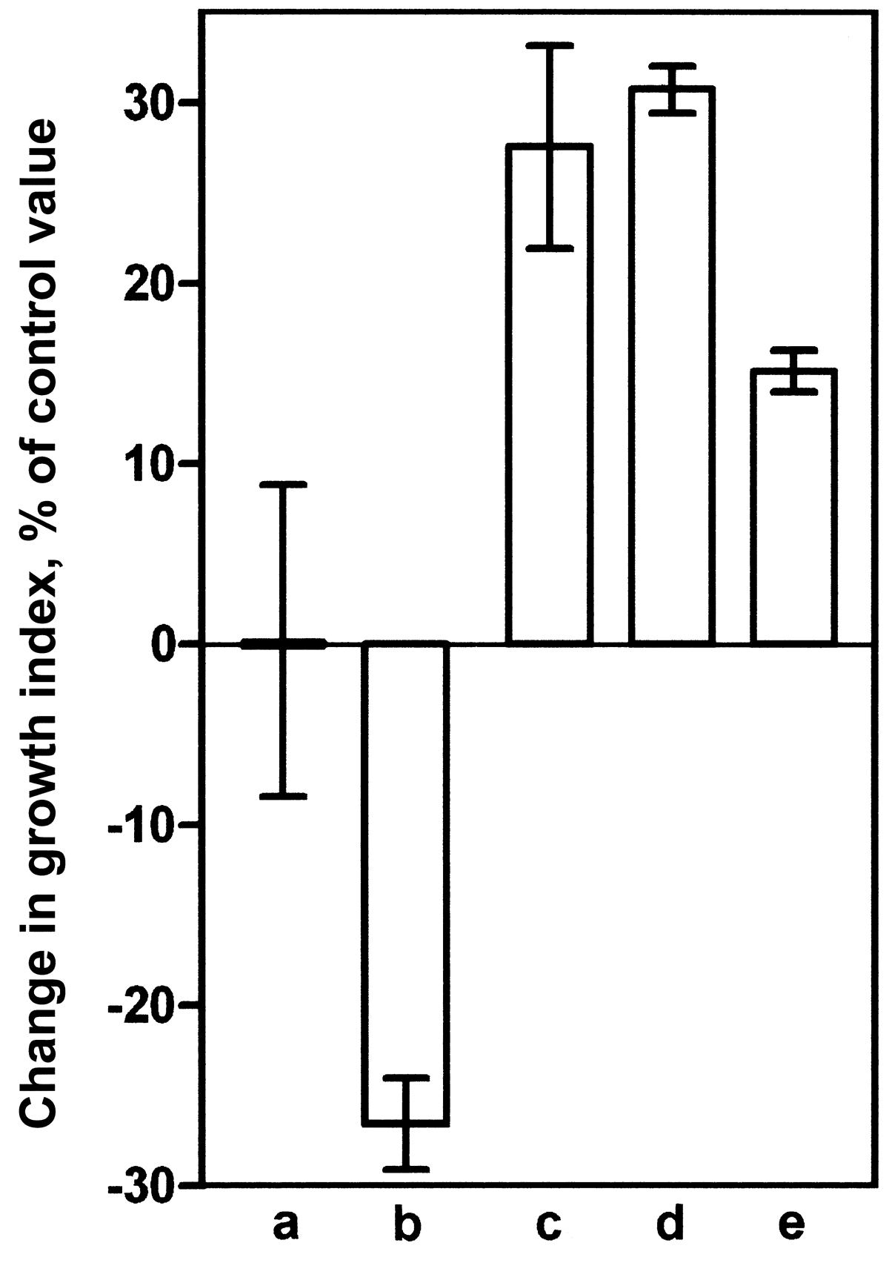
Figure 5. Role of nitric oxide and hydrogen peroxide in the impairment of the growth of Listeria monocytogenes induced ...
Notes:
Figure 5. Role of nitric oxide and hydrogen peroxide in the impairment of the growth of Listeria monocytogenes induced by granulocyte macrophage colony-stimulating factor (GM-CSF) in THP-1 cells: influence of GM-CSF (20 ng/mL), GM-CSF (20 ng/mL) plus Nω-nitro-l-arginine methyl ester (l-NAME; 400 µmol/L), and catalase (1500 U/mL), and only L-NAME (400 µmol/L) and catalase (1500 U/mL), each in combination with GM-CSF (20 ng/mL). Cells incubated with l-NAME and catalase but without GM-CSF showed a bacterial growth similar to that observed when they were combined with GMCSF (data not shown). Experiments were conducted as described in figure 2 (see caption for the definition of the growth index). Data are means (αSD) of pooled data from 2 series of experiments (with 3 determinations in each series). Statistical analysis (Student's t test with P < .05) showed that a, b, c, and e are different from one another but not c and d. a, Control; b, GM-CSF; c, GM-CSF, catalase, and l-NAME; d, GM-CSF and catalase; and e, GM-CSF and l-NAME.
Unless provided in the caption above, the following copyright applies to the content of this slide: © 2004 by the Infectious Diseases Society of America

