Slide 1
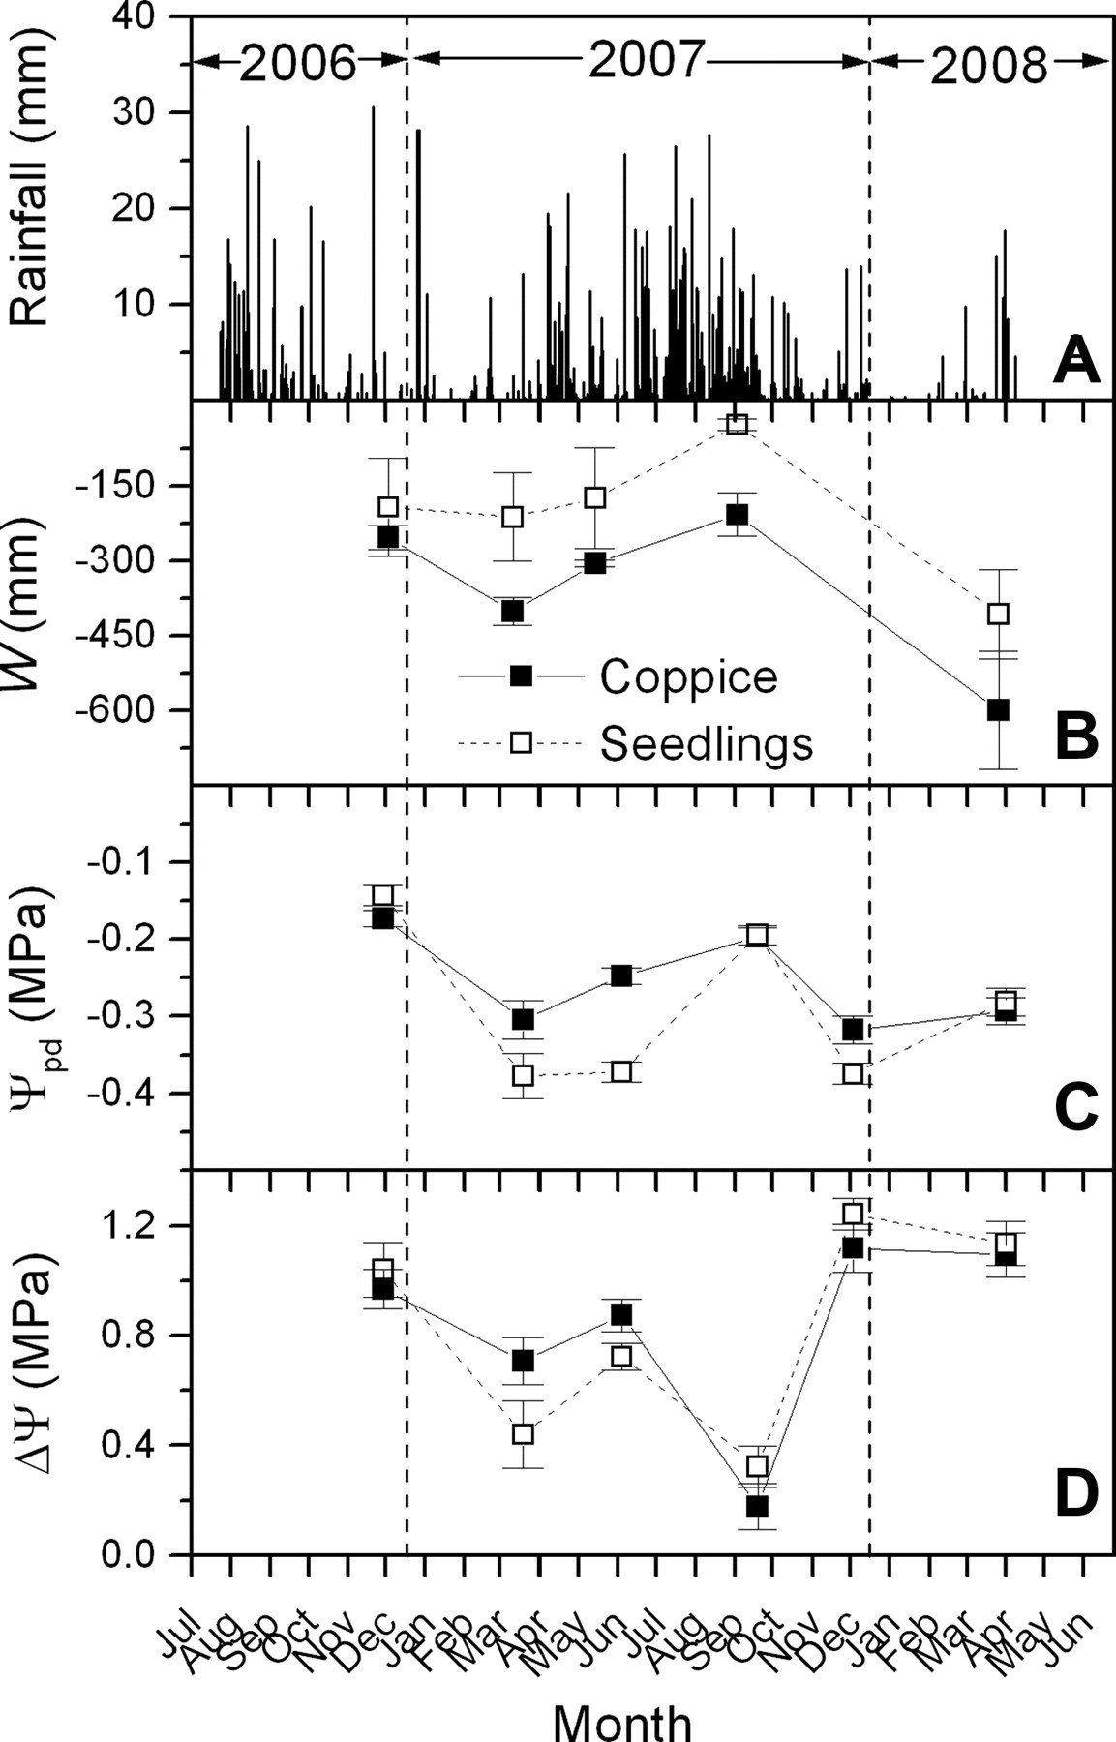
Figure 1. (A) Daily rainfall (mm), (B) soil water deficit (W, mm), (C) mean predawn (±SE, n = 15) leaf water potential ...
Notes:
Figure 1. (A) Daily rainfall (mm), (B) soil water deficit (W, mm), (C) mean predawn (±SE, n = 15) leaf water potential and (D) mean (±SE, n = 15) maximum root to leaf hydrodynamic pressure gradient (ΔΨ, MPa) of coppice and seedlings between December 2006 and April 2008.
Unless provided in the caption above, the following copyright applies to the content of this slide: © The Author 2009. Published by Oxford University Press. All rights reserved. For Permissions, please email: journals.permissions@oxfordjournals.org

Slide 2
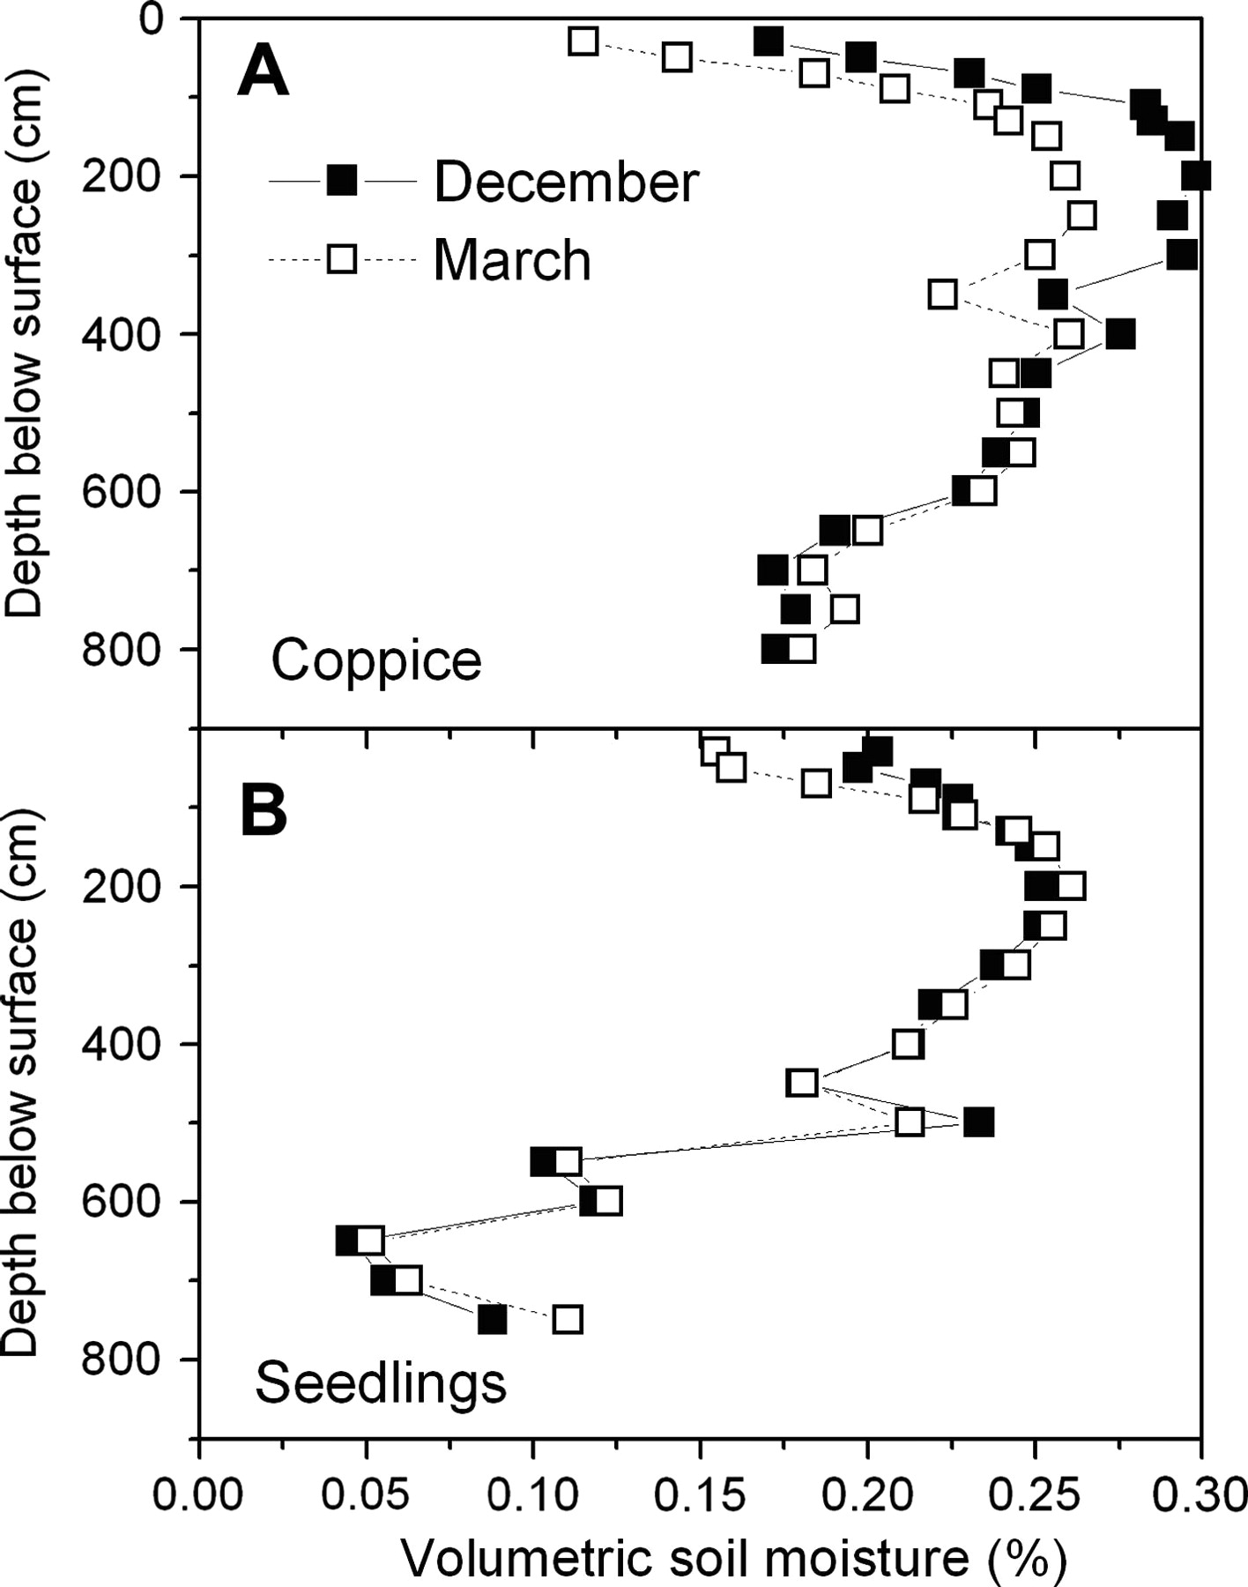
Figure 2. Volumetric soil water fraction, as a function of soil depth for (A) coppice and (B) seedlings.
Notes:
Figure 2. Volumetric soil water fraction, as a function of soil depth for (A) coppice and (B) seedlings.
Unless provided in the caption above, the following copyright applies to the content of this slide: © The Author 2009. Published by Oxford University Press. All rights reserved. For Permissions, please email: journals.permissions@oxfordjournals.org

Slide 3
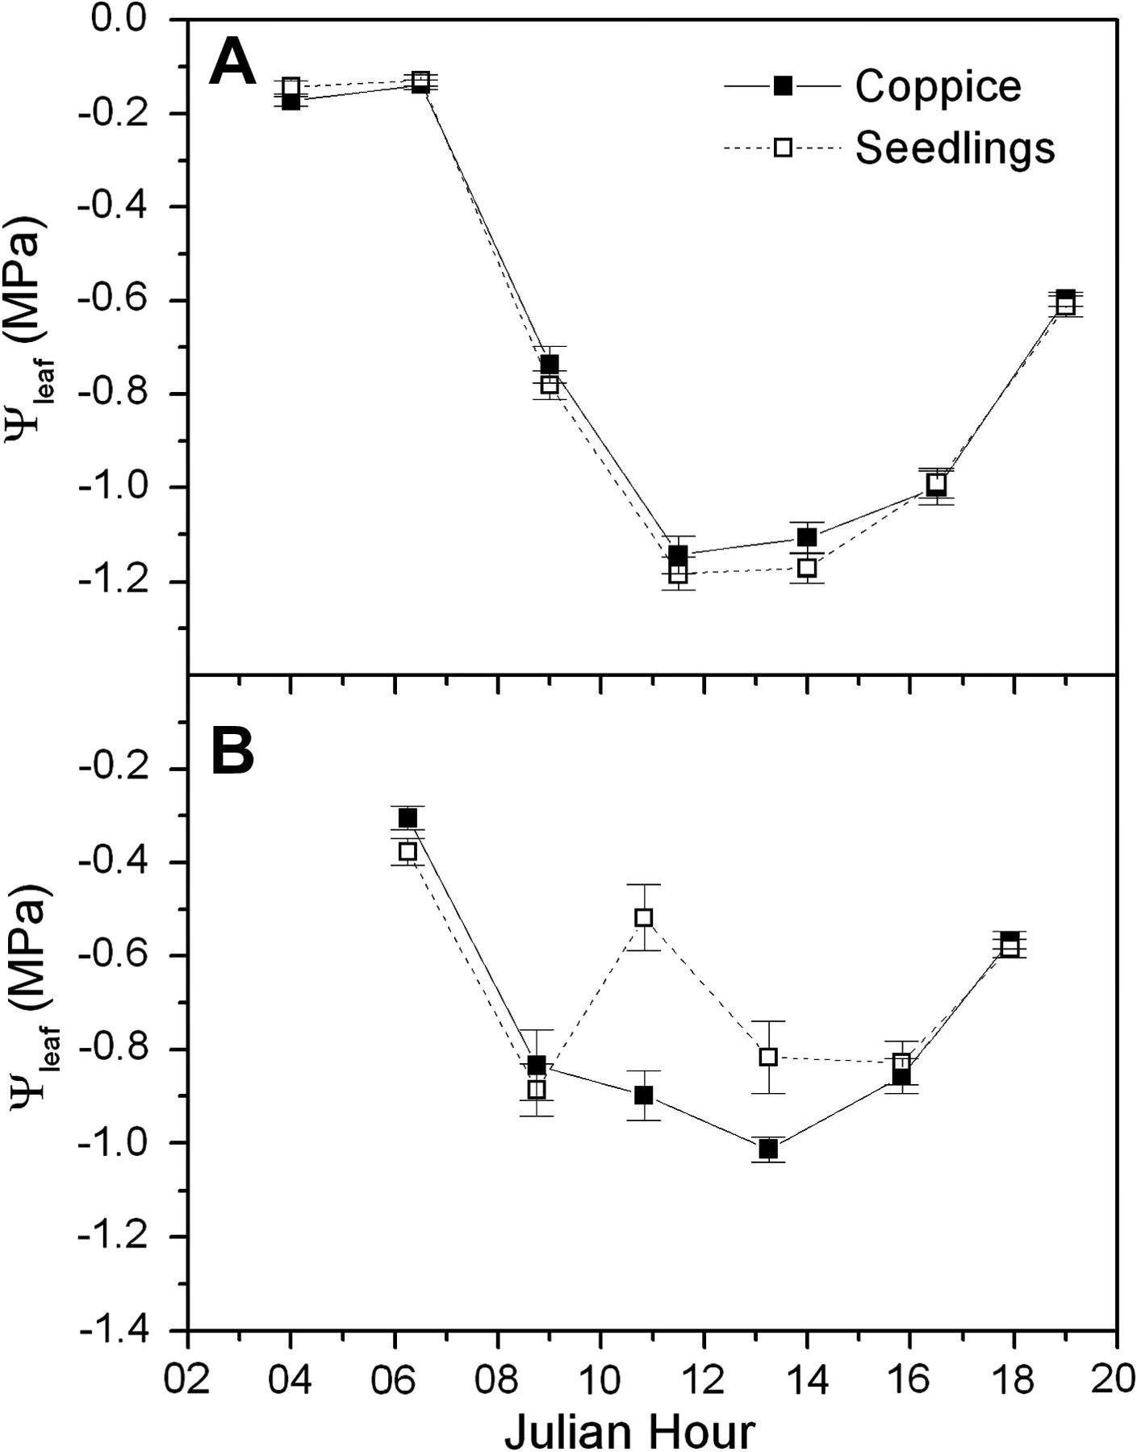
Figure 3. Diurnal course of leaf water potential (Ψ_{leaf}) for E. globulus coppice and seedlings during (A) ...
Notes:
Figure 3. Diurnal course of leaf water potential (Ψleaf) for E. globulus coppice and seedlings during (A) December 2006 and (B) March 2007.
Unless provided in the caption above, the following copyright applies to the content of this slide: © The Author 2009. Published by Oxford University Press. All rights reserved. For Permissions, please email: journals.permissions@oxfordjournals.org

Slide 4
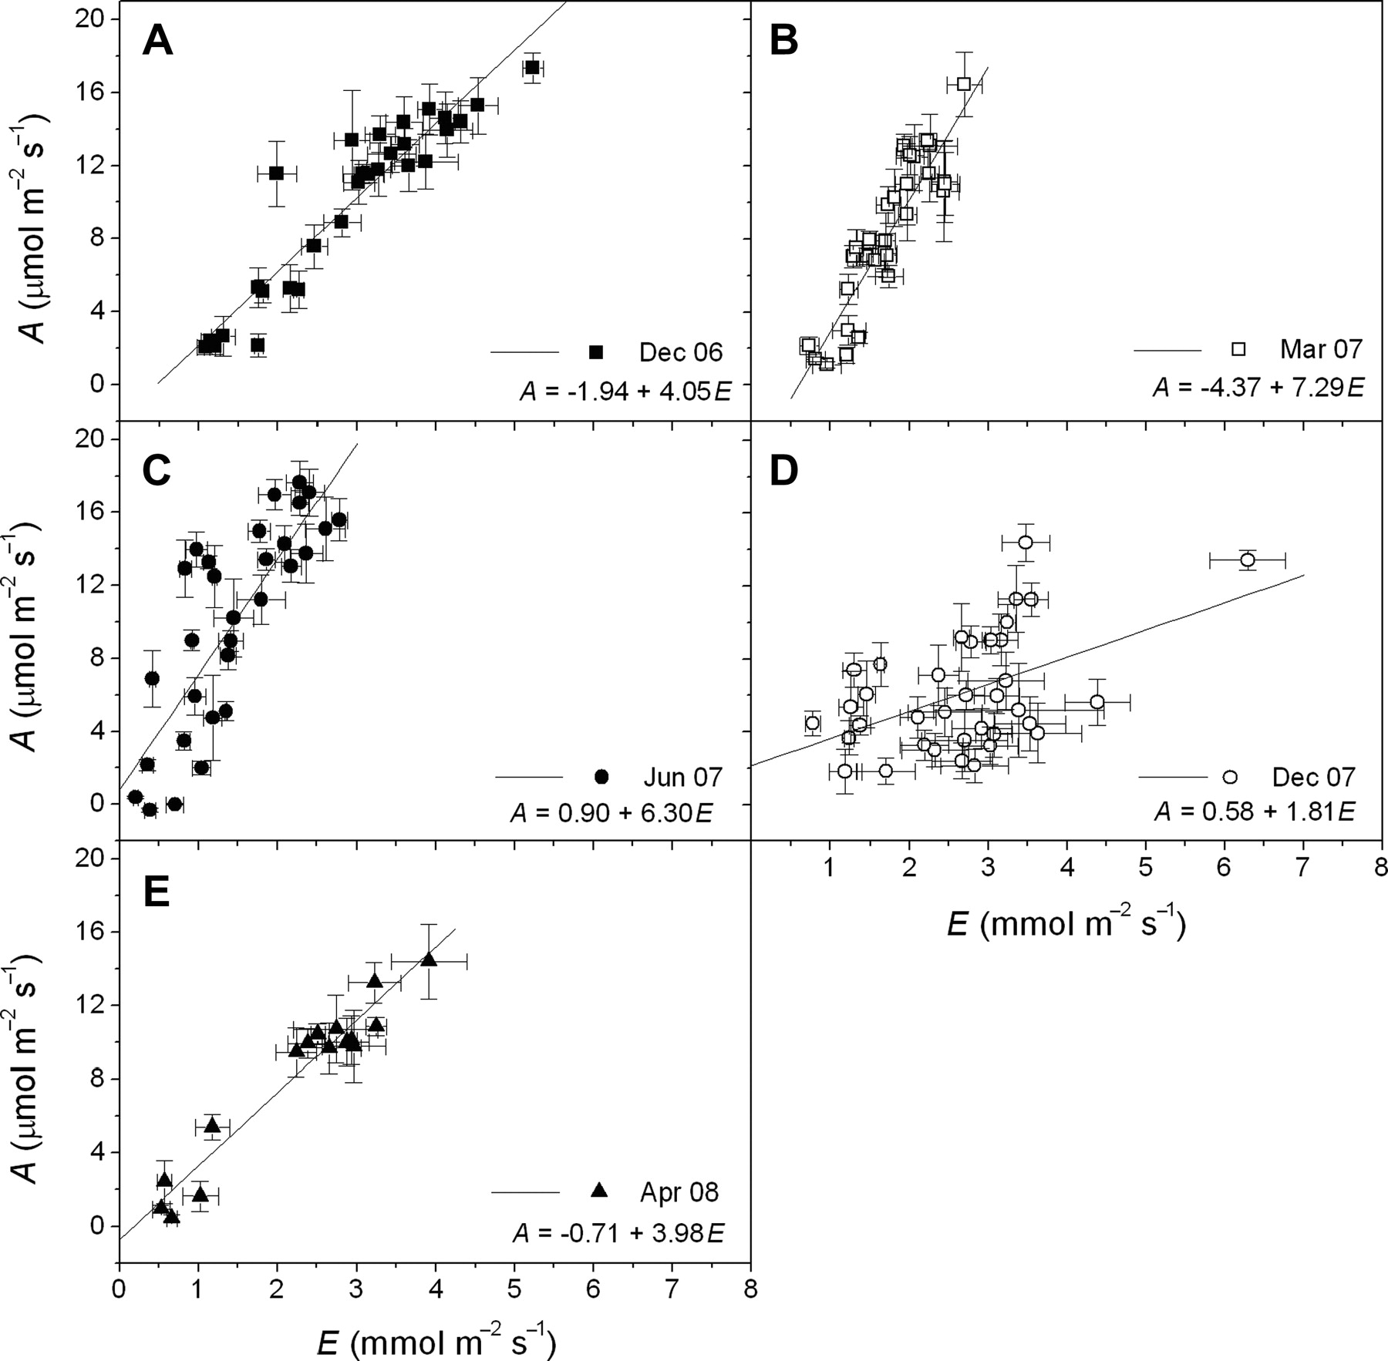
Figure 4. Leaf photosynthetic rate (A) as a function of leaf transpiration rate (E) on five diurnal measurements made ...
Notes:
Figure 4. Leaf photosynthetic rate (A) as a function of leaf transpiration rate (E) on five diurnal measurements made between December 2006 and April 2008 (A–E). For each time period r2 and P values for fitted models were as follows: (A) December 2006: 0.88 and < 0.0001; (B) March 2007: 0.81 and < 0.0001; (C) June 2007: 0.65 and < 0.0001; (D) December 2007: 0.34 and < 0.0001; and (E) April 2008: 0.94 and < 0.0001. Note that data obtained before sunrise and after sunset have been omitted and also note that coppice resprout and seedling data are pooled.
Unless provided in the caption above, the following copyright applies to the content of this slide: © The Author 2009. Published by Oxford University Press. All rights reserved. For Permissions, please email: journals.permissions@oxfordjournals.org

Slide 5
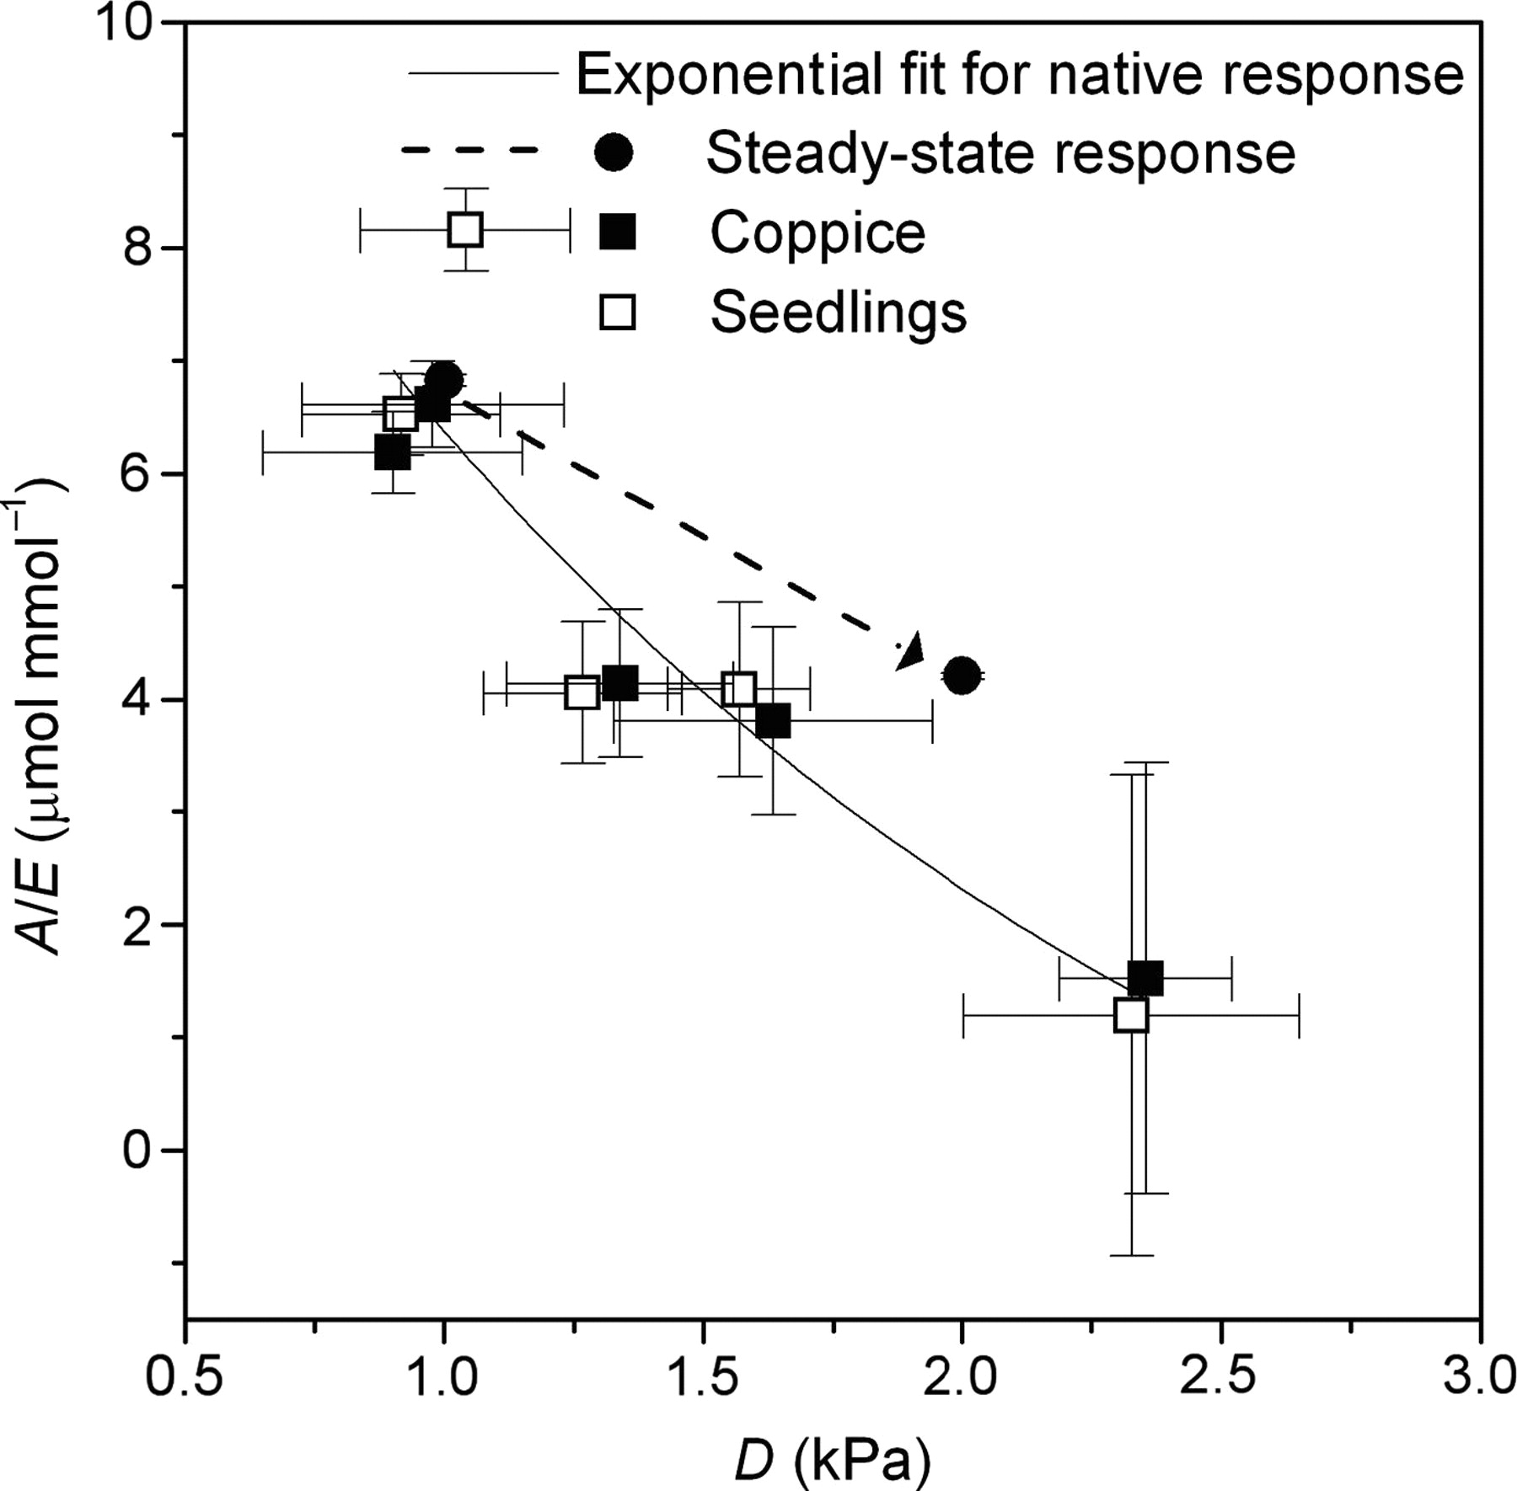
Figure 5. Daily integrated leaf-scale WUE, defined as the quotient of photosynthetic rate and transpiration rate (A/E), ...
Notes:
Figure 5. Daily integrated leaf-scale WUE, defined as the quotient of photosynthetic rate and transpiration rate (A/E), as a function of the daily average leaf-to-air vapour pressure difference (D) (note data for coppice and seedlings were pooled). The fitted exponential decay function has the equation: A/E = −3.12 + 10.03e((D − 0.90)/1.79) (r2 = 0.86). Also shown on the graph is a typical steady-state response of A/E to D for field-grown seedling E. globulus (Drake, unpublished data).
Unless provided in the caption above, the following copyright applies to the content of this slide: © The Author 2009. Published by Oxford University Press. All rights reserved. For Permissions, please email: journals.permissions@oxfordjournals.org

Slide 6
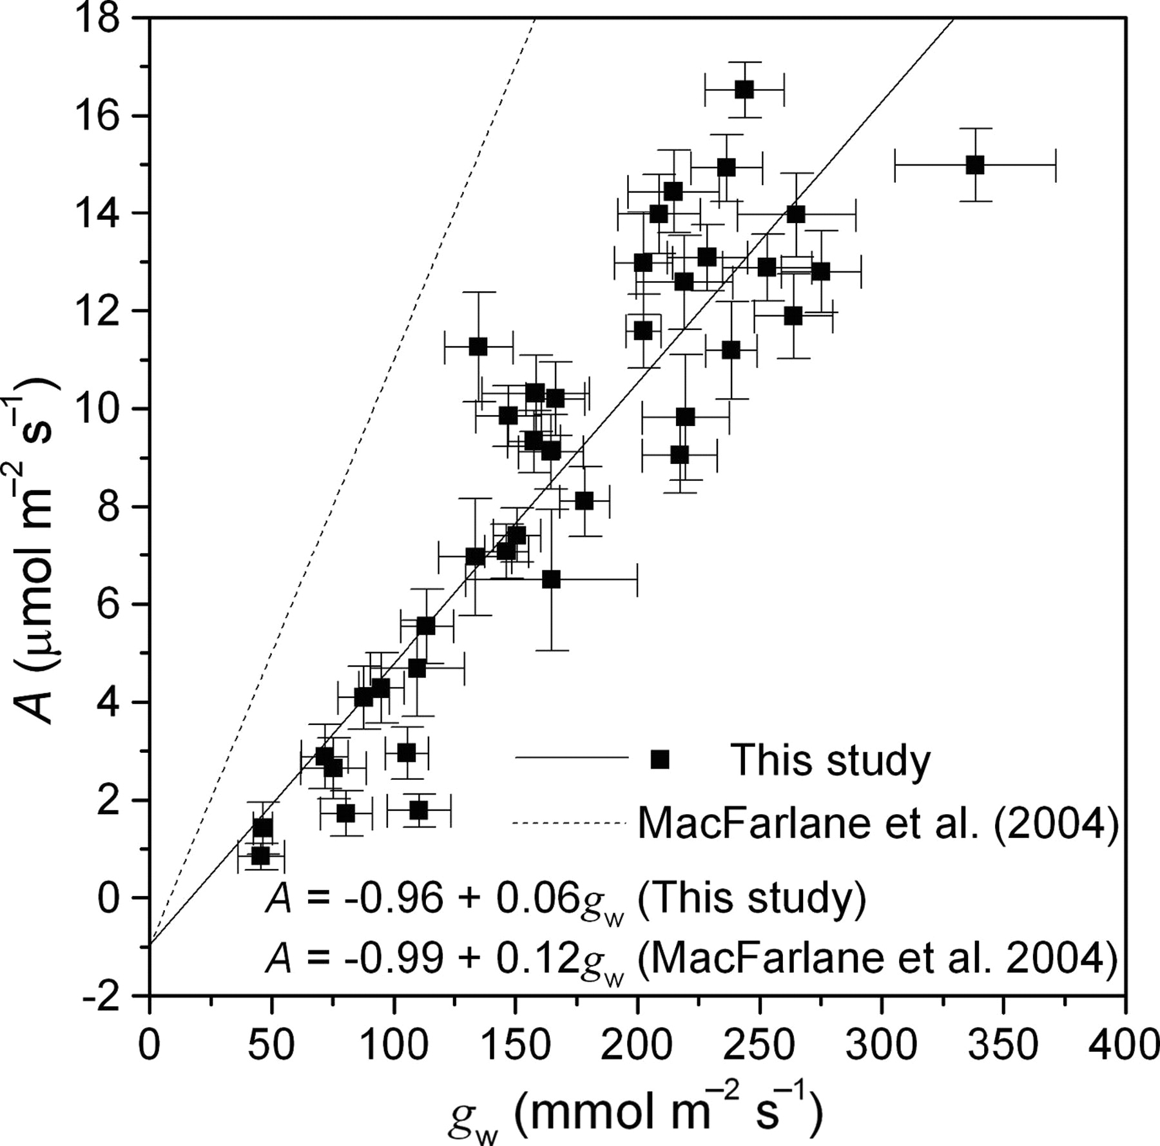
Figure 6. Leaf photosynthetic rate (A) was positively correlated with stomatal conductance to water vapour ...
Notes:
Figure 6. Leaf photosynthetic rate (A) was positively correlated with stomatal conductance to water vapour (gw) in a linear fashion (r2 = 0.81, P < 0.0001). Also shown on the graph is the same relationship for droughted E. globulus observed by Macfarlane et al. (2004b).
Unless provided in the caption above, the following copyright applies to the content of this slide: © The Author 2009. Published by Oxford University Press. All rights reserved. For Permissions, please email: journals.permissions@oxfordjournals.org

Slide 7
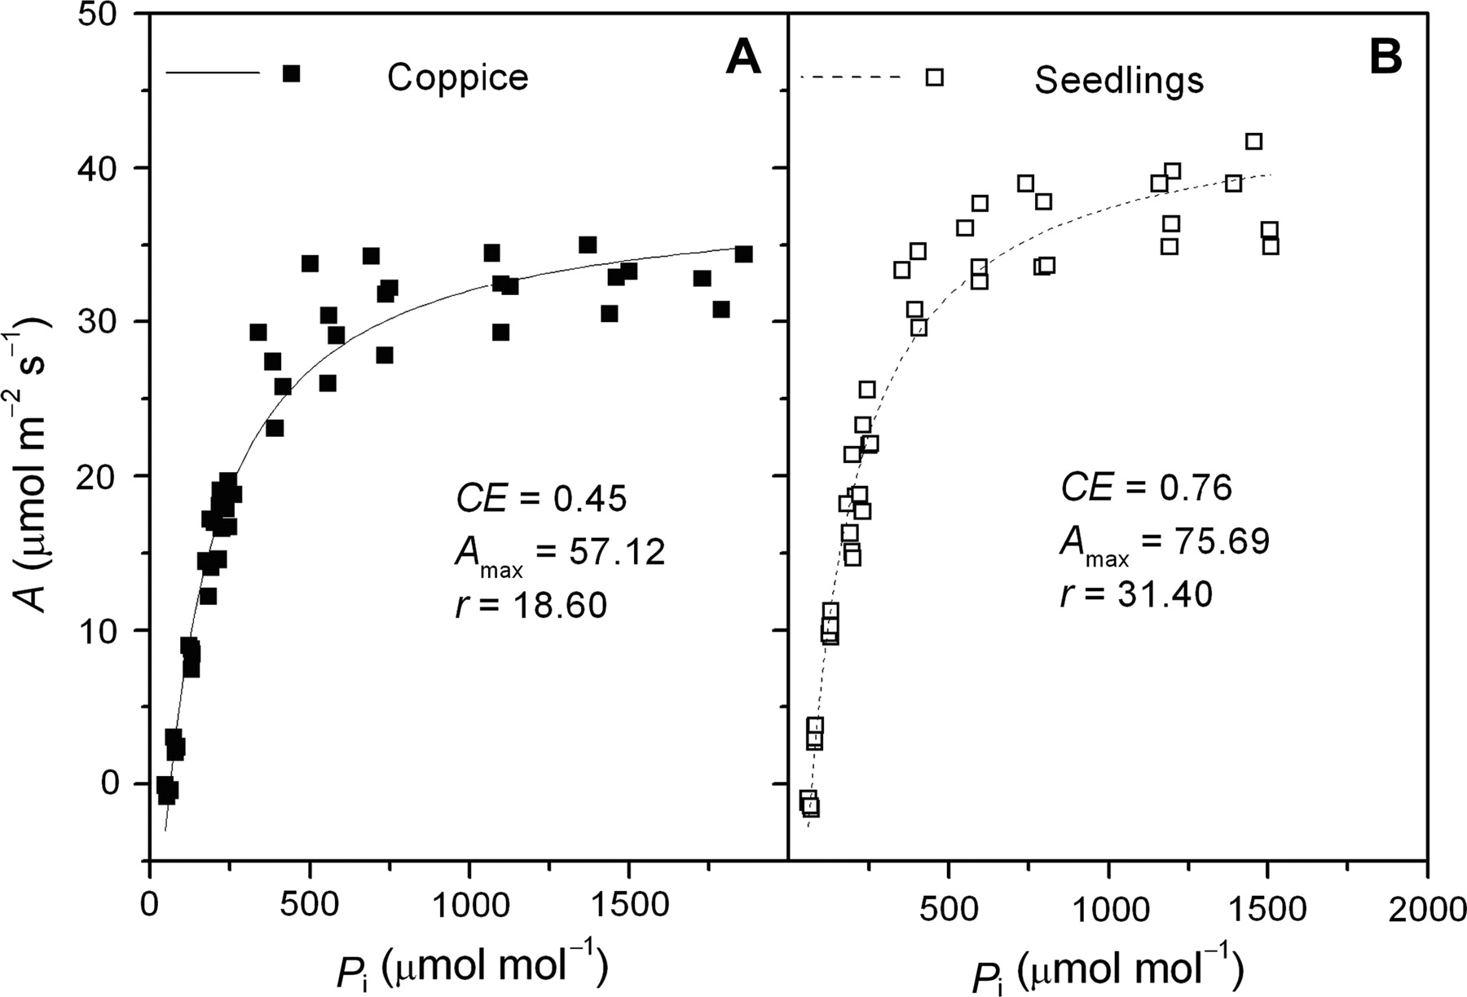
Figure 7. Comparative plots of leaf photosynthetic rate (A) versus the intercellular partial pressure of CO₂ ...
Notes:
Figure 7. Comparative plots of leaf photosynthetic rate (A) versus the intercellular partial pressure of CO2 (Pi) for coppice (A) and seedlings (B) (n = 4 for each). The fitted lines are rectangular hyperbolas: r2 = 0.96 for coppice and r2 = 0.97 for seedlings.
Unless provided in the caption above, the following copyright applies to the content of this slide: © The Author 2009. Published by Oxford University Press. All rights reserved. For Permissions, please email: journals.permissions@oxfordjournals.org

Slide 8
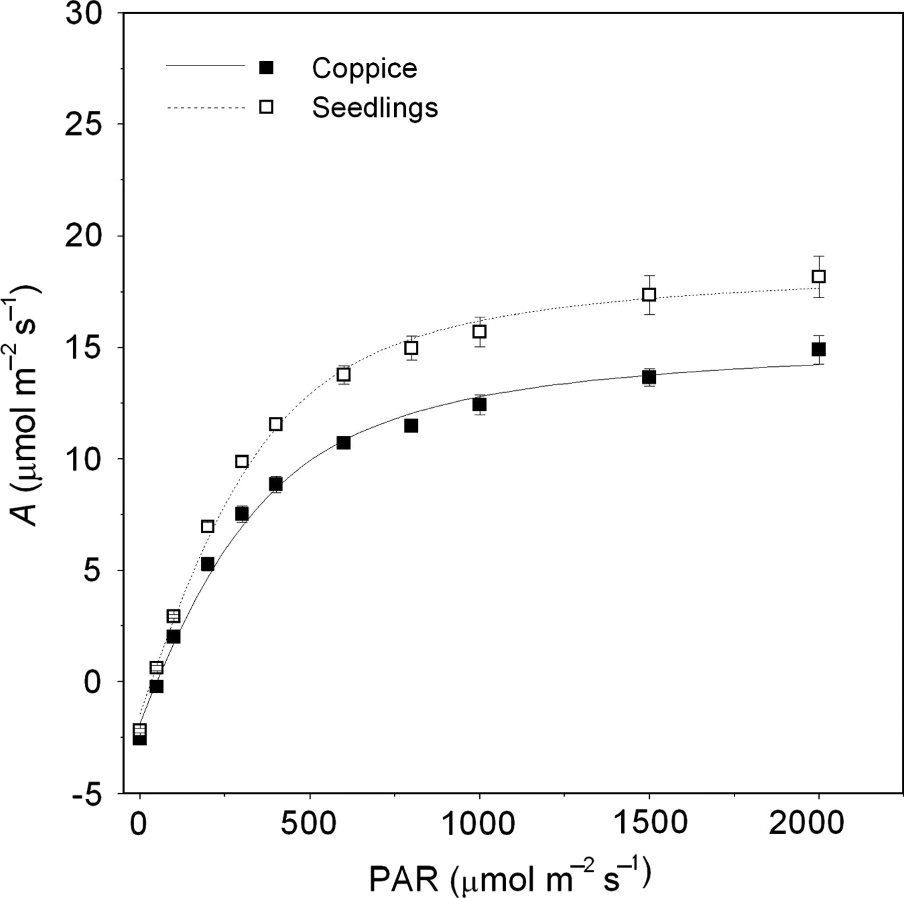
Figure 8. Leaf photosynthetic rate (A) as a function of PAR (or Q_{x} in Eq. 2) for coppice and seedlings. The ...
Notes:
Figure 8. Leaf photosynthetic rate (A) as a function of PAR (or Qx in Eq. 2) for coppice and seedlings. The fitted lines are non-rectangular hyperbolas: r2 = 0.99 for coppice and r2 = 0.99 for seedlings. The models yielded the following values for coppice and seedlings, respectively: apparent quantum yield (Φ): 0.04 and 0.05; light-saturated photosynthetic rate (Amax*): 17.40 and 20.32 μmol m−2 s−1 and leaf dark respiration rate (rd): 1.86 and 1.44 μmol m−2 s−1.
Unless provided in the caption above, the following copyright applies to the content of this slide: © The Author 2009. Published by Oxford University Press. All rights reserved. For Permissions, please email: journals.permissions@oxfordjournals.org

Slide 9
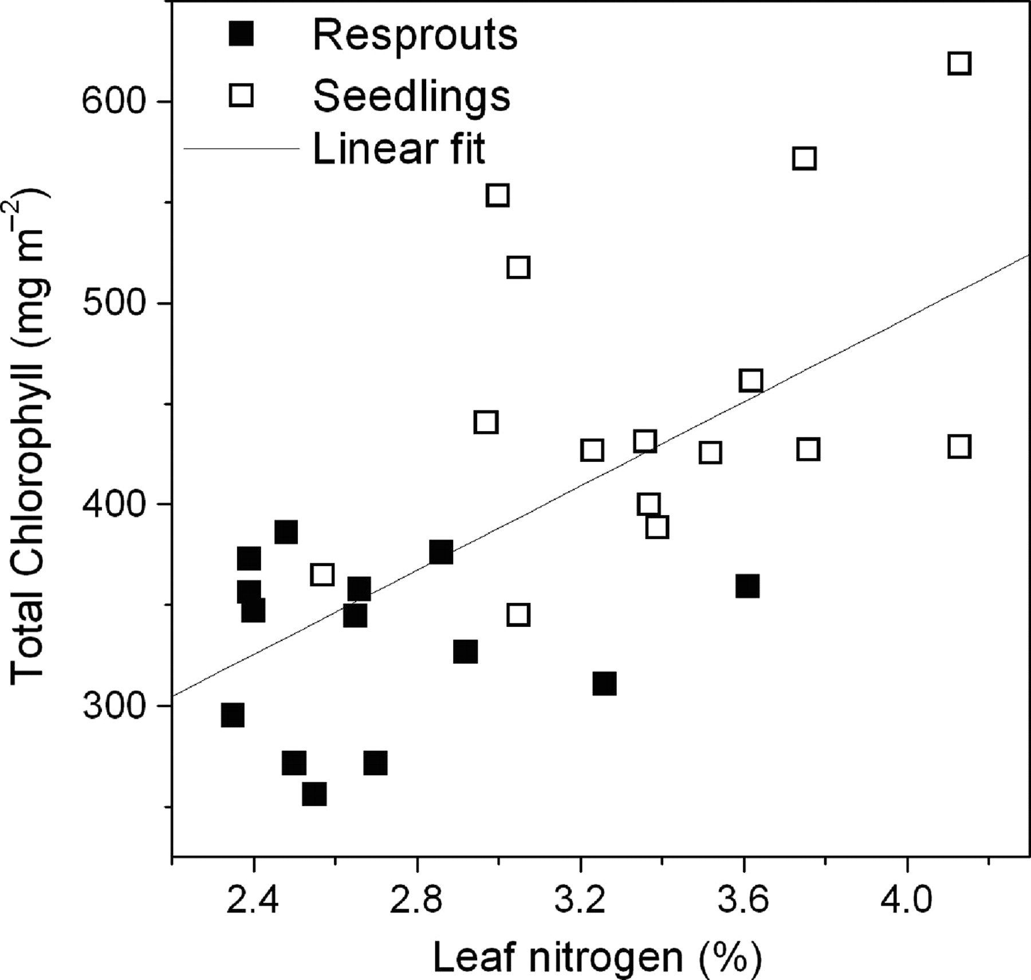
Figure 9. Total leaf chlorophyll (mg m⁻²) was positively correlated with leaf nitrogen content (%). The ...
Notes:
Figure 9. Total leaf chlorophyll (mg m−2) was positively correlated with leaf nitrogen content (%). The fitted linear model has the equation: total chlorophyll = 74.81 − 104.48 × leaf nitrogen (r2 = 0.40, P < 0.01).
Unless provided in the caption above, the following copyright applies to the content of this slide: © The Author 2009. Published by Oxford University Press. All rights reserved. For Permissions, please email: journals.permissions@oxfordjournals.org

