Slide 1
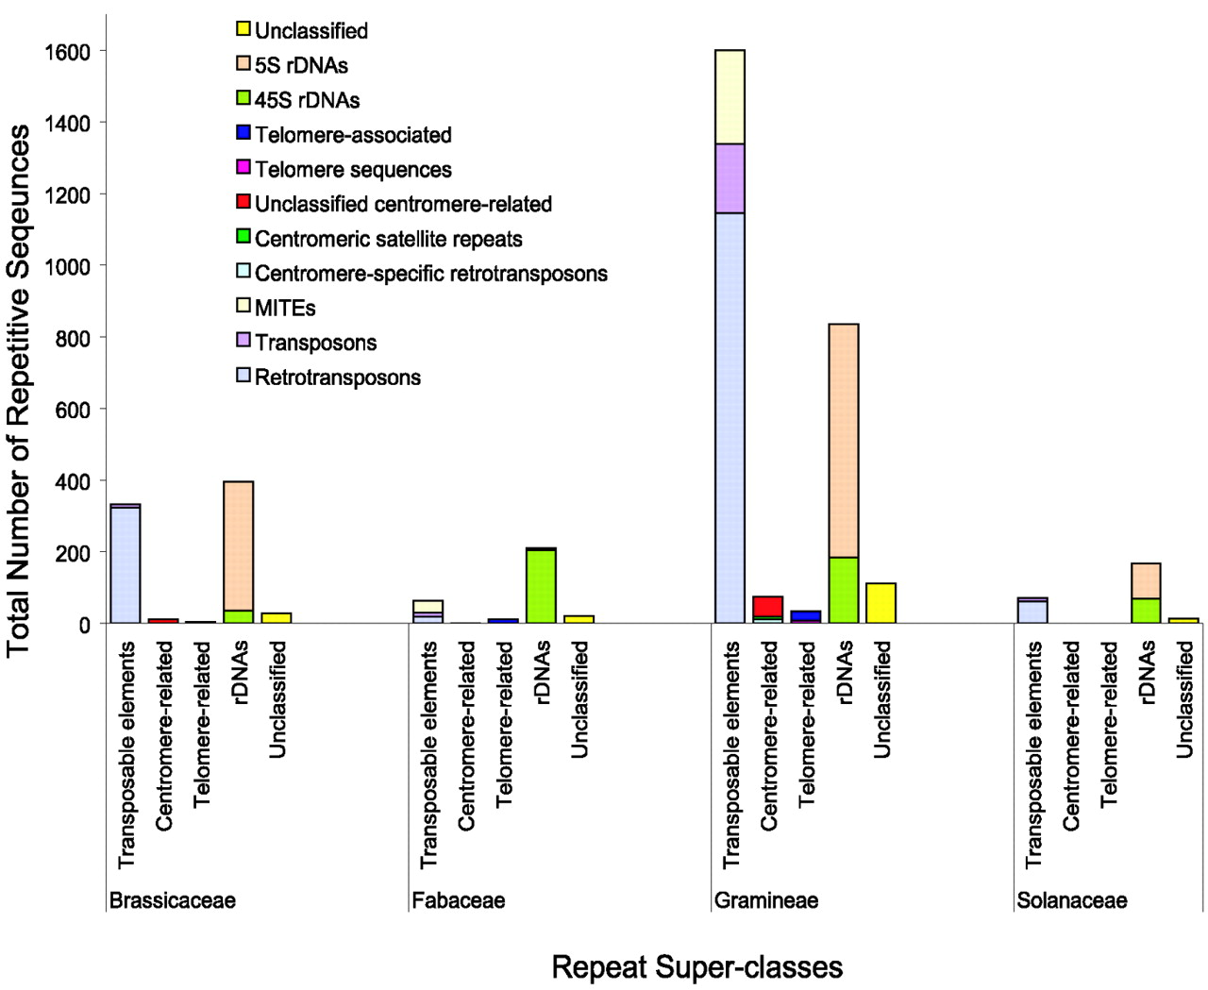
Figure 1. Composition of the plant family repeat databases. The numbers for each of the five repeat ...
Notes:
Figure 1. Composition of the plant family repeat databases. The numbers for each of the five repeat super‐classes and major classes within the four plant family repeat databases are shown.
Unless provided in the caption above, the following copyright applies to the content of this slide: Oxford University Press

