Slide 1
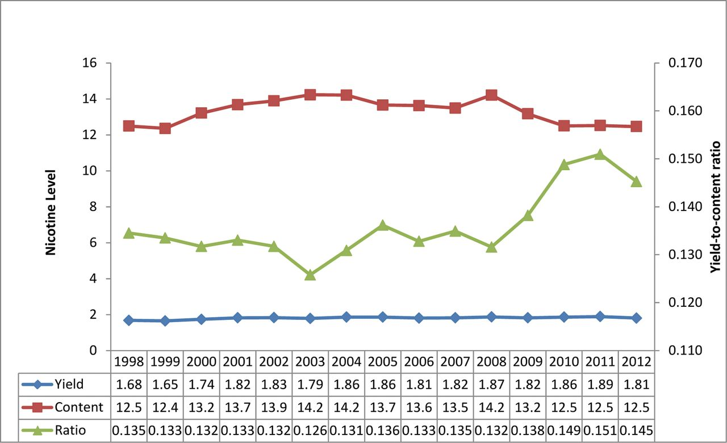
Figure 1. Trends in nicotine yield, content, and yield-to-content ratio.
Notes:
Figure 1. Trends in nicotine yield, content, and yield-to-content ratio.
Unless provided in the caption above, the following copyright applies to the content of this slide: © The Author 2014. Published by Oxford University Press on behalf of the Society for Research on Nicotine and Tobacco. All rights reserved. For permissions, please e-mail: journals.permissions@oup.com.

Slide 2
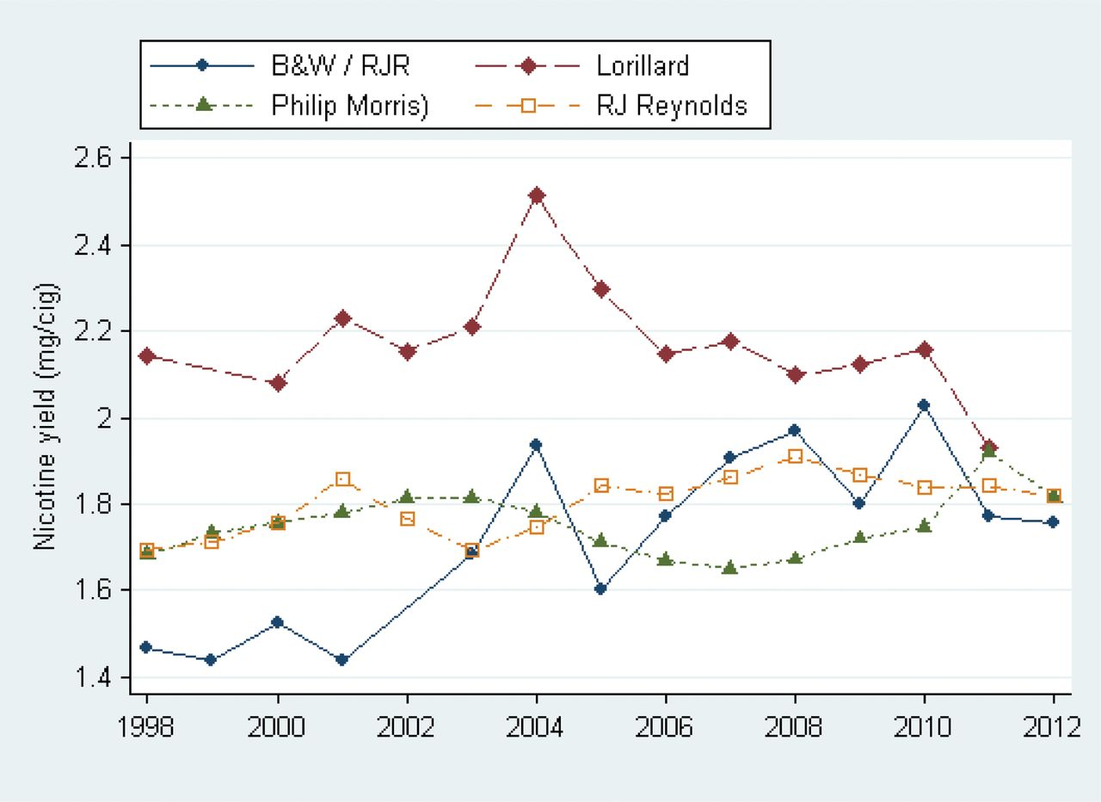
Figure 2. Mean nicotine yield (mg/cig) by manufacturer.
Notes:
Figure 2. Mean nicotine yield (mg/cig) by manufacturer.
Unless provided in the caption above, the following copyright applies to the content of this slide: © The Author 2014. Published by Oxford University Press on behalf of the Society for Research on Nicotine and Tobacco. All rights reserved. For permissions, please e-mail: journals.permissions@oup.com.

