Slide 1
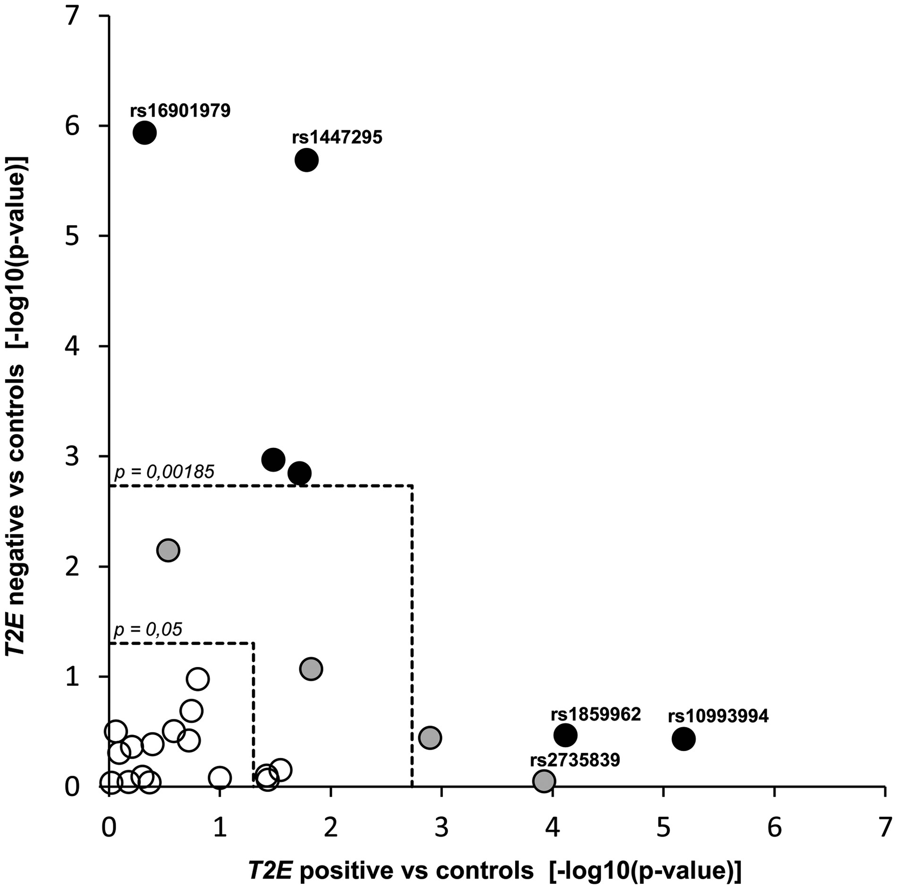
Figure 1. Mantel-Haenszel analysis showing associations between common PrCa risk variants and TMPRSS2:ERG (T2E) ...
Notes:
Figure 1. Mantel-Haenszel analysis showing associations between common PrCa risk variants and TMPRSS2:ERG (T2E) positive (x-axis) and T2E negative cases (y-axis) compared with controls. Analyses included n = 296 T2E fusion-positive and n = 256 T2E fusion-negative PrCa cases, which were separately compared with n = 7650 controls. Threshold lines correspond to nominal significance (P = 0.05, inner dashed square) and study significance adjusted for 27 variants (P = 0.00185, outer dashed square). Circles are colored based on separate analyses, where the variants were pre-checked for overall association with PrCa risk in all phenotyped cases (n = 552) versus all controls (Open circles: P > 0.05; gray: P < 0.05; black: P < 0.00185; Supplementary Material, Table S1). The majority of common risk variants was not associated with PrCa risk in the T2E phenotyped sample as compared with controls, and these remain unrelated to molecular subtype. Candidates significantly associated with PrCa risk showed stronger or unique associations for either T2E positive or negative PrCa. No variant was significantly associated with both subtypes. The highest ranked candidate variants, which were later genotyped in a replication dataset, are annotated with variant rs ID numbers.
Unless provided in the caption above, the following copyright applies to the content of this slide: © The Author 2016. Published by Oxford University Press.This is an Open Access article distributed under the terms of the Creative Commons Attribution License (http://creativecommons.org/licenses/by/4.0/), which permits unrestricted reuse, distribution, and reproduction in any medium, provided the original work is properly cited.

Slide 2
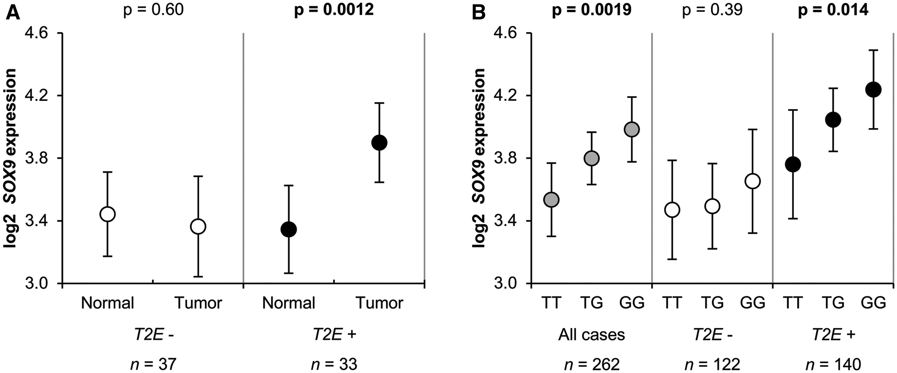
Figure 2. Expression levels of SOX9 according to TMPRSS2:ERG fusion status in adjacent benign and matched tumor tissues ...
Notes:
Figure 2. Expression levels of SOX9 according to TMPRSS2:ERG fusion status in adjacent benign and matched tumor tissues (A) and in eQTL analyses of rs1859962 (B). Mean values of log2 expression levels are presented with corresponding 95% CI. Significant P-values are in bold-type. (A) SOX9 expression levels in pairs of 70 tumor and adjacent benign tissues for TMPRSS2:ERG fusion-negative (open circles) and fusion-positive cases (black circles). P-values are derived from paired t-tests. (B) SOX9 expression levels according to rs1859962 genotype for all tumor samples (n = 262; gray circles), TMPRSS2:ERG fusion-negative samples (n = 22; open circles) and fusion-positive samples (n = 140; black circles). P-values correspond to the association between risk alleles and expression levels in a linear regression model.
Unless provided in the caption above, the following copyright applies to the content of this slide: © The Author 2016. Published by Oxford University Press.This is an Open Access article distributed under the terms of the Creative Commons Attribution License (http://creativecommons.org/licenses/by/4.0/), which permits unrestricted reuse, distribution, and reproduction in any medium, provided the original work is properly cited.

