Slide 1
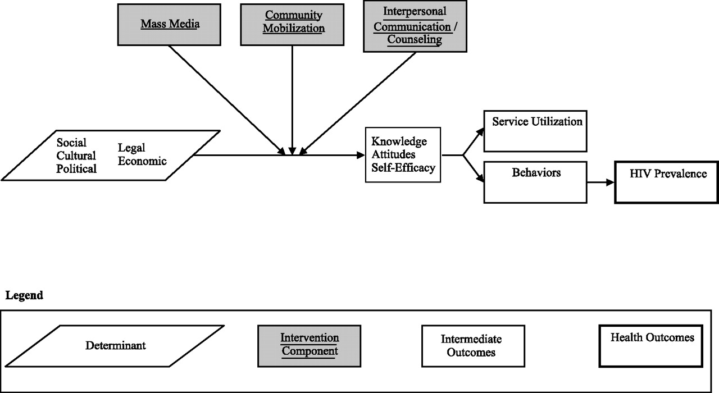
Fig. 1 Conceptual framework for the effect of communication programs.
Notes:
Fig. 1 Conceptual framework for the effect of communication programs.
Unless provided in the caption above, the following copyright applies to the content of this slide: © 2006 The Author(s).This is an Open Access article distributed under the terms of the Creative Commons Attribution Non-Commercial License (http://creativecommons.org/licenses/by-nc/2.0/uk/) which permits unrestricted non-commercial use, distribution, and reproduction in any medium, provided the original work is properly cited.

Slide 2
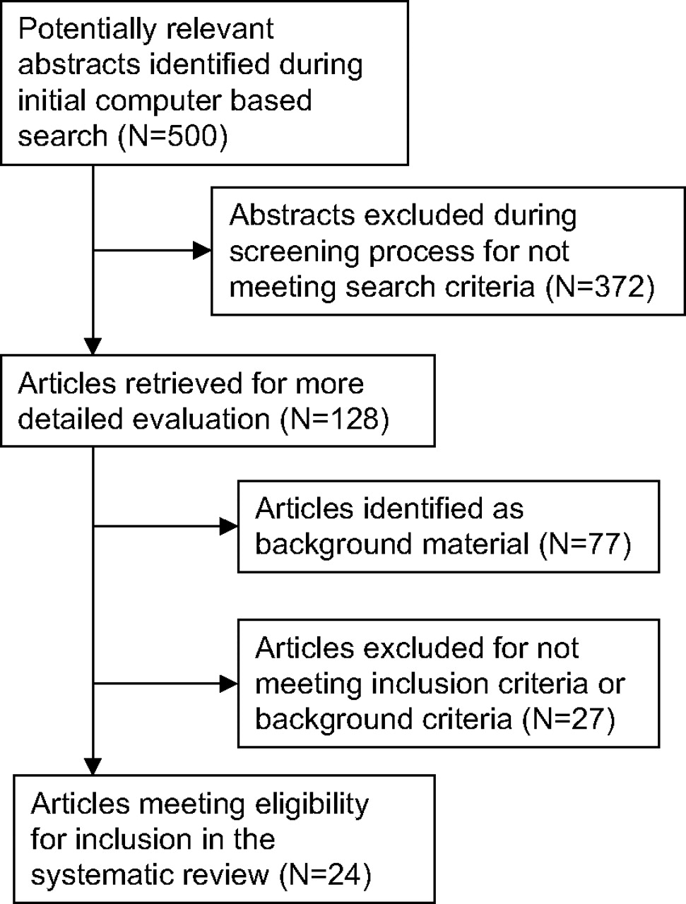
Fig. 2 Selection of articles for systematic review.
Notes:
Fig. 2 Selection of articles for systematic review.
Unless provided in the caption above, the following copyright applies to the content of this slide: © 2006 The Author(s).This is an Open Access article distributed under the terms of the Creative Commons Attribution Non-Commercial License (http://creativecommons.org/licenses/by-nc/2.0/uk/) which permits unrestricted non-commercial use, distribution, and reproduction in any medium, provided the original work is properly cited.

