Slide 1
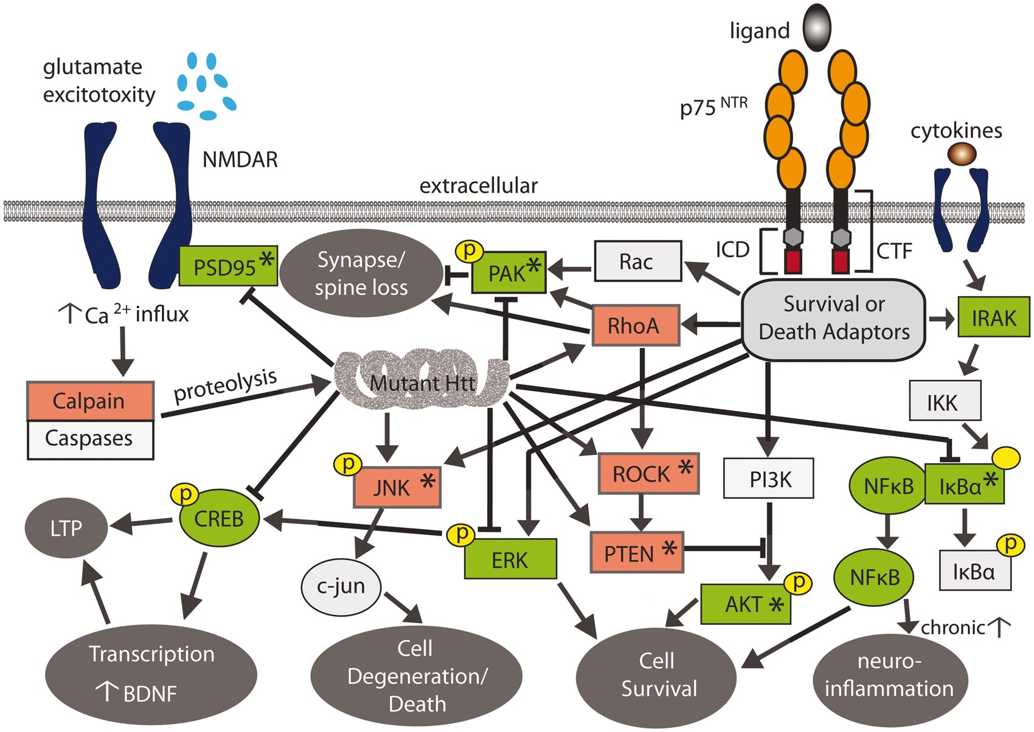
Figure 1 p75^{NTR} signalling pathways and HD neuropathological mechanisms are affected by LM11A-31. ...
Notes:
Figure 1 p75NTR signalling pathways and HD neuropathological mechanisms are affected by LM11A-31. Simplified schematic showing the signalling pathways regulated by p75NTR and their overlap with muHtt-affected signalling networks contributing to HD neuropathology. Many signalling pathways regulated by p75NTR are dysregulated by muHtt (arrows indicate up-regulation; ⊢ indicates inhibition). LM11A-31 activates signalling intermediates shown in green while inhibiting those in red as shown previously (23); asterisks indicate intermediates shown to be affected in R6/2 and/or BACHD mice in the present study.
Unless provided in the caption above, the following copyright applies to the content of this slide: © The Author 2016. Published by Oxford University Press.This is an Open Access article distributed under the terms of the Creative Commons Attribution Non-Commercial License (http://creativecommons.org/licenses/by-nc/4.0/), which permits non-commercial re-use, distribution, and reproduction in any medium, provided the original work is properly cited. For commercial re-use, please contact journals.permissions@oup.com

Slide 2
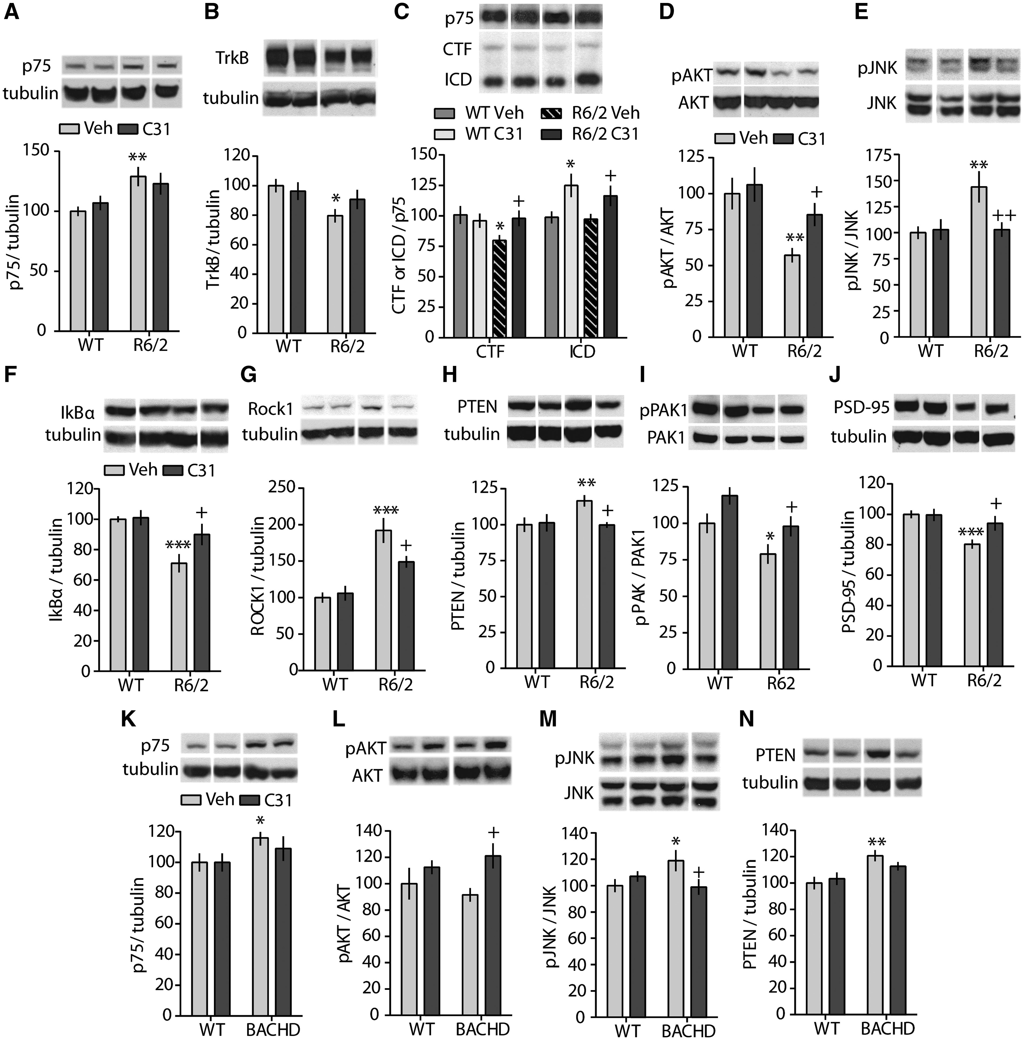
Figure 2 LM11A-31 initiates p75^{NTR} cleavage and normalizes p75^{NTR}-associated signalling in ...
Notes:
Figure 2 LM11A-31 initiates p75NTR cleavage and normalizes p75NTR-associated signalling in striatum of R6/2 and/or BACHD mice. (A–J) Representative western blots of striatal homogenates from WT and R6/2 mice treated with vehicle (Veh) or LM11A-31 (C31) depicting: (A) full-length p75NTR, (B) TrkB, (C) p75-CTF and -ICD, (D) pAKT, (E) pJNK, (F) Iκβα, (G) Rock1, (H) PTEN, (I) pPAK1 and (J) PSD-95. (K–N) Representative western blots of striatal homogenates from WT and BACHD mice showing (K) full-length p75NTR, (L) pAKT, (M) pJNK and (N) PTEN. *P < 0.05, **P ≤ 0.01, ***P ≤ 0.005 vs. their respective WT-Veh groups; +P < 0.05, ++P ≤ 0.01 vs. transgenic (R6/2 or BACHD) Veh groups; ANOVA with Fisher’s LSD post hoc test; n = 8–20 mice/group. Means (± s.e.m.) were from 4 to 6 replicated runs for each mouse sample and were normalized to the WT-Veh group run on the same gel. Immunobands from one mouse per group run on the same gel and corresponding group densitometric analyses are shown. In some instances, non-adjacent bands from the same gel were juxtaposed to facilitate comparisons. These bands were separated by spaces to indicate they were not adjacent in the original gel. Tubulin or the non-phosphorylated protein from the same stripped and re-probed gel is also shown.
Unless provided in the caption above, the following copyright applies to the content of this slide: © The Author 2016. Published by Oxford University Press.This is an Open Access article distributed under the terms of the Creative Commons Attribution Non-Commercial License (http://creativecommons.org/licenses/by-nc/4.0/), which permits non-commercial re-use, distribution, and reproduction in any medium, provided the original work is properly cited. For commercial re-use, please contact journals.permissions@oup.com

Slide 3
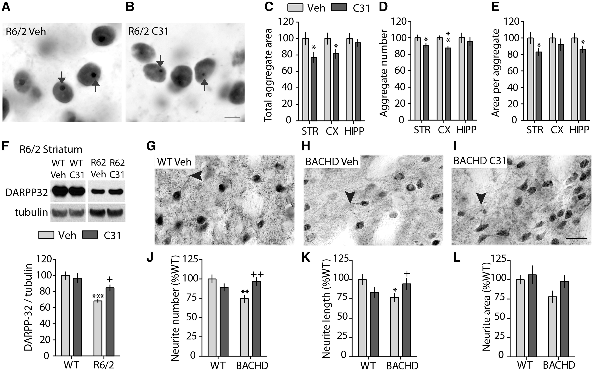
Figure 3 LM11A-31 ameliorates two principal HD neuropathologies: intranuclear Htt aggregates and striatal DARPP-32 ...
Notes:
Figure 3 LM11A-31 ameliorates two principal HD neuropathologies: intranuclear Htt aggregates and striatal DARPP-32 deficits. (A–B) Representative photomicrographs showing nuclear Htt immunostaining in striatum (STR) of R6/2 mice treated with Veh (A) or C31 (B). Arrows indicate intranuclear Htt aggregates. Scale bar in B= 20 μm. (C–E) Quantification of the total area occupied by Htt aggregates (C), aggregate number (D) and aggregate size (E) in STR, cortex (CX), and hippocampus (HIPP) of R6/2 mice given Veh or C31 (*P < 0.05, **P = 0.002 vs. R6/2-Veh, one-tailed Student’s t-test; n = 11–12 mice/group). Values in C–E are normalized to the R6/2-Veh group. (F) Representative Western blot for DARPP-32 showing immunobands from striatal homogenates of WT and R6/2 mice treated with Veh or C31and corresponding densitometric group analyses (***P < 0.001 vs. R6/2-Veh; +P ≤ 0.05; n = 11–12 mice/group; ANOVA with Fisher’s LSD). To facilitate comparisons, non-adjacent bands from the same gel were juxtaposed and separated by spaces to indicate they were not adjacent in the original gel. Tubulin from the same stripped and re-probed gel is also shown. (G–I) DARPP-32 immunostaining in striata of WT-Veh mice and BACHD mice treated with Veh or C31. Scale bar in I = 20 μm. Arrowheads indicate distal ends of neurites. (J–L) Quantification of the number (J), length (K), and area (L) of DARPP-32-stained neurites in STR of WT and BACHD mice (*P ≤ 0.05, **P = 0.005 vs. WT-Veh; +P = 0.05, ++P ≤ 0.005 vs. BACHD-Veh; n = 7–11 mice/group; ANOVA with Fisher’s LSD). Values in (F–L) are normalized to their respective WT-Veh groups. Results are expressed as mean ± s.e.m.
Unless provided in the caption above, the following copyright applies to the content of this slide: © The Author 2016. Published by Oxford University Press.This is an Open Access article distributed under the terms of the Creative Commons Attribution Non-Commercial License (http://creativecommons.org/licenses/by-nc/4.0/), which permits non-commercial re-use, distribution, and reproduction in any medium, provided the original work is properly cited. For commercial re-use, please contact journals.permissions@oup.com

Slide 4
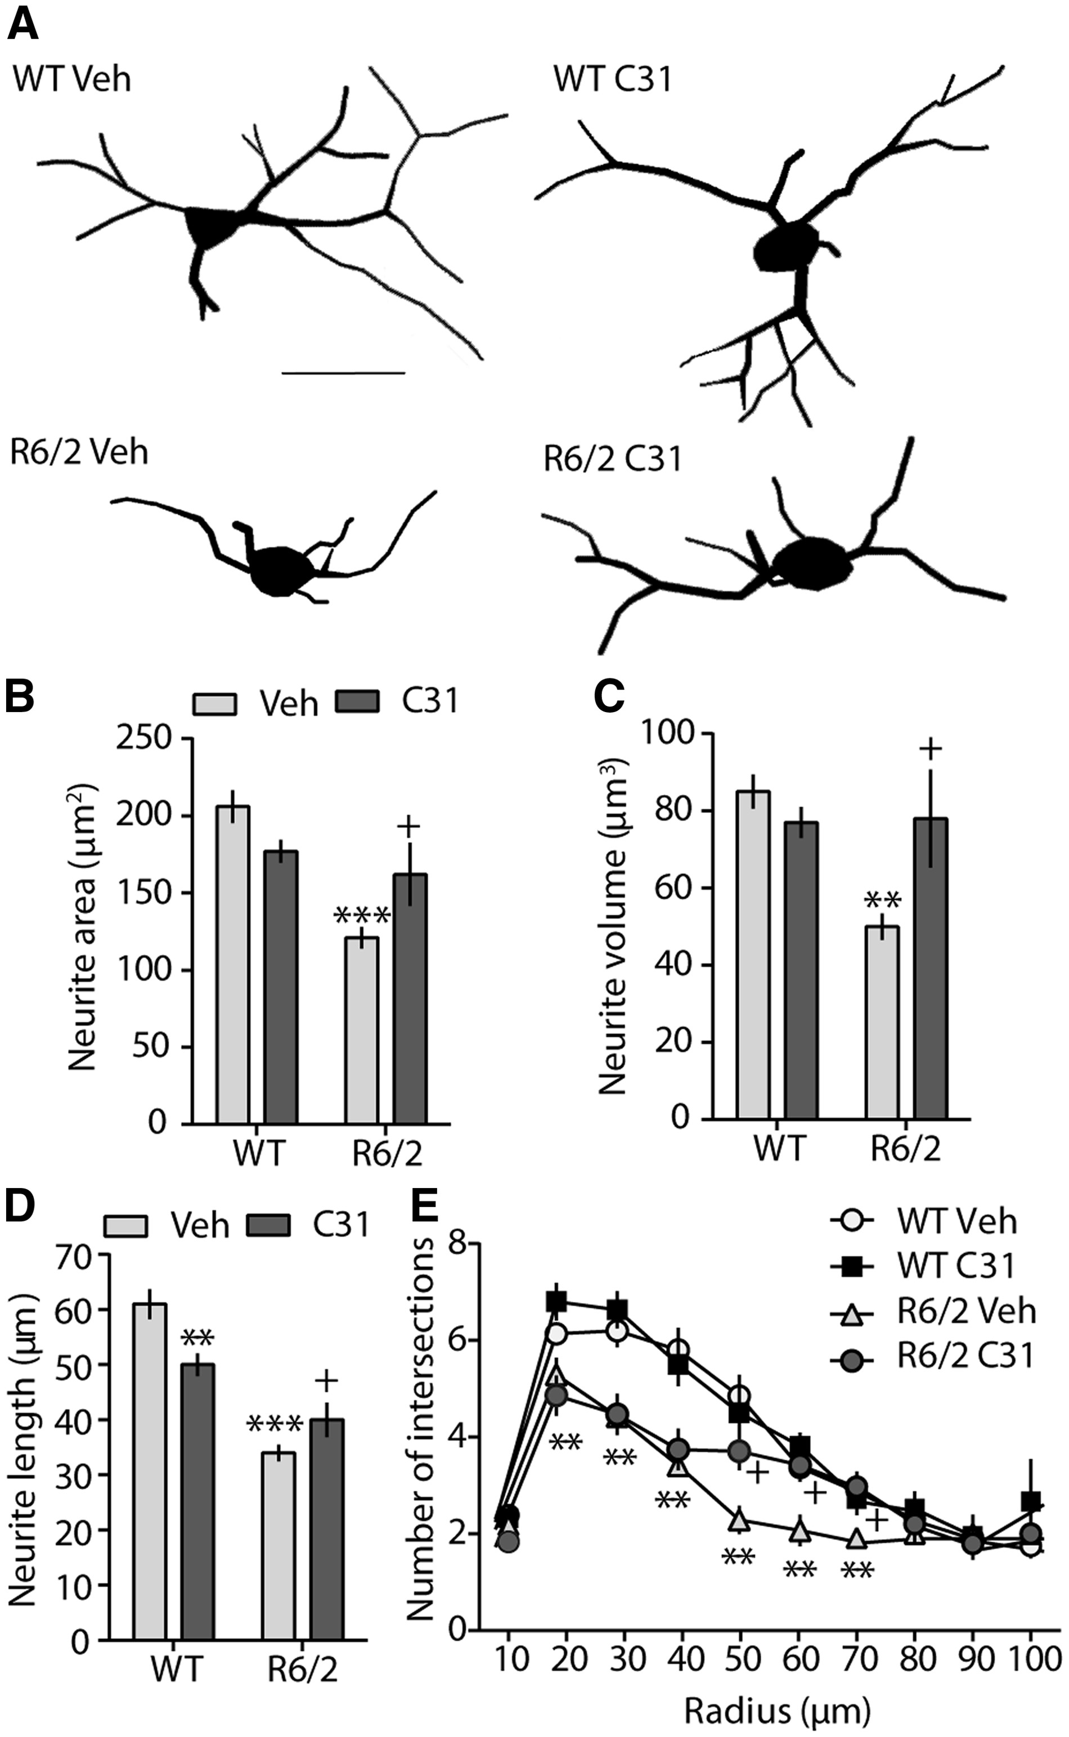
Figure 4 Dystrophic neurites of cholinergic interneurons in R6/2 striatum are mitigated by LM11A-31. (A) Reconstructed ...
Notes:
Figure 4 Dystrophic neurites of cholinergic interneurons in R6/2 striatum are mitigated by LM11A-31. (A) Reconstructed drawings from tracings of ChAT-immunostained interneurons in R6/2 striatum. Scale bar = 20 μm. (B–E) Quantification (mean ± s.e.m.) of the mean area (B), volume (C), length (D), and arbourizations (E) of ChAT-immunostained neurites in Veh- and C31-treated WT and R6/2 mice (**P ≤ 0.01, ***P ≤ 0.001 vs. R6/2 Veh mice; +P ≤ 0.05 vs. R6/2 Veh; n = 9-11/group; ANOVA with Fisher’s LSD).
Unless provided in the caption above, the following copyright applies to the content of this slide: © The Author 2016. Published by Oxford University Press.This is an Open Access article distributed under the terms of the Creative Commons Attribution Non-Commercial License (http://creativecommons.org/licenses/by-nc/4.0/), which permits non-commercial re-use, distribution, and reproduction in any medium, provided the original work is properly cited. For commercial re-use, please contact journals.permissions@oup.com

Slide 5
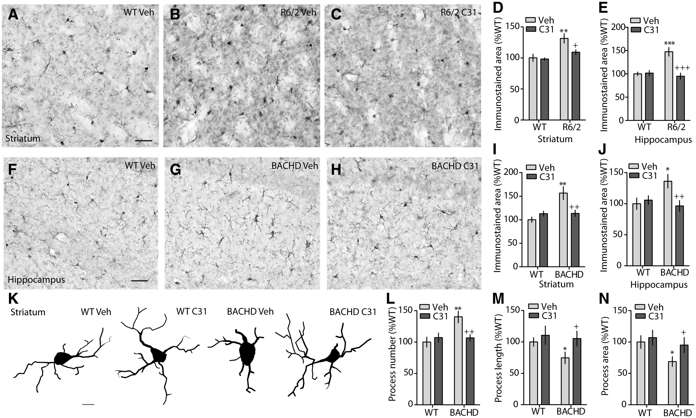
Figure 5 Inflammation is reduced by LM11A-31 in the R6/2 and BACHD striatum and hippocampus. (A–C) Representative ...
Notes:
Figure 5 Inflammation is reduced by LM11A-31 in the R6/2 and BACHD striatum and hippocampus. (A–C) Representative photomicrographs of immunostaining for the microglial marker, IBA-1, in the striatum of a Veh-treated WT (A) and R6/2 mouse (B), and a C31-treated R6/2 mouse (C). Scale bar in A = 40 μm. (D,E) Quantification of the area occupied by IBA-1-immunostained soma and processes in R6/2 striatum (D) and hippocampus (E) (**P ≤ 0.005 and ***P ≤ 0.005 vs. WT-Veh; +P < 0.05 and +++P ≤ 0.001 vs. R6/2-Veh; n = 6-10/group; ANOVA and Fisher’s LSD). (F–H) Representative photomicrographs of IBA-1 immunostaining in the hippocampus of a Veh-treated WT (F) and BACHD mouse (G), and a C31-treated BACHD mouse (H). Scale bar in F = 40 μm. (I,J) Quantification of the area occupied by IBA-1-immunostained soma and processes in the BACHD striatum (I) and hippocampus (J) (*P ≤ 0.05 and **P ≤ 0.005 vs. WT-Veh; ++P < 0.005 vs. BACHD-Veh; n = 7–11/group; ANOVA and Fisher’s LSD). (K) Reconstructed drawings from tracings of microglia in the striata of WT and BACHD mice given Veh or C31. Scale bar = 6.5 μm. (L–N) Quantification of the mean number (L), length (M), and area (N) of IBA1-immunostained processes in striatum of WT and BACHD mice (*P ≤ 0.05 and **P ≤ 0.005 vs. WT-Veh; +P ≤ 0.05 and ++P ≤ 0.005 vs. BACHD-Veh; n = 7–11 mice/group; ANOVA and Fisher’s LSD). Results are expressed as mean ± s.e.m. and normalized to respective WT-Veh groups.
Unless provided in the caption above, the following copyright applies to the content of this slide: © The Author 2016. Published by Oxford University Press.This is an Open Access article distributed under the terms of the Creative Commons Attribution Non-Commercial License (http://creativecommons.org/licenses/by-nc/4.0/), which permits non-commercial re-use, distribution, and reproduction in any medium, provided the original work is properly cited. For commercial re-use, please contact journals.permissions@oup.com

Slide 6
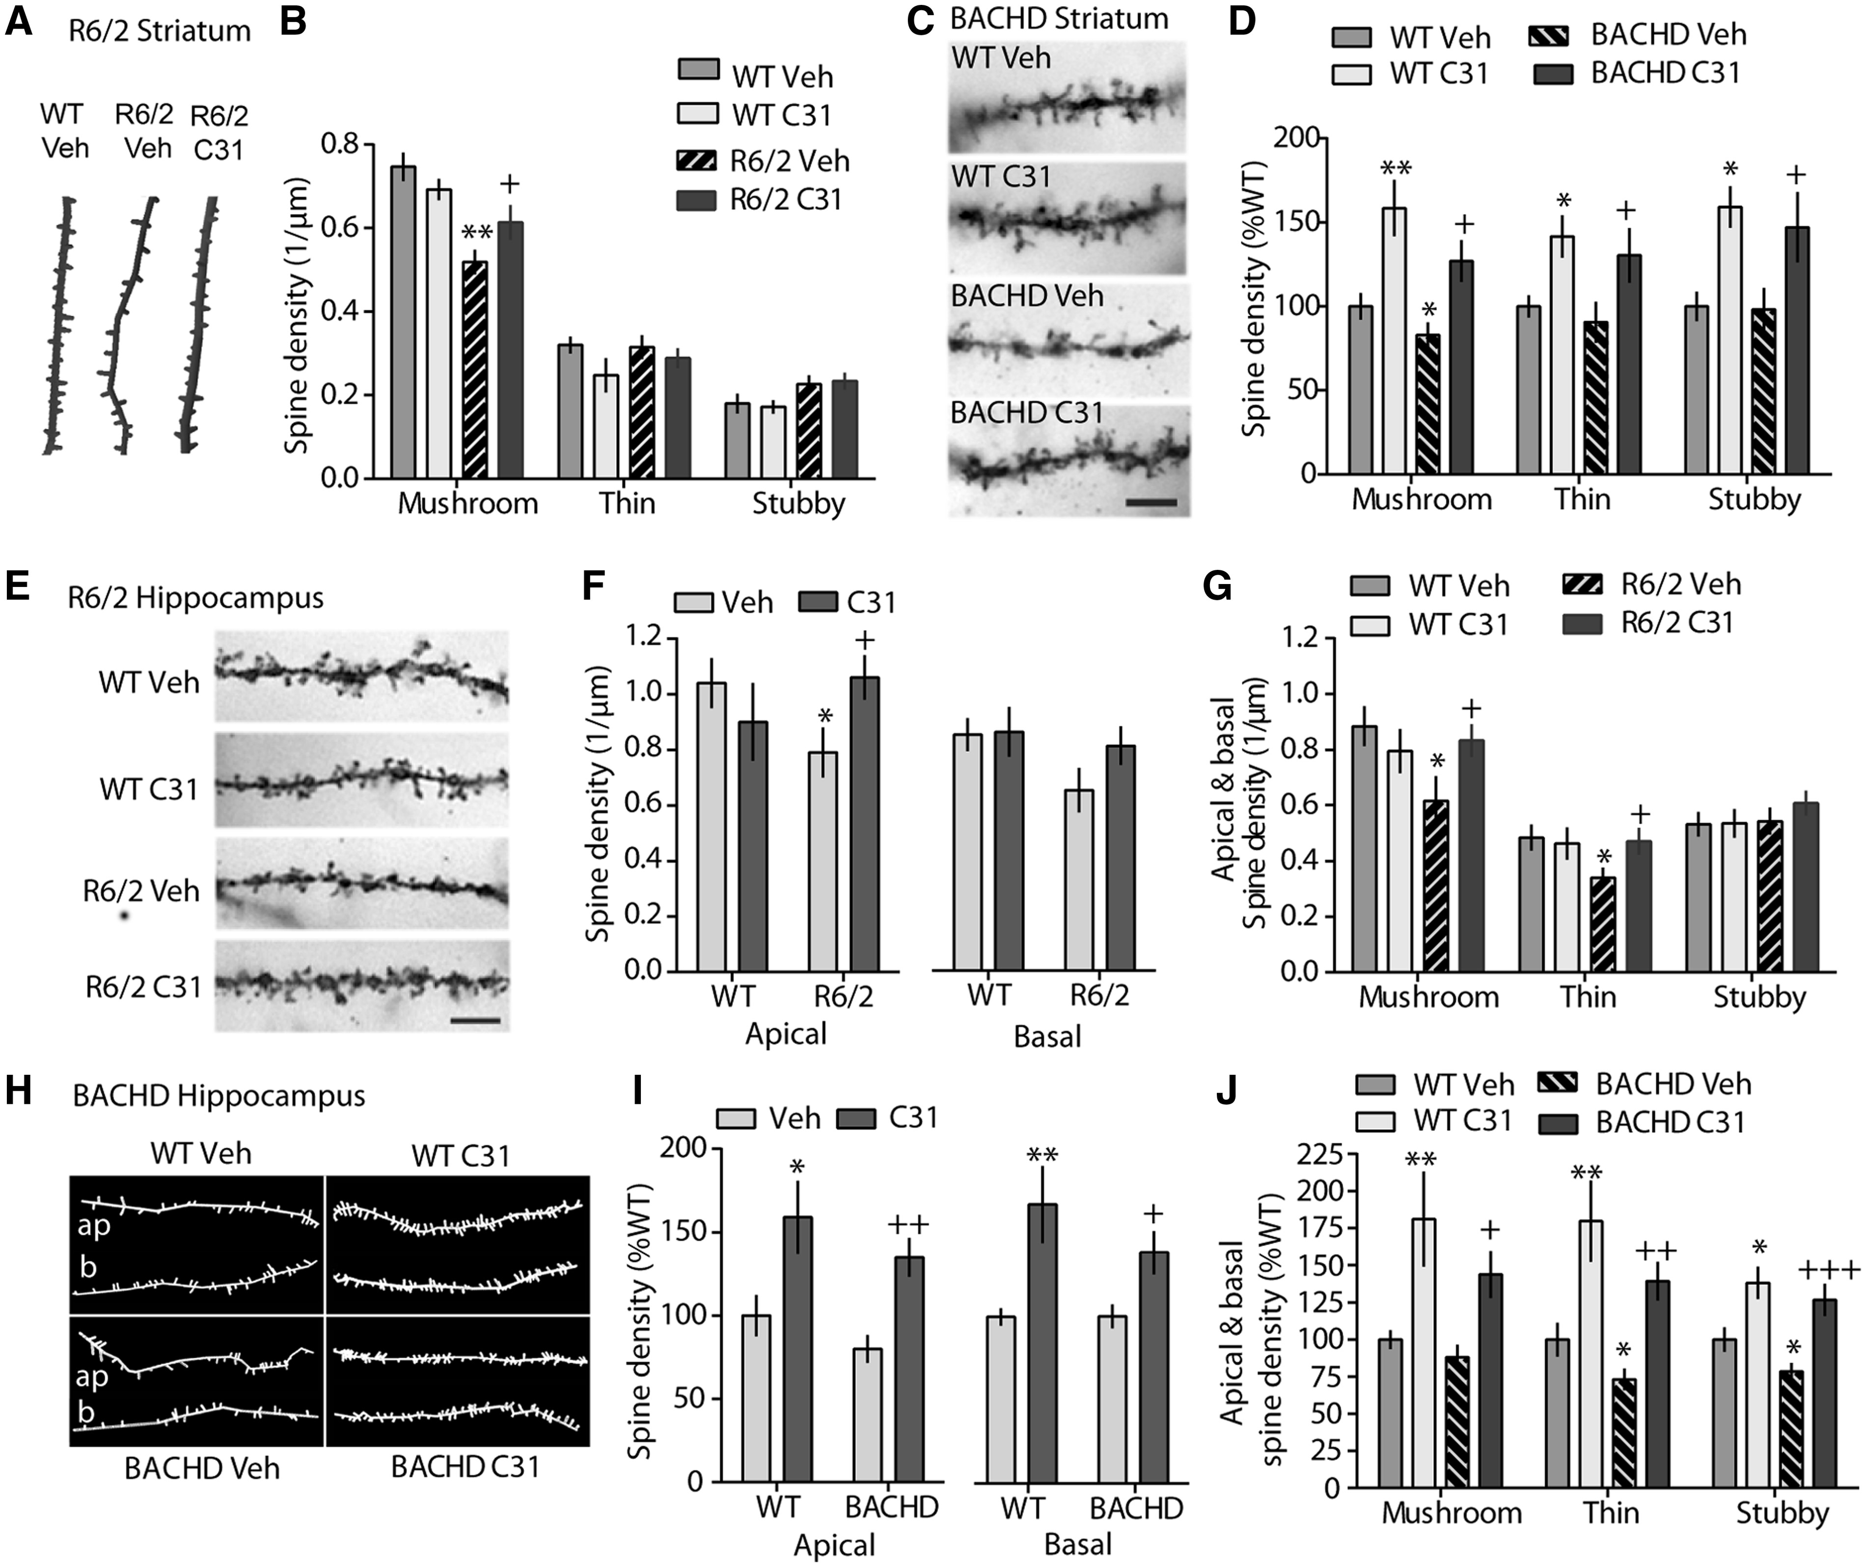
Figure 6 LM11A-31 ameliorates dendritic spine loss in striatum and hippocampus of R6/2 and BACHD mice. (A–B) Dendritic ...
Notes:
Figure 6 LM11A-31 ameliorates dendritic spine loss in striatum and hippocampus of R6/2 and BACHD mice. (A–B) Dendritic spine density in R6/2 striatum: Reconstructed tracings (A) of striatal MSN dendrite segments of WT and R6/2 mice and quantification (B) of their spine morphology (**P ≤ 0.002 vs. WT-Veh; +P = 0.02 vs. R6/2-Veh; n = 6-10 mice/group). (C–D) Dendritic spine density in BACHD striatum: Representative photomicrographs (C) of dendrite segments of Golgi-stained MSNs of Veh- or C31-treated WT and BACHD mice (Scale bar = 5 μm) and quantification (D) of their spine morphology (*P ≤ 0.05, **P ≤ 0.005 vs. WT-Veh; +P ≤ 0.05 vs. BACHD-Veh; n = 7-10 mice/group). (E–G) Dendritic spine density in R6/2 hippocampus: Representative photomicrographs (E) showing dendrite segments of golgi-stained CA1 pyramidal neurons in hippocampus of Veh- or C31-treated WT and R6/2 mice (Scale bar = 5 μm) and quantification of spine density (F) and morphology (G) (*P ≤ 0.05 vs. WT-Veh; +P ≤ 0.05 vs. R6/2-Veh). (H–J) Dendritic spine density in BACHD hippocampus: Reconstructed tracings (H) from a segment of an apical (ap) and a basal (b) dendrite on CA1 pyramidal neurons of Veh- or C31-treated WT and BACHD mice and quantification of their spine density (I) and morphology (J) (*P ≤ 0.05, **P ≤ 0.01 vs. WT-Veh; +P ≤ 0.05, ++P ≤ 0.01, +++P ≤ 0.001 vs. BACHD-Veh). In BACHD mice, Golgi staining was performed in two sets and results were normalized to the WT-Veh group of that staining set. All results are from ≥3rd branch order dendrites, expressed as mean ± s.e.m., and statistical significance was determined by an ANOVA with Fisher’s LSD.
Unless provided in the caption above, the following copyright applies to the content of this slide: © The Author 2016. Published by Oxford University Press.This is an Open Access article distributed under the terms of the Creative Commons Attribution Non-Commercial License (http://creativecommons.org/licenses/by-nc/4.0/), which permits non-commercial re-use, distribution, and reproduction in any medium, provided the original work is properly cited. For commercial re-use, please contact journals.permissions@oup.com

Slide 7
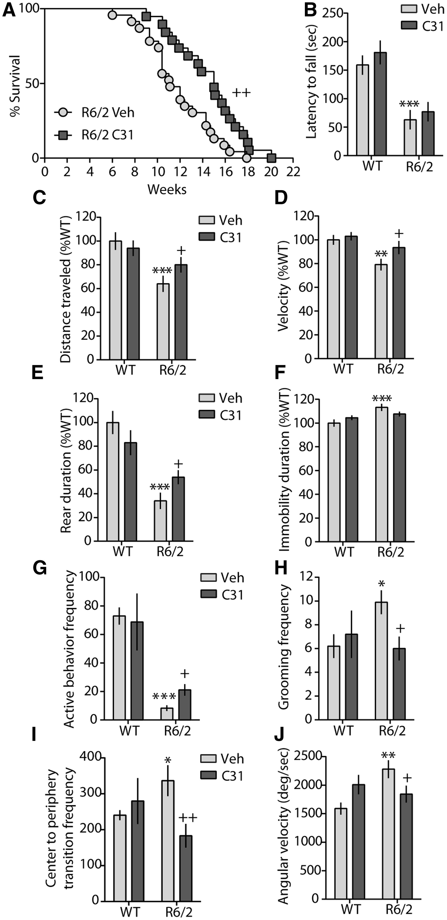
Figure 7 LM11A-31 extends survival and improves motor performance in R6/2 mice. (A) Kaplan-Meier analysis curve ...
Notes:
Figure 7 LM11A-31 extends survival and improves motor performance in R6/2 mice. (A) Kaplan-Meier analysis curve showing that C31 significantly improves survival of R6/2 mice (++P = 0.006, log rank Mantel-Cox test; n = 20–24 mice/group). (B) Latency to fall from an accelerating rotarod was shortened in 10 week-old R6/2 mice (***P = 0.0003 vs. WT-Veh; ANOVA and Fisher’s LSD) and was not affected by C31 treatment (n = 14–20 mice/group). (C–F) During 10 min of exploring an activity chamber, deficits in travelling distance (C), velocity (D), and rearing duration (E) of R6/2-Veh mice were improved by C31 while increased immobility duration was unchanged (**P < 0.01, ***P ≤ 0.001 vs. WT-Veh; +P < 0.05 vs. R6/2-Veh; n = 10-13 mice/group; ANOVA and Fisher’s LSD; values normalized to WT-Veh group). (G–J) C31-treated R6/2 mice showed increased active behaviours (digging and rearing)(G), and decreased grooming (H), periphery-to-centre transitions (I) and angular velocity (J) compared to R6/2-Veh mice during 10 min of exploring a novel standard cage (*P ≤ 0.05, **P = 0.008, ***P < 0.0001 vs. WT-Veh; +P ≤ 0.05, ++P = 0.005 vs. R6/2-Veh; n = 10–13 mice/group; ANOVA and Fisher’s LSD). All results are expressed as mean ± s.e.m.
Unless provided in the caption above, the following copyright applies to the content of this slide: © The Author 2016. Published by Oxford University Press.This is an Open Access article distributed under the terms of the Creative Commons Attribution Non-Commercial License (http://creativecommons.org/licenses/by-nc/4.0/), which permits non-commercial re-use, distribution, and reproduction in any medium, provided the original work is properly cited. For commercial re-use, please contact journals.permissions@oup.com

Slide 8
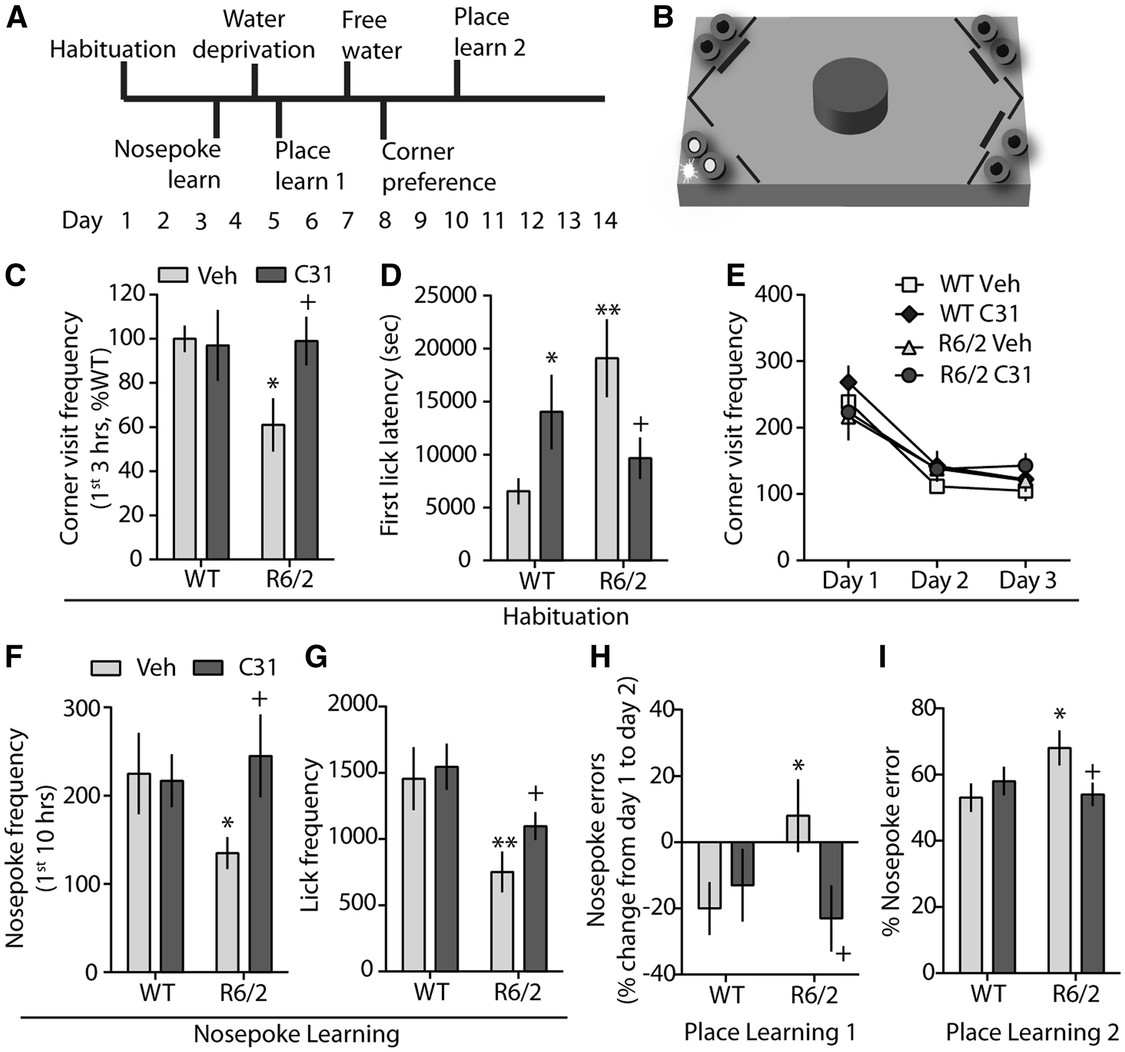
Figure 8 LM11A-31 improves exploratory activity and learning of R6/2 mice in a novel social environment. (A) Testing ...
Notes:
Figure 8 LM11A-31 improves exploratory activity and learning of R6/2 mice in a novel social environment. (A) Testing timeline: during the 2 weeks WT and R6/2 mice were group-housed in an IntelliCage (n = 10–13 mice/group). (B) IntelliCage schematic: during place learning, all doors are closed (thick lines) and water is only accessible from each mouse’s least preferred corner after opening the door (no thick line) with a nosepoke (bottom left, LED light illuminated). (C–E) Habituation: water is available from all corners without nosepoke. R6/2-Veh mice visited corners less frequently during the first 3 h in the cage (C) and had longer first lick latencies (D); C31 corrected these deficits. Deficits were not due to decreased locomotion as all groups visited corners with equal frequencies after the first 3 h (E). (F–G) Nosepoke learning: doors were closed preventing water access unless opened with a nosepoke. R6/2-Veh mice performed fewer nosepokes for first 10 h (F) and licked less (G) over 24 h; C31 normalized these behaviours. (H–I) Place learning: During place learning I (H), R6/2-Veh mice performed more errors on the second versus first day while WTs and C31-treated R6/2 mice made fewer nosepoke errors. Similarly during 4 days of place learning II (I), WTs and C31-treated R6/2 mice performed fewer combined errors than R6/2-Veh mice. *P < 0.05, **P < 0.01 vs. WT-Veh; +P < 0.05 vs. R6/2-Veh, ANOVA and Fisher’s LSD. Results are expressed as mean ± s.e.m.
Unless provided in the caption above, the following copyright applies to the content of this slide: © The Author 2016. Published by Oxford University Press.This is an Open Access article distributed under the terms of the Creative Commons Attribution Non-Commercial License (http://creativecommons.org/licenses/by-nc/4.0/), which permits non-commercial re-use, distribution, and reproduction in any medium, provided the original work is properly cited. For commercial re-use, please contact journals.permissions@oup.com

Slide 9
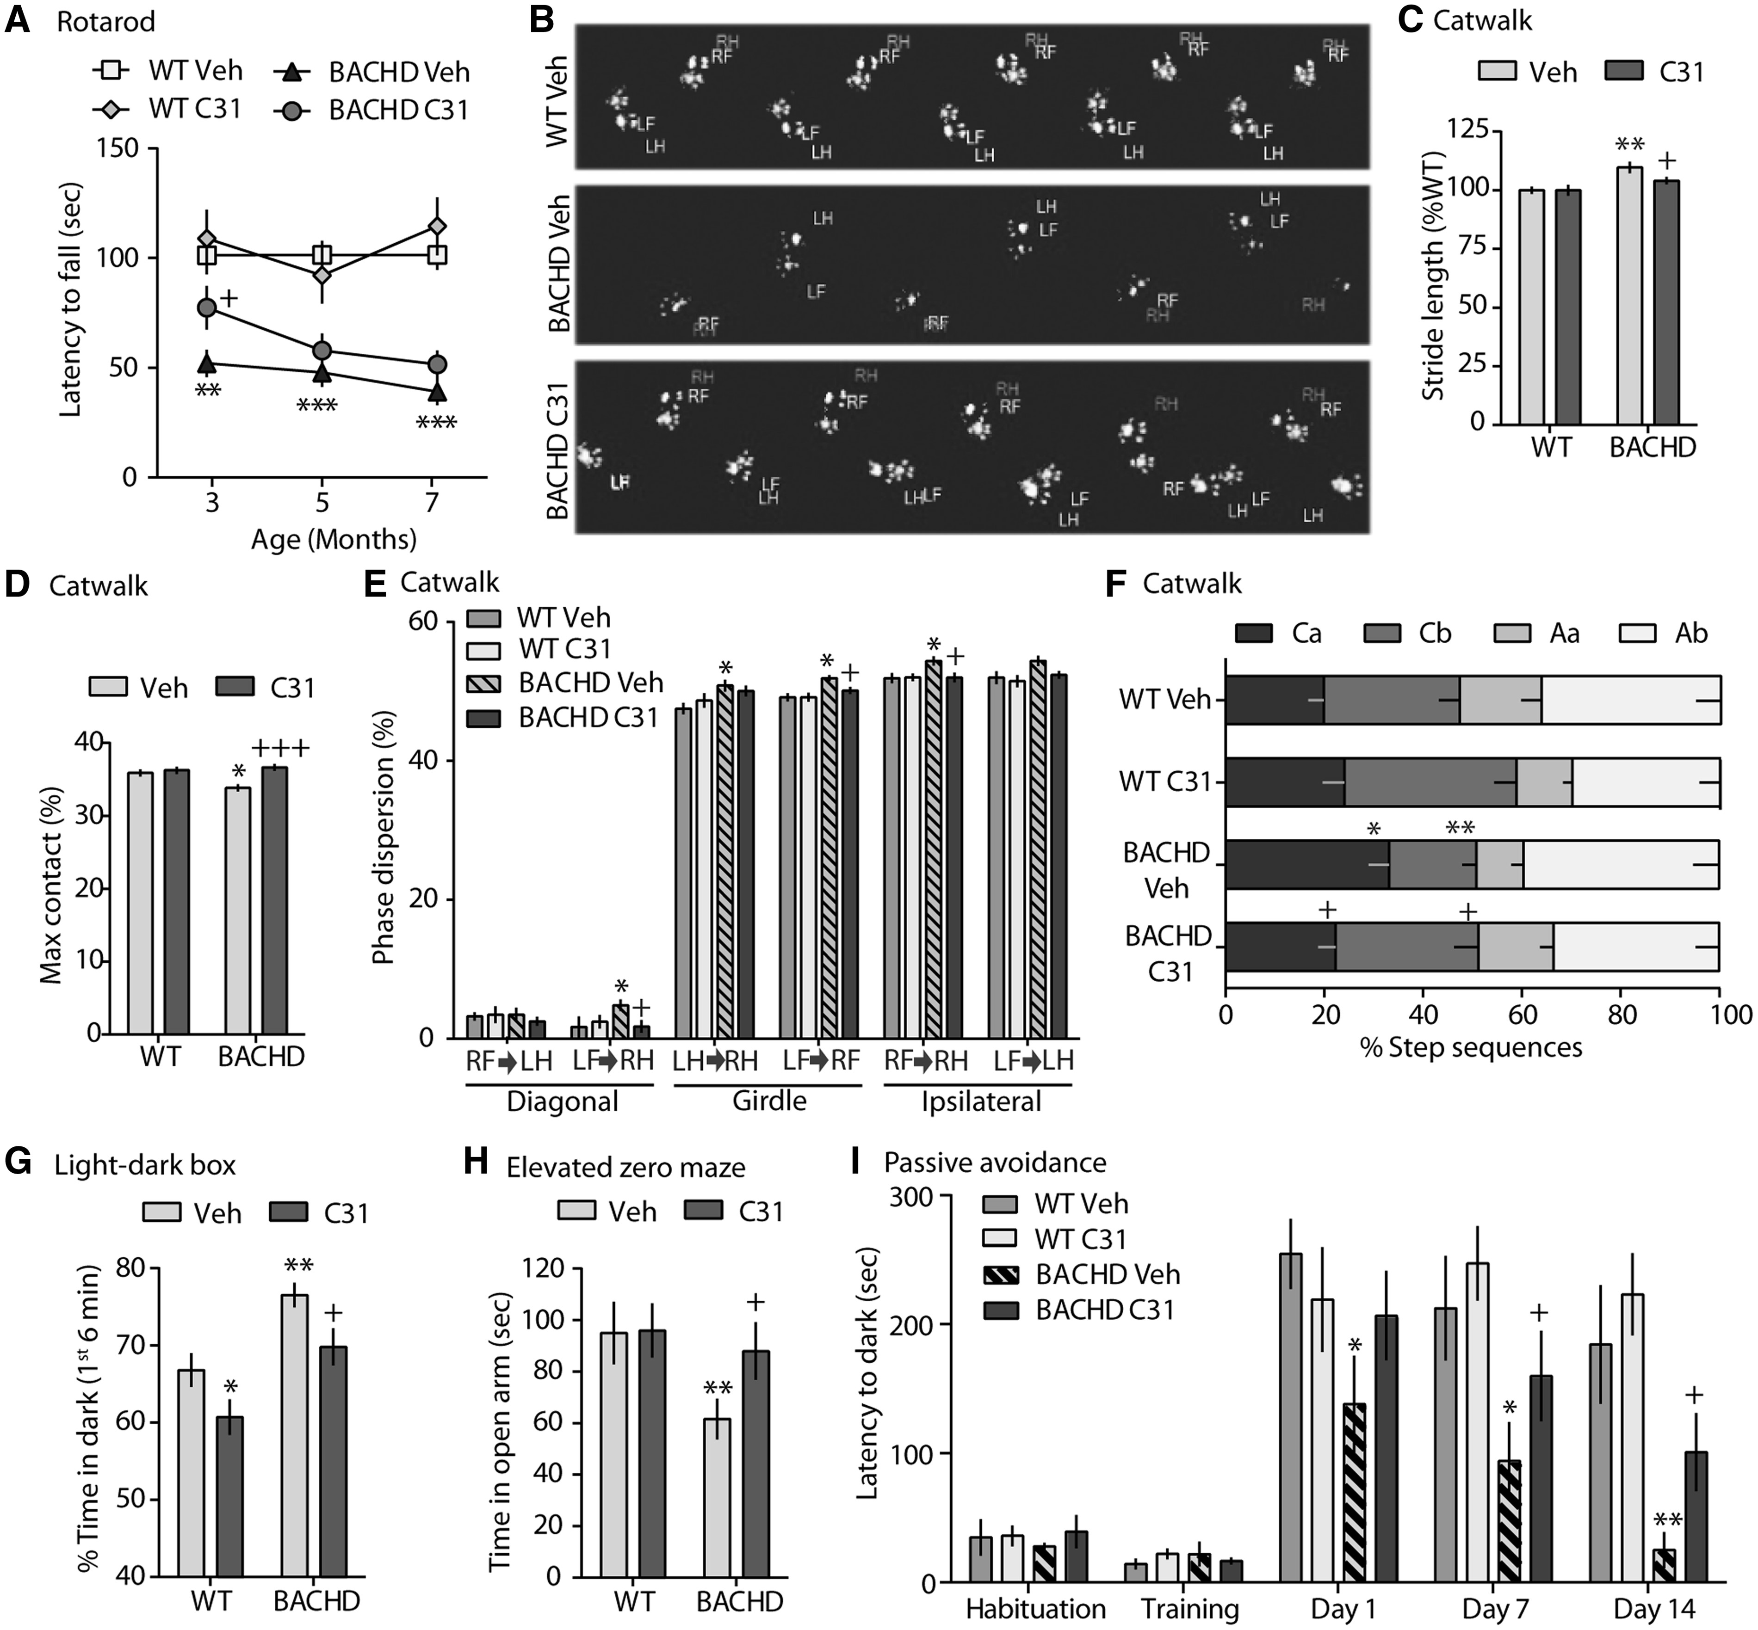
Figure 9 Motor performance and memory are improved by LM11A-31 while anxiety is palliated in BACHD mice. (A) ...
Notes:
Figure 9 Motor performance and memory are improved by LM11A-31 while anxiety is palliated in BACHD mice. (A) Performance of BACHD mice at 3, 5 and 7 months of age on an accelerating rotarod. (B–F) Gait abnormalities were assessed using Catwalk footprint visualizations (B) showing the inter-paw distance and footfall patterns of right (R) and left (L) forelimbs (F) and hind limbs (H). Gait measures analysed included: (C) stride length, (D) maximum (Max) contact (i.e. time paws maximally contact floor), (E) phase dispersion (i.e. time of initial target paw contact expressed as a percentage of the step cycle time of an anchor paw; anchor-target paw placements are diagonal, girdle, and ipsilateral), and (F) step sequences [i.e. percent of times mice perform pre-defined footfall patterns: cruciate a or b [Ca: right front paw (RF) - left front paw (LF) - right hind paw (RH) - left hind paw (LH); Cb: LF - RF - LH - RH] and alternate a or b [Aa: RF - RH - LF - LH; Ab: LF - RH - RF - LH]. (G–H) Anxiety-like behaviour was assessed using a light-dark box (G) and an elevated zero maze (H). (I) A passive avoidance task was used to evaluate memory in WT and BACHD mice, with retention testing one day after aversive learning and extinction tests on Days 7 and 14. Statistical significance was determined with an ANOVA and a Fisher’s LSD, except for phase dispersion analysis, which used a 2-way ANOVA with Tukey’s multiple comparisons post hoc test. *P ≤ 0.05, **P ≤ 0.01, ***P ≤ 0.001 vs. WT Veh; +P ≤ 0.05, +++P ≤ 0.001 vs. BACHD Veh; n = 20–22 mice/group, except passive avoidance n = 10/group.
Unless provided in the caption above, the following copyright applies to the content of this slide: © The Author 2016. Published by Oxford University Press.This is an Open Access article distributed under the terms of the Creative Commons Attribution Non-Commercial License (http://creativecommons.org/licenses/by-nc/4.0/), which permits non-commercial re-use, distribution, and reproduction in any medium, provided the original work is properly cited. For commercial re-use, please contact journals.permissions@oup.com

