Slide 1
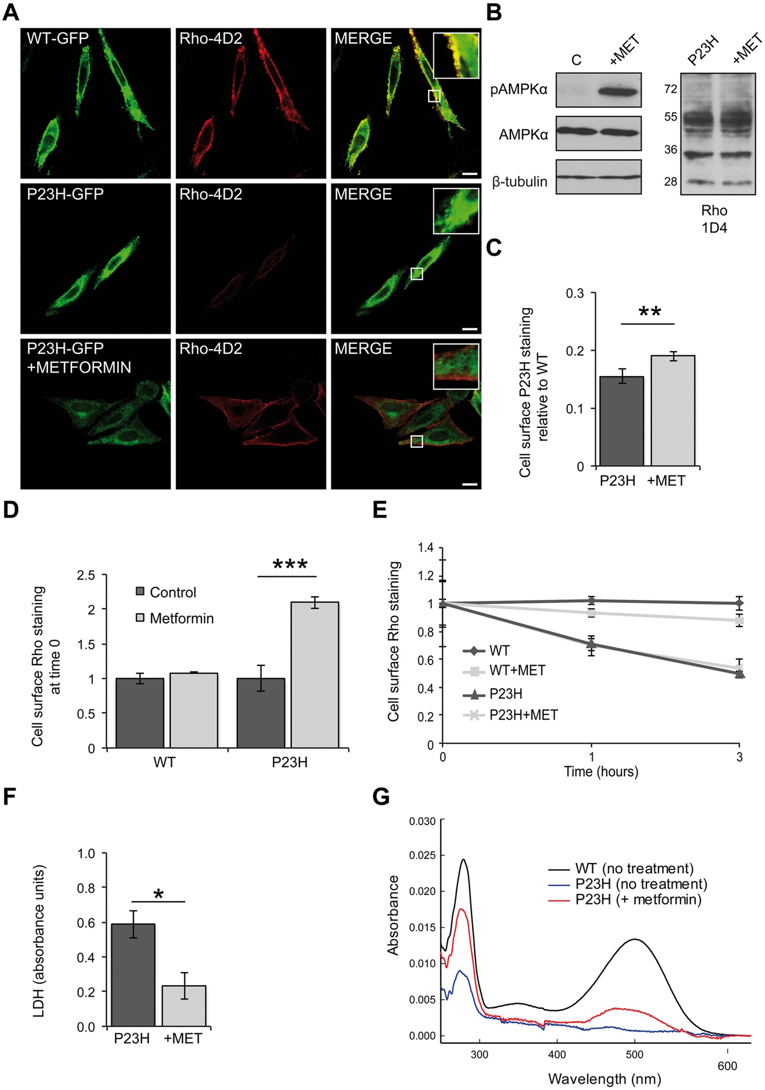
Figure 1 Metformin improves P23H rod opsin traffic and folding and reduces P23H-induced cell death. (A) SK-N-SH cells ...
Notes:
Figure 1 Metformin improves P23H rod opsin traffic and folding and reduces P23H-induced cell death. (A) SK-N-SH cells transfected with WT-GFP rod opsin (green) or P23H-GFP rod opsin (green) were treated with metformin (1 mM) for 18 h. Fixed, non-permeabilised cells were stained with Rho-4D2 antibody against the extracellular N-terminus (red). Confocal microscopy imaging under identical conditions. Scale bar: 10 μm. Boxed regions show higher magnification. (B) Immunoblot with an anti-phospho-AMPKα (p-AMPKα) or an anti-AMPKα antibody. β-Tubulin was used as a loading control. Untreated- (C) and metformin- (+MET) treated P23H-GFP cells were blotted with the Rho-1D4 antibody. (C) In-cell western analysis of HA-P23H rod opsin. SK-N-SH cells were fixed and immunostained with an HA antibody against the extracellular N-terminus of rod opsin. The non-permeabilised (cell surface) immunoreactivity was determined as a percentage of total permeabilised immunoreactivity. The data were normalised to the amount of cell surface HA-WT rod opsin, values ± SEM, n ≥ 4, **P < 0.01, unpaired two-sided Student's t test. (D-E) Rhodopsin internalisation assay in HA-WT or HA-P23H SK-N-SH untreated cells or metformin treated (18 h). Live cells were incubated with an HA antibody for 30 min at 37 °C, washed, media returned and rod opsin was allowed to internalise for 0, 1 and 3 h. (D) Cell surface rod opsin staining at time 0. Values ± SEM, n ≥ 3, ***P < 0.001, unpaired two-sided Student's t test. (E) Remaining cell surface WT or P23H rod opsin staining after 0, 1 and 3 h of internalisation in the presence or absence of metformin, normalised to time 0. Values ± 2SEM, n ≥ 3. (F) LDH assay on cells expressing P23H-GFP rod opsin treated with 1 mM metformin (+MET). Average absorbance values ± SEM, n ≥ 3, *P < 0.05, unpaired two-sided Student's t test. The LDH positive control (100% cell death) was 2.3 absorbance units. (G) UV-visible absorption spectra of immunoaffinity purified WT (black) and P23H (blue) rhodopsin pigments obtained from tetracycline inducible HEK293S cell lines treated with 300 μM metformin (red) for 24 h during expression The WT sample was diluted to show the profile on a similar scale.
Unless provided in the caption above, the following copyright applies to the content of this slide: © The Author 2016. Published by Oxford University Press.This is an Open Access article distributed under the terms of the Creative Commons Attribution License (http://creativecommons.org/licenses/by/4.0/), which permits unrestricted reuse, distribution, and reproduction in any medium, provided the original work is properly cited.

Slide 2
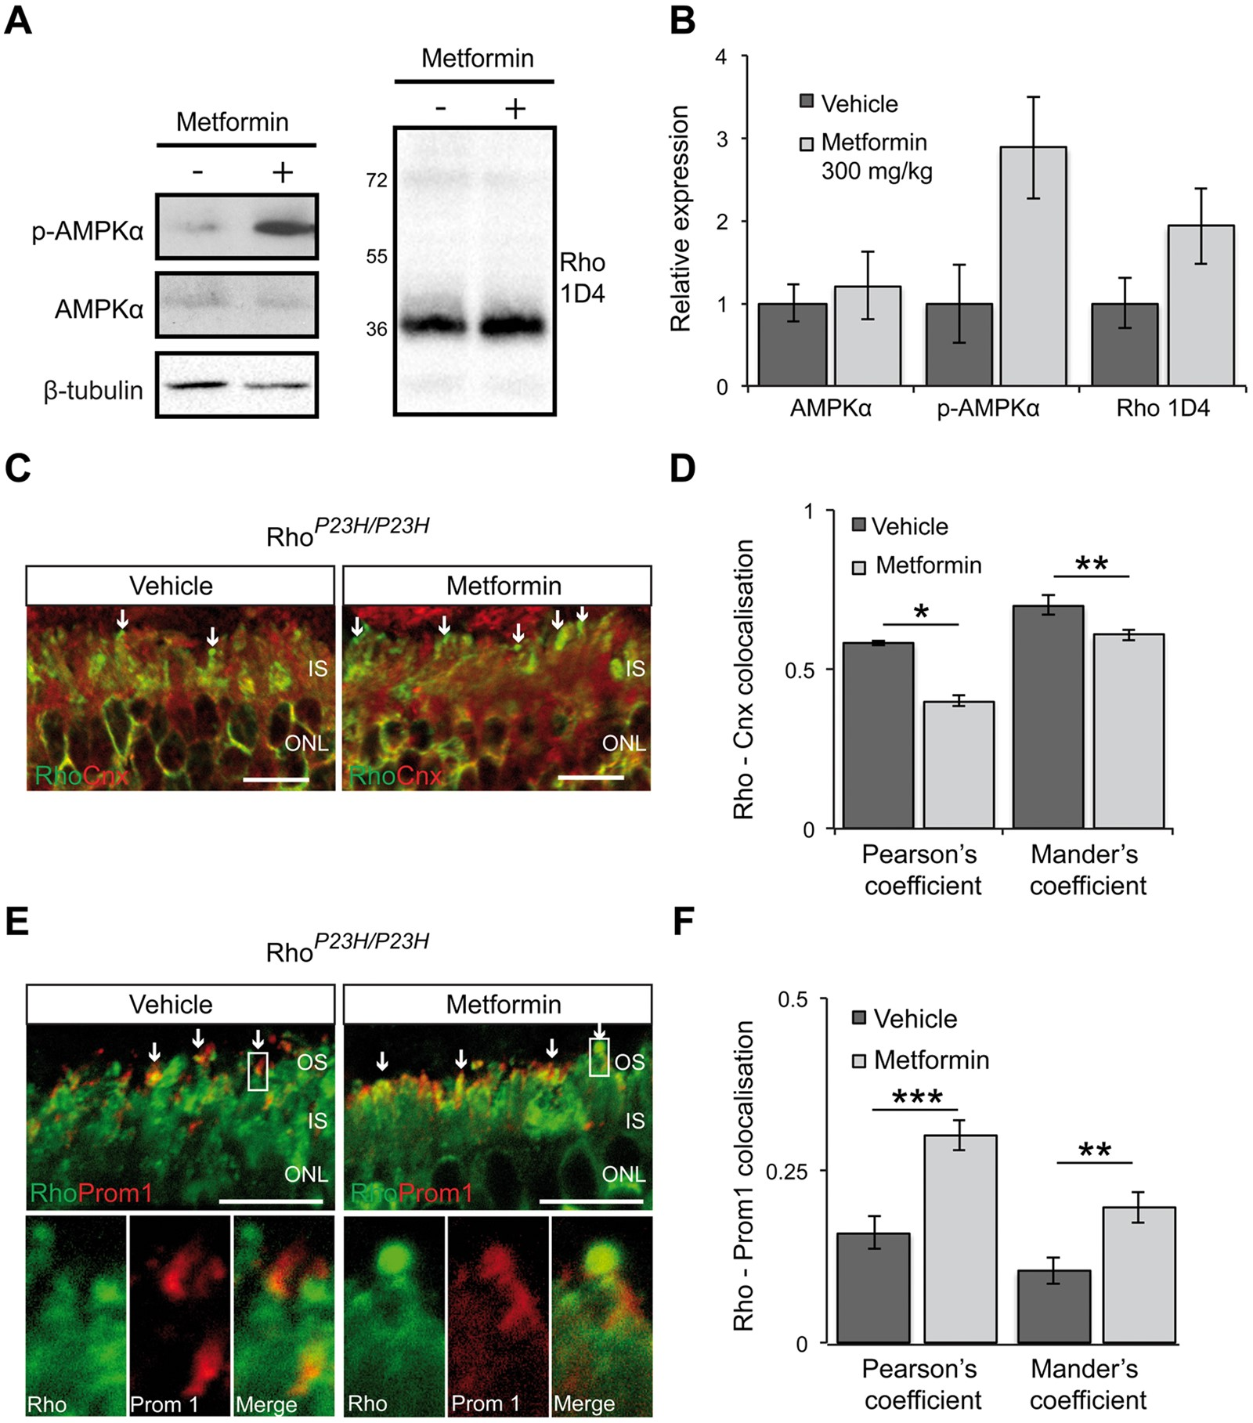
Figure 2 Increased levels of P23H in the ROS of Rho^{P23H/P23H} mice after metformin treatment. (A) Retinal ...
Notes:
Figure 2 Increased levels of P23H in the ROS of RhoP23H/P23H mice after metformin treatment. (A) Retinal extracts from metformin- (+) or vehicle- treated (-) RhoP23H/P23H(P14) KI mice were western blotted with anti-rhodopsin Rho-1D4 antibody and p-AMPKα or anti-AMPKα antibody. β-Tubulin was used as a loading control. (B) Quantification of p-AMPKα and rhodopsin levels in the RhoP23H/P23H KI mouse retina relative to β-tubulin. Densitometric analysis was used to calculate the levels of rhodopsin in metformin-treated mice relative to vehicle; values are means ± SEM, n≥3 biological replicates. (C) Subcellular localisation of rhodopsin (green) and the ER marker calnexin (red) in the retina from RhoP23H/P23H KI mice treated with either vehicle-PBS or metformin. Scale bar 10 µm. (D) Rhodopsin-calnexin IS staining quantified by calculating the Pearson's and Mander's co-localisation co-efficients using the JaCOP plug-in and ImageJ software, n = 18 images each from 2 vehicle-treated mice and 2 metformin-treated mice. Values are means ± SEM, *P < 0.05, **P < 0.01, unpaired two-sided Student's t test. (E) Subcellular localisation of rhodopsin (green) in RhoP23H/P23H KI mice retina treated with vehicle or metformin in relation to prominin 1 (red). Arrows highlight small OS, boxed area shown in close up below. Scale bar: 10 µm. (F) Rhodopsin-prominin 1 (Prom1) staining was quantified by calculating the Pearson's and Mander's co-localisation co-efficients using the JaCOP plug-in and ImageJ software, n = 9 technical replicates/condition from 2 biological/condition. Values are means ± SEM, **P < 0.01, ***P < 0.001, unpaired two-sided Student's t test.
Unless provided in the caption above, the following copyright applies to the content of this slide: © The Author 2016. Published by Oxford University Press.This is an Open Access article distributed under the terms of the Creative Commons Attribution License (http://creativecommons.org/licenses/by/4.0/), which permits unrestricted reuse, distribution, and reproduction in any medium, provided the original work is properly cited.

Slide 3
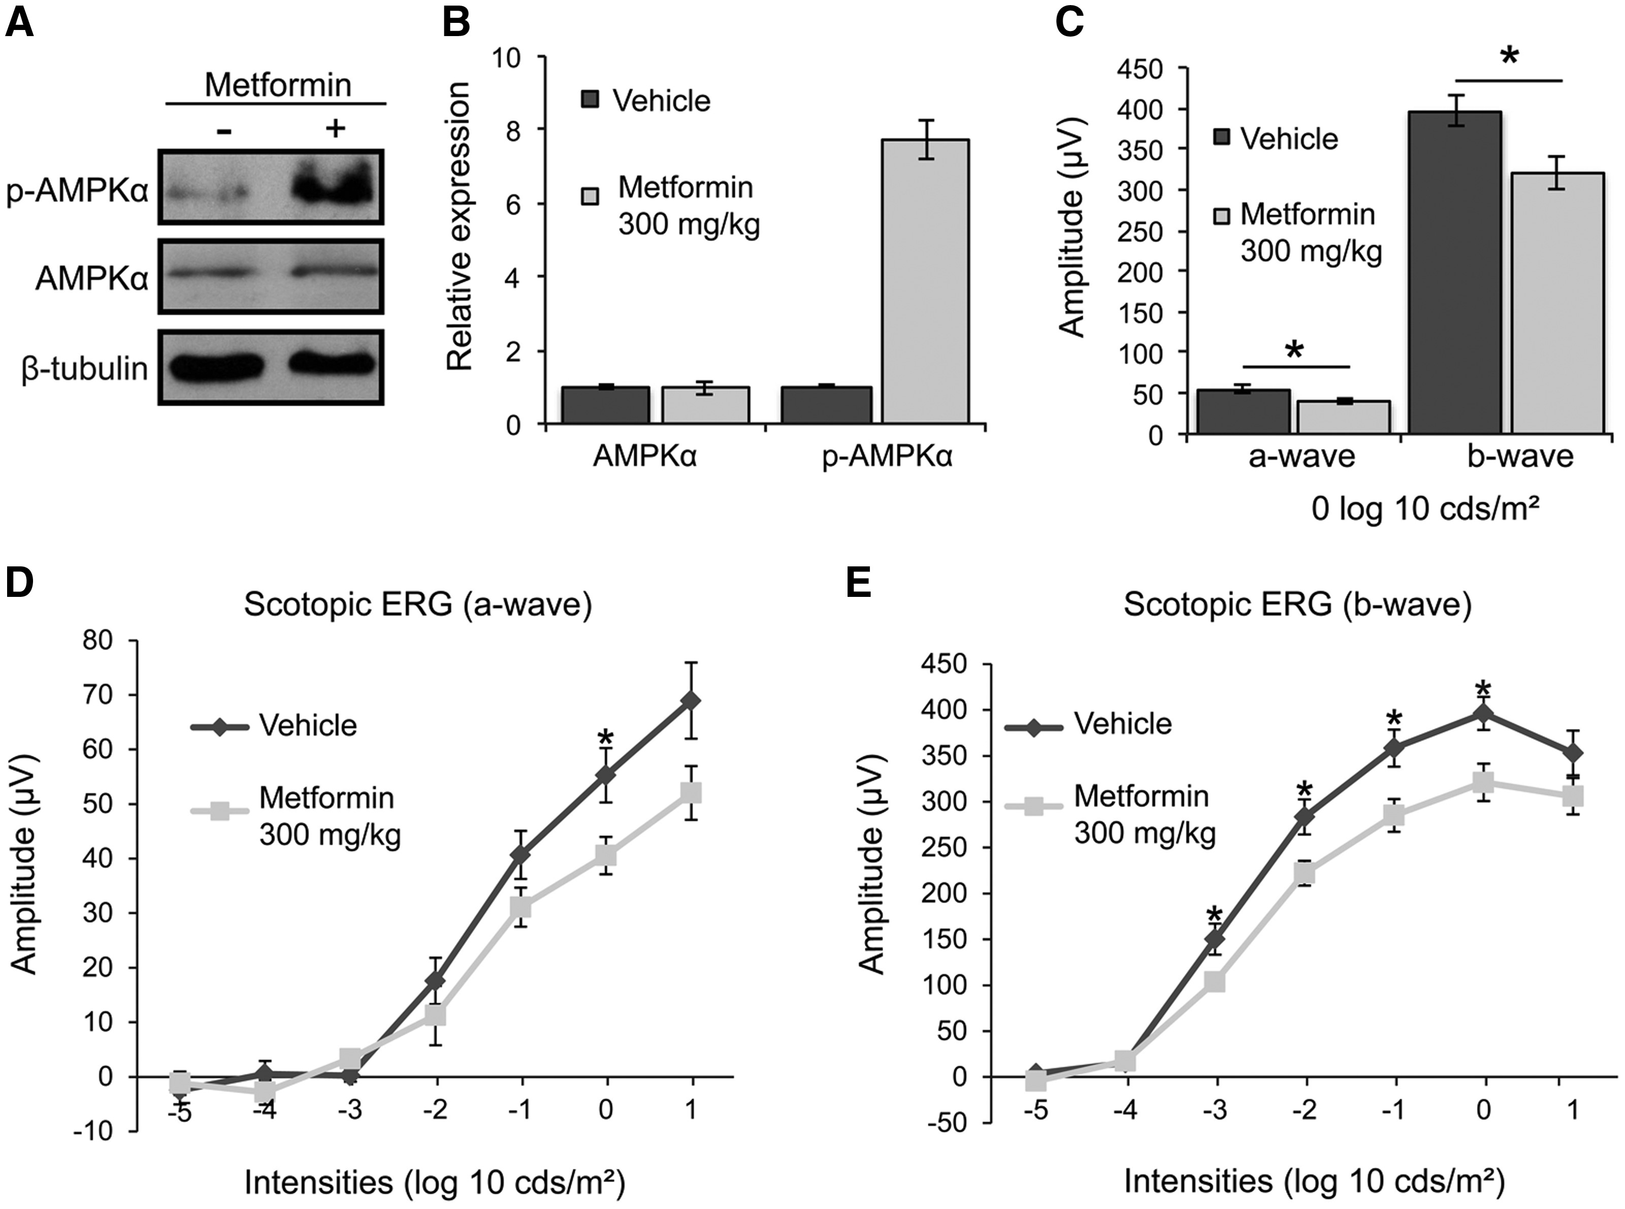
Figure 3 Metformin impairs photoreceptor function in P23H-1 rats. P23H-1 rats were treated from P21-P35 with either ...
Notes:
Figure 3 Metformin impairs photoreceptor function in P23H-1 rats. P23H-1 rats were treated from P21-P35 with either 300 mg/kg metformin or vehicle-PBS administered daily via IP injection. (A) Retinae of metformin- (+) or vehicle- treated (-) P23H-1 rats were western blotted with p-AMPKα or an anti-AMPKα antibody to confirm the activation of AMPKα protein in the rat retina after metformin treatment, as indicated. β-Tubulin was used as a loading control. (B) Quantified expression levels of AMPKα and p-AMPKα in P23H-1 retina relative to β-tubulin. Densitometric analysis was used to calculate the levels of AMPKα and p-AMPKα relative to the vehicle control; values are means ± SEM, n ≥ 3 biological replicates. (C-E) Scotopic ERG responses; (C) average at 0 log cds/m2, (D) a-wave, (e) b-wave of P23H-1 rats (P36) treated with either 300 mg/kg metformin (n = 16 biological replicates) or vehicle-PBS (n = 14 biological replicates), values are means ± SEM. *P < 0.05, unpaired two-sided Student's t test.
Unless provided in the caption above, the following copyright applies to the content of this slide: © The Author 2016. Published by Oxford University Press.This is an Open Access article distributed under the terms of the Creative Commons Attribution License (http://creativecommons.org/licenses/by/4.0/), which permits unrestricted reuse, distribution, and reproduction in any medium, provided the original work is properly cited.

Slide 4
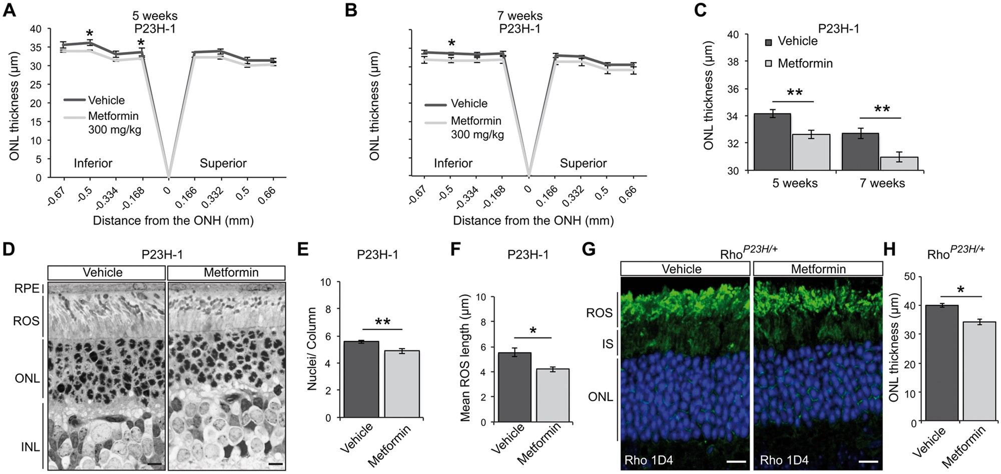
Figure 4 Metformin treatment accelerates photoreceptor loss in P23H rodent models. (A-C) ONL thickness of P23H-1 rats ...
Notes:
Figure 4 Metformin treatment accelerates photoreceptor loss in P23H rodent models. (A-C) ONL thickness of P23H-1 rats treated from P21-P35 (A) or from P21-P49 (B) with either 300 mg/kg metformin or vehicle-PBS daily via IP injection. P23H-1 ONL thickness at P36 (A) for metformin-treated (n = 8 biological replicates) or vehicle-PBS treated rats (n = 6 biological replicates) or P49 (B) (7 weeks of age) for metformin-treated (n = 5 biological replicates) or vehicle-PBS treated rats (n = 5 biological replicates) as assessed by OCT measurements across the inferior-superior meridian. Results are either expressed as a spider plot from the optic nerve head (ONH) (A-B) or as mean ONL thickness across the whole retina (C). Values are means ± SEM. **P < 0.01, unpaired two-sided Student's t test. (D) Representative images of semi-thin resin retinal sections from P23H-1 (P36) rats treated with vehicle or metformin. Sections were stained with toluidine blue. Scale bar: 10 μm. (E-F) Quantification of (E) number of nuclei/column across the retina of vehicle- or metformin-treated P23H-1 rats at P36 (n ≥ 4 biological replicates). (F) ROS length analysis was assessed within five images of ≥ 20 ROS across the retina from ≥3 animals per treatment. Values are means ± SEM. *P < 0.05; **P < 0.01, unpaired two-sided Student's t test. (G) Representative retinal images of P23H heterozygous KI (RhoP23H/+; P45) mice treated with vehicle or metformin, as indicated. Subcellular localisation of rhodopsin stained with Rho 1D4 antibody. Nuclei stained with DAPI. Scale bar: 10 µm. (H) Quantification of mean RhoP23H/+ ONL thickness across the whole retina of 4 animals per treatment. Values are means ± SEM. *P < 0.05.
Unless provided in the caption above, the following copyright applies to the content of this slide: © The Author 2016. Published by Oxford University Press.This is an Open Access article distributed under the terms of the Creative Commons Attribution License (http://creativecommons.org/licenses/by/4.0/), which permits unrestricted reuse, distribution, and reproduction in any medium, provided the original work is properly cited.

Slide 5
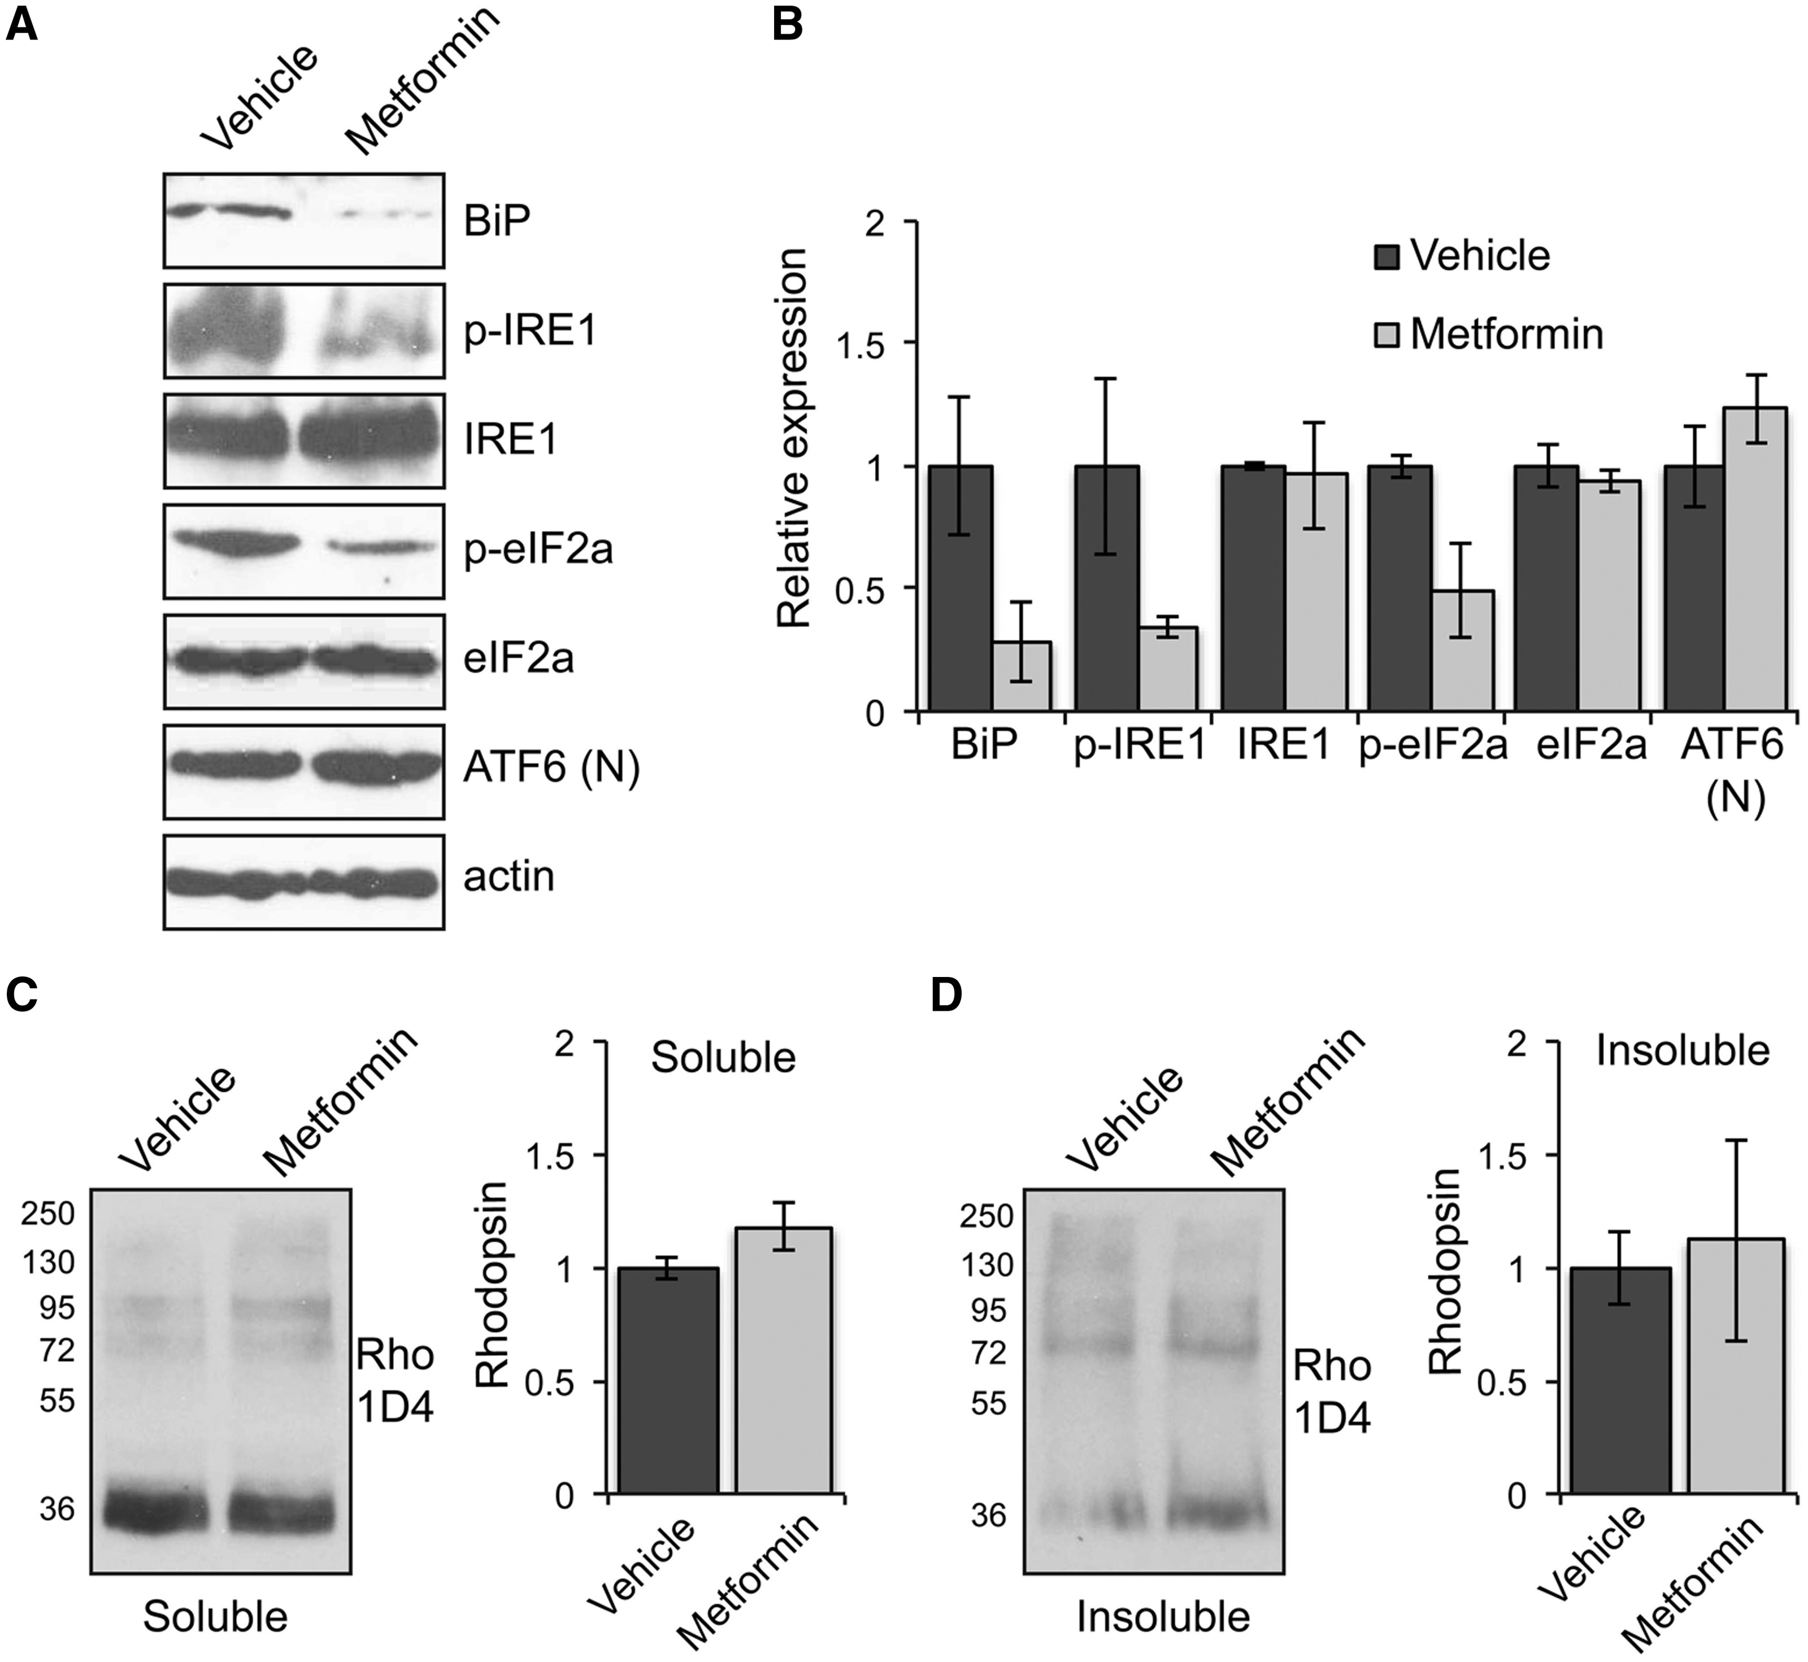
Figure 5 Metformin reduces the unfolded protein response (UPR) and does not affect the levels of rhodopsin in the ...
Notes:
Figure 5 Metformin reduces the unfolded protein response (UPR) and does not affect the levels of rhodopsin in the retina of P23H-1 rats. (A) Retinae of P23H-1 rats treated from P21-P35 with either 300 mg/kg metformin or vehicle-PBS were analysed with markers of the three UPR branches and blotted with antibodies against BiP, p-IRE1, IRE1, p-eIF2A, eIF2a, and ATF6 cleaved or nuclear (N). Actin was used as a loading control. (B) Densitometric analysis was used to calculate the levels of BiP, p-IRE1, IRE1, p-eIF2A, eIF2a, and ATF6 (N) relative to vehicle after normalisation to actin; values are means ± SEM, n ≥ 3 (biological replicates). (C and D) Retinae of P23H-1 rats treated from P21-P35 with either 300 mg/kg metformin or vehicle-PBS were analysed by a sedimentation assay. Fractions were immunoblotted with the 1D4 antibody against rhodopsin. Densitometric analysis was used to calculate the levels of (C) soluble rhodopsin relative to the vehicle treated and (D) insoluble rhodopsin relative to the vehicle after normalisation to soluble rhodopsin. Values are means ± SEM, n ≥ 4 (biological replicates).
Unless provided in the caption above, the following copyright applies to the content of this slide: © The Author 2016. Published by Oxford University Press.This is an Open Access article distributed under the terms of the Creative Commons Attribution License (http://creativecommons.org/licenses/by/4.0/), which permits unrestricted reuse, distribution, and reproduction in any medium, provided the original work is properly cited.

Slide 6
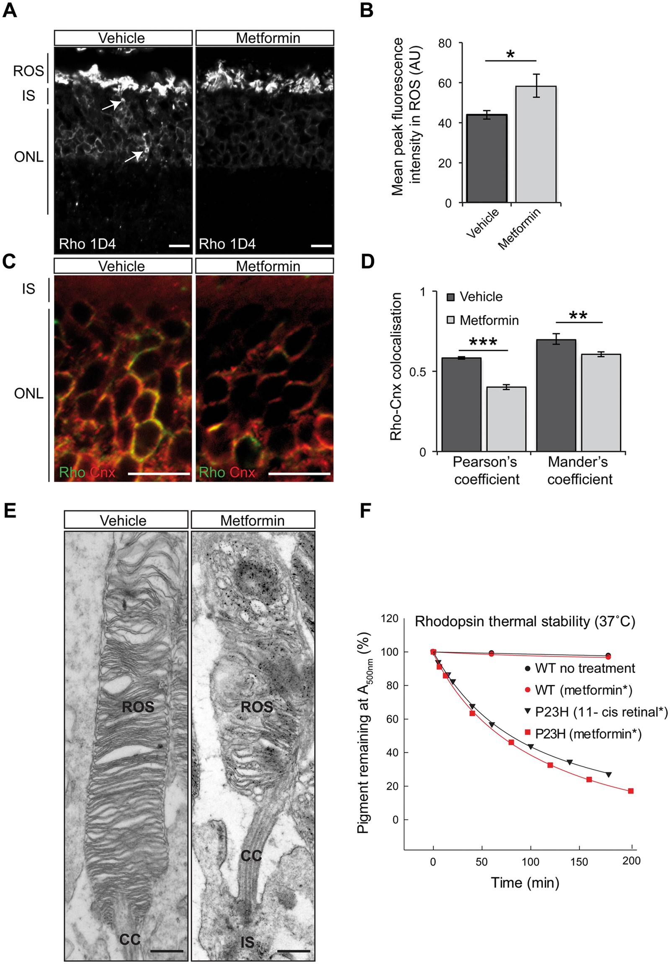
Figure 6 Improvement of rhodopsin trafficking correlates with disorganised ROS in the retinae of P23H-1 ...
Notes:
Figure 6 Improvement of rhodopsin trafficking correlates with disorganised ROS in the retinae of P23H-1 metformin-treated rats. (A) Representative retinal images of P23H-1 (P36) rats treated with vehicle or metformin, as indicated. Subcellular localisation of rhodopsin stained with Rho 1D4 antibody. Scale bar: 10 µm. (B) Quantification of rhodopsin immunofluorescence intensity in the ROS. A line scan was performed and the mean maximum intensity was assessed within 12 images of ≥ 15 ROS from three animals per treatment. Values are means ± SEM, *P < 0.05. (C) ONL staining of rhodopsin (green) and the ER marker, calnexin (red). Scale bar 10 µm. (D) Rhodopsin-calnexin ONL overlap was quantified by calculating the Pearson's and Mander's co-localisation co-efficients, using the JaCOP plug-in and ImageJ software, n = 15 images each from two vehicle-treated rats and two metformin-treated rats. Values are means ± SEM, **P < 0.01, ***P < 0.001, unpaired two-sided Student's t test. (E) Representative TEM images of vehicle- and metformin-treated P23H-1 retina at P36 illustrating the structure of ROS. Scale bar: 500 nm. ROS, rod outer segment; CC, connecting cilium/cilia; IS, photoreceptor cell inner segment. (F) Rhodopsin thermal stability at 37 °C. Purified WT or P23H mutant pigments from transfected HEK-293S cells following biosynthetic treatment with either metformin (red circles or red squares) or 11-cis retinal treatment (black triangles). WT pigment from non-treated cells (black circles). Pigments were held at 37 °C (equilibrated for 2 min) before commencing repeated scans by UV-visible absorbance spectroscopy (650–250 nm) at 30 min intervals for at least 4 h. Spectra were normalised at 650 nm and 280 nm and the change in A500 nm was plotted as a function of time. All data were fitted with exponential decay function using SigmaPlot 12 in order to determine half-life values.
Unless provided in the caption above, the following copyright applies to the content of this slide: © The Author 2016. Published by Oxford University Press.This is an Open Access article distributed under the terms of the Creative Commons Attribution License (http://creativecommons.org/licenses/by/4.0/), which permits unrestricted reuse, distribution, and reproduction in any medium, provided the original work is properly cited.

