Slide 1
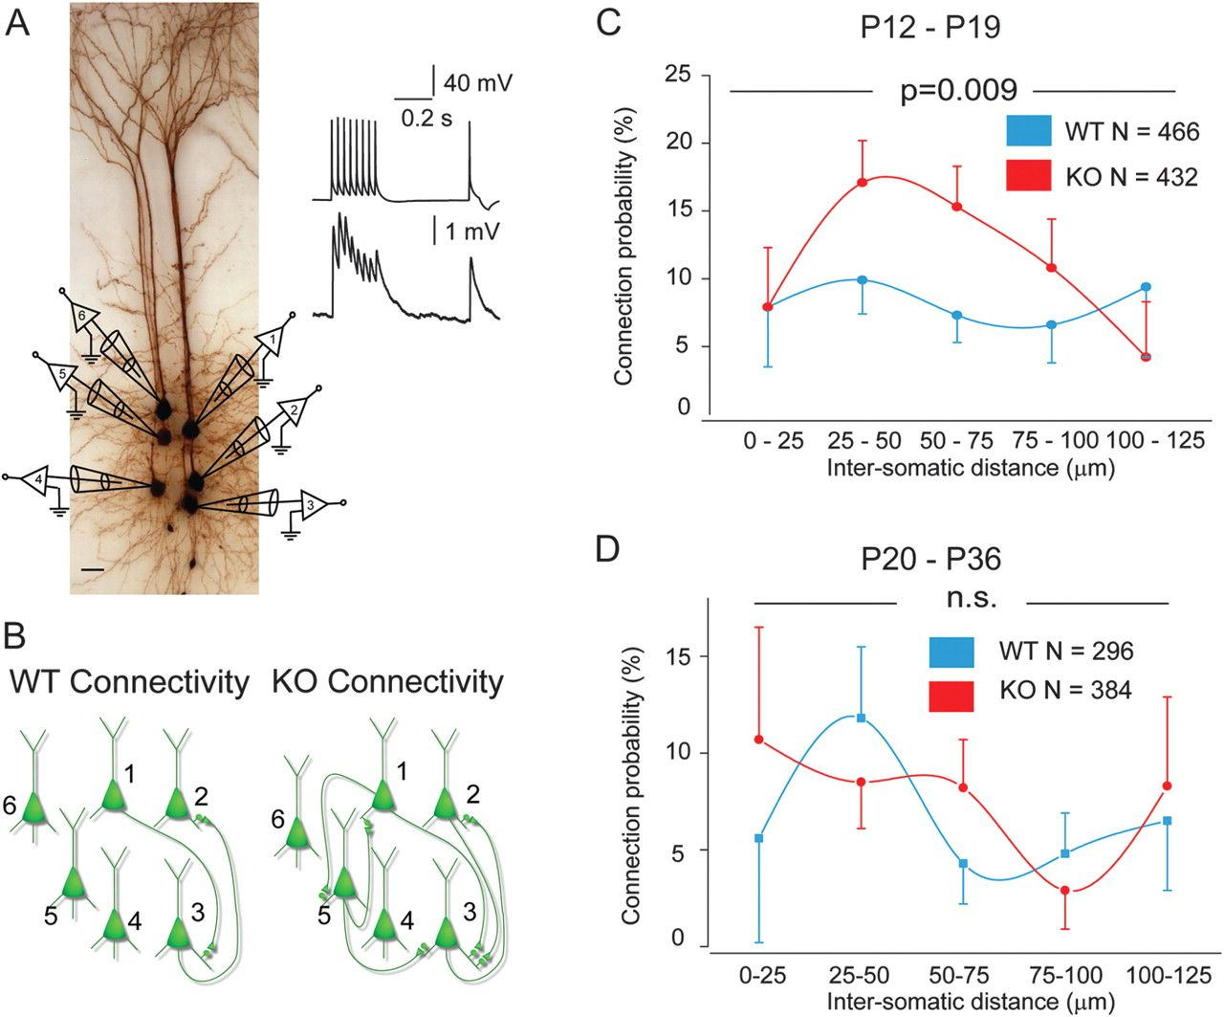
Figure 1. Hyperconnectivity of layer 5 pyramidal neurons in mPFC of 2–3 week but not 3- to 5-week-old Fmr1-KO mice. (A) ...
Notes:
Figure 1. Hyperconnectivity of layer 5 pyramidal neurons in mPFC of 2–3 week but not 3- to 5-week-old Fmr1-KO mice. (A) Hexa-patch recorded cluster of 6 biocytin-stained pyramidal neurons (scale bar 25 μm). Inset top, 8 AP stimulation at 30 Hz with single test pulse 500 ms later, and inset bottom, corresponding EPSPs from monosynaptic connection. (B) Connectivity outline for examples of a recorded WT (2 of 30 possible synaptic connections) and an Fmr1-KO cluster (6 of 30 possible synaptic connections), calculated from a connectivity matrix of all possible synaptic connections for one example cluster (see Supplementary Fig. 1). (C) CP distributions for the clusters of Fmr1-KO (N = 432 neurons) and WT neurons (N = 466), up to 125 μm apart, were significantly different (Wilcoxon sum rank test, **P < 0.01). (D) CP distributions for the clusters of Fmr1-KO (N = 384 neurons) and WT neurons (N = 296), up to 125 μm apart, were not significantly different from each other (Wilcoxon sum rank test, P = 0.5). Individual values listed for both age groups in Supplementary Table 1.
Unless provided in the caption above, the following copyright applies to the content of this slide: © The Author 2011. Published by Oxford University Press. All rights reserved. For permissions, please e-mail: journals.permissions@oup.com

Slide 2
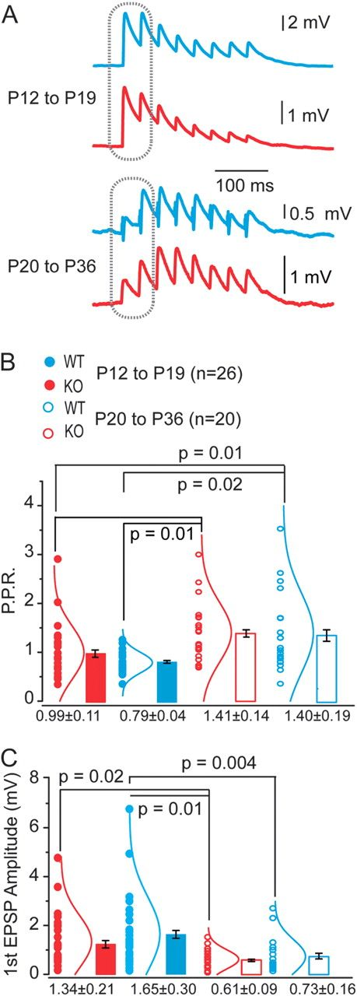
Figure 2. Synaptic maturation and dynamics of WT and Fmr1-KO connections during development. (A) Example EPSP traces of ...
Notes:
Figure 2. Synaptic maturation and dynamics of WT and Fmr1-KO connections during development. (A) Example EPSP traces of typical responses to AP trains in WT (blue) or KO neurons (red) at P12–19 (above) and P20–36 (below). (B) Paired-pulse ratios, measured at responses indicated on traces in A, are significantly increased in the older age groups for both WT and KO. *P values indicated, Fisher’s analysis of variance (ANOVA). No significant difference exists between WT and KO at either age group. Mean ± SEM shown. Individual data points (circles) and the corresponding normal distribution curves shown by each bar. (C) Amplitude of first EPSP in evoked train is significantly reduced in older age groups (P20–36) compared with younger (P12–19) for both WT and KO neurons. *P values indicated, Fisher’s ANOVA. Mean ± SEM shown. Individual data points (circles) and the corresponding normal distribution curves shown by each bar.
Unless provided in the caption above, the following copyright applies to the content of this slide: © The Author 2011. Published by Oxford University Press. All rights reserved. For permissions, please e-mail: journals.permissions@oup.com

Slide 3
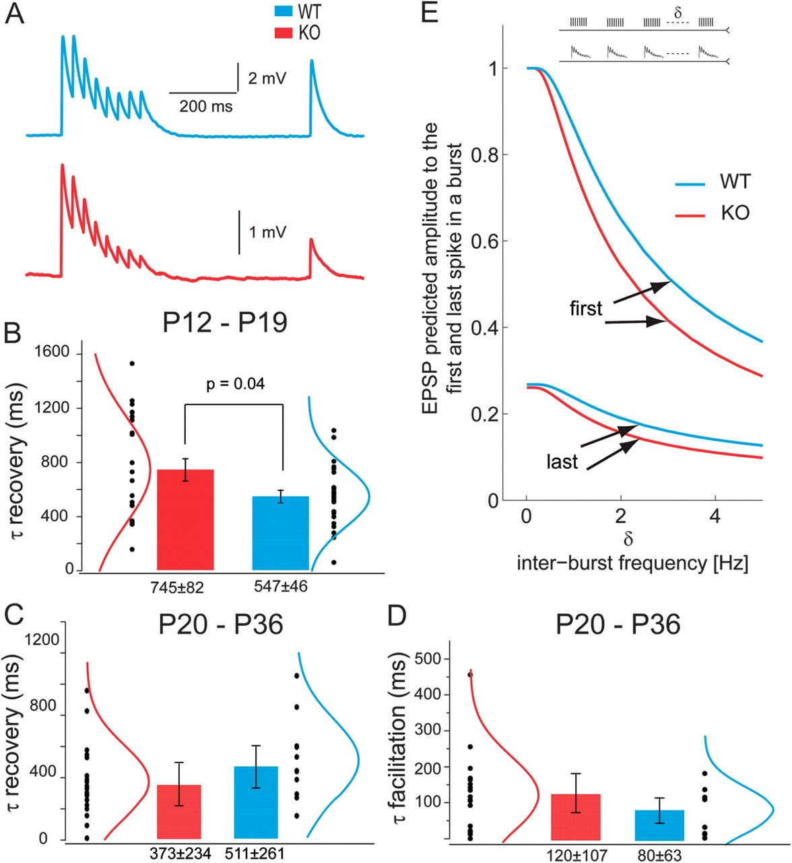
Figure 3. Delayed recovery of EPSPs following short-term depression in Fmr1-KO synapses. (A) Example EPSP traces from ...
Notes:
Figure 3. Delayed recovery of EPSPs following short-term depression in Fmr1-KO synapses. (A) Example EPSP traces from evoked AP trains from WT (blue) and KO (red) synaptic connections used for extracting the 5 synaptic dynamic parameters with the T-M model. See Materials and Methods for model fitting details. (B) The recovery time constant from depression, τrec, is significantly delayed in Fmr1-KO than WT synapses *P < 0.04. Mean ± SEM shown. Individual data points (black circles) and the corresponding normal distribution curves shown by each bar. No significant differences in other dynamic parameters or in absolute synaptic efficacy were observed. (C) No significant difference exists in the recovery time constant from depression τrec, between KO and WT synapses. Mean ± SEM shown. (D) Time constant of synaptic facilitation, τfacil, is measured only in older synapses and does not differ between KO and WT groups. Mean ± SEM shown. Individual data points (black circles) and the corresponding normal distribution curves shown by each bar. (E) Smaller EPSP amplitudes in response to first and last spike in the 8 AP train at 30 Hz for WT and KO synapse simulation, repeatedly stimulated at intervals (δ) of 0–5 Hz, as predicted by the model (eqs. 3,4).
Unless provided in the caption above, the following copyright applies to the content of this slide: © The Author 2011. Published by Oxford University Press. All rights reserved. For permissions, please e-mail: journals.permissions@oup.com

Slide 4
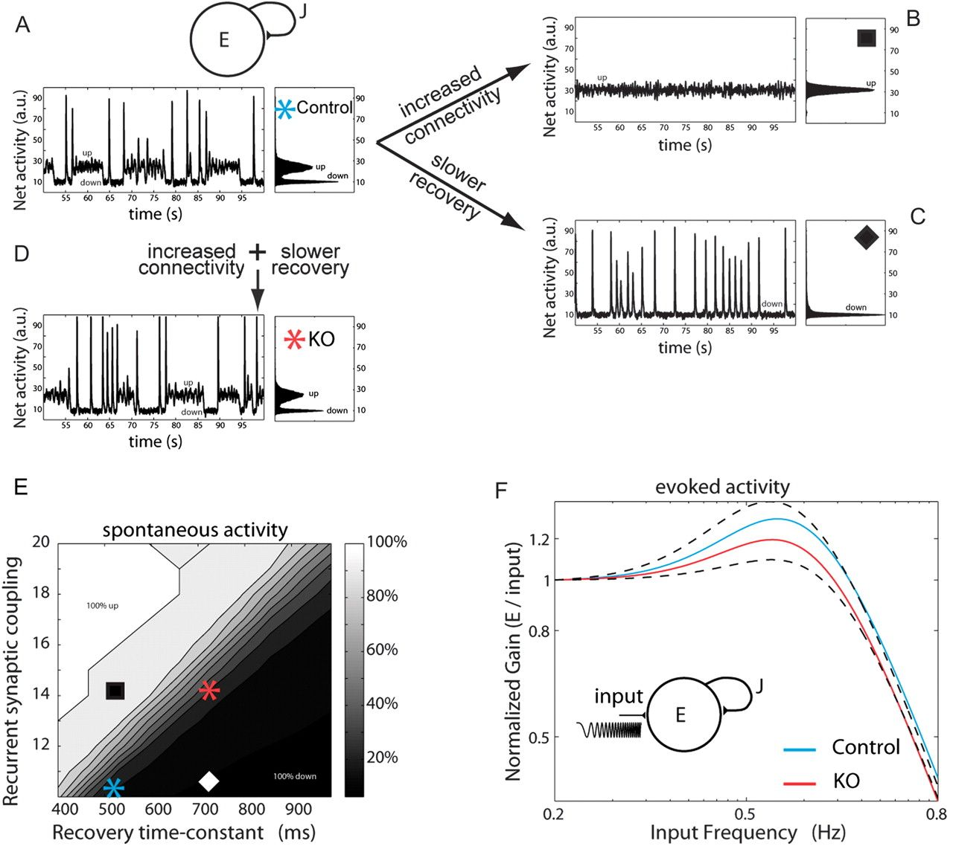
Figure 4. Slower time constants counterbalance hyperconnectivity in a developing network model of Fmr1-KO cortex. (A) ...
Notes:
Figure 4. Slower time constants counterbalance hyperconnectivity in a developing network model of Fmr1-KO cortex. (A) Above, schematic of the recurrent network model that includes connectivity strength J and synaptic connections that exhibit short-term depression (see Materials and Methods). Below, the WT network displays a dynamic range of activity states for periods of a few seconds with transient high discharges of synchronous firing (left). Histogram of mean network activity illustrates bistable network state interspersed with transient high-firing synchrony (right). (B–D) Increased connectivity or slower tau recovery constants from depression significantly alter the network activity. Co-occurrence of increased connectivity and slow tau recovery, simulating experimental data from KO synapses, rescue the dynamic transitions of the network. (E) Map of spontaneous activity revealing relative changes in recurrent synaptic connections against recovery time constant after depression for 4 different network states, as shown in A–D. (F) Evoked stimulation at a range of physiological rhythm frequencies reveals lower gain entrainment of KO synaptic networks between 0.5 and 0.6 Hz range.
Unless provided in the caption above, the following copyright applies to the content of this slide: © The Author 2011. Published by Oxford University Press. All rights reserved. For permissions, please e-mail: journals.permissions@oup.com

Slide 5
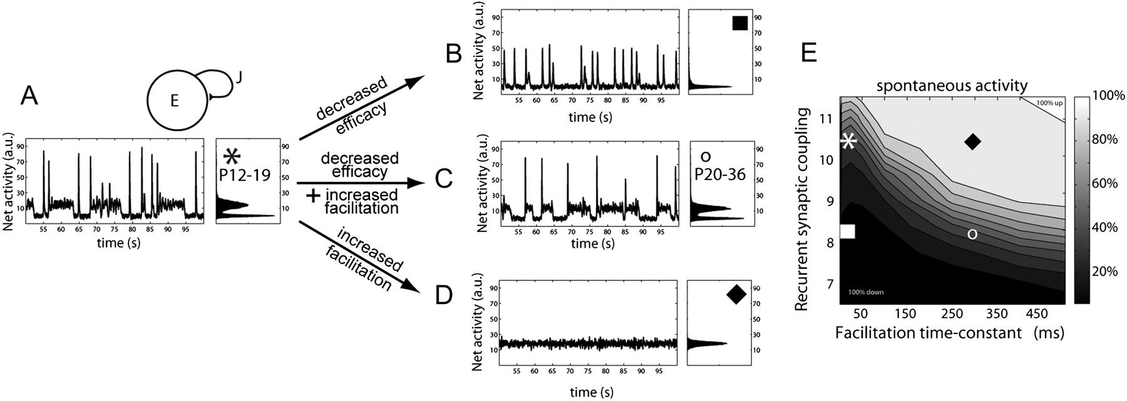
Figure 5. Decreased synaptic efficacy during maturation counterbalances the appearance of short-term facilitation, in a ...
Notes:
Figure 5. Decreased synaptic efficacy during maturation counterbalances the appearance of short-term facilitation, in a network model of young adult cortex. (A) Above, schematic of the recurrent network model that includes connectivity strength J and synaptic connections that exhibit both short-term depression and facilitation (see Materials and Methods). Below, the adult network displays a dynamic range of activity states for periods of a few seconds with transient high discharges of synchronous firing (left). Histogram of mean network activity illustrates bistable network state interspersed with transient high-firing synchrony (right). (B–D) Decreased efficacy of synaptic transmission or increased facilitation significantly alters the network activity. Co-occurrence of decreased efficacy and increased facilitation in adult networks simulating experimental data from synapses in young adult animals, rescue the dynamic transitions of the network. (E) Map of spontaneous activity revealing relative changes in recurrent synaptic connections against facilitation time constant for 4 different networks, as shown in A–D. Compare to panel E of Figure 4 and note the smaller values for recurrent synaptic coupling.
Unless provided in the caption above, the following copyright applies to the content of this slide: © The Author 2011. Published by Oxford University Press. All rights reserved. For permissions, please e-mail: journals.permissions@oup.com

