Slide 1
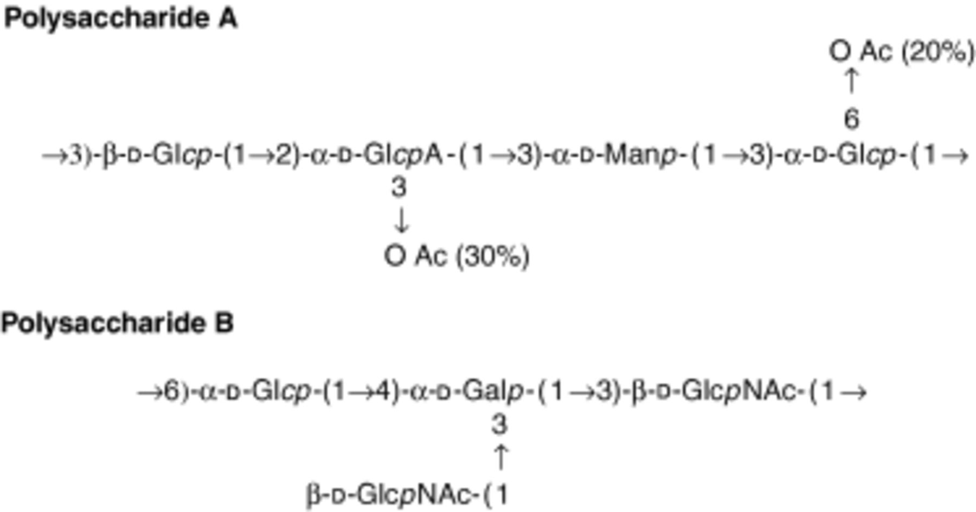
1 Structures of the two polysaccharides of Campylobacter jejuni 81116 as described previously (Muldoon et al., ...
Notes:
1 Structures of the two polysaccharides of Campylobacter jejuni 81116 as described previously (Muldoon et al., 2002). Both are composed of tetrasaccharide repeating units; polysaccharide A is acidic whereas polysaccharide B is neutral, and occur in a 3 : 1 ratio, respectively. Gal, galactose; GalNAc, N-acetylgalactosamine; Glc, glucose; GlcA, glucuronic acid; GlcNAc, N-acetylglucosamine; Man, mannose; OAc, O-acetyl group; p, pyranose ring form.
Unless provided in the caption above, the following copyright applies to the content of this slide: © 2006 Federation of European Microbiological Societies

Slide 2
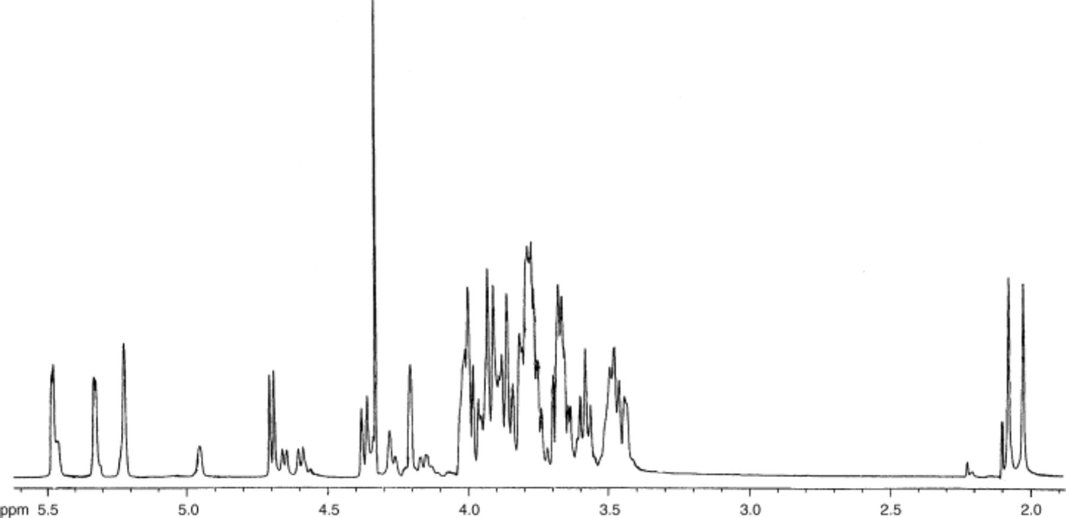
4 Five hundred MHz ¹H-NMR spectrum of fraction sp1 containing a mixture of delipidated and ...
Notes:
4 Five hundred MHz 1H-NMR spectrum of fraction sp1 containing a mixture of delipidated and de-O-acetylated polysaccharides A and B of Campylobacter jejuni 81116.
Unless provided in the caption above, the following copyright applies to the content of this slide: © 2006 Federation of European Microbiological Societies

Slide 3
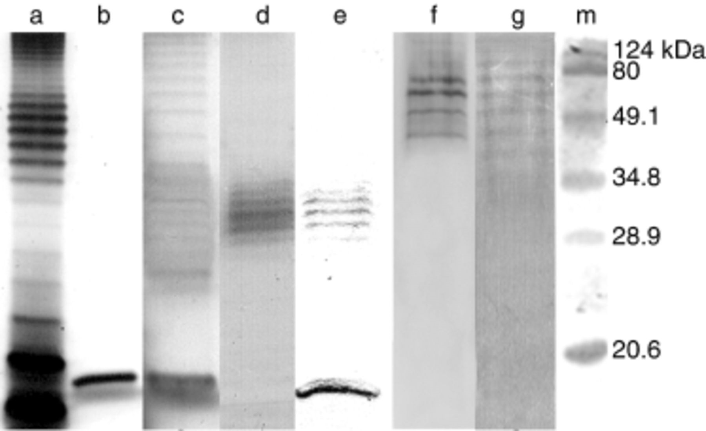
3 SDS-PAGE and Western blot analyses of Campylobacter jejuni 81116 phenol–water extract. (a) Silver-stained ...
Notes:
3 SDS-PAGE and Western blot analyses of Campylobacter jejuni 81116 phenol–water extract. (a) Silver-stained Escherichia coli LPS as control, (b) silver-stained C. jejuni 81116 extract exhibiting only low-Mr bands, (c) silver-stained C. jejuni 81116 extract showing mid- to high-Mr bands; (d) Alcian blue-stained gel of C. jejuni 81116 extract; (e) Western blot of C. jejuni 81116 extract with HS:6 antiserum, (f) Western blot of C. jejuni 81116 extract with HS:7 antiserum, (g) silver-stained purified polysaccharide B, and (m) protein molecular weight markers. As protein weight markers cannot be used to determine the size of glycolipids accurately, these markers are included for comparative purposes only. Nevertheless, comparison of the banding pattern and mobility of E. coli LPS with that of the C. jejuni preparations shows the presence of molecules of low-, mid-, and high-Mr.
Unless provided in the caption above, the following copyright applies to the content of this slide: © 2006 Federation of European Microbiological Societies

Slide 4
2 Schematic representation of the steps and fractions obtained during the isolation of polysaccharide B from ...
Notes:
2 Schematic representation of the steps and fractions obtained during the isolation of polysaccharide B from Campylobacter jejuni 81116 phenol–water extract.
Unless provided in the caption above, the following copyright applies to the content of this slide: © 2006 Federation of European Microbiological Societies

Slide 5
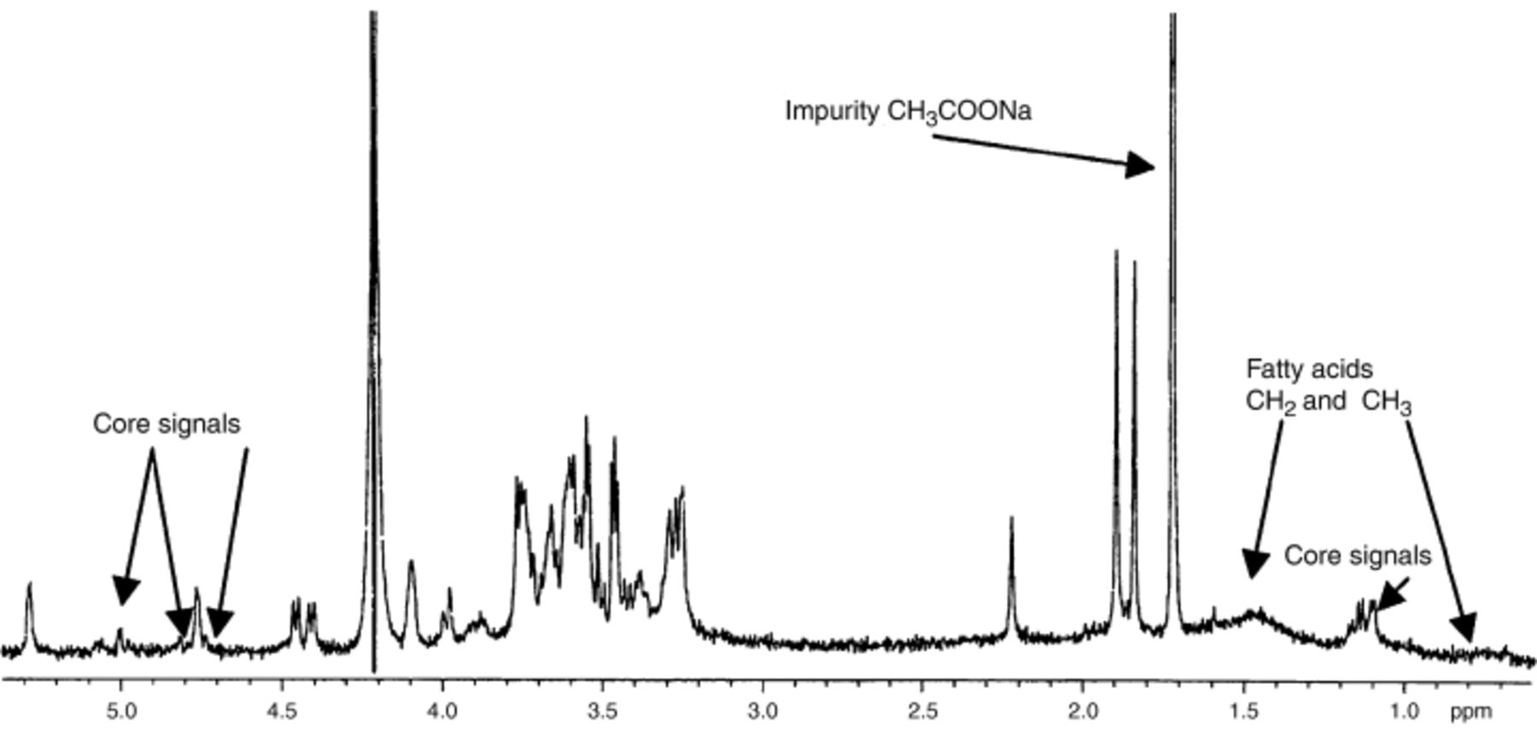
5 Five hundred MHz ¹H-NMR spectrum of fraction sp2 containing purified and untreated polysaccharide ...
Notes:
5 Five hundred MHz 1H-NMR spectrum of fraction sp2 containing purified and untreated polysaccharide B of Campylobacter jejuni 81116. Arrows: Core signals, derived from sugars in the core oligosaccharide of LPS; Fatty acids CH2 and CH3, derived from fatty acid chains; impurity CH3COONa, from the occurrence of sodium acetate as a salt in the preparation due to the work-up procedure. The signal for acetone reference can be seen at δ 2.225.
Unless provided in the caption above, the following copyright applies to the content of this slide: © 2006 Federation of European Microbiological Societies

