Slide 1
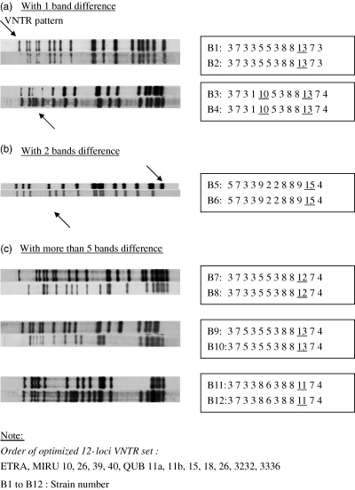
1 IS6110 restriction fragment length polymorphism of isolates that shared the same variable number tandem ...
Notes:
1 IS6110 restriction fragment length polymorphism of isolates that shared the same variable number tandem repeat (12 loci) patterns amongst some Mycobacterium tuberculosis isolates of the Beijing family.
Unless provided in the caption above, the following copyright applies to the content of this slide: © 2006 Federation of European Microbiological Societies

