Slide 1
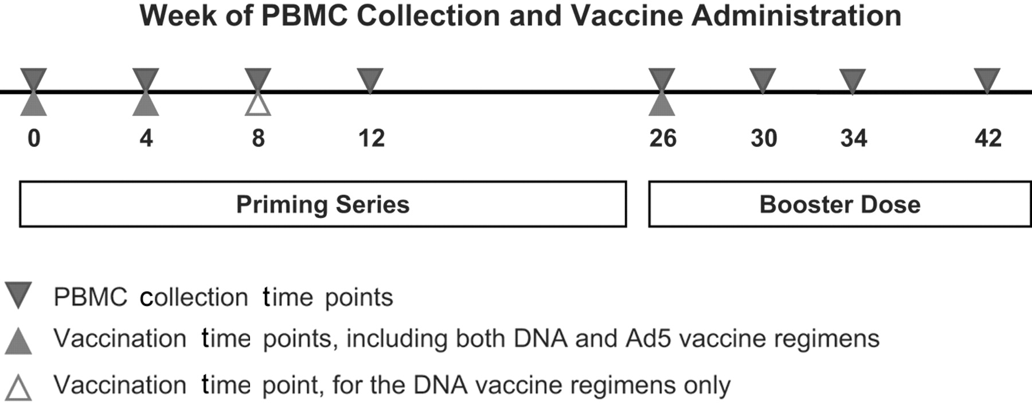
Figure 1 Treatment paradigms. Specimens obtained at vaccination visits were collected before administration of ...
Notes:
Figure 1 Treatment paradigms. Specimens obtained at vaccination visits were collected before administration of vaccine. Ad5, adenovirus type 5; PBMC, peripheral blood mononuclear cell
Unless provided in the caption above, the following copyright applies to the content of this slide: © 2010 by the Infectious Diseases Society of America

Slide 2
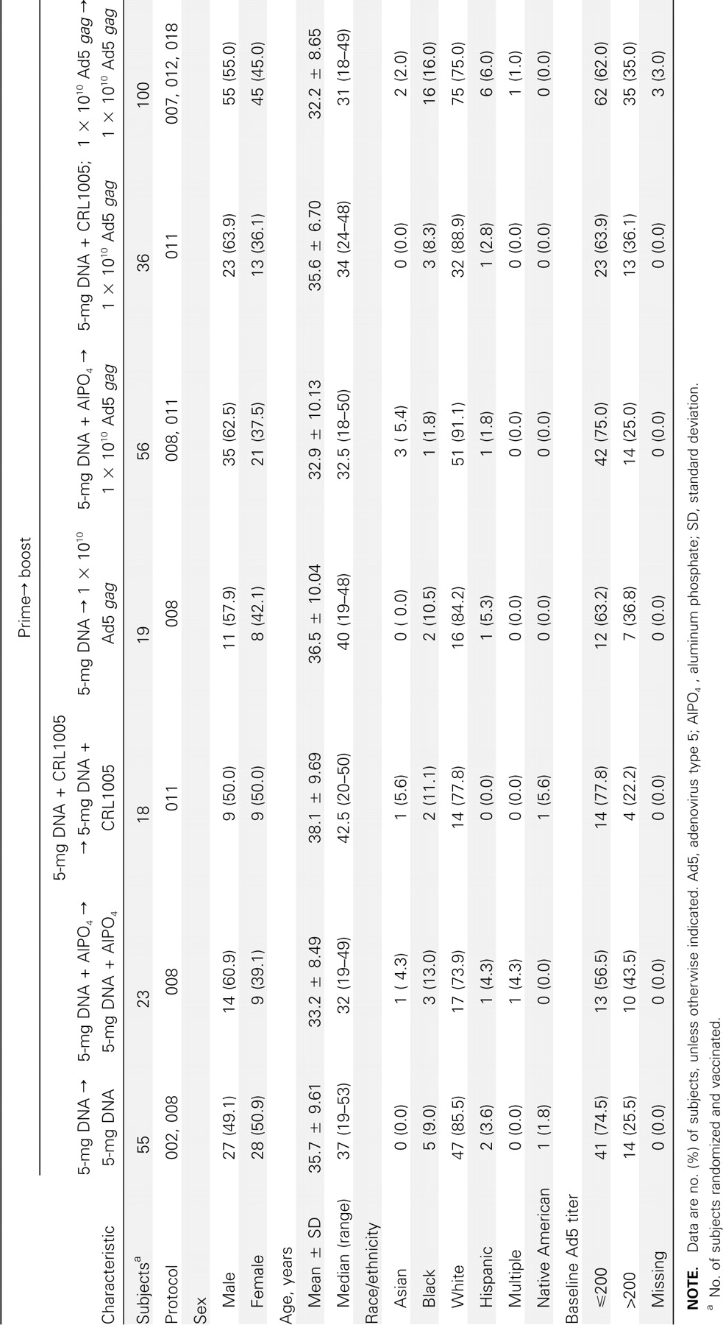
Table 1 Baseline Characteristics by Treatment Group (Pooled from Protocols 002, 007, 008, 011, 012, and 018)
Notes:
Table 1 Baseline Characteristics by Treatment Group (Pooled from Protocols 002, 007, 008, 011, 012, and 018)
Unless provided in the caption above, the following copyright applies to the content of this slide: © 2010 by the Infectious Diseases Society of America

Slide 3
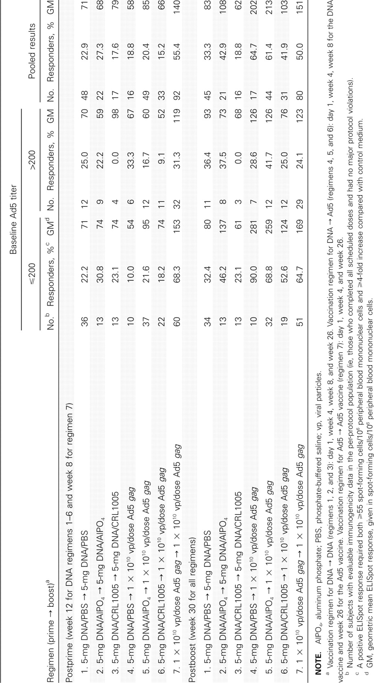
Table 2 Summary of Human Immunodeficiency Virus Type 1 gag-Specific Enzyme-Linked Immunospot (ELISpot) Responses, by ...
Notes:
Table 2 Summary of Human Immunodeficiency Virus Type 1 gag-Specific Enzyme-Linked Immunospot (ELISpot) Responses, by Baseline Adenovirus Type 5 (Ad5) Titer (⩽200 vs >200) and Vaccine Regimen
Unless provided in the caption above, the following copyright applies to the content of this slide: © 2010 by the Infectious Diseases Society of America

Slide 4
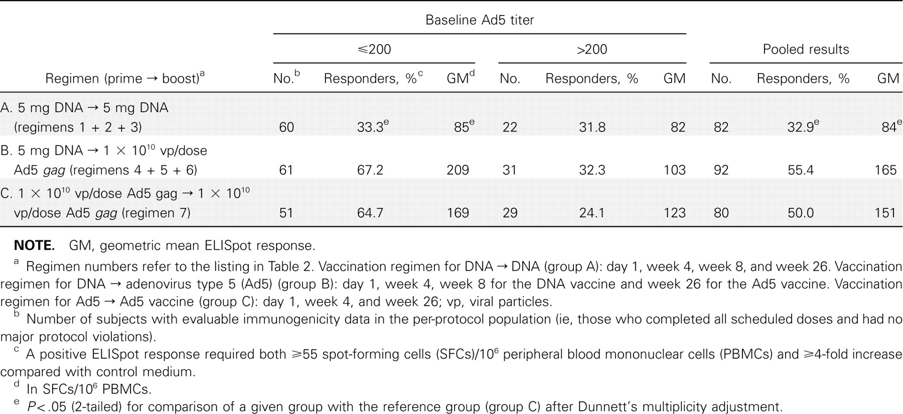
Table 3 Summary of Human Immunodeficiency Virus Type 1 gag-Specific Enzyme-Linked Immunospot (ELISpot) Responses 4 ...
Notes:
Table 3 Summary of Human Immunodeficiency Virus Type 1 gag-Specific Enzyme-Linked Immunospot (ELISpot) Responses 4 Weeks after Booster Dose (at Week 30)
Unless provided in the caption above, the following copyright applies to the content of this slide: © 2010 by the Infectious Diseases Society of America

Slide 5
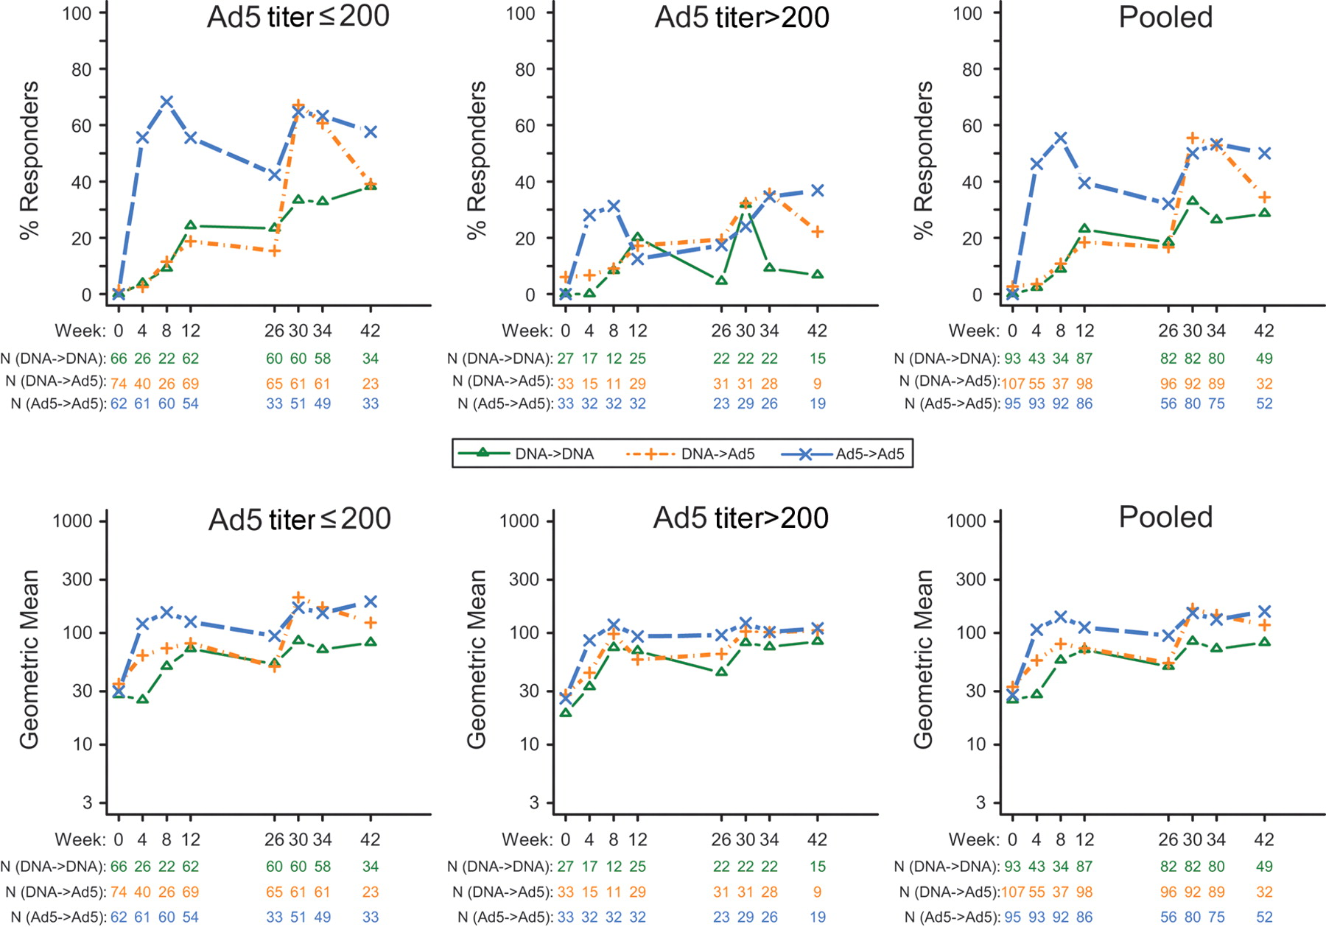
Figure 2 Human immunodeficiency virus type 1 gag-specific enzyme-linked immunospot (ELISpot) responses over time by ...
Notes:
Figure 2 Human immunodeficiency virus type 1 gag-specific enzyme-linked immunospot (ELISpot) responses over time by regimen. A positive ELISpot response was defined as ⩾55 spot-forming cells (SFCs)/106 peripheral blood mononuclear cells (PBMCs) and ⩾4-fold higher than the control medium. Geometric mean ELISpot responses are reported as SFCs/106 PBMCs, and include both responders and nonresponders. Numbers under graphs (N) represent all subjects with available data who had completed the vaccine series to the specified time point
Unless provided in the caption above, the following copyright applies to the content of this slide: © 2010 by the Infectious Diseases Society of America

Slide 6
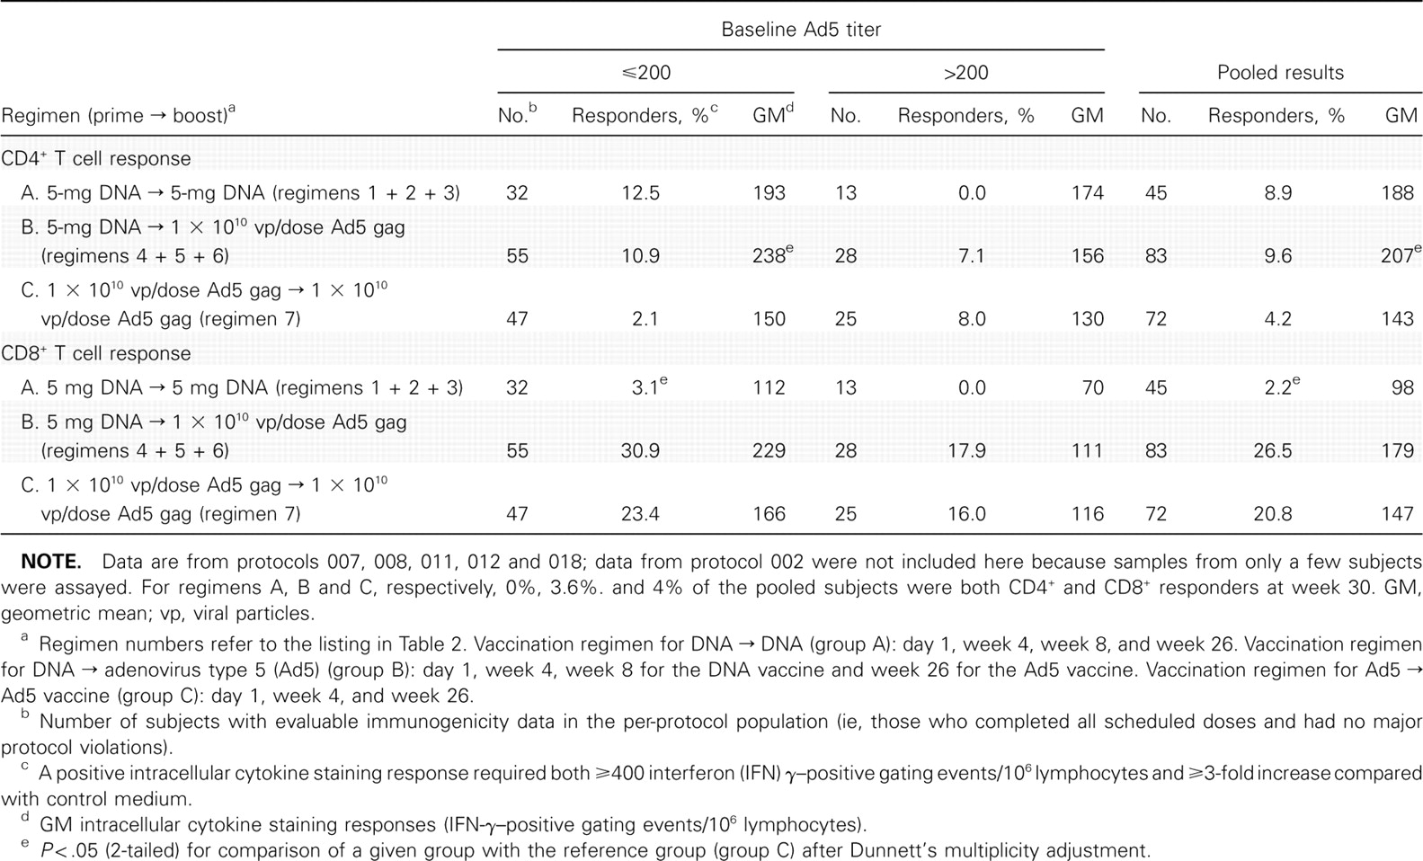
Table 4 Summary of Human Immunodeficiency Virus Type 1 gag-Specific Intracellular Cytokine Staining CD4+ T Cell and ...
Notes:
Table 4 Summary of Human Immunodeficiency Virus Type 1 gag-Specific Intracellular Cytokine Staining CD4+ T Cell and CD8+ T Cell Responses 4 Weeks after Booster Dose (at Week 30)
Unless provided in the caption above, the following copyright applies to the content of this slide: © 2010 by the Infectious Diseases Society of America

