Slide 1
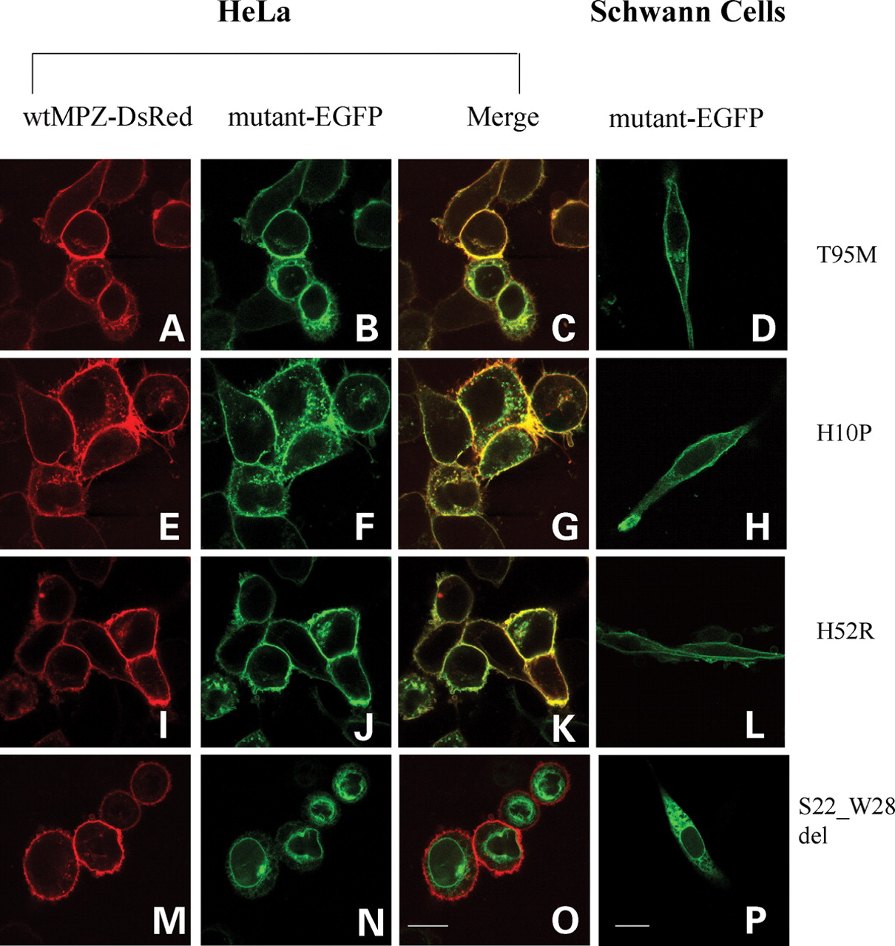
Figure 1. Surface expression on confocal microscope. HeLa cells have been transiently transfected with both ...
Notes:
Figure 1. Surface expression on confocal microscope. HeLa cells have been transiently transfected with both wtMPZ-DsRed ( A, E, I, M ) and MPZ mutants conjugated with EGFP ( B, F, J, N ). The third column shows the merging pattern of the two fluorophores ( C, G, K, O ). Both late-onset mutations, T95M (C) and H10P (G) and early-onset H52R (K) co-localized with wtMPZ-DsRed. The early-onset mutation S22_W28del (O) did not co-localize with wtMPZ, but appears to be retained within the cytoplasm. In murine Schwann cells ( D,H,L,P ) the pattern of localization of the mutants-EGFP is comparable with HeLa cells. The late-onset T95M (D) and H10P (H) mutants are clearly trafficked to the membrane surface, as well as the early-onset H52R mutant (L). The S22_W28del early-onset mutation (P) appears to be retained into the cytoplasm of the Schwann cell. Images were collected by confocal microscopy using a MRC-1024 instrument (Bio-Rad, Hercules, CA, USA) attached to a Nikon Diaphot 200 inverted microscope (Nikon Inc., Tokio, Japan) and using a plan-apochromatic oil immersion objective 60×/1.4 numeric aperture. Bars: 14.5 µm.
Unless provided in the caption above, the following copyright applies to the content of this slide: © The Author 2008. Published by Oxford University Press. All rights reserved. For Permissions, please email: journals.permissions@oxfordjournals.org

Slide 2
Figure 2. Endoglycosidases digestions. The images show three lanes for each transfected protein corresponding to ...
Notes:
Figure 2. Endoglycosidases digestions. The images show three lanes for each transfected protein corresponding to undigested protein extract (−); proteins digested by PNGaseF (P) and proteins digested with Endo H (E). Undigested proteins ran at 55 kDa (MPZ: 29 kDa; EGFP: 26 kDa), those sensitive to PNGaseF (P) or to endo-H digestion (E) ran at about 51 kDa. Fusion proteins were sensitive to PNGse, except for T95M which was undigestible by both endoglycosidases, demonstrating that this protein is not glycosylated. The S22_W28del was sensitive to endo-H digestion, suggesting that this mutation is retained prior to the trans-Golgi.
Unless provided in the caption above, the following copyright applies to the content of this slide: © The Author 2008. Published by Oxford University Press. All rights reserved. For Permissions, please email: journals.permissions@oxfordjournals.org

Slide 3
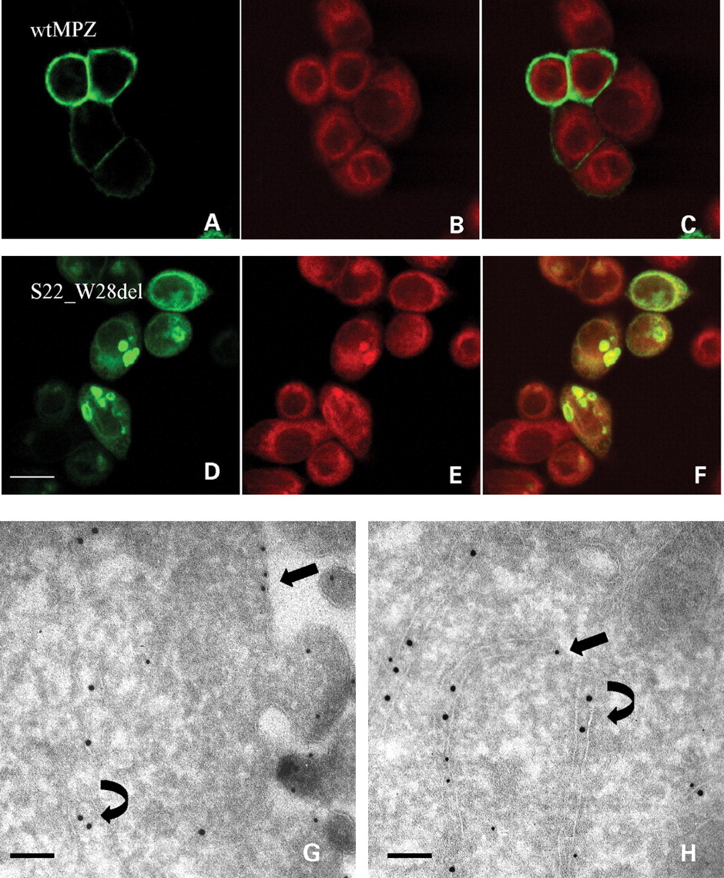
Figure 3. Co-localizazion of S22_W28del with ER markers. HeLa cells were transiently transfected with wtMPZ ( A – C ) ...
Notes:
Figure 3. Co-localizazion of S22_W28del with ER markers. HeLa cells were transiently transfected with wtMPZ ( A – C ) or S22_W28del ( D – F ). After transfection, cells were labeled with the red fluorescent lipophilic tracer: ER-Tracker (Molecular Probes, Invitrogen, Italy, San Giuliano Milanese, MI, Italy) (B and E). The Pearson's correlation coefficient ( R R ) between the two fluorences was calculated by evaluating a minimum of 100 cells for each transfection. Wild-type MPZ does not co-localize with the ER-tracer (C), while the mutant S22_W28del (F) co-localizes with the ER marker (R R 0.86 versus R R 0.20 of wtMPZ). Bar: 14.5 µm. Immunoelectron microscopy was performed on cells expressing wtMPZ ( G ) and S22_W28del ( H ). EGFP staining was followed by 10 nm colloidal gold-conjugated protein A (straight arrows). The ER was stained by an anti-calreticulin antibody, followed by 15 nm colloidal gold-conjugated protein A (curved arrows). Wild-type MPZ was located on the cellular surface and did not co-localize with calreticulin (G), while the S22_W28del MPZ can be observed in tubular structures which are positive for calreticulin staining (H). Bars: 150 nm.
Unless provided in the caption above, the following copyright applies to the content of this slide: © The Author 2008. Published by Oxford University Press. All rights reserved. For Permissions, please email: journals.permissions@oxfordjournals.org

Slide 4
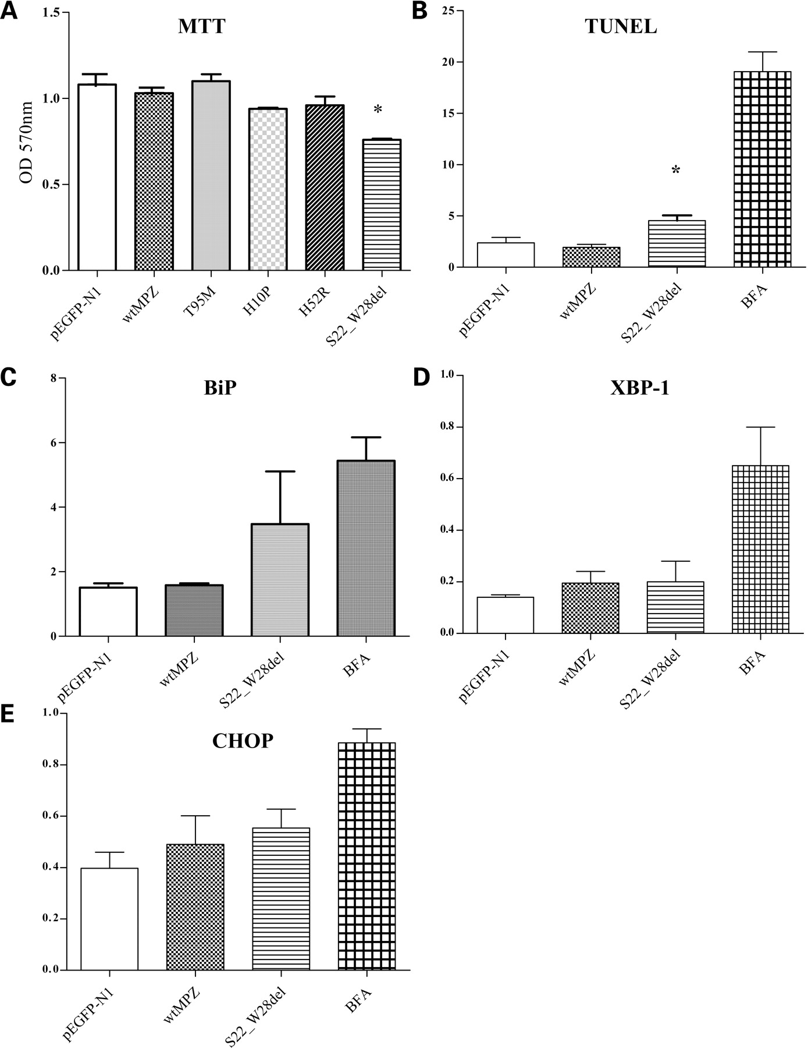
Figure 4. Viability, apoptosis and UPR response. The results of the MTT test are shown in ( A ). The cells transfected ...
Notes:
Figure 4. Viability, apoptosis and UPR response. The results of the MTT test are shown in ( A ). The cells transfected with S22_W28del MPZ were characterized by a significantly decreased (*) cellular viability: 0.76 ± 0.01 when compared with cells expressing wtMPZ: 1.03 ± 0.003, P < 0.05. The Tunel test ( B ) showed a significantly increased (*) percentage of apoptotic cells in HeLa cells transfected with S22_W28del (5.46% ± 0.5) compared with those expressing the wild-type protein (1.51% ± 0.4, P < 0.001). The activation of the UPR was investigated by measuring, by RT–PCR, the expression levels of Bip mRNA ( C ), the XBP-1 mRNA alternative splicing ( D ) and the expression of Chop ( E ). None of those parameters was significantly upregulated in cells expressing the S22_W28del mutation. Cells exposed to BFA represent the positive control.
Unless provided in the caption above, the following copyright applies to the content of this slide: © The Author 2008. Published by Oxford University Press. All rights reserved. For Permissions, please email: journals.permissions@oxfordjournals.org

Slide 5
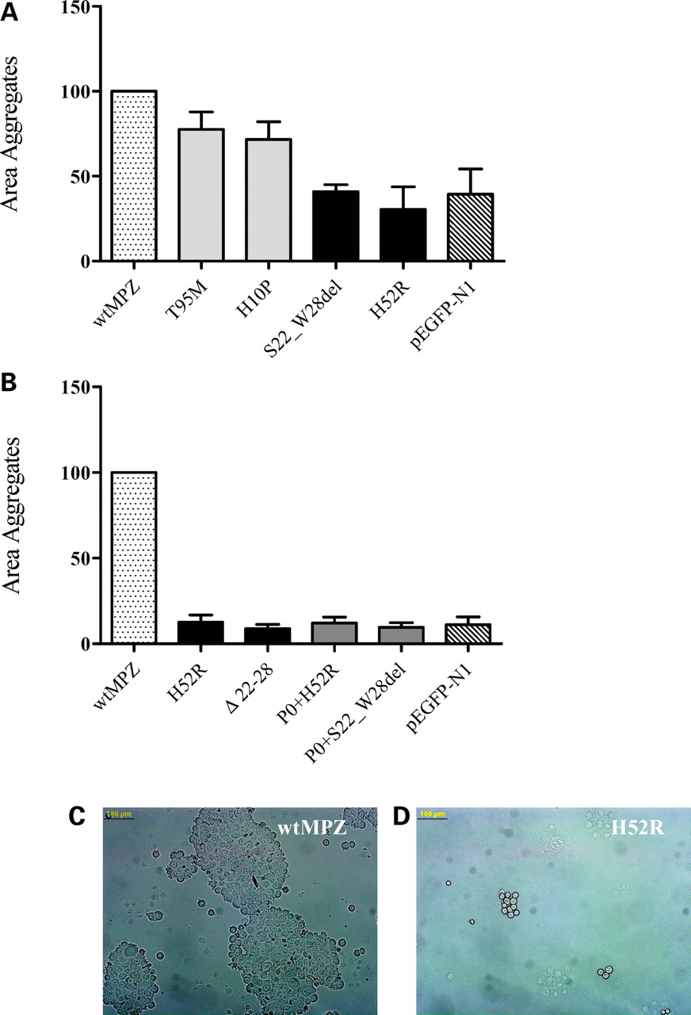
Figure 5. Intercellular adhesion. ( A ) The results of the aggregation test performed with cells transfected with ...
Notes:
Figure 5. Intercellular adhesion. ( A ) The results of the aggregation test performed with cells transfected with wtMPZ, with each mutant and the empty vector alone (pEGFP-N1). The average surface of aggregates expressing each early-onset mutation, normalized to the area of aggregates produced by wtMPZ expressing cells was reduced to about 30% ( P < 0.001). The late-onset mutations moderately interfered with intercellular adhesion ( P -value: n.s.). ( B ) The results of the aggregation test performed on cells expressing wtMPZ, the empty vector alone (pEGFP-N1), the early-onset mutations (H52R, S22_W28del) either alone or doubly transfected with wtMPZ. The average surface of aggregates formed by cotransfected cells was comparable ( P -value: n.s.) with those observed from cells expressing the mutation alone. These data suggest that both early-onset mutations prevent the correct function of the wild-type protein. ( C ) Example of aggregate formed by wtMPZ expressing cells. ( D ) Example of aggregate formed by H52R transfected cells. Bars: 100 µm.
Unless provided in the caption above, the following copyright applies to the content of this slide: © The Author 2008. Published by Oxford University Press. All rights reserved. For Permissions, please email: journals.permissions@oxfordjournals.org

