Slide 1
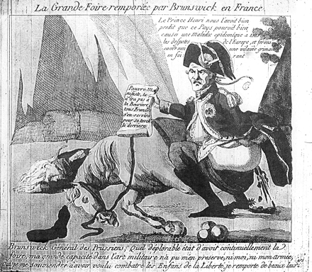
Figure 1 ‘La Grande Foire Remporté par Brunswick en France [The Great Diarrhea won by Brunswick in France.’ Publisher ...
Notes:
Figure 1 ‘La Grande Foire Remporté par Brunswick en France [The Great Diarrhea won by Brunswick in France.’ Publisher unknown. Courtesy of the Bibliothèque nationale de France, Paris.
Unless provided in the caption above, the following copyright applies to the content of this slide: © The Author 2011. Published by Oxford University Press on behalf of the Society for the Study of French History. All rights reserved. For permissions, please e-mail: journals.permissions@oup.com

Slide 2
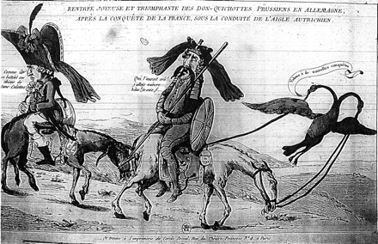
Figure 2 ‘Rentré Joyeuse et Triomphant des Don-Quichottes Prussiens en Allemagne [The Joyous and Triumphant Reentry ...
Notes:
Figure 2 ‘Rentré Joyeuse et Triomphant des Don-Quichottes Prussiens en Allemagne [The Joyous and Triumphant Reentry into Germany by the Prussian Don Quixotes].’ Printed by the Girondin ‘Imprimerie du Cercle Social.’ Courtesy of the Bibliothèque nationale de France, Paris.
Unless provided in the caption above, the following copyright applies to the content of this slide: © The Author 2011. Published by Oxford University Press on behalf of the Society for the Study of French History. All rights reserved. For permissions, please e-mail: journals.permissions@oup.com

Slide 3
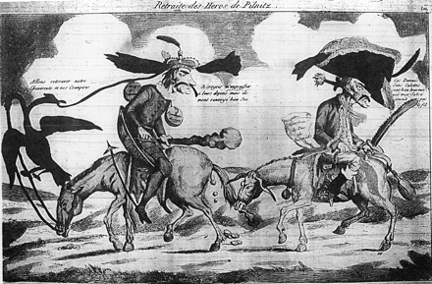
Figure 3 ‘Retraite des Heros de Pilnitz[sic] [The Retreat of the Heroes of Pilnitz]’ Courtesy of the Bibliothèque ...
Notes:
Figure 3 ‘Retraite des Heros de Pilnitz[sic] [The Retreat of the Heroes of Pilnitz]’ Courtesy of the Bibliothèque nationale de France, Paris.
Unless provided in the caption above, the following copyright applies to the content of this slide: © The Author 2011. Published by Oxford University Press on behalf of the Society for the Study of French History. All rights reserved. For permissions, please e-mail: journals.permissions@oup.com

Slide 4
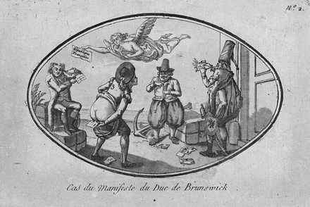
Figure 4 ‘Cas du Manifeste du Duc de Brunswick [The Case of the Brunswick Manifesto].’ Courtesy of the Library of ...
Notes:
Figure 4 ‘Cas du Manifeste du Duc de Brunswick [The Case of the Brunswick Manifesto].’ Courtesy of the Library of Congress, Washington, D.C. The nations are unidentified, but one can reasonably infer by their attire that they represent Russia, Britain, the United States and Holland, with the French Republic overhead.
Unless provided in the caption above, the following copyright applies to the content of this slide: © The Author 2011. Published by Oxford University Press on behalf of the Society for the Study of French History. All rights reserved. For permissions, please e-mail: journals.permissions@oup.com

Slide 5
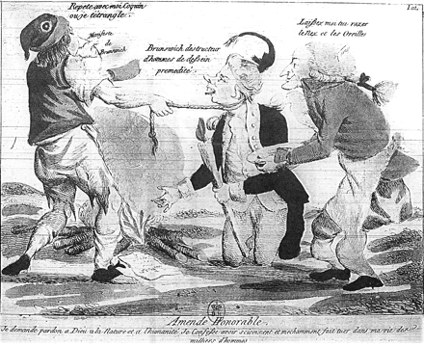
Figure 5 ‘Amende Honorable.’ Courtesy of the Bibliothèque nationale de France, Paris.
Notes:
Figure 5 ‘Amende Honorable.’ Courtesy of the Bibliothèque nationale de France, Paris.
Unless provided in the caption above, the following copyright applies to the content of this slide: © The Author 2011. Published by Oxford University Press on behalf of the Society for the Study of French History. All rights reserved. For permissions, please e-mail: journals.permissions@oup.com

Slide 6
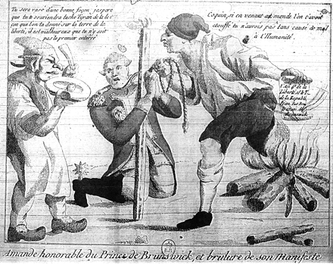
Figure 6 ‘Amande[sic] honorable du Prince de Brunswick, et brulure de son Manifeste [Amende honorable of the Prince of ...
Notes:
Figure 6 ‘Amande[sic] honorable du Prince de Brunswick, et brulure de son Manifeste [Amende honorable of the Prince of Brunswick, and burning of his Manifesto.] Courtesy of the Bibliothèque nationale de France, Paris.
Unless provided in the caption above, the following copyright applies to the content of this slide: © The Author 2011. Published by Oxford University Press on behalf of the Society for the Study of French History. All rights reserved. For permissions, please e-mail: journals.permissions@oup.com

