Slide 1
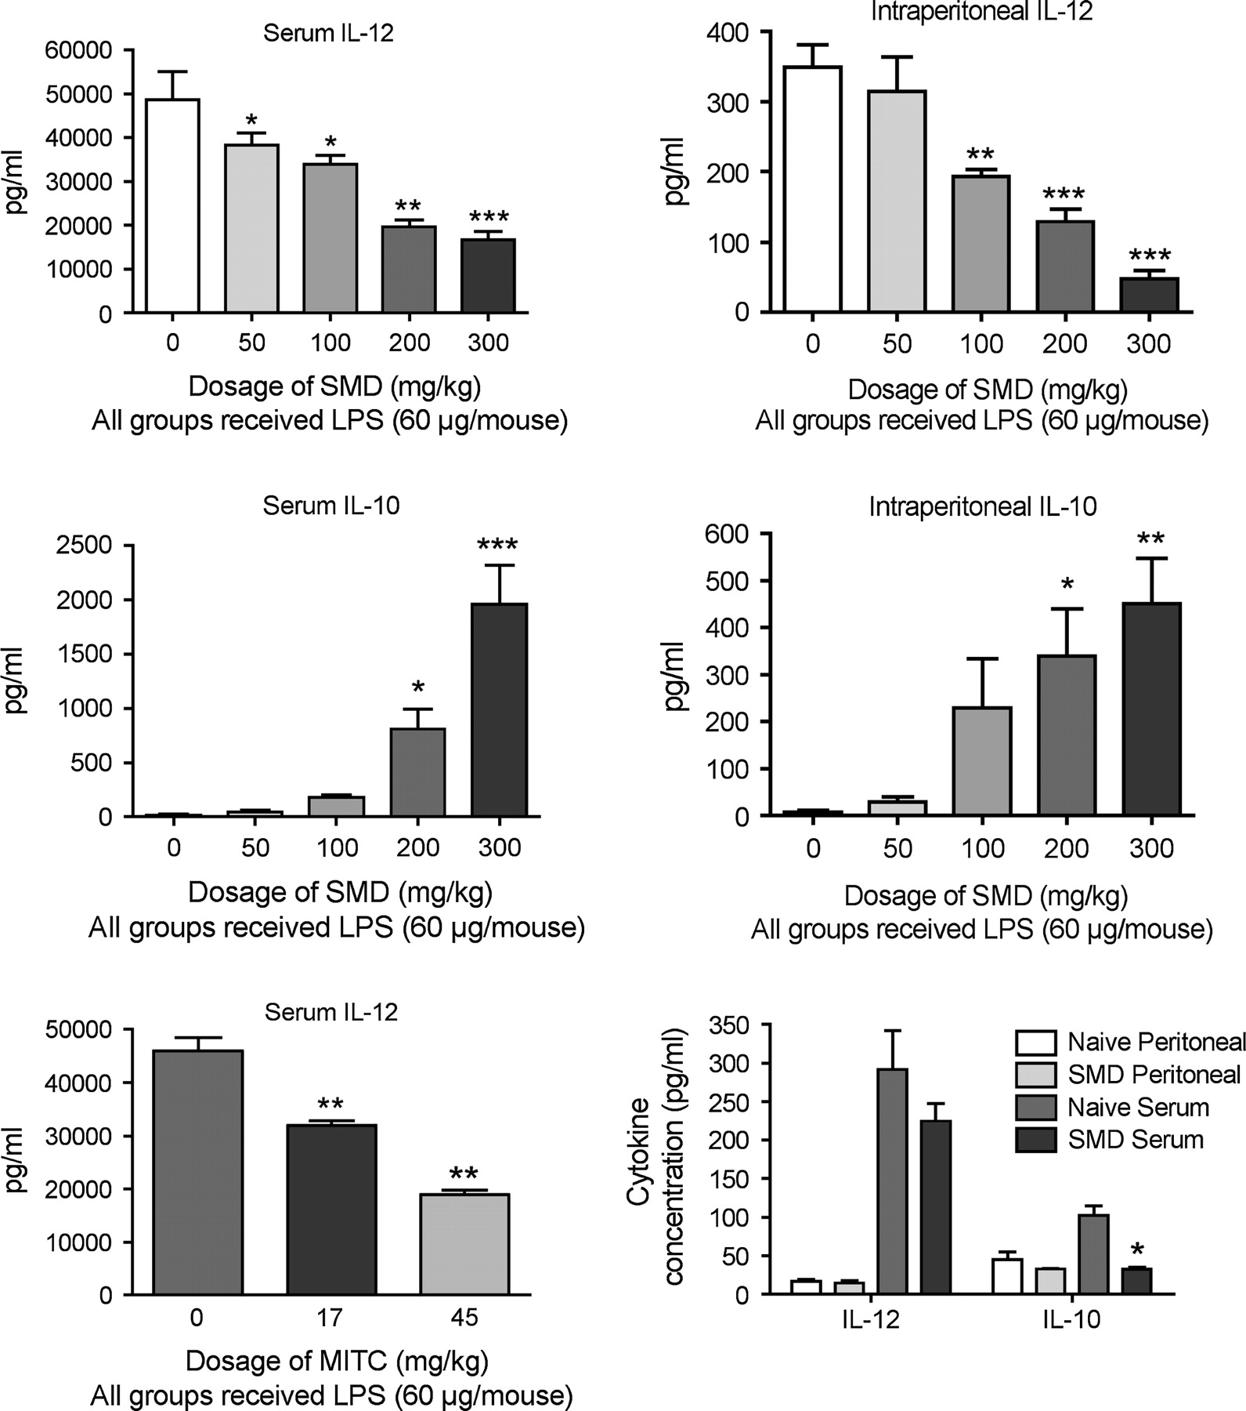
FIG. 1. The effects of SMD and MITC on cytokine production are dose responsive and occur at dosages relevant to human ...
Notes:
FIG. 1. The effects of SMD and MITC on cytokine production are dose responsive and occur at dosages relevant to human exposure levels. Mice were treated with LPS (intravenously at 60 μg/mouse) 10 min after SMD or MITC (orally by gavage at the indicated dosages). Samples were obtained for cytokine analysis 3 h later. In the experiment in which mice received SMD, the LPS was ultrapure LPS from List Labs, which is derived from Salmonella minnesota (in contrast to the standard LPS used in most experiments, which was derived from E. coli). The graph on the bottom right of the figure indicates the effect of SMD alone (at 250 mg/kg) on basal levels of IL-12 (p40) and IL-10. The results shown are means ± SEM (n = 5), and values significantly different from the values for groups treated with LPS only or naive (for the bottom right graph) are indicated by *(p < 0.05), **(p < 0.01), or ***(p < 0.001).
Unless provided in the caption above, the following copyright applies to the content of this slide: © The Author 2005. Published by Oxford University Press on behalf of the Society of Toxicology. All rights reserved. For Permissions, please email: journals.permissions@oupjournals.org

Slide 2
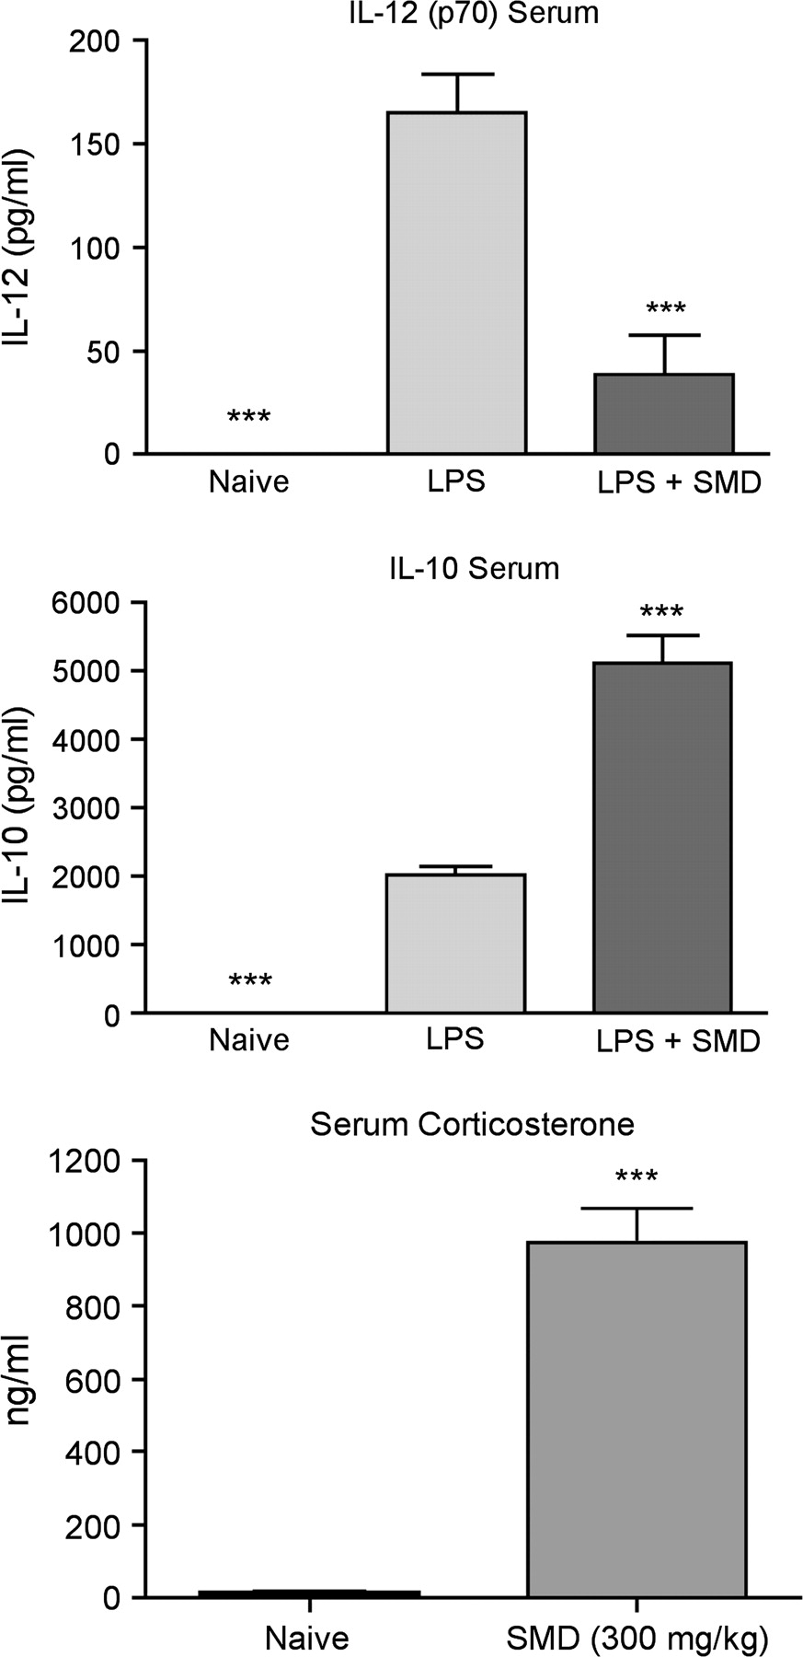
FIG. 2. Dermal administration of SMD increases LPS-induced IL-10 in the serum, decreases IL-12, and increases serum ...
Notes:
FIG. 2. Dermal administration of SMD increases LPS-induced IL-10 in the serum, decreases IL-12, and increases serum corticosterone. Mice were treated with SMD (300 mg/kg, dermally) 10 min before administration of LPS (60 μg/mouse, iv), and mice were bled 2 h later to obtain serum for cytokine analysis. Separate groups were untreated or treated with SMD only (dermally), and blood samples were obtained 1.5 h later for corticosterone analysis by RIA. Cytokines were analyzed by multiplexed bead array (BioPlex). Values shown are means ± SEM (n = 5 mice per group), and values significantly different from the LPS group are indicated by ***(p < 0.001 by ANOVA and Newman Keul's test).
Unless provided in the caption above, the following copyright applies to the content of this slide: © The Author 2005. Published by Oxford University Press on behalf of the Society of Toxicology. All rights reserved. For Permissions, please email: journals.permissions@oupjournals.org

Slide 3
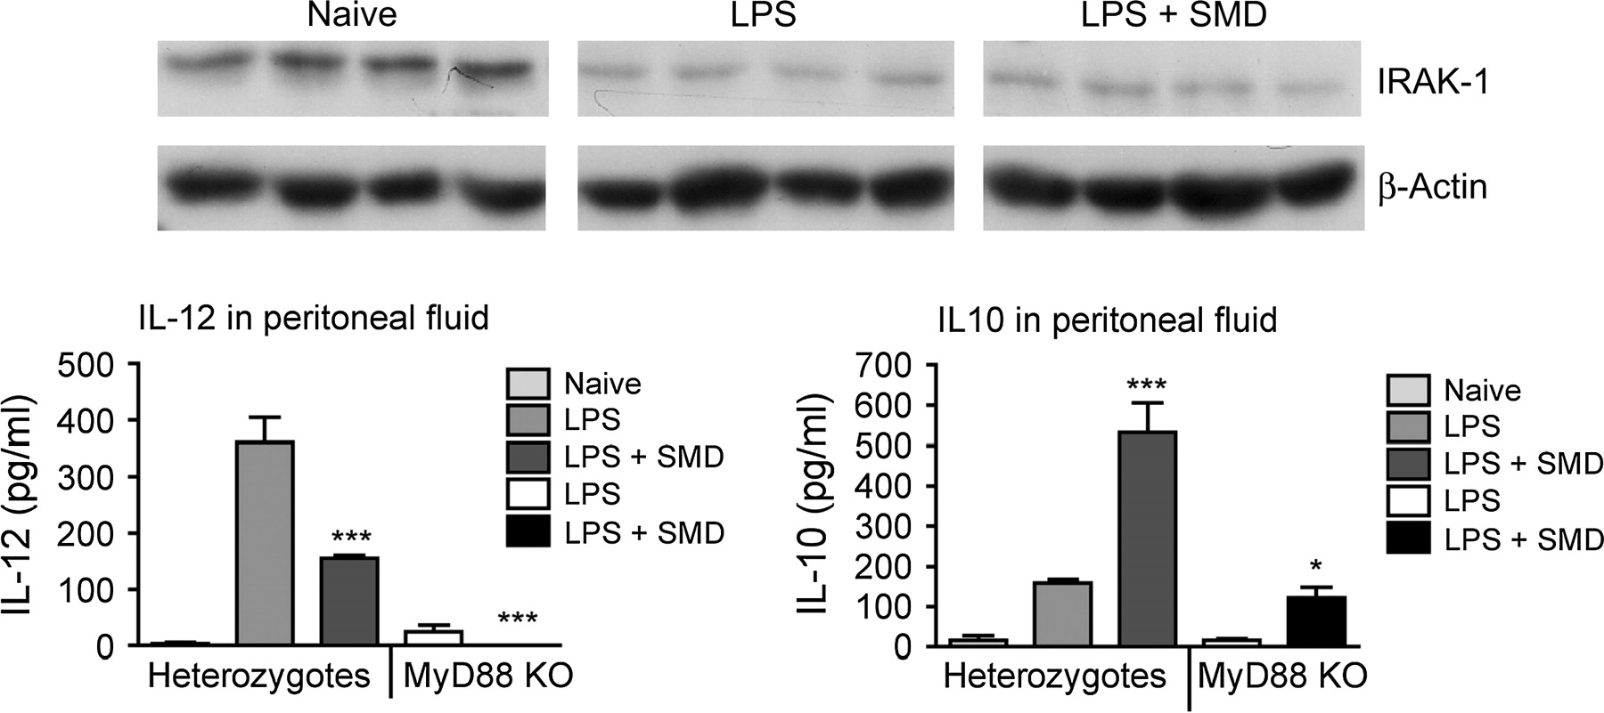
FIG. 3. In the lower panel, C57BL/6 heterozygotes or MyD88 knockout (KO) mice were treated with SMD (300 mg/kg by ...
Notes:
FIG. 3. In the lower panel, C57BL/6 heterozygotes or MyD88 knockout (KO) mice were treated with SMD (300 mg/kg by gavage) immediately before LPS (60 μg/mouse, iv). Values shown are means ± SEM (n = 5 mice/group), and significant differences between LPS and LPS + SMD groups are indicated by *(p < 0.05) or ***(p < 0.001). In the upper panel, mice were treated with SMD immediately before LPS, and peritoneal cells were obtained by lavage from B6C3F1 mice 1 h after LPS.
Unless provided in the caption above, the following copyright applies to the content of this slide: © The Author 2005. Published by Oxford University Press on behalf of the Society of Toxicology. All rights reserved. For Permissions, please email: journals.permissions@oupjournals.org

Slide 4
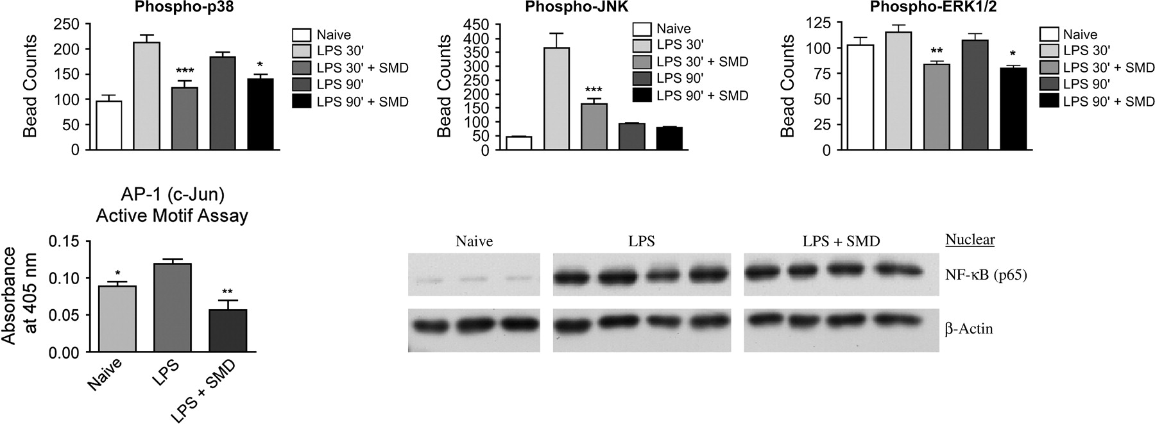
FIG. 4. SMD (300 mg/kg by gavage) 30 min before LPS (60 μg/mouse, iv) inhibits signaling in peritoneal macrophages. ...
Notes:
FIG. 4. SMD (300 mg/kg by gavage) 30 min before LPS (60 μg/mouse, iv) inhibits signaling in peritoneal macrophages. In the upper panel, peritoneal cells were isolated 30 min or 90 min after LPS administration and whole cell extracts were prepared (as described in the Methods section). Values shown are means ± SEM (n = 5 mice/group) and significant differences between LPS and LPS + SMD groups are indicated by *(p < 0.05), **(p < 0.01), or ***(p < 0.001). In the lower panel, the treatments were the same, but nuclear extracts, not whole cell extracts were used.
Unless provided in the caption above, the following copyright applies to the content of this slide: © The Author 2005. Published by Oxford University Press on behalf of the Society of Toxicology. All rights reserved. For Permissions, please email: journals.permissions@oupjournals.org

Slide 5
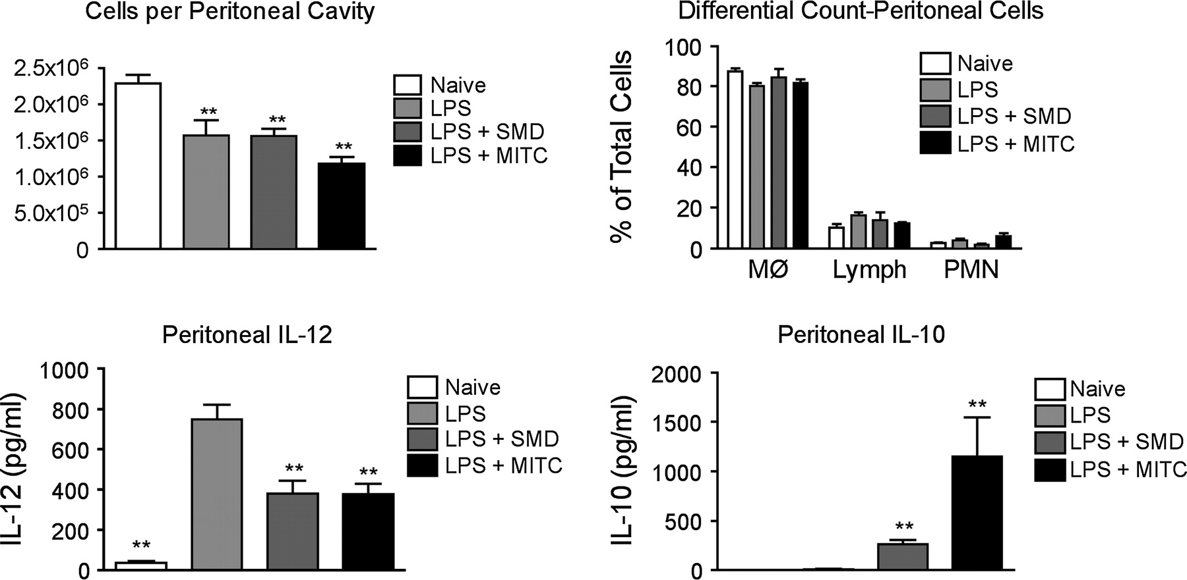
FIG. 5. Mice were treated with SMD (300 mg/kg by gavage) or MITC (45 mg/kg) 30 min before LPS (60 μg/mouse, iv), and ...
Notes:
FIG. 5. Mice were treated with SMD (300 mg/kg by gavage) or MITC (45 mg/kg) 30 min before LPS (60 μg/mouse, iv), and cytokines in peritoneal lavage fluid were analyzed 3 h after LPS treatment. Cell counts were determined by Coulter counter, and differential counts were determined using cytospin preparations. Values shown are means ± SEM (n = 5 mice/group), and significant differences between LPS and LPS + SMD groups are indicated by **(p < 0.01).
Unless provided in the caption above, the following copyright applies to the content of this slide: © The Author 2005. Published by Oxford University Press on behalf of the Society of Toxicology. All rights reserved. For Permissions, please email: journals.permissions@oupjournals.org

Slide 6
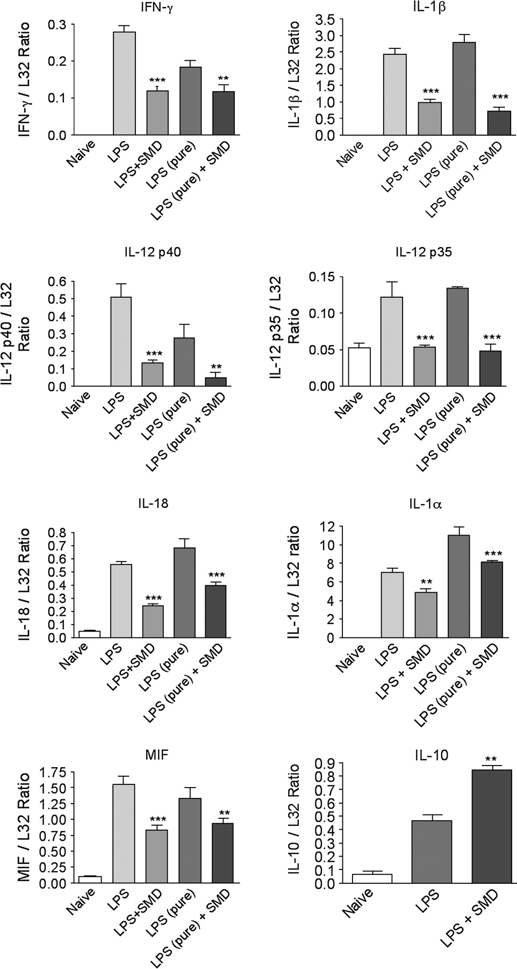
FIG. 6. Mice were treated with SMD (300 mg/kg by gavage) 30 min before LPS (60 μg/mouse, iv), and peritoneal cells ...
Notes:
FIG. 6. Mice were treated with SMD (300 mg/kg by gavage) 30 min before LPS (60 μg/mouse, iv), and peritoneal cells were obtained by lavage 3 h (for IL-10) or 2 h (for all others) after LPS. RNAse protection assay was performed using a kit from BD Pharmingen on RNA isolated from macrophage extracts. Values shown represent mean ± SME of band density for the cytokine of interest divided by band density for L32 (a housekeeping mRNA). The group size was five mice per group. Values significantly different from the LPS only control are indicated by **(p < 0.01) or ***(p < 0.001). Labeled probes, negative control, and positive control lanes are not shown, but they were included on all gels and indicated that the assay conditions were appropriate.
Unless provided in the caption above, the following copyright applies to the content of this slide: © The Author 2005. Published by Oxford University Press on behalf of the Society of Toxicology. All rights reserved. For Permissions, please email: journals.permissions@oupjournals.org

Slide 7
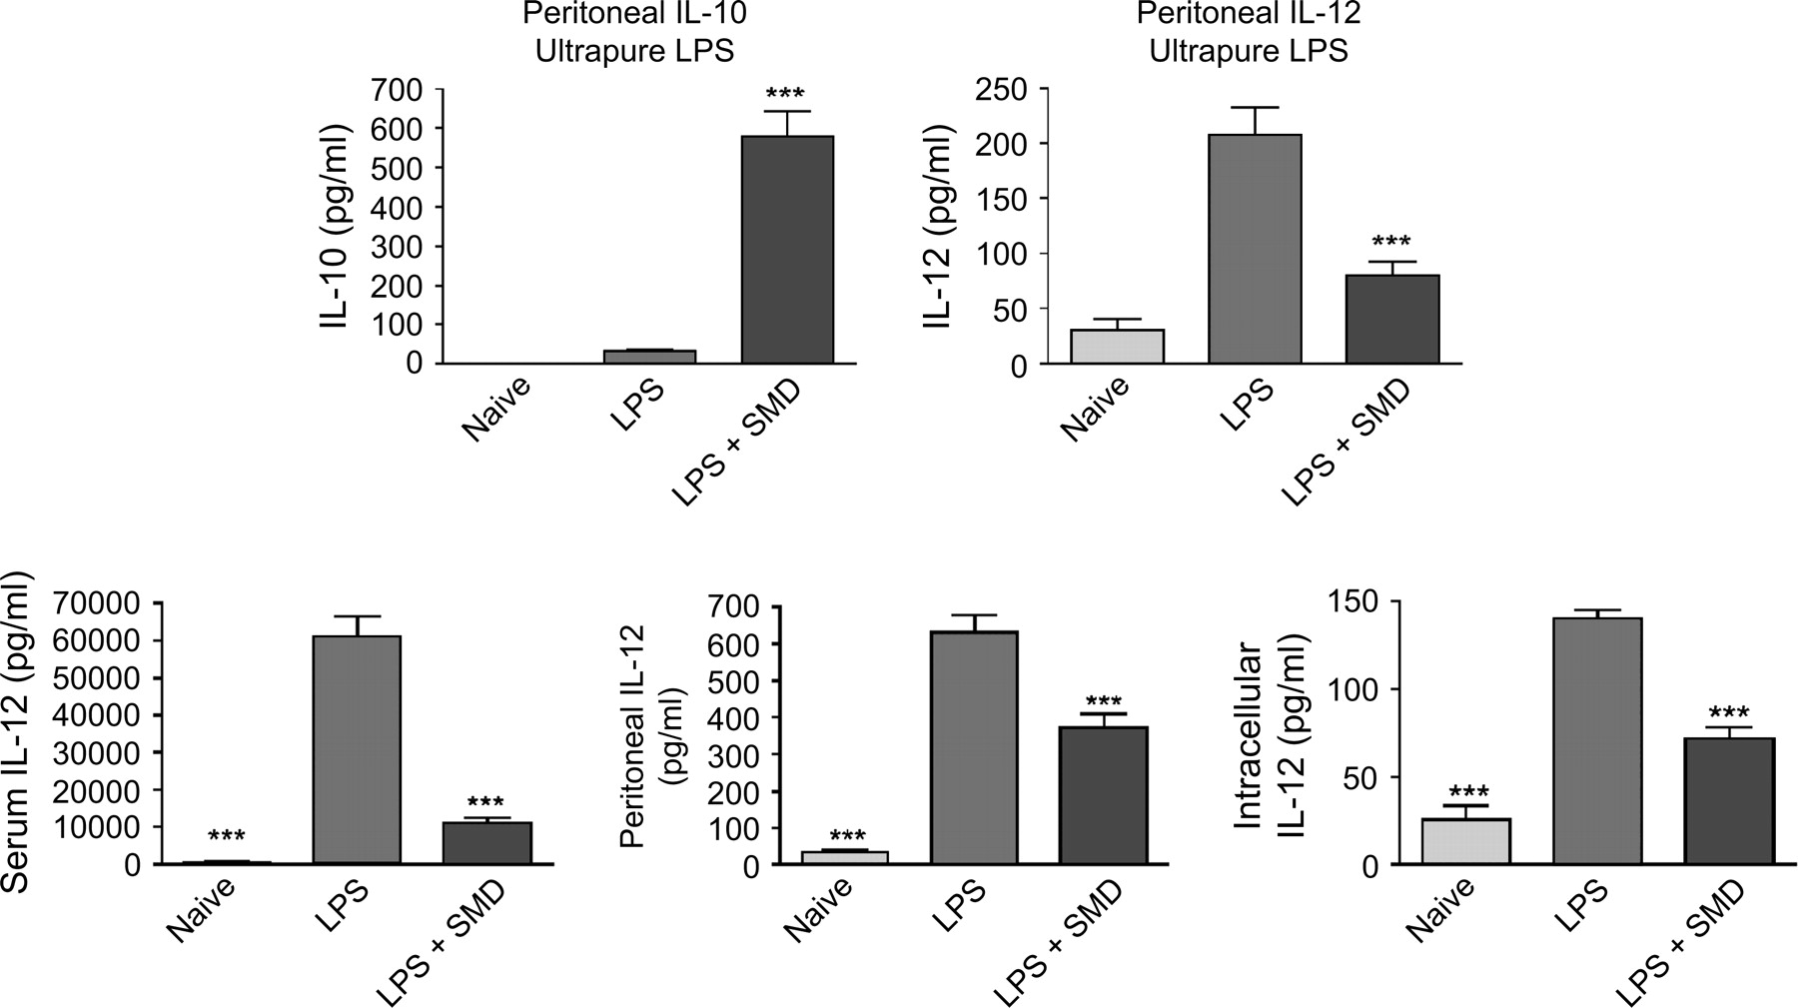
FIG. 7. Values shown are means ± SEM (n = 4–5 mice/group) and significant differences between LPS groups and other ...
Notes:
FIG. 7. Values shown are means ± SEM (n = 4–5 mice/group) and significant differences between LPS groups and other groups are indicated by *(p < 0.05), serum, or ***(p < 0.001). In the upper panel, ultrapure LPS (List Biological Labs) was used to insure that the effects detected in other experiments were not mediated by activation of TLR2 receptors by lipoproteins that can occur as contaminants of standard LPS preparations. In the lower panel, IL-12 (p40) concentrations in serum peritoneal lavage fluid, and in lysates of peritoneal macrophages obtained from the same mice are shown.
Unless provided in the caption above, the following copyright applies to the content of this slide: © The Author 2005. Published by Oxford University Press on behalf of the Society of Toxicology. All rights reserved. For Permissions, please email: journals.permissions@oupjournals.org

Slide 8
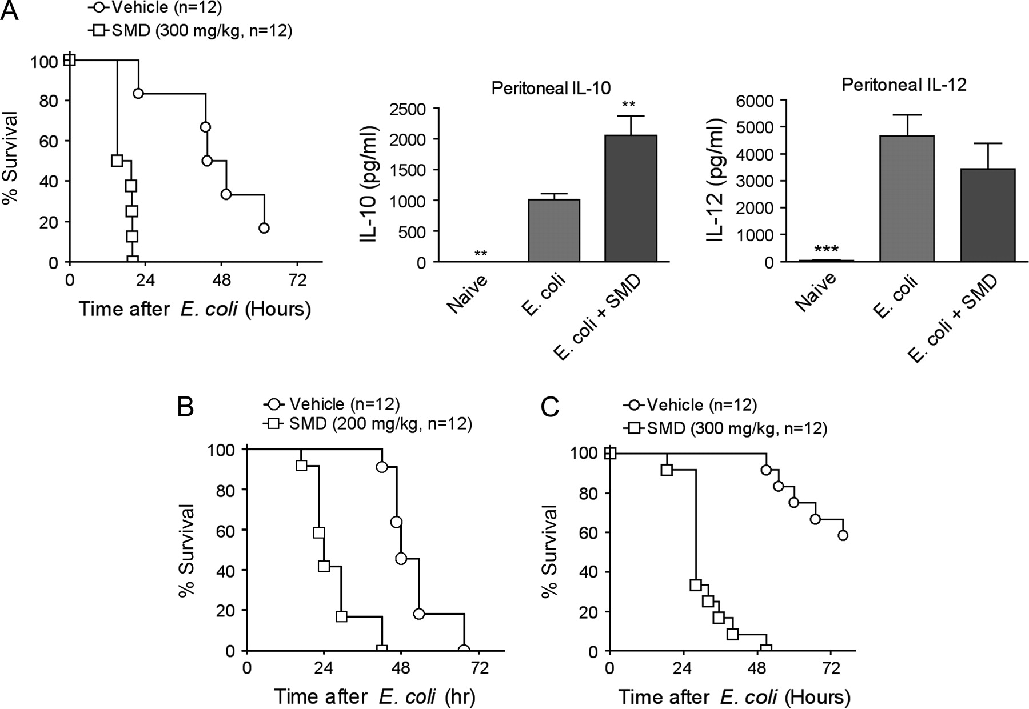
FIG. 8. SMD at the indicated dosages was administered at the same time as E. coli. The doses of E. coli were: panel ...
Notes:
FIG. 8. SMD at the indicated dosages was administered at the same time as E. coli. The doses of E. coli were: panel A, 2 × 109/mouse; panel B, 1 × 109/mouse; panel C, 8 × 108 per mouse. Survival was significantly decreased in all cases by SMD as indicated by the log-rank test. Cytokine results represent means ± SEM (n = 5), and values significantly different from the E. coli only group are indicated by **(p < 0.01) or ***(p < 0.001). These mice were treated at the same time and with the same doses of E. coli and SMD as those in panel A of the survival studies, and cytokines were evaluated at 11 h.
Unless provided in the caption above, the following copyright applies to the content of this slide: © The Author 2005. Published by Oxford University Press on behalf of the Society of Toxicology. All rights reserved. For Permissions, please email: journals.permissions@oupjournals.org

