Slide 1
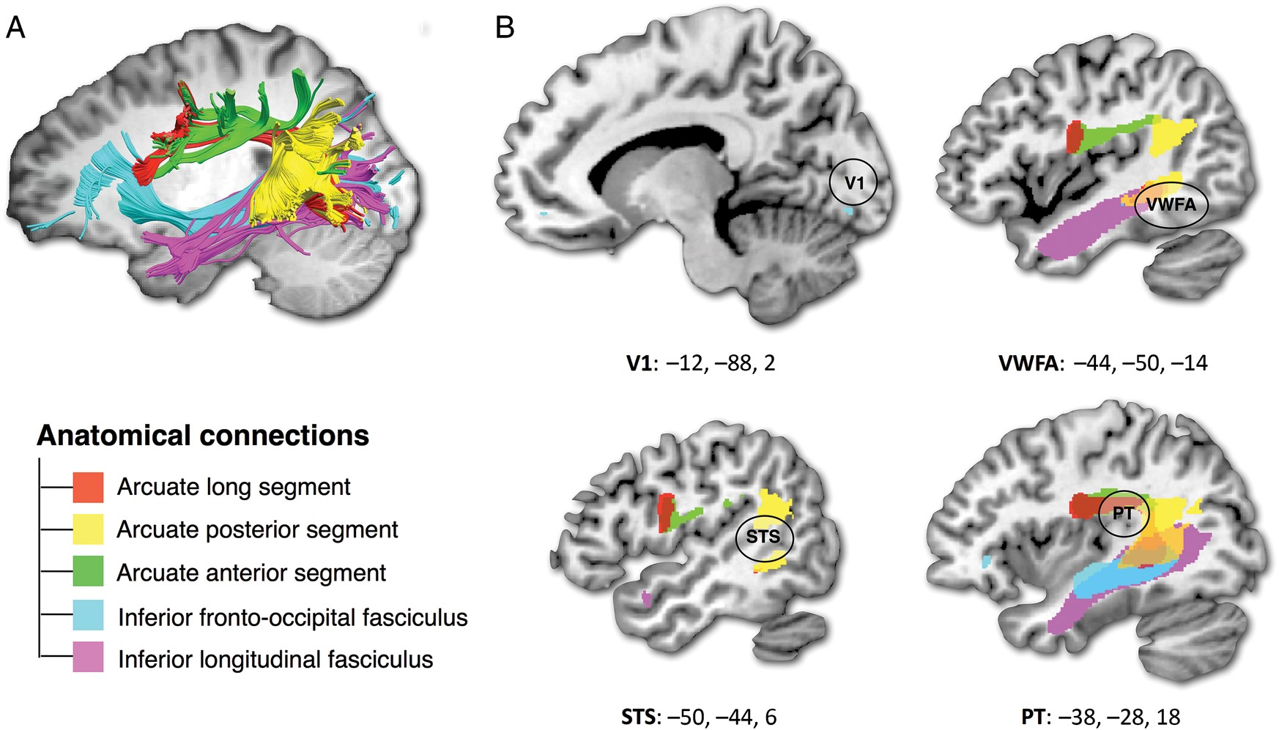
Figure 1. The extended reading network. fMRI has revealed a common network whose activation is modulated by the ...
Notes:
Figure 1. The extended reading network. fMRI has revealed a common network whose activation is modulated by the acquisition of literacy including the primary visual area (V1), the Visual Word Form Area (VWFA), the superior temporal sulcus (STS), and the planum temporale (PT; Dehaene et al. 2010). This network is highly interconnected via the arcuate fasciculus (long, posterior and anterior segment), the inferior fronto-occipital fasciculus, and the inferior longitudinal fasciculus, which therefore appear as prime candidates for a literacy-induced change in white matter organization. Tracts displayed in (A) come from a single representative participant, and in (B) from an atlas of human brain connections (http://www.natbrainlab.com, see Thiebaut de Schotten, ffytche, et al. 2011).
Unless provided in the caption above, the following copyright applies to the content of this slide: © The Author 2012. Published by Oxford University Press. All rights reserved. For Permissions, please e-mail: journals.permissions@oup.com

Slide 2
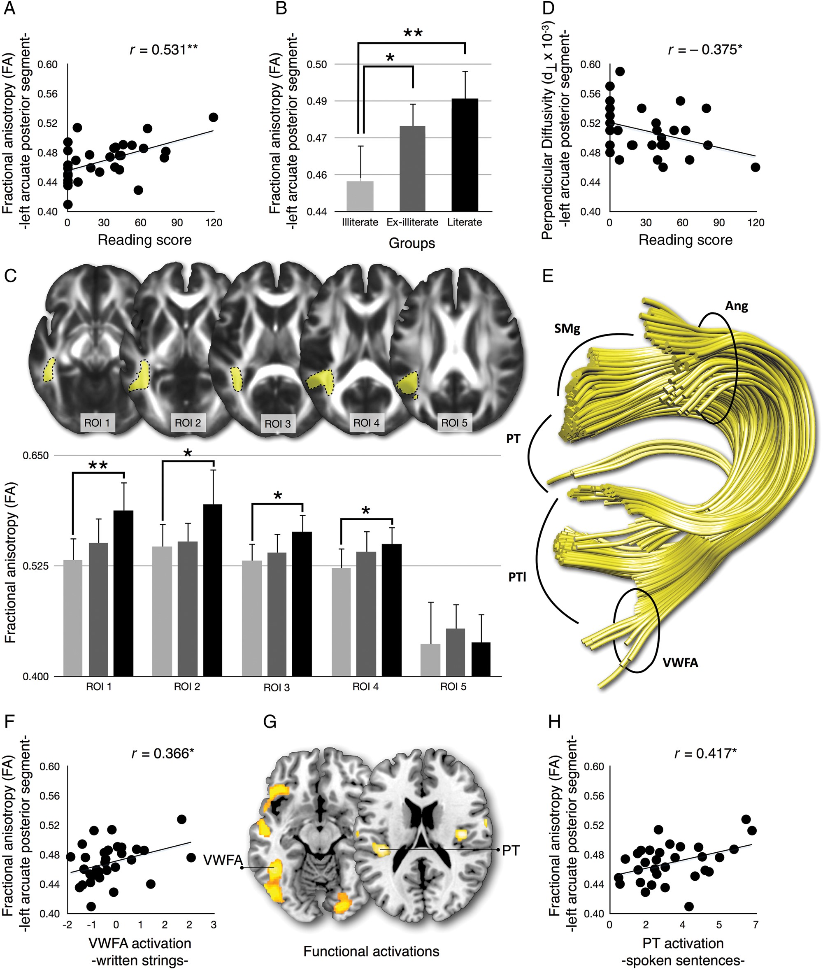
Figure 2. Links between the microstructure of the posterior segment of the arcuate fasciculus, behavioral reading ...
Notes:
Figure 2. Links between the microstructure of the posterior segment of the arcuate fasciculus, behavioral reading scores, and functional neuroimaging correlates of literacy. (A) Correlation between the FA in the posterior segment of the left arcuate fasciculus and reading performance. (B) Average FA in the left posterior segment (with 95% confidence intervals) for the illiterate (light gray), ex-illiterate (dark gray), and literate groups (black). (C) Average measurements of FA along the left posterior segment of the arcuate fasciculus made using 5 regions of interest selected on axial slices. (D) Correlation between the d⊥ in the left posterior segment of the arcuate fasciculus and reading performance. (E) The posterior segment of the arcuate fasciculus and its projections (posterior coronal view). (F) Correlation between the FA in the posterior segment of the left arcuate fasciculus and the level of activation of the VWFA to written strings relative to checkers. (G) Functional activations in response to letter strings (left) and to spoken language (right) (Dehaene et al. 2010). (H) Correlation between the FA in the posterior segment of the left arcuate fasciculus and the level of activation of the PT in response to spoken sentences. SMg: supramarginal gyrus; Ang: angular gyrus; PT: planum temporale; VWFA: Visual Word Form Area; PTl: posterior temporal lobe; **P < 0.01; *P < 0.05.
Unless provided in the caption above, the following copyright applies to the content of this slide: © The Author 2012. Published by Oxford University Press. All rights reserved. For Permissions, please e-mail: journals.permissions@oup.com

