Slide 1
Figure 1. Observable states of human papillomavirus infection at enrollment and follow-up and the possible transitions ...
Notes:
Figure 1. Observable states of human papillomavirus infection at enrollment and follow-up and the possible transitions between them. I, incident infection; P, prevalent infection; U, uninfected.
Unless provided in the caption above, the following copyright applies to the content of this slide: © 2007 by the Infectious Diseases Society of America

Slide 2
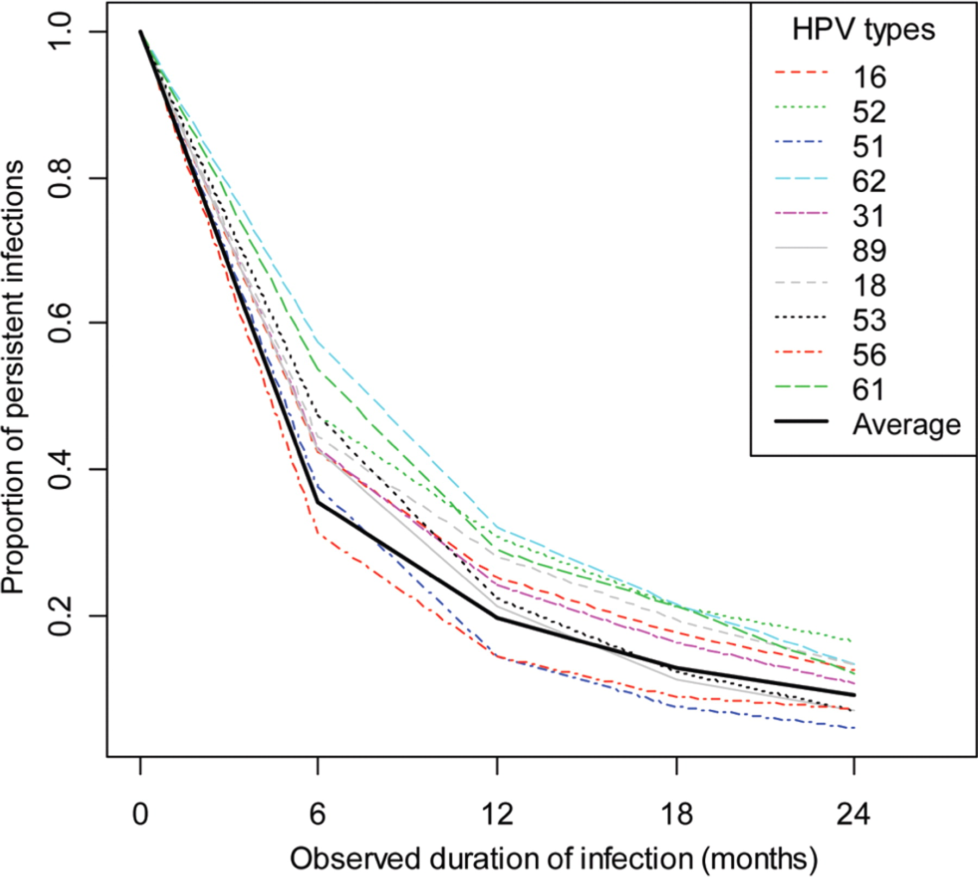
Figure 2. Clearance of prevalent human papillomavirus (HPV) infection with time for the 10 most common prevalent HPV ...
Notes:
Figure 2. Clearance of prevalent human papillomavirus (HPV) infection with time for the 10 most common prevalent HPV types at enrollment.
Unless provided in the caption above, the following copyright applies to the content of this slide: © 2007 by the Infectious Diseases Society of America

Slide 3
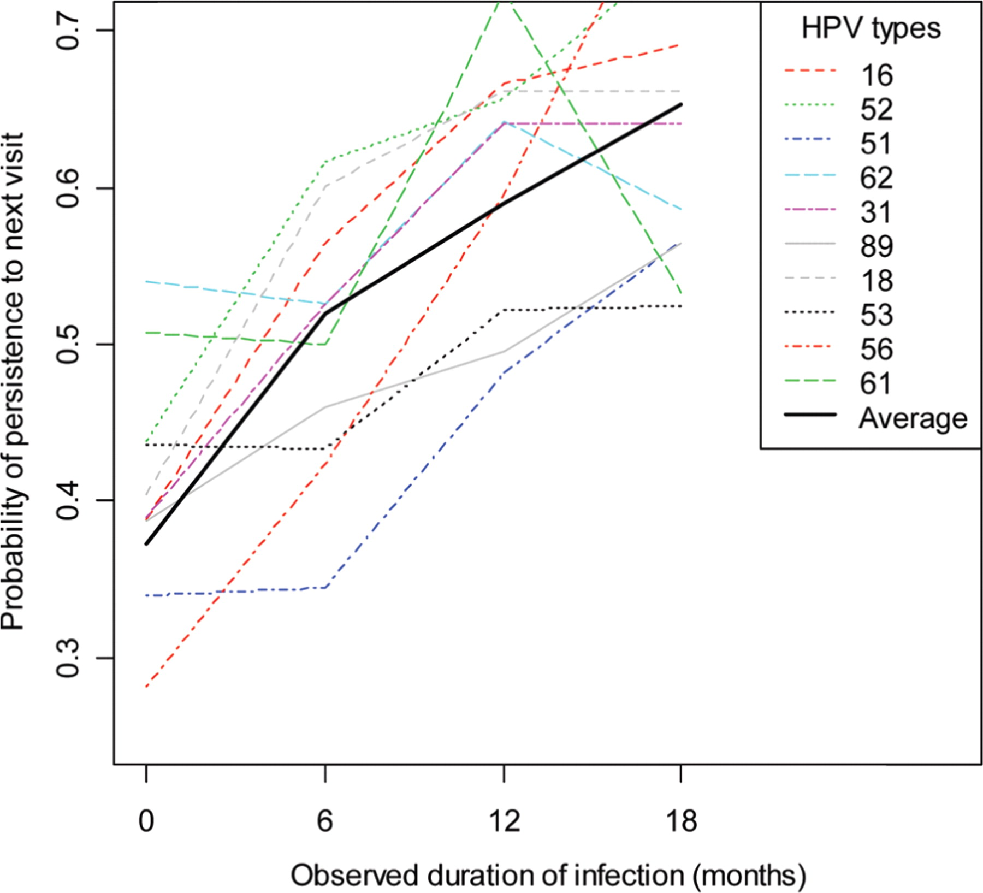
Figure 3. The effect of observed duration on persistence of prevalent infections for the 10 most common human ...
Notes:
Figure 3. The effect of observed duration on persistence of prevalent infections for the 10 most common human papillomavirus (HPV) types at enrollment.
Unless provided in the caption above, the following copyright applies to the content of this slide: © 2007 by the Infectious Diseases Society of America

Slide 4
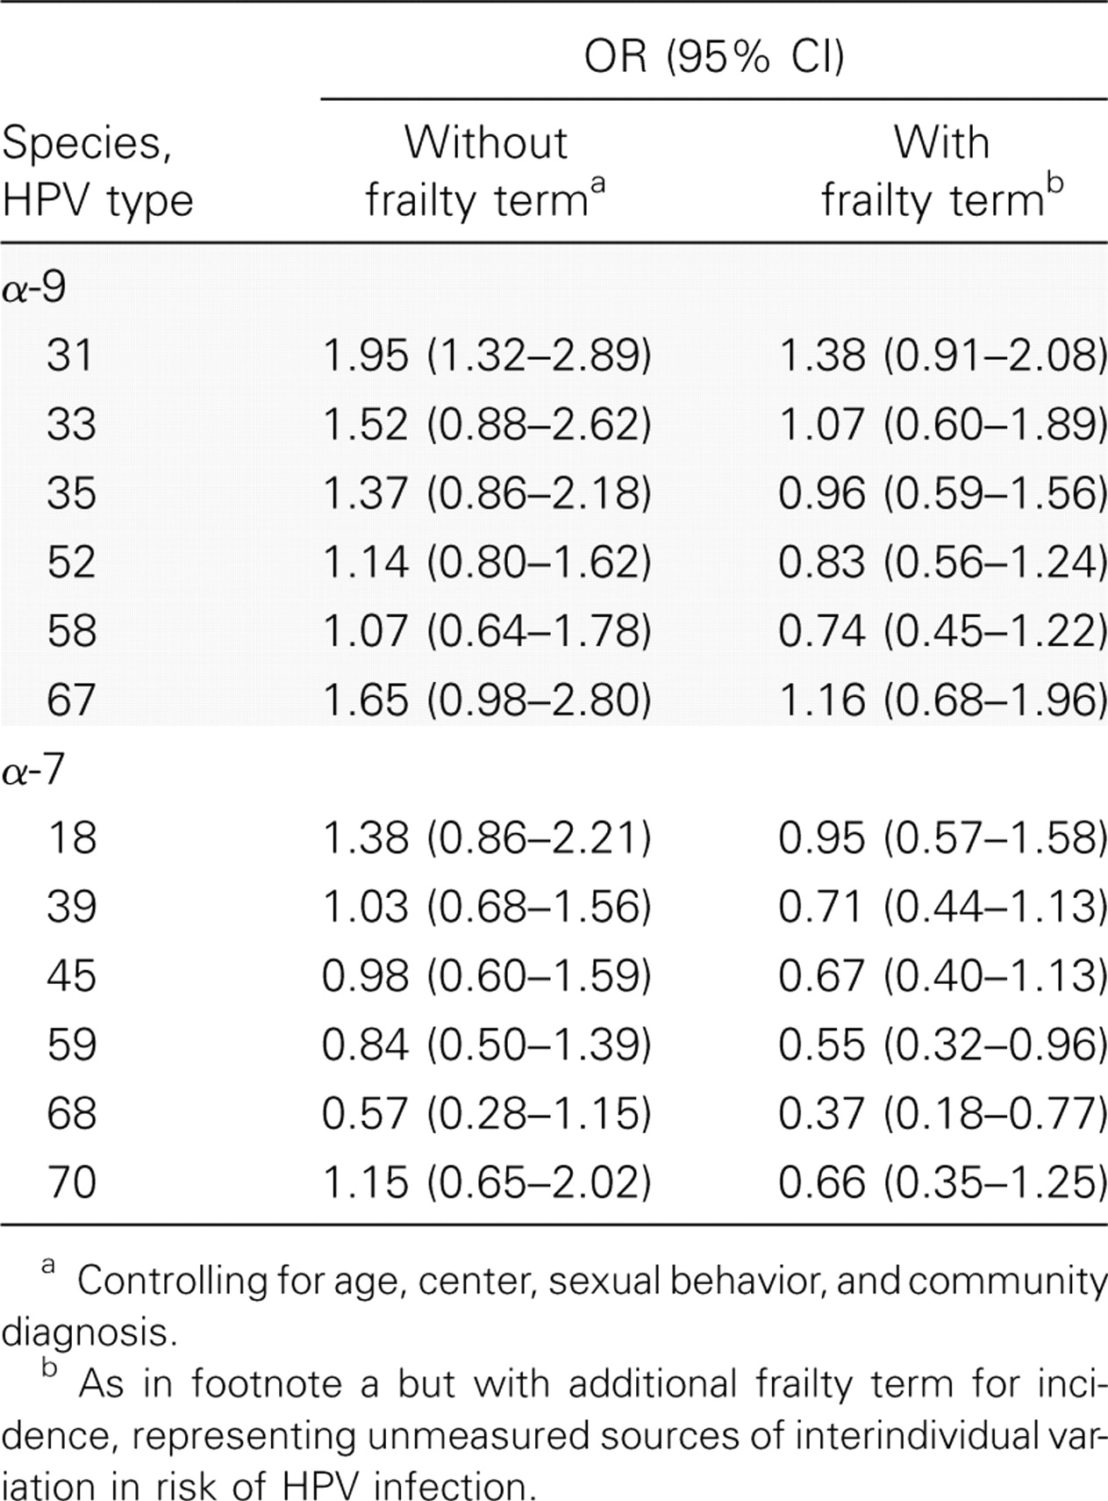
Table 3. Odds ratios (ORs) and 95% credible intervals (CIs) for incident infection of human papillomavirus (HPV) types ...
Notes:
Table 3. Odds ratios (ORs) and 95% credible intervals (CIs) for incident infection of human papillomavirus (HPV) types in species a-7 and a-9 at the next visit, given the presence vs. absence of current HPV-16 infection.
Unless provided in the caption above, the following copyright applies to the content of this slide: © 2007 by the Infectious Diseases Society of America

Slide 5
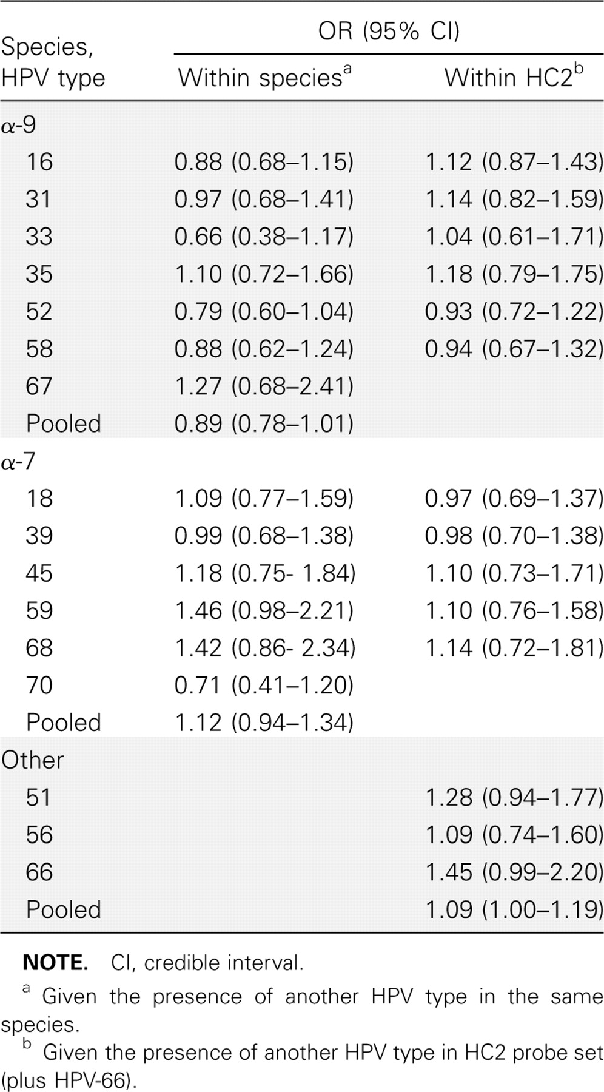
Table 2. Odds ratios (ORs) for persistence of human papillomavirus (HPV) types given the presence vs. absence of ...
Notes:
Table 2. Odds ratios (ORs) for persistence of human papillomavirus (HPV) types given the presence vs. absence of another HPV type within the same species or within the Hybrid Capture 2 (HC2) probe set.
Unless provided in the caption above, the following copyright applies to the content of this slide: © 2007 by the Infectious Diseases Society of America

