Slide 1
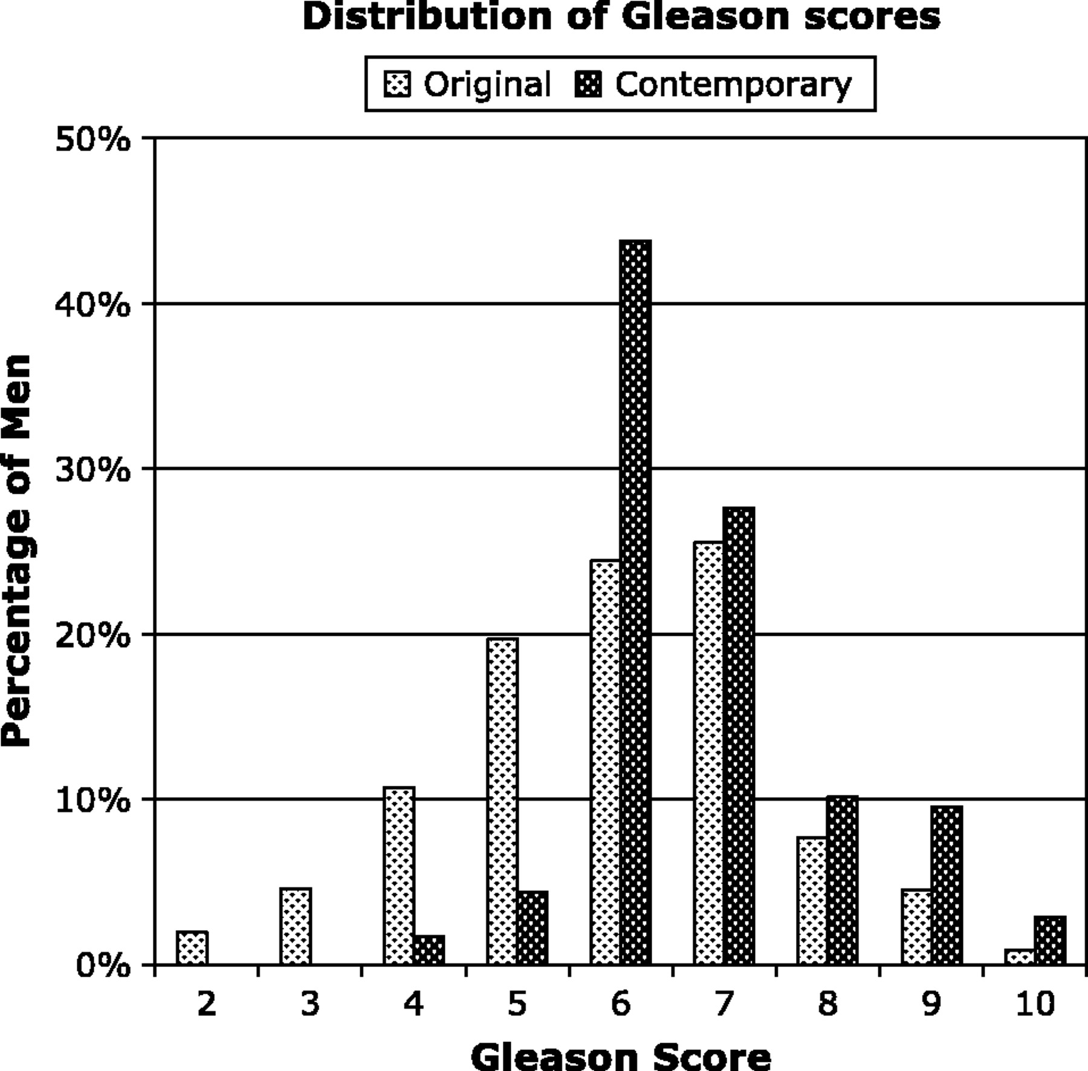
Fig. 1. Distribution of the original and contemporary Gleason score readings for the 1858 men for whom both prostate ...
Notes:
Fig. 1. Distribution of the original and contemporary Gleason score readings for the 1858 men for whom both prostate biopsy specimen readings were available.
Unless provided in the caption above, the following copyright applies to the content of this slide: © The Author 2005. Published by Oxford University Press. All rights reserved. For Permissions, please e-mail: journals.permissions@oupjournals.org.

Slide 2
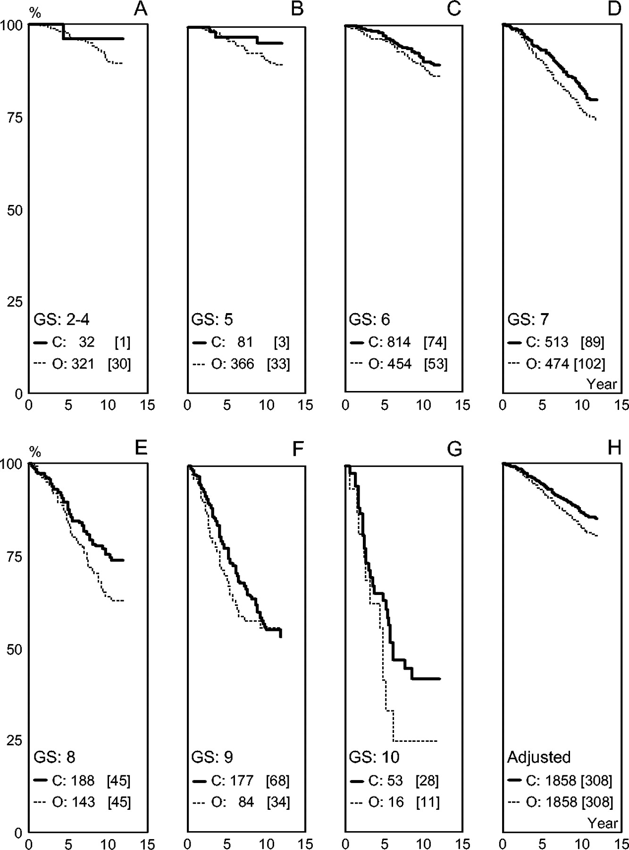
Fig. 2. Cause-specific survival curves for patients whose tumors was assigned the indicated biopsy Gleason score ...
Notes:
Fig. 2. Cause-specific survival curves for patients whose tumors was assigned the indicated biopsy Gleason score (GS) on the original (O) reading and on the contemporary (C) reading. Horizontal axis shows years since diagnosis, and vertical axis shows percentage cause-specific survival. Curves for the original reading are shown in black dashed lines, and those for the contemporary reading are shown in black solid lines. Numbers in each panel represent numbers of patients; numbers of deaths from prostate cancer are shown in square brackets. A–G ) Kaplan–Meier cause-specific curves for survival among patients with Gleason score 2–4 ( A ), Gleason score 5 ( B ), Gleason score 6 ( C ), Gleason score 7 ( D ), Gleason score 8 ( E ), Gleason score 9 ( F ), Gleason score 10 ( G ). H ) Cause-specific survival curves of the entire contemporary series of 1858 patients ( black solid line ) and the entire historical series (i.e., the same set of 1858 patients, black dashed line ) from a Cox proportional hazards model that adjusted for the differences in the distribution of Gleason scores between the two series. The contemporary series and the historical series were each standardized to the average of the two distributions of Gleason scores.
Unless provided in the caption above, the following copyright applies to the content of this slide: © The Author 2005. Published by Oxford University Press. All rights reserved. For Permissions, please e-mail: journals.permissions@oupjournals.org.

