Slide 1
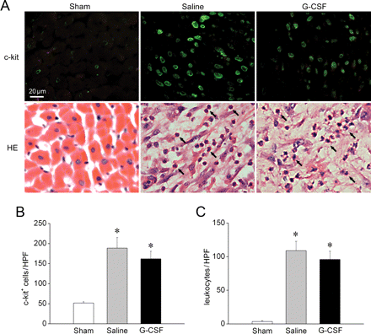
Figure 1 Infiltration of c-kit⁺ cells and leukocytes in the infarcted myocardium. (A) Representative heart ...
Notes:
Figure 1 Infiltration of c-kit+ cells and leukocytes in the infarcted myocardium. (A) Representative heart sections of the three groups of animals after c-kit immunostaining (top) or haematoxylin-eosin staining (bottom). Green fluorescence represents the transmembrane c-kit antigen. Arrows indicate infiltrating leukocytes. Scale bar = 20 µm. (B and C) The number of c-kit+ cells (B) or leukocytes (C) in the infarcted myocardium did not differ significantly between saline- and G-CSF-treated animals. *P < 0.05 vs. Sham.
Unless provided in the caption above, the following copyright applies to the content of this slide: Published on behalf of the European Society of Cardiology. All rights reserved. © The Author 2008. For permissions please email: journals.permissions@oxfordjournals.org

Slide 2
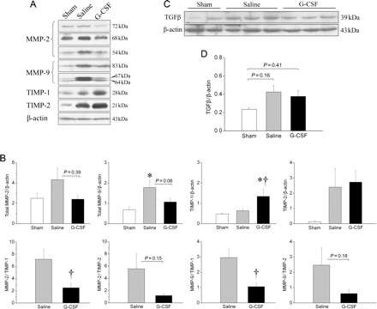
Figure 2 Expression of MMPs, TIMPs, and TGFβ in the infarcted myocardium. (A) Representative western blots for MMP-2, ...
Notes:
Figure 2 Expression of MMPs, TIMPs, and TGFβ in the infarcted myocardium. (A) Representative western blots for MMP-2, MMP-9, TIMP-1, TIMP-2, and β-actin. (B) Top panel: Relative abundance of MMP-2, MMP-9, TIMP-1, and TIMP-2 normalized to β-actin content on each blot. Bottom panel: Ratios of MMP-2/TIMP-1, MMP-2/TIMP-2, MMP-9/TIMP-1, and MMP-9/TIMP-2. (C) Representative western blots for TGFβ and β-actin. (D) Relative abundance of TGFβ normalized to β-actin content. Values are mean ± SEM. *P < 0.05 vs. Sham; †P < 0.05 vs. Saline.
Unless provided in the caption above, the following copyright applies to the content of this slide: Published on behalf of the European Society of Cardiology. All rights reserved. © The Author 2008. For permissions please email: journals.permissions@oxfordjournals.org

Slide 3
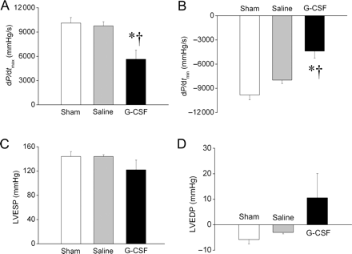
Figure 3 Haemodynamic parameters at 3 months after infarction. (A) dP/dt_{max}, maximal rate of pressure ...
Notes:
Figure 3 Haemodynamic parameters at 3 months after infarction. (A) dP/dtmax, maximal rate of pressure increase; (B) dP/dtmin, maximal rate of pressure decrease; (C) LVESP, LV end-systolic pressure; (D) LVEDP, LV end-diastolic pressure. Values are mean ± SEM. *P < 0.05 vs. Sham; †P < 0.05 vs. Saline.
Unless provided in the caption above, the following copyright applies to the content of this slide: Published on behalf of the European Society of Cardiology. All rights reserved. © The Author 2008. For permissions please email: journals.permissions@oxfordjournals.org

Slide 4
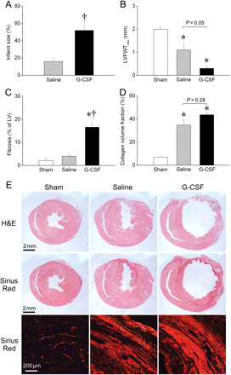
Figure 4 Histological evaluation of left ventricular remodelling 3 months after infarction. (A) infarct size; (B) ...
Notes:
Figure 4 Histological evaluation of left ventricular remodelling 3 months after infarction. (A) infarct size; (B) LVFWTmin, minimal thickness of LV free wall; (C) percent fibrosis; (D) collagen volume fraction in the infarct scar. Values are mean ± SEM. *P < 0.05 vs. Sham; †P < 0.05 vs. Saline. (E) Representative sections stained with haematoxylin-eosin and picrosirius red observed under normal light (top and middle, scale bars = 2 mm) and polarized light (bottom, scale bar=200 µm).
Unless provided in the caption above, the following copyright applies to the content of this slide: Published on behalf of the European Society of Cardiology. All rights reserved. © The Author 2008. For permissions please email: journals.permissions@oxfordjournals.org

Slide 5
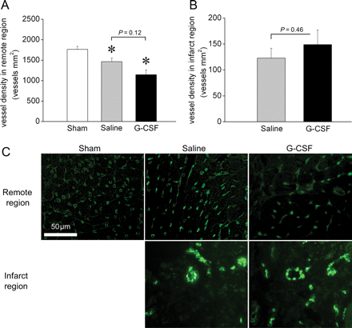
Figure 5 Assessment of vessel density 3 months after infarction. (A and B) Quantitative analysis of vessel density in ...
Notes:
Figure 5 Assessment of vessel density 3 months after infarction. (A and B) Quantitative analysis of vessel density in the remote area (A) and infarct region (B). Values are mean ± SEM. *P < 0.05 vs. Sham. (C) Representative images of vessels in the remote area (top) and infarct region (bottom). Scale bar indicates 50 µm.
Unless provided in the caption above, the following copyright applies to the content of this slide: Published on behalf of the European Society of Cardiology. All rights reserved. © The Author 2008. For permissions please email: journals.permissions@oxfordjournals.org

Slide 6
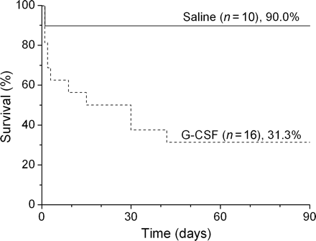
Figure 6 Cumulative survival of MI rats treated with saline or G-CSF during the observation period of 3 months. ...
Notes:
Figure 6 Cumulative survival of MI rats treated with saline or G-CSF during the observation period of 3 months. Lifespan was estimated by the Kaplan–Meier method. Survival rate of G-CSF-treated rats was significantly lower than that of saline-treated rats (P < 0.01).
Unless provided in the caption above, the following copyright applies to the content of this slide: Published on behalf of the European Society of Cardiology. All rights reserved. © The Author 2008. For permissions please email: journals.permissions@oxfordjournals.org

